Slide 1
Technique of creating useful Layouts using CSS3
Sayed Minhal, October 4, 2017

Slide 2
Table of Contents
What is Layout?
Data Centric Layouts
Overview
Practical Demonstration
Example
Presentation Centric Layouts
Overview
Practical Demonstration
Example

Slide 3
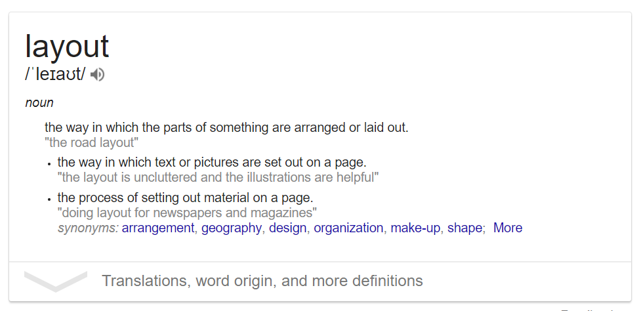
What is Layout?
Page layout
is the part of design that deals in the arrangement of visual elements on a page. It generally involves organizational principles of composition to achieve specific communication objectives
O'Connor, Z (2014). Elements and principles of design: Tools for digital imagery, art and design.

Slide 4
Data-centric Layouts
Data Centric Layouts – Overview
Data Centric layout is centered around structured data, it allows you to design apps that are data-centric.
A data-centric app is an application that is based on structured, consistent, homogeneous information such as
MIS Systems,
Phone Books,
DBMS like Oracle or MySQL,
JSON file or XML file
Grid View, Tree View, Cards or Collapsible etc. are such UI components that can be used to show data on a View Component, for e.g. Forms or Reports or Graphs,

Slide 5
Presentation-centric Layouts
Presentation Centric Layouts – Overview
Presentation Centric layout is centered around unstructured contents, it allows you to design apps that are aesthetical.
A presentation-centric app is an application that is based on mixed contents, consisting of heterogeneous information including
Video files and Images
Blogs and Articles
Datalist
Carousals, Gallery, Wizards or Article List etc. are such Design components that can be used to show contents on a View Component, for e.g. Product/Service Catalogue, Guided Tour, Walkthrough, Social Network Feeds, Activity Streams.

Slide 6

Layout Examples

Slide 7
Layout Example

Slide 8
Layout Example
Prod | 2011 | 2012 | 2013 | 2014
X1 | 1200 | 1250 | 1350 | 1550
X2 | 200 | 150 | 100 | 120
X3 | 120 | 140 | 100 | 120
X4 | 1100 | 1200 | 1300 | 1200

Slide 9
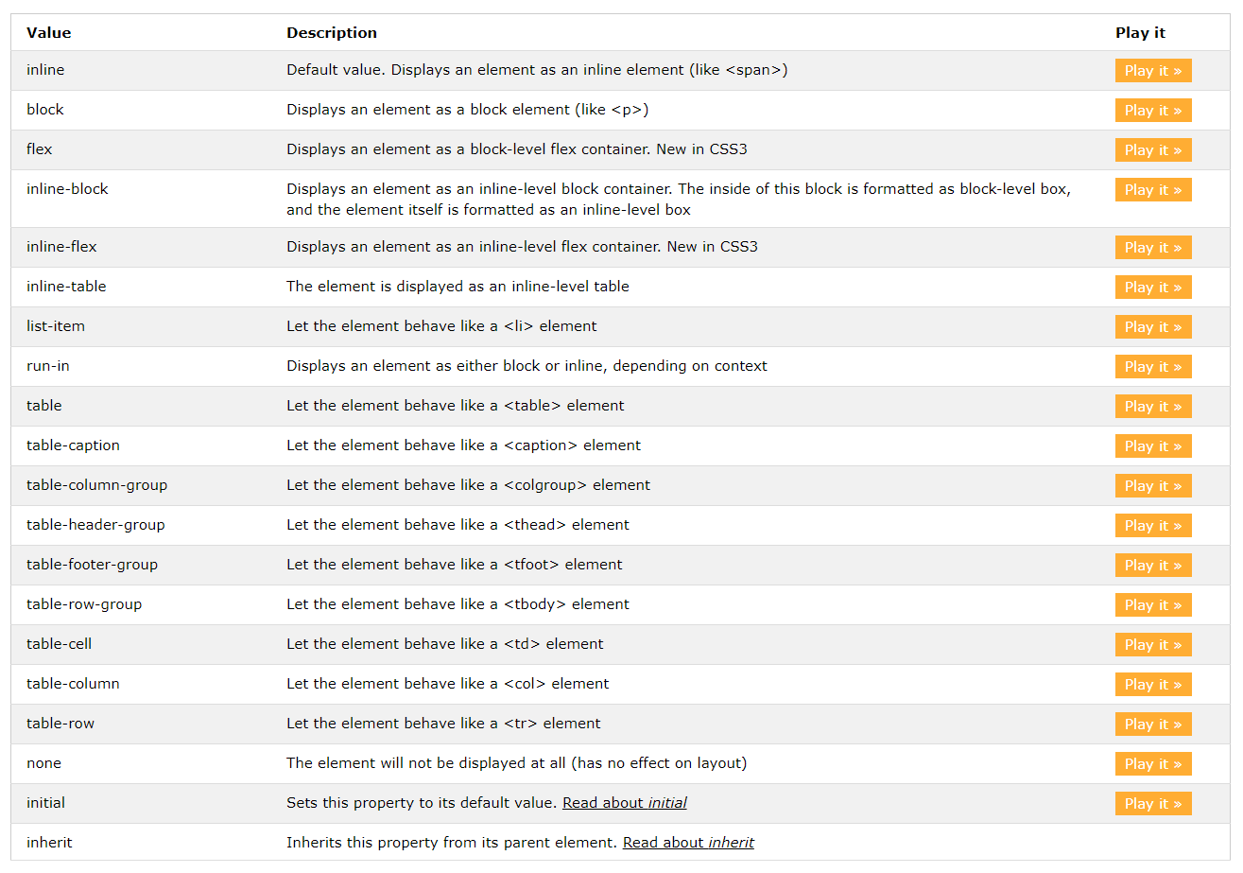
Use CSS3 for Layouts
Source:
W3schools.com

Slide 10
@media, new measurement units
{width: X [% | em | pt | in | cm | ch | vh | px | ...] }
The fr units
@media screen and (min-width | max-width | aspect-ratio:…..

Slide 11
Flex Layout
Properties for container :
{ display: flex}
{ flex-direction: row | row-reverse | column | column-reverse;}
{ justify-content: justify-content: flex-start | flex-end | center | space-between | space-around | space-evenly;}
{ align-items: flex-start | flex-end | center | baseline | stretch; }
{ align-content: flex-start | flex-end | center | space-between | space-around | stretch; }
Properties for children
{ order: <integer>; }
{ flex-grow: <number>; /* default 0 */ }
{ flex-shrink: <number>; /* default 1 */ }

Slide 12
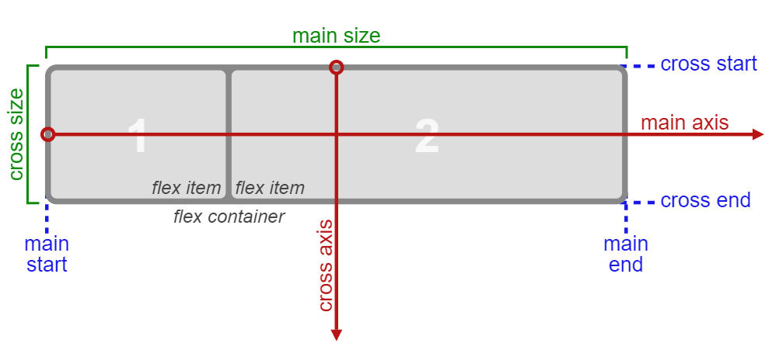
Flex Matrix

Slide 13
Grid Layout
Properties for container
{display:grid}
{ grid-template-columns: 40px 50px auto 50px 40px; }
{ grid-template-rows: 25% 100px auto; }
{ grid-column-gap: 5px; }
{ grid-row-gap: 5px; }
{ justify-items: start | end | center | stretch; } – horizontal
{ align-items: start | end | center | stretch; } – Vertical
Properties for children
{ justify-self: start | end | center | stretch; }
{ align-self: start | end | center | stretch; }
{ grid-column: 3 / span 2; }
{grid-row: third-line / 4; }

Slide 14
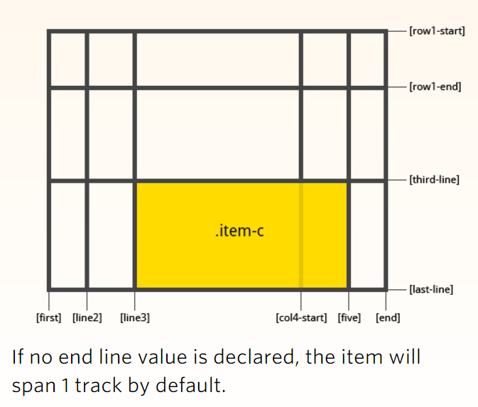
Grid Layout points

Slide 15
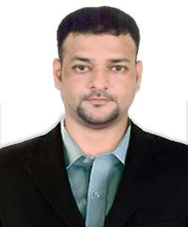
Contact information
Insert contact picture
Sayed Minhal
Consultant/Front-end developer sayed.minhal@capgemini.com
Vikhroli, India 9987364540

