Slide 1
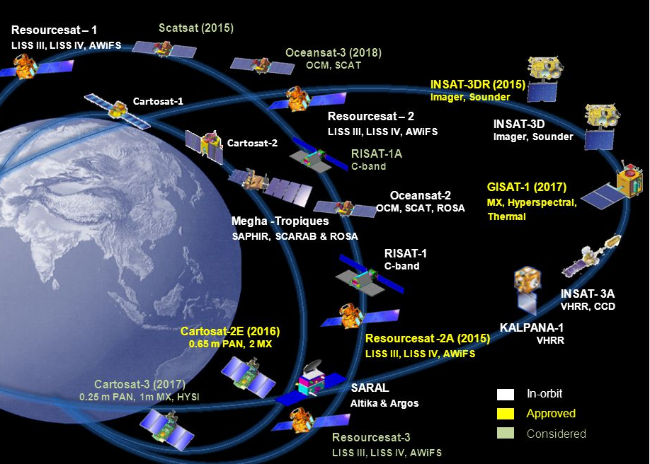
Introduction to Google Earth Engine
15 January 2020
ritu.anilkumar@gmail.com
Volume: 10-20 TB /day
Variety: Large number of sources i.e. many sensors on many satellites as well as formats
Veracity: Requirement for accuracy for models.
Velocity: Requirement for real-time analysis.
The 4 V’s of big data applied to remote sensing
Notes:
On this first slide, you see a picture of the satellites launched by ISRO (Image courtesy. Director EOS, ISRO HQ DVA Raghavamurthy). You see there are a large number of sensors providing large quantities of a variety of data for use in real-time models/analysis to provide accurate inputs for governance, planning and day to day life. In Earth Observation, we have large volumes of data ranging from 10-20 TB/day (I’m getting varying numbers in different papers, so I just put a range), a large variety of sensors acquiring data over different regions of the electromagnetic spectrum and lots of data in different formats. These datasets can be used for different models or analysis, let’s take the example of assessing crop damage for providing compensation to the farmers. We will need to provide real-time output to the govt. Agencies and these must be very accurate. Thus the need for velocity and veracity. Together these make up the 4Vs of Big data. Now that we categorize satellite data as big data, let’s see how we can work with it.
1

Slide 2
How can we work with the data
High end PCs/Workstations with multiple cores.
Graphics Processing Units
HPC, Parallel, clustered or distributed systems
High costs for installation and maintenance.
Not suitable for small organizations or individuals.
CLOUD COMPUTING: Scalable, no hassle of downloading data, parallelized set up, pocket-friendly.
Notes:
For using this data, we can use high end PCs or workstations, very good GPU systems, High Performance Computers etc. But for an everyday user from a regular Line Dept, this is difficult to obtain. Working on lower end systems takes several hours and days to process the data before any useful results can be obtained. This is more so difficult if you want to study global phenomenon or time variant phenomenon. My next few sentences are to make things more clear. It is largely derived from the Earth Engine tutorials by Noel Gorelick/Nick Clinton. The user has the question to answer but is unable to work with the large volumes of data. So it is often easier to take the questions to the data than vice versa. Consider again the example of the compensation for farmers across a state or country. We will need to assess the change of the crop before and after the disaster across large areas. Processing this on regular systems will require large volumes of data to be downloaded, processed (in our low-end systems) and made into maps. Instead, we can directly work on external high-end servers where the data is pre-loaded and download the maps directly. This will save our time in data download and processing.
1

Slide 3
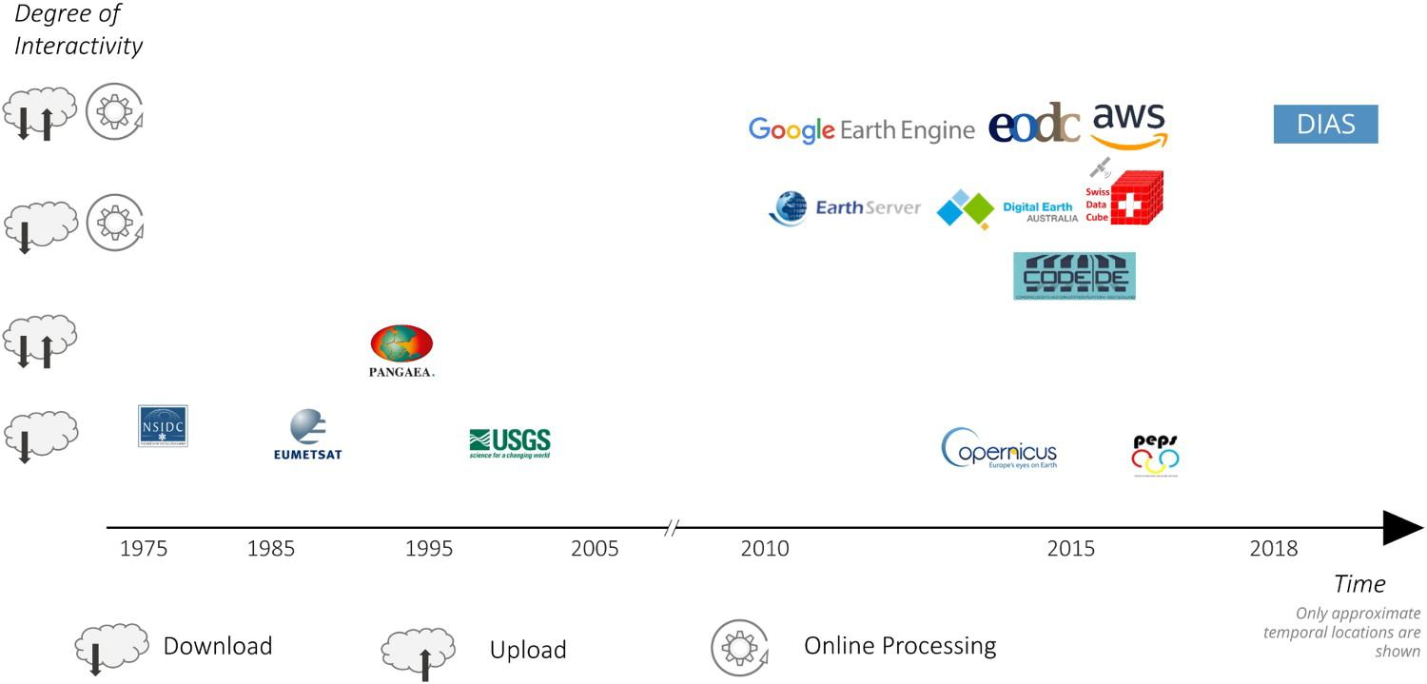
Some Existing Platforms
Image source: Sudmanns et al, 2019 International Journal of Digital Earth
Notes:
Some of the existing platforms presently available are listed in the above diagram from Sudmann’s et al 2019. Next few slides belong to Noel Gorelick/Nick Clinton from the Earth Engine team.
1

Slide 4
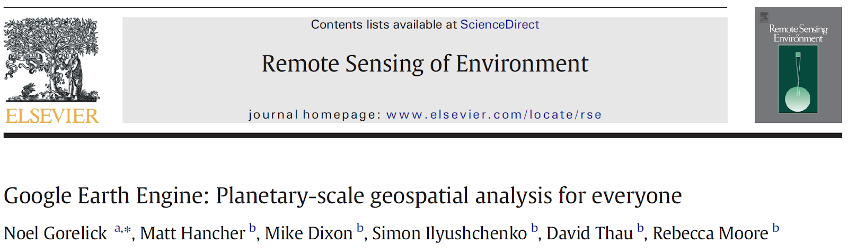

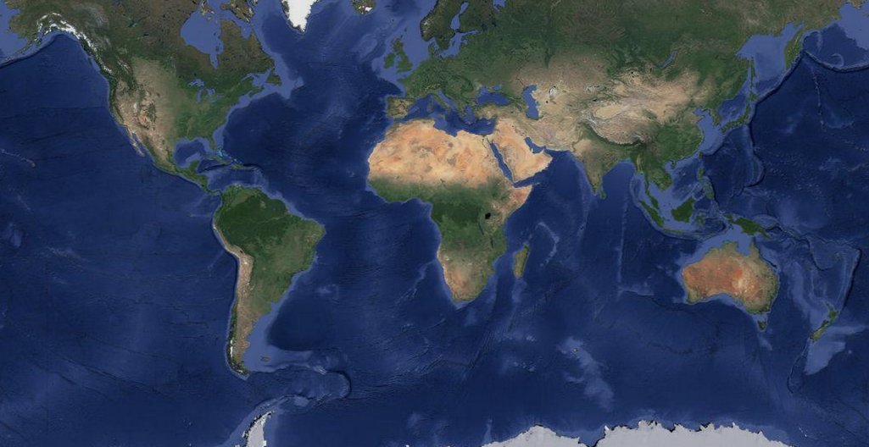

Earth Engine:
Google's Cloud Platform for Big Earth Data Analytics
Image courtesy: Gennadii Donchyts
Notes:
Google Earth and Earth Engine are two separate technologies, focused on solving separate problems.
Google Earth is a rich 3-D basemap on which raster and vector data can be overlaid.
Earth Engine enables the processing of massive amounts of raster and vector data, that may results in a variety of outputs such as tiles for 2-D interactive maps, tables, video, or images that can be displayed on Google Earth.
1

Slide 5
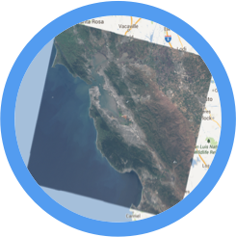
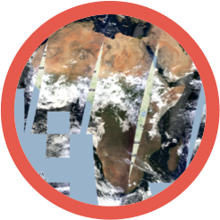
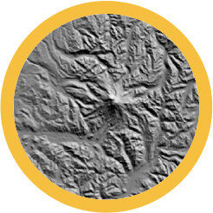
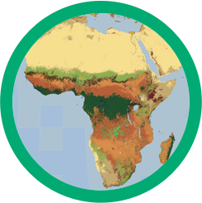
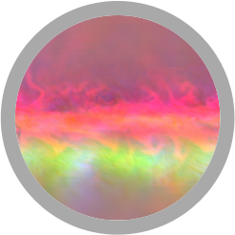
The Earth Engine Public Data Catalog
Landsat 4, 5, 7, 8
Raw, TOA, SR, ...
MODIS
Daily, NBAR, LST, ...
Terrain
SRTM, GTOPO, NED, ...
Land Cover
GlobCover, NLCD, ...
Atmospheric
NOAA NCEP, OMI, ...
... and many more, updating daily!
> 200 public datasets
> 4000 new images every day
> 5 million images
> 5 petabytes of data
> 33 years of data
> 3 quadrillion pixels
Stats and Image courtesy: Gennadii Donchyts, Nick Clinton

Slide 6
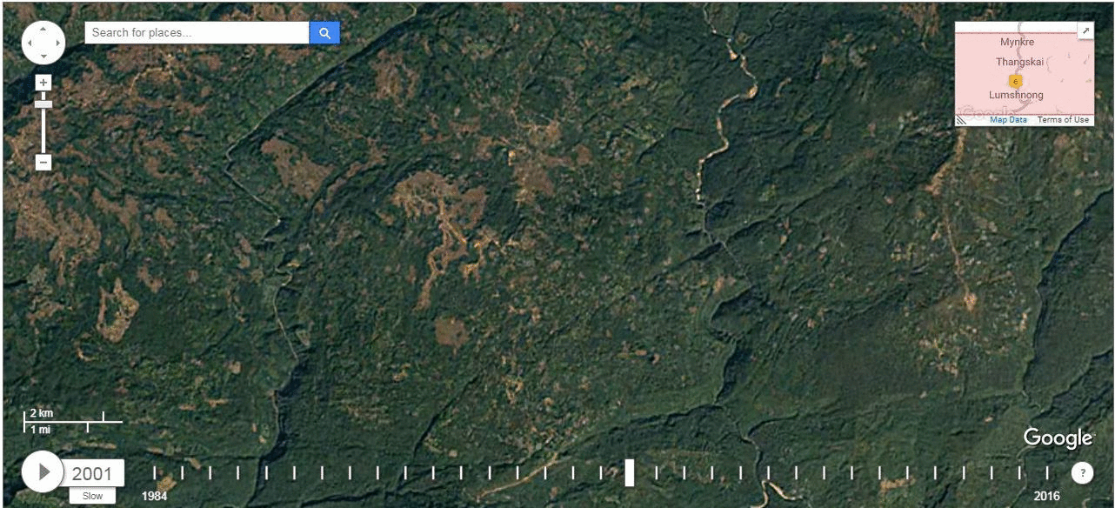
Some Cool Things We Did
Limestone Mine Identification in Jaintia Hills, Meghalaya
Bamboo mapping for Tripura
Pan-NE Deforestation Studies
Glacier change studies: Sikkim
Identification of permanent river islands in Assam
Burnt area assessment
Limestone Quarries in East Jaintia Hills, Meghalaya
Notes:
1

Slide 7
What are the things you can do with Google Earth Engine?
All the world's your stage
SO LET’S DIVE RIGHT IN...

Slide 8
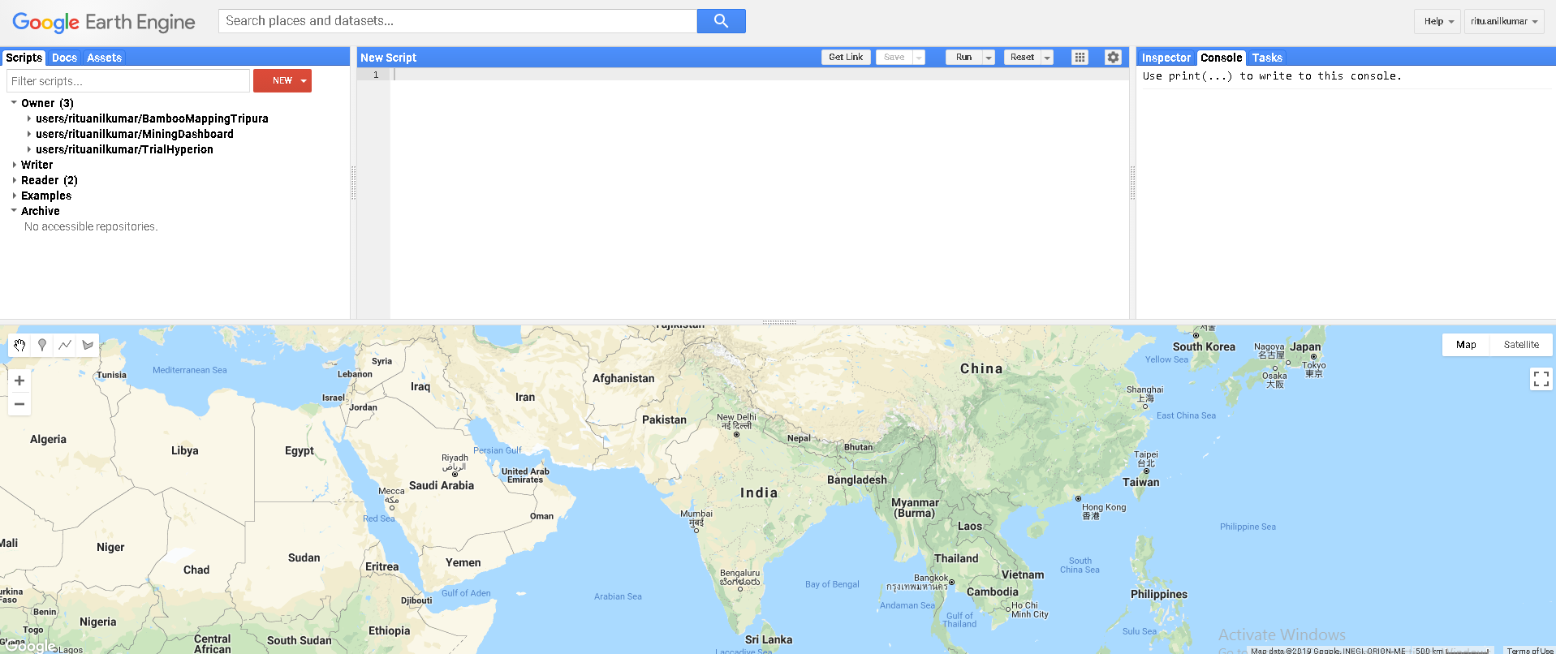
All your saved and example scripts
Task status: E.g. Exports
User Guide/ Discussions Forum
Documentation
Console output
All your uploaded assets
Inspecting map elements
Code Editing Window
Map Window
Tools for creation of vectors, pan, zoom
Search box for all datasets
Link sharing, saving, running etc
Map/Satellite View Toggle
Notes:
<number>

Slide 9
JavaScript Demo: Click Here
Some Resources: Click Here
Here
Here
and here
Notes:
<number>

Slide 10
Tasks for today
Access images stored on the cloud and filter using
  Date
  Boundary
  Metadata
Display images in various band combinations
Compute NDVI

Slide 11
Python Hands-on: Click Here

Slide 12
THANK YOU

