Slide 1
Assignment-3: NoSQL, MongoDB, R
Ritu Sanjay

Slide 2
Data Description
This is a sample dataset pertaining to transaction details of a store on Black Friday. The objectives behind this analysis may be stated as follows:
Understand customer behavior
Develop a model to predict purchase amounts

Slide 3
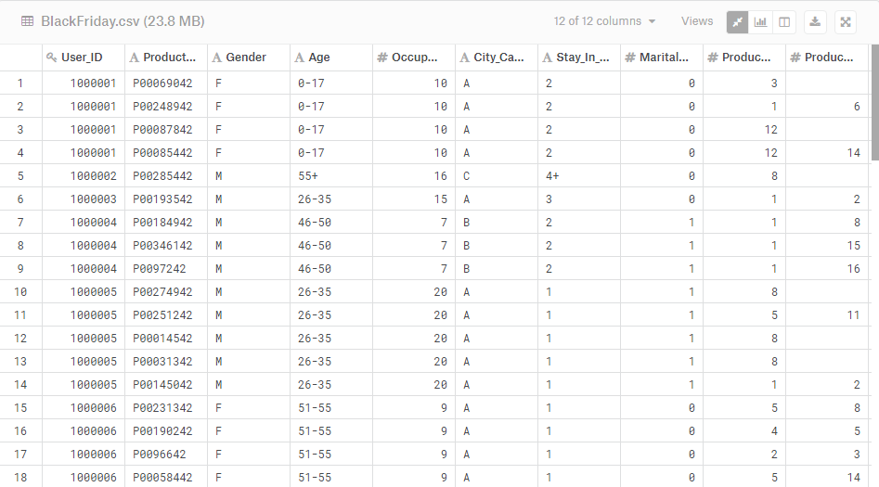
BLACK FRIDAY
Source: Kaggle (https://www.kaggle.com/mehdidag/black-friday)

Slide 4
Data Fields
1) User_ID : each customer has been assigned a unique ID
2) Product_ID: each product has a unique ID
3) Gender: ‘M’ or F
4) Age: customers have been assigned to different age groups
5) Occupation: customer professions have been encoded into different categories
6) City_Category: the region of residence in the city has been segregated
7) Stay_In_Current_City_Years: how long the customer has lived in a particular region
8) Marital_Status : ‘1’ for married and ‘0’ for single
9) Product_Category_1 : product type tag 1
10) Product_Category_2: product type tag 2
11) Product_Category_3: product type tag 3
12) Purchase : amount purchased (of particular product) for each customer ie. there are multiple transactions against a single customer

Slide 5
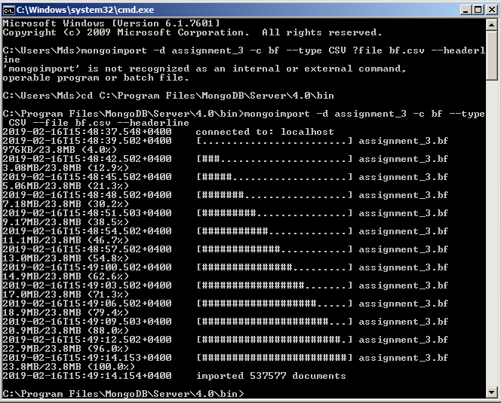
Adding dataset to MongoDB
>>mongoimport -d assignment_3 -c bf --type CSV –file bf.csv –headerline

Slide 6
R and MongoDB
It is quite simple to use MongoDB with R
All you need is the mongolite package installed in R-studio
Mongolite is a fast and simple-to-use MongoDB client that allows users to perform queries, aggregate and MapReduce functions

Slide 7
Packages used
bindr
Caret
e1071
GGally
Ggplot2
mongolite
plotly
plyr
rlang
scatterplot3d
utils
tidyverse

Slide 8
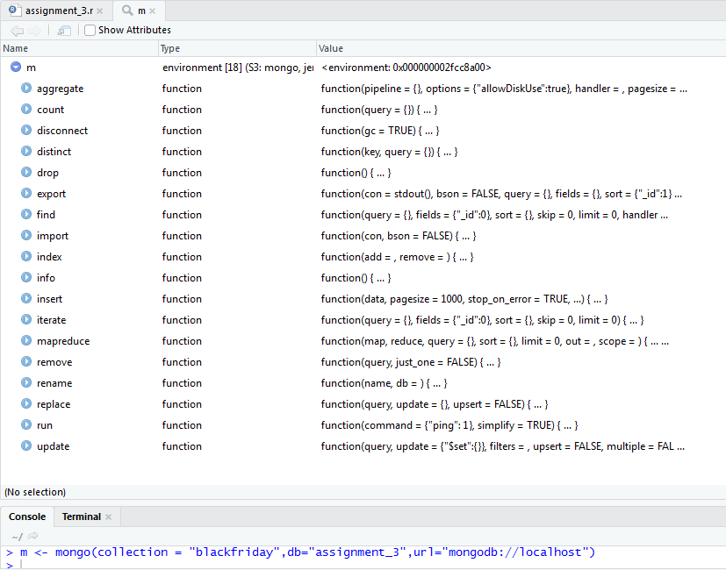
Using MongoDB data in r
m <- mongo(collection = "blackfriday",db="assignment_3",url="mongodb://localhost")
# this creates an environment variable m that can be used to perform mongodb #operations

Slide 9
Data Analysis
Queries to extract further details and subsets of the dataset
Check different hypothesis
Predict purchase price using linear regression

Slide 10
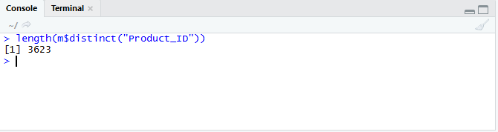
Find number of unique products
length(m$distinct("Product_ID"))

Slide 11
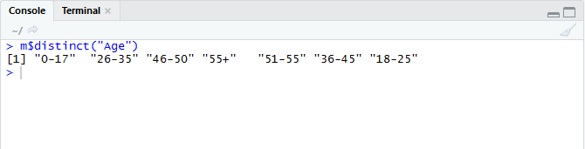
Find list of distinct age groups
m$distinct("Age")

Slide 12
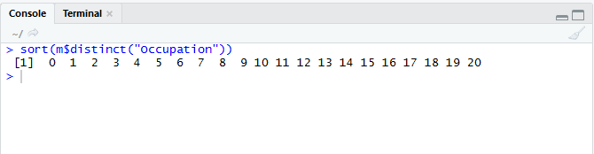
Find list of distinct occupations
sort(m$distinct("Occupation"))

Slide 13
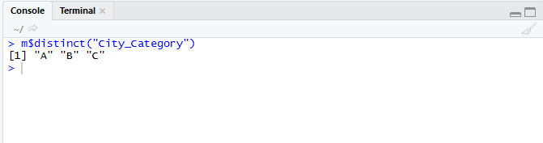
Find list of unique city regions
m$distinct("City_Category")

Slide 14
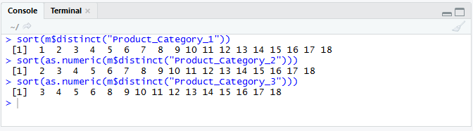
find unique 3-level product category combination
sort(m$distinct("Product_Category_1"))
sort(as.numeric(m$distinct("Product_Category_2")))
sort(as.numeric(m$distinct("Product_Category_3")))
#find the unique individual categorization

Slide 15
find unique 3-level product category combination (…contd)
m$aggregate('[
{"$group":
{ "_id":
{"tag1":"$Product_Category_1",
"tag2":"$Product_Category_2",
"tag3":"$Product_Category_3"}
}
}
]')
#equivalent mongodb version:
#> var distinctProductTags = {$group: { _id: #{tag1:"$Product_Category_1",
#tag2:"$Product_Category_2",tag3:"$Product_Category_3"}}}
#> db.blackfriday.aggregate([distinctProductTags])

Slide 16
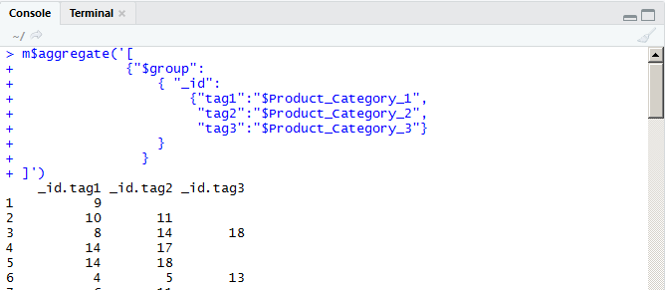
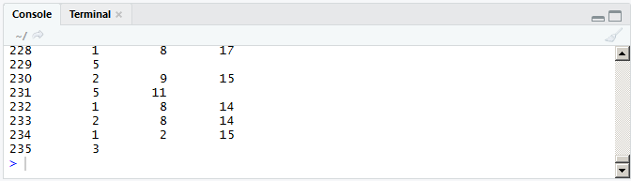
find unique 3-level product category combination (…contd)
.
.
.

Slide 17
find no of customers in each age group by gender
m$aggregate('[
{"$group": {"_id": {"gender":"$Gender","age":"$Age"},
"numOfCust":{"$sum": 1}}},
{"$sort": {"Gender":1}}
]')
#equivalent mongodb version
#db.blackfriday.aggregate([
# {$group: {_id: {gender:"$Gender",age:"$Age"},
# num:{$sum: 1}}},
# {$sort: {Gender:1}}
# ])

Slide 18
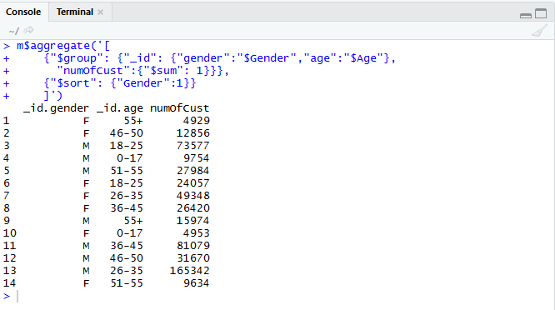
find no of customers in each age group by gender (…contd)

Slide 19
find average and total spending by each age group
m$aggregate('[
{"$group":
{ "_id": "$Age",
"tot_sales": {"$sum": "$Purchase"},
"avg_sales": {"$avg": "$Purchase"}
}
}]')
#equivalent mongodb code
#> db.blackfriday.aggregate([
# { $group: {_id :"$Age",
# tot_sales: {$sum: "$Purchase"},
# avg_sales: {$avg: "$Purchase"}
# }} ])

Slide 20
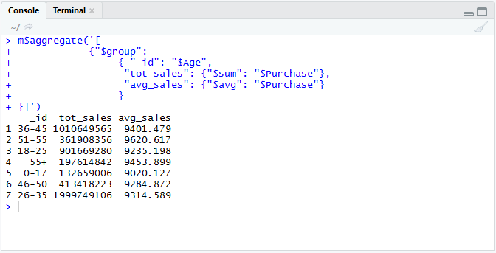
find average and total spending by each age group (…contd)

Slide 21
find average and total spending by each gender
m$aggregate('[
{"$group":
{ "_id": "$Gender",
"tot_sales": {"$sum": "$Purchase"},
"avg_sales": {"$avg": "$Purchase"}
}
}]')

Slide 22
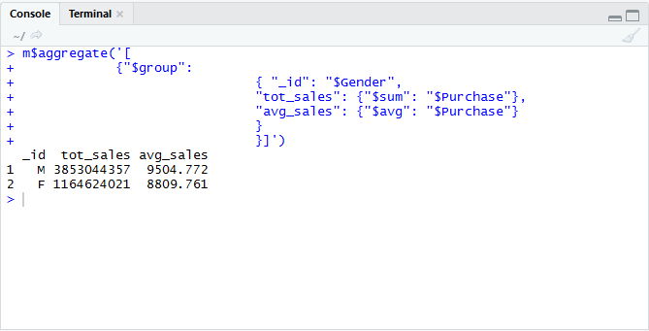
find average and total spending by each gender (…contd)

Slide 23
find average and total spending by each occupation
m$aggregate('[
{"$group":
{ "_id": "$Occupation",
"tot_sales": {"$sum": "$Purchase"},
"avg_sales": {"$avg": "$Purchase"}
}
}]')

Slide 24
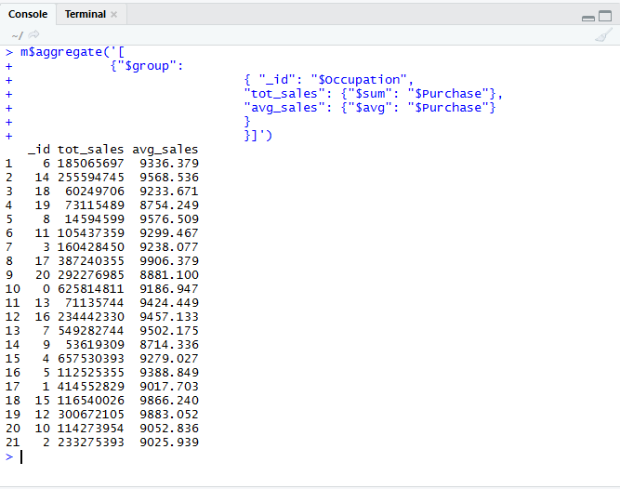
find average and total spending by each occupation (…contd)

Slide 25
find average and total spending by each city category
m$aggregate('[
{"$group":
{ "_id": {"cityCategory":"$City_Category",
"noOfYrsInCity":"$Stay_In_Current_City_Years"},
"tot_sales": {"$sum": "$Purchase"},
"avg_sales": {"$avg": "$Purchase"}
}
}]')

Slide 26
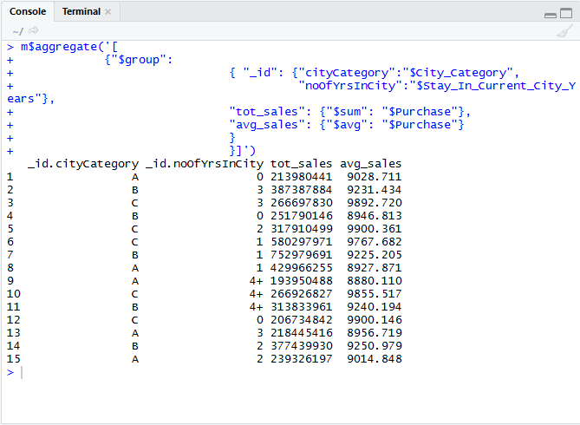
find average and total spending by each city category (…contd)

Slide 27
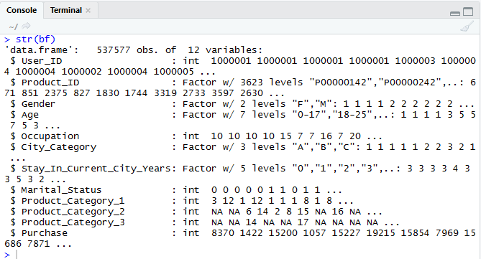
Checking hypothesis
# first change data types
bf$Product_ID = as.factor(bf$Product_ID)
bf$Gender= as.factor(bf$Gender)
bf$Age = as.factor(bf$Age)
bf$City_Category =as.factor(bf$City_Category)
bf$Stay_In_Current_City_Years= as.factor(bf$Stay_In_Current_City_Years)
bf$Product_Category_2 =as.integer(bf$Product_Category_2)
bf$Product_Category_3 = as.integer(bf$Product_Category_3)
str(bf)

Slide 28
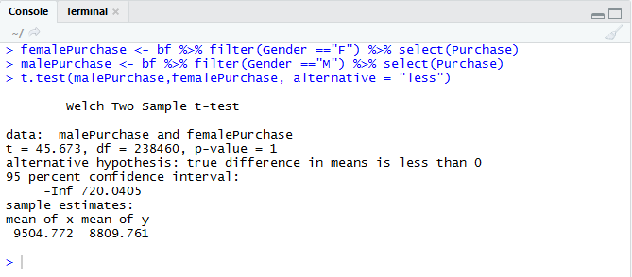
Hypothesis 1:women are more likely to spend
# 1) women are more likely to spend
femalePurchase <- bf %>% filter(Gender =="F") %>% select(Purchase)
malePurchase <- bf %>% filter(Gender =="M") %>% select(Purchase)
t.test(malePurchase,femalePurchase, alternative = "less")
###implies that men are more likely to spend more
ggplot(aes(x=Gender,y=Purchase,fill=Gender),data=bf)+
geom_boxplot()+ggtitle("Black Friday Purchases:Men vs Women")

Slide 29
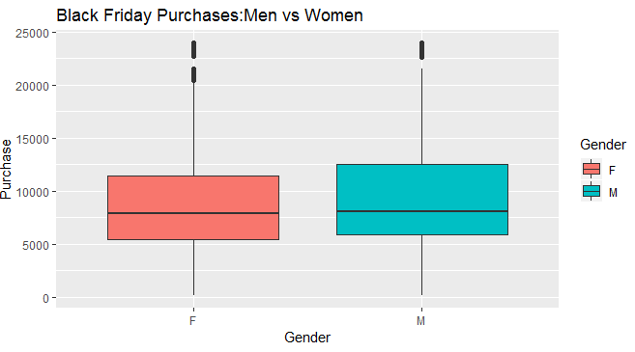
Hypothesis 1:women are more likely to spend (…contd)
Conclusion : Our hypothesis is wrong i.e men (in this sample) spend greater amounts on purchases

Slide 30
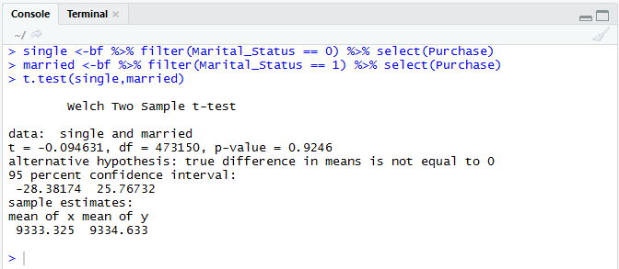
Hypothesis 2: married couples spend more on black friday sales
# 2) married couples spend more on black friday sales
single <-bf %>% filter(Marital_Status == 0) %>% select(Purchase)
married <-bf %>% filter(Marital_Status == 1) %>% select(Purchase)
t.test(single,married)
###implies taht there is no significant difference between
#married or single customers
ggplot(aes(x=factor(Marital_Status),y=Purchase,fill=Gender),data=bf)+
geom_boxplot()+ggtitle("Black Friday Purchases:Married vs Single")

Slide 31
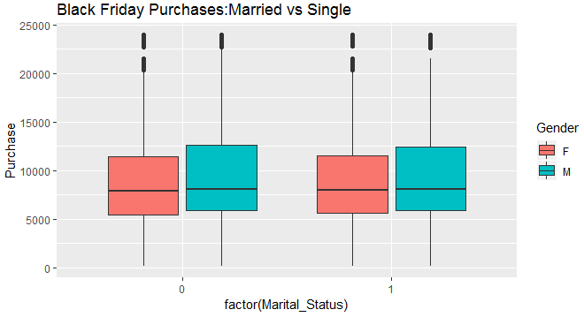
Hypothesis 2: married couples spend more on black friday sales (…contd)
Conclusion : There is no significant difference in spending between married and single customers. However, as found earlier, in both cases men are more likely to spend.

Slide 32
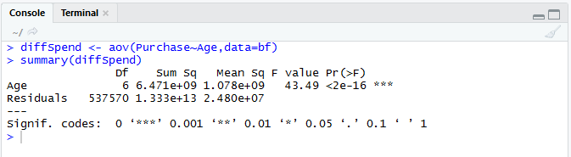
Hypothesis 3:how does age impact spending – younger customers are more likely to spend
diffSpend <- aov(Purchase~Age,data=bf)
summary(diffSpend)
### implies that the Pr(>F) betwen the different ranges is too small
# and hence there is an impact on purchase
#pairwise.t.test(bf$Purchase,as.factor(bf$Age))
ggplot(aes(x=Age,y=Purchase,fill=Gender),data=bf)+
geom_boxplot()+ggtitle("Black Friday Purchases:Who Shall We Target")

Slide 33
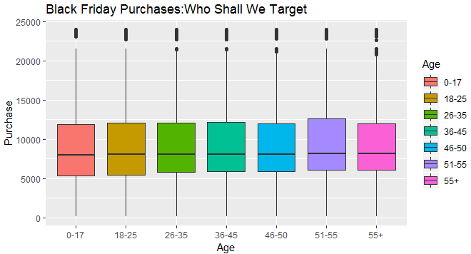
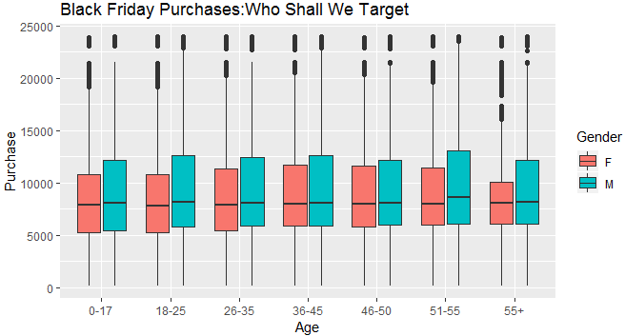
Hypothesis 3:how does age impact spending – younger customers are more likely to spend (…contd)
Conclusion : Customers in age group 51-55 , especially men, are more likely to spend more on black friday

Slide 34
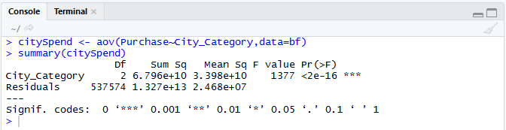
Hypothesis 4:does it(spending) matter which part of the city they live in - customers from well-to-do regions spend more
# 4) does it(spending) matter which part of the city they live in
citySpend <- aov(Purchase~City_Category,data=bf)
summary(citySpend)
###implies that the area of residence in the city affects amt of spending
ggplot(aes(x=City_Category,y=Purchase,fill=Age),data=bf)+
geom_boxplot()+ggtitle("Black Friday Purchases:City Divisions")

Slide 35
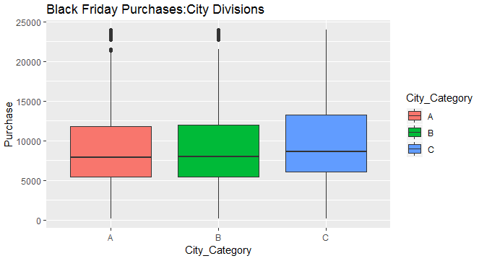
Hypothesis 4:does it(spending) matter which part of the city they live in - customers from well-to-do regions spend more (…contd)
Conclusion : Customers living in region c of the city are expected to spend more

Slide 36
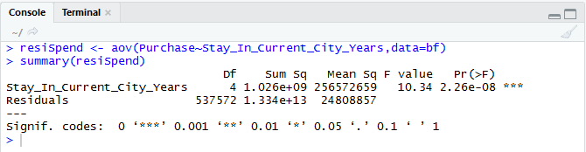
Hypothesis 5:customers who have lived at their present residences longer tend to spend more during a black Friday sale
# 5) does how long they have been at their current residences impact spending
resiSpend <- aov(Purchase~Stay_In_Current_City_Years,data=bf)
summary(resiSpend)
### implies no significant difference
ggplot(aes(x=Stay_In_Current_City_Years,y=Purchase,fill=City_Category),data=bf)+
geom_boxplot()+ggtitle("Black Friday Purchases:Years of Residence")

Slide 37
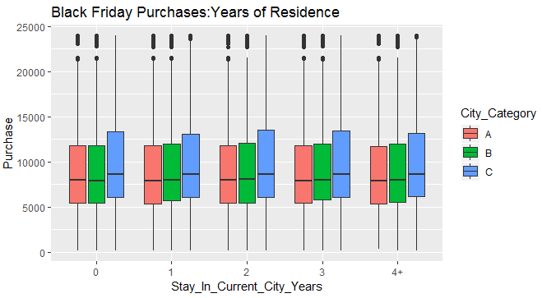
Hypothesis 5:customers who have lived at their present residences longer tend to spend more during a black Friday sale
(…contd)
Conclusion : There is no significant difference between customers who have lived at their current residence for less than a year or more than 3 years.

Slide 38
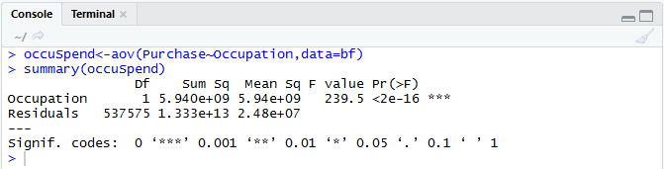
Hypothesis 6: people in certain occupations tend to spend more
# 6) do people in certain occupations tend to spend more
occuSpend<-aov(Purchase~Occupation,data=bf)
summary(occuSpend)
ggplot(aes(x=as.factor(Occupation),y=Purchase,fill=Gender),data=bf)+
geom_boxplot()+ggtitle("Black Friday Purchases:Occupation")

Slide 39
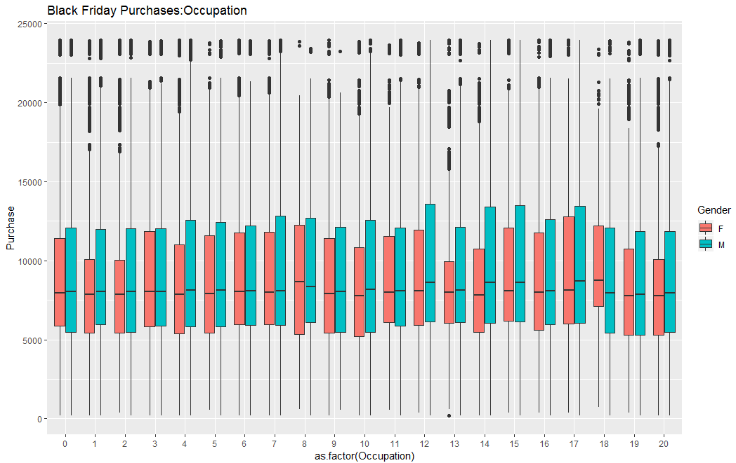
Hypothesis 6: people in certain occupations tend to spend more (…contd)
Conclusion : Customers engaged in professions 12, 14 and 17 tend to spend more.

Slide 40
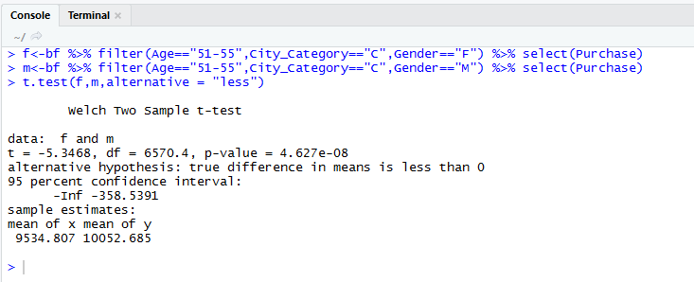
Hypothesis 7: Men between ages 51-55,living in area C, engaged in occupation 12 compared to women in the same criteria
bf %>% filter(Age=="51-55",City_Category=="C",Occupation=="12") %>%
ggplot(aes(x=Gender,y=Purchase,fill =Gender))+geom_boxplot()
### guess we could say that our hypothesis is true visually ie.
f<-bf %>% filter(Age=="51-55",City_Category=="C",Gender=="F") %>% select(Purchase)
m<-bf %>% filter(Age=="51-55",City_Category=="C",Gender=="M") %>% select(Purchase)
t.test(f,m,alternative = "less")

Slide 41
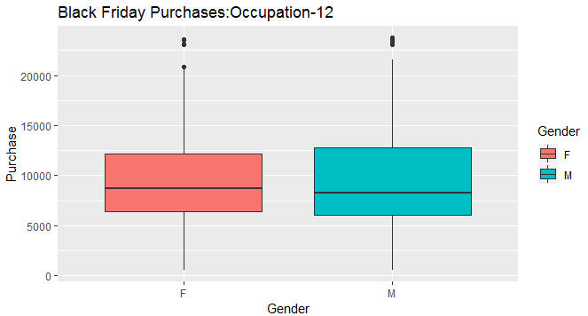
Hypothesis 7: Men spend more than women, between ages 51-55,living in area C, engaged in occupation 12 (…contd)

Slide 42
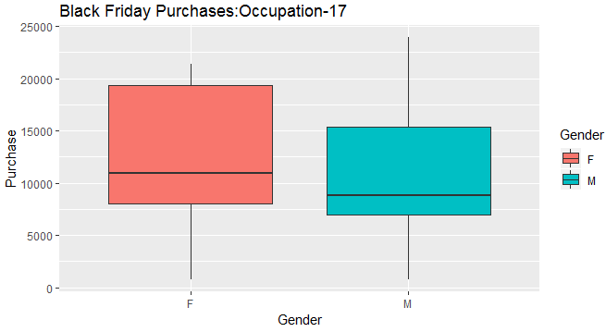
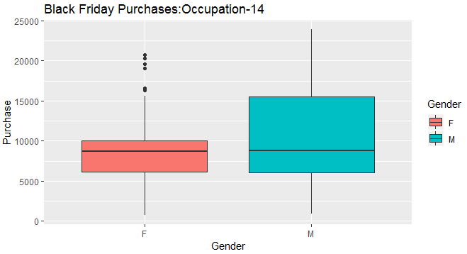
Hypothesis 7: Men spend more than women, between ages 51-55,living in area C, engaged in occupation 12 (…contd)
Conclusion : We are correct in our original hypothesis. However, women in occupation 17 tend to spend more and men engaged in occupation 14 are more likely to spend greater amounts on Black Friday purchases

Slide 43
Predicting purchase with linear regression
#dependent variable : blackfriday$purchase
#independent categorical variable : blackfriday$Gender,blackfriday$Age,
#blackfriday$Occupation, blackfriday$City_Category, blackfriday$Marital_Status,
#independent variable:blackfriday$Stay_In_Current_City_Years
sample <- sample(1:nrow(bf),size=floor(nrow(bf)*0.7))
train<-bf[sample,]
test<-bf[-sample,]
lr_mod1 <- lm(Purchase~
Gender+Age+Occupation+City_Category+Stay_In_Current_City_Years+
Marital_Status+Product_Category_1,data = train)
summary(lr_mod1)

Slide 44
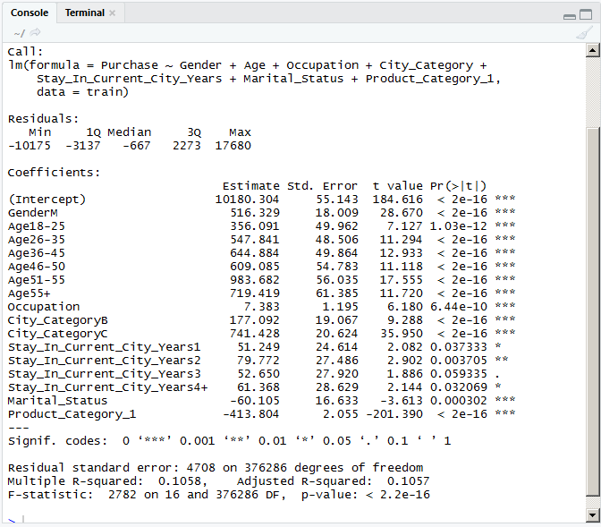

Slide 45
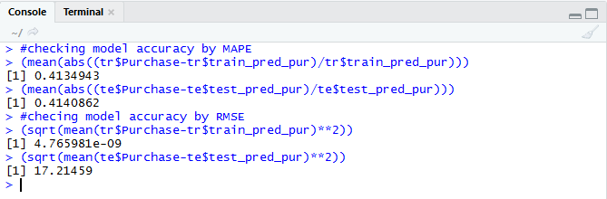
Accuracy of regression model
train_pred_pur <- predict(lr_mod1,newdata = train)
tr <- cbind(train,train_pred_pur)
test_pred_pur <- predict(lr_mod1,newdata = test)
te <- cbind(test,test_pred_pur)
#checking model accuracy by MAPE
(mean(abs((tr$Purchase-tr$train_pred_pur)/tr$train_pred_pur)))
(mean(abs((te$Purchase-te$test_pred_pur)/te$test_pred_pur)))
#checing model accuracy by RMSE
(sqrt(mean(tr$Purchase-tr$train_pred_pur)**2))
(sqrt(mean(te$Purchase-te$test_pred_pur)**2))

Slide 46
MAPREDUCE in mongodb
An alternate method to aggregate values in mongoDB

Slide 47

Average spending by gender
> var mapfunction = function(){
... emit(this.Gender,this.Purchase);
... }
> var reducefunction = function(varG,varP){
... return Array.avg(varP);
... };
> db.blackfriday.mapReduce(
... mapfunction,reducefunction,{out:"GendervVsPurchase"}
... )
{
"result" : "GendervVsPurchase",
"timeMillis" : 30888,
"counts" : {
"input" : 537577,
"emit" : 537577,
"reduce" : 10558,
"output" : 2
},
"ok" : 1
}

Slide 48
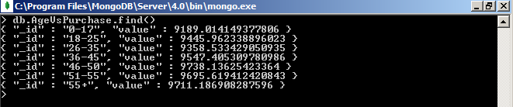
Average spending by age
> var mapfunction = function(){
... emit(this.Age,this.Purchase);
... }
> var reducefunction = function(varA,varP){
... return Array.avg(varP);
... };
> db.blackfriday.mapReduce(
... mapfunction,reducefunction,{out:"AgeVsPurchase"}
... )
{
"result" : "AgeVsPurchase",
"timeMillis" : 32964,
"counts" : {
"input" : 537577,
"emit" : 537577,
"reduce" : 26914,
"output" : 7
},
"ok" : 1

Slide 49
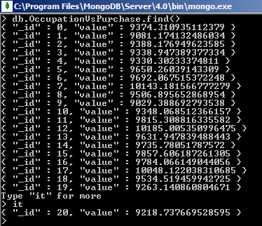
Average spending by occupation
> var mapfunction = function(){
... emit(this.Occupation,this.Purchase);
... }
> var reducefunction = function(varO,varP){
... return Array.avg(varP);
... };
> db.blackfriday.mapReduce(
... mapfunction,reducefunction,{out:"OccupationVsPurchase"}
... )
{
"result" : "OccupationVsPurchase",
"timeMillis" : 32748,
"counts" : {
"input" : 537577,
"emit" : 537577,
"reduce" : 32974,
"output" : 21
},
"ok" : 1
}

Slide 50

Average spending by city category
> var mapfunction = function(){
... emit(this.City_Category,this.Purchase);
... }
> var reducefunction = function(varCC,varP){
... return Array.avg(varP);
... };
> db.blackfriday.mapReduce(
... mapfunction,reducefunction,{out:"CityCategoryVsPurchase"}
... )
{
"result" : "CityCategoryVsPurchase",
"timeMillis" : 31702,
"counts" : {
"input" : 537577,
"emit" : 537577,
"reduce" : 15613,
"output" : 3
},
"ok" : 1
}

Slide 51
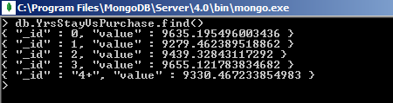
Average spending by Number of years of stay in present region
> var mapfunction = function(){
... emit(this.Stay_In_Current_City_Years,this.Purchase);
... }
> var reducefunction = function(varS,varP){
... return Array.avg(varP);
... };
> db.blackfriday.mapReduce(
... mapfunction,reducefunction,{out:"YrsStayVsPurchase"}
... )
{
"result" : "YrsStayVsPurchase",
"timeMillis" : 32467,
"counts" : {
"input" : 537577,
"emit" : 537577,
"reduce" : 24595,
"output" : 5
},
"ok" : 1
}

Slide 52

Average spending by marital status
> var mapfunction = function(){
... emit(this.Marital_Status,this.Purchase);
... }
> var reducefunction = function(varM,varP){
... return Array.avg(varP);
... };
> db.blackfriday.mapReduce(
... mapfunction,reducefunction,{out:"MaritalStatusVsPurchase"}
... )
{
"result" : "MaritalStatusVsPurchase",
"timeMillis" : 30178,
"counts" : {
"input" : 537577,
"emit" : 537577,
"reduce" : 10720,
"output" : 2
},
"ok" : 1
}

Slide 53
Alternative Tableau Visualisation
Export the MapReduce collections created in MongoDB as JSON files to Tableau Desktop to plot charts
***Tableau workbook submitted

Slide 54
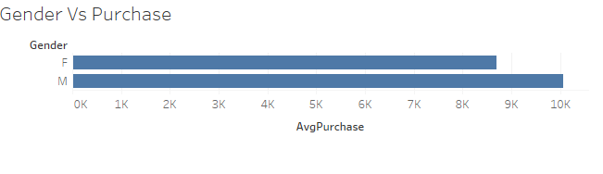
Gender vs purchase
Conclusion : Men tend to spend more than women

Slide 55
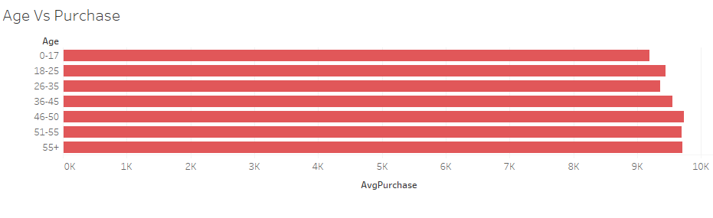
Age VS Purchase
Conclusion :Customers aged between 46 and 55 shop more.

Slide 56
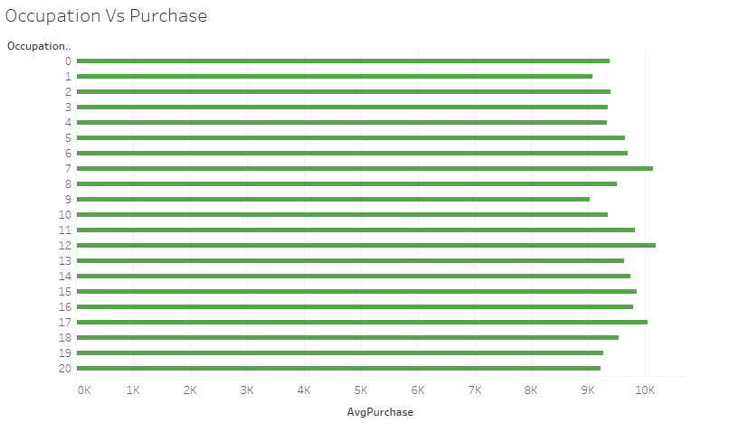
OCCUPATION VS Purchase
Conclusion : Customers in occupations 12 and 17 tend to purchase more products.

Slide 57
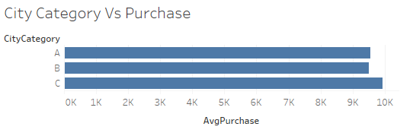
City Category vs purchase
Conclusion : Customers residing in city C spend more during Black Friday Sales.

Slide 58
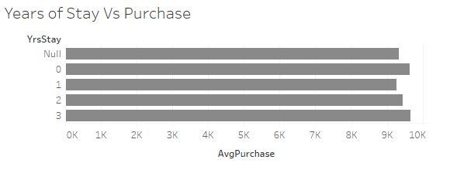
Years-of-stay vs purchase
Conclusion :Customers who have lived at their current residences for less than a year or about 3 years tend to purchase more.

Slide 59
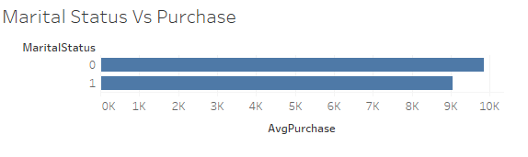
Marital status vs purchase
Conclusion : Unmarried customers tend to spend more on average.

Slide 60
Thank you

