Slide 1
Python Data Scientist Track
DataCamp

Slide 2
Course 1
Intro to Python for Data science

Slide 3
The Python Interface
In the Python script on the right, you can type Python code to solve the exercises. If you hit Run Code or Submit Answer, your python script (script.py) is executed and the output is shown in the IPython Shell. Submit Answer checks whether your submission is correct and gives you feedback.
You can hit Run Code and Submit Answer as often as you want. If you're stuck, you can click Get Hint, and ultimately Get Solution.
You can also use the IPython Shell interactively by simply typing commands and hitting Enter. When you work in the shell directly, your code will not be checked for correctness so it is a great way to experiment.

Slide 4
Instructions
100 XP
Experiment in the IPython Shell; type 5 / 8, for example.
Add another line of code to the Python script on the top-right (not in the Shell): print(7 + 10).
Hit Submit Answer to execute the Python script and receive feedback.

Slide 5
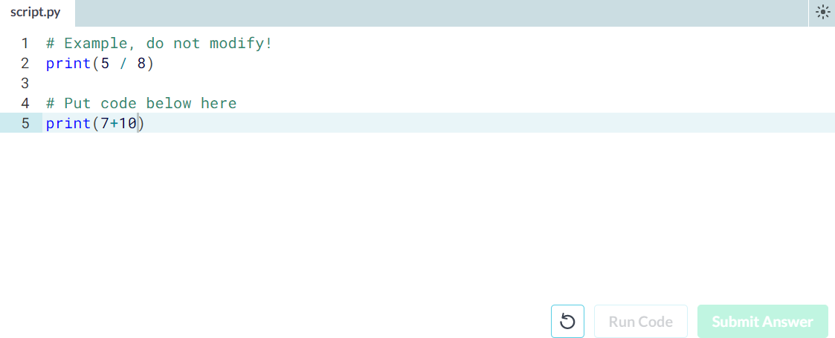

Slide 6
Any comments?
Something that Filip didn't mention in his videos is that you can add comments to your Python scripts. Comments are important to make sure that you and others can understand what your code is about.
To add comments to your Python script, you can use the # tag. These comments are not run as Python code, so they will not influence your result. As an example, take the comment on the right, # Division; it is completely ignored during execution.

Slide 7
Instructions
100 XP
Above the print(7 + 10), add the comment # Addition.

Slide 8
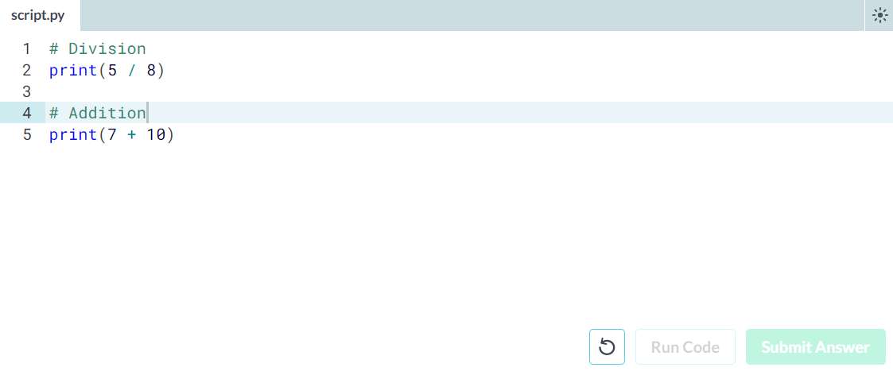

Slide 9
Python as a calculator
Python is perfectly suited to do basic calculations. Apart from addition, subtraction, multiplication and division, there is also support for more advanced operations such as:
Exponentiation: **. This operator raises the number to its left to the power of the number to its right. For example 4**2 will give 16.
Modulo: %. This operator returns the remainder of the division of the number to the left by the number on its right. For example 18 % 7 equals 4.
The code in the script on the right gives some examples.

Slide 10
Instructions
100 XP
Suppose you have $100, which you can invest with a 10% return each year. After one year, it's 100×1.1=110 dollars, and after two years it's 100×1.1×1.1=121. Add code on the right to calculate how much money you end up with after 7 years.

Slide 11
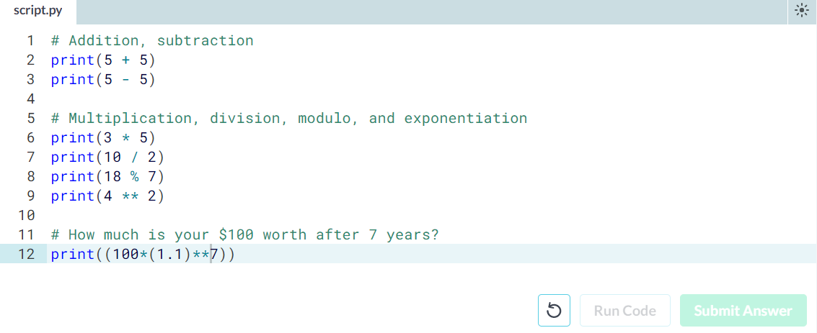

Slide 12
Variable Assignment
In Python, a variable allows you to refer to a value with a name. To create a variable use =, like this example:
x = 5
You can now use the name of this variable, x, instead of the actual value, 5.
Remember, = in Python means assignment, it doesn't test equality!

Slide 13
Instructions
100 XP
Create a variable savings with the value 100.
Check out this variable by typing print(savings) in the script.

Slide 14
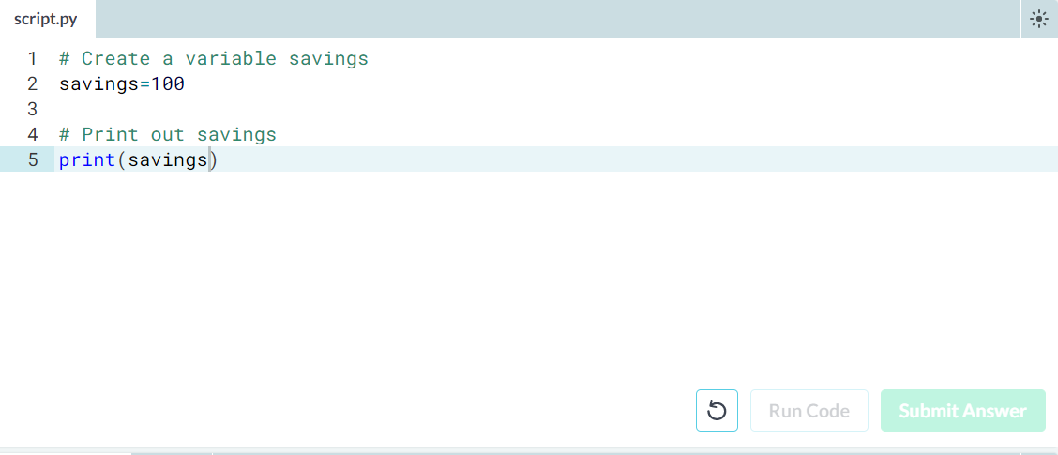

Slide 15
Calculations with variables
Remember how you calculated the money you ended up with after 7 years of investing $100? You did something like this:
100 * 1.1 ** 7
Instead of calculating with the actual values, you can use variables instead. The savings variable you've created in the previous exercise represents the $100 you started with. It's up to you to create a new variable to represent 1.1 and then redo the calculations!

Slide 16
Instructions
100 XP
Create a variable growth_multiplier, equal to 1.1.
Create a variable, result, equal to the amount of money you saved after 7 years.
Print out the value of result.

Slide 17
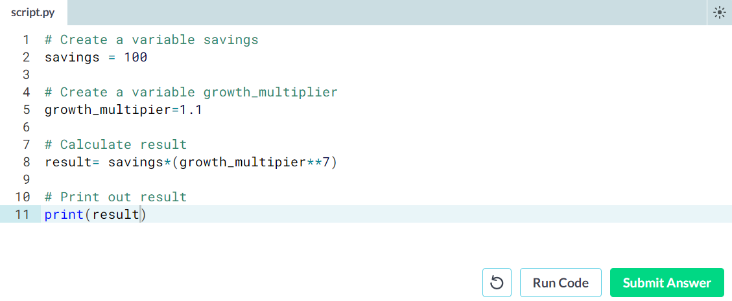

Slide 18
Other variable types
In the previous exercise, you worked with two Python data types:
int, or integer: a number without a fractional part. savings, with the value 100, is an example of an integer.
float, or floating point: a number that has both an integer and fractional part, separated by a point. growth_multiplier, with the value 1.1, is an example of a float.
Next to numerical data types, there are two other very common data types:
str, or string: a type to represent text. You can use single or double quotes to build a string.
bool, or boolean: a type to represent logical values. Can only be True or False (the capitalization is important!).

Slide 19
Instructions
100 XP
Create a new string, desc, with the value "compound interest".
Create a new boolean, profitable, with the value True.

Slide 20
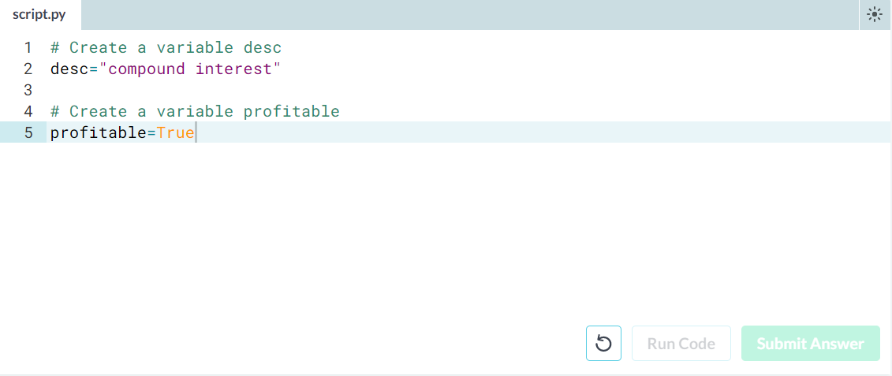

Slide 21
Operations with other types
Filip mentioned that different types behave differently in Python.
When you sum two strings, for example, you'll get different behavior than when you sum two integers or two booleans.
In the script some variables with different types have already been created. It's up to you to use them.

Slide 22
Instructions
100 XP
Calculate the product of savings and growth_multiplier. Store the result in year1.
What do you think the resulting type will be? Find out by printing out the type of year1.
Calculate the sum of desc and desc and store the result in a new variable doubledesc.
Print out doubledesc. Did you expect this?

Slide 23
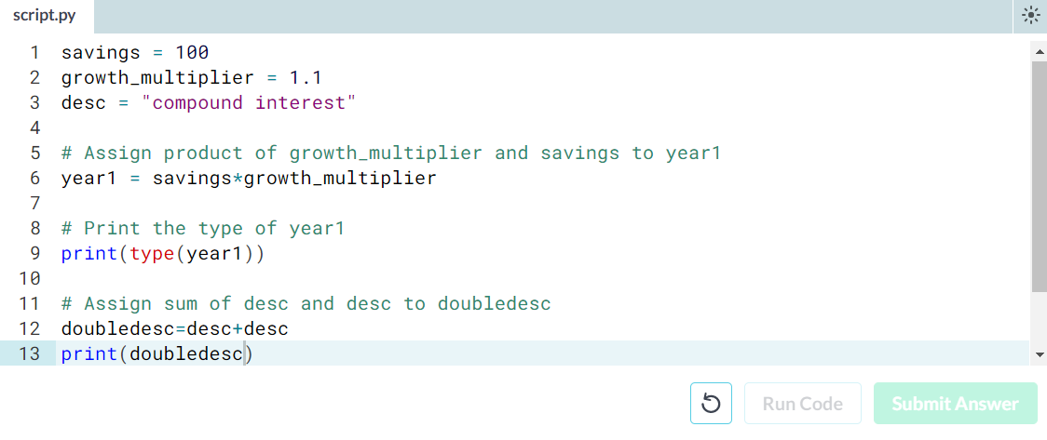

Slide 24
Type conversion
Using the + operator to paste together two strings can be very useful in building custom messages.
Suppose, for example, that you've calculated the return of your investment and want to summarize the results in a string. Assuming the floats savings and result are defined, you can try something like this:
print("I started with $" + savings + " and now have $" + result + ". Awesome!")
This will not work, though, as you cannot simply sum strings and floats.
To fix the error, you'll need to explicitly convert the types of your variables. More specifically, you'll need str(), to convert a value into a string. str(savings), for example, will convert the float savings to a string.
Similar functions such as int(), float() and bool() will help you convert Python values into any type.

Slide 25
Instructions
100 XP
Hit Run Code to run the code on the right. Try to understand the error message.
Fix the code on the right such that the printout runs without errors; use the function str() to convert the variables to strings.
Convert the variable pi_string to a float and store this float as a new variable, pi_float.

Slide 26
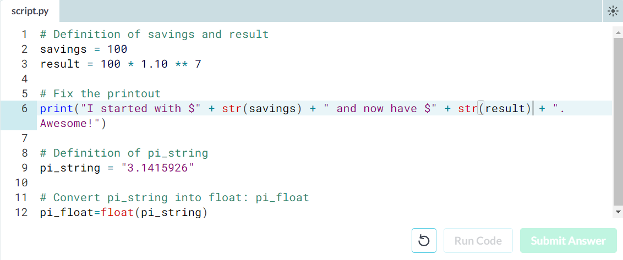

Slide 27
Create a list
As opposed to int, bool etc., a list is a compound data type; you can group values together:
a = "is"
b = "nice"
my_list = ["my", "list", a, b]
After measuring the height of your family, you decide to collect some information on the house you're living in. The areas of the different parts of your house are stored in separate variables for now, as shown in the script.

Slide 28
Instructions
100 XP
Create a list, areas, that contains the area of the hallway (hall), kitchen (kit), living room (liv), bedroom (bed) and bathroom (bath), in this order. Use the predefined variables.
Print areas with the print() function.

Slide 29
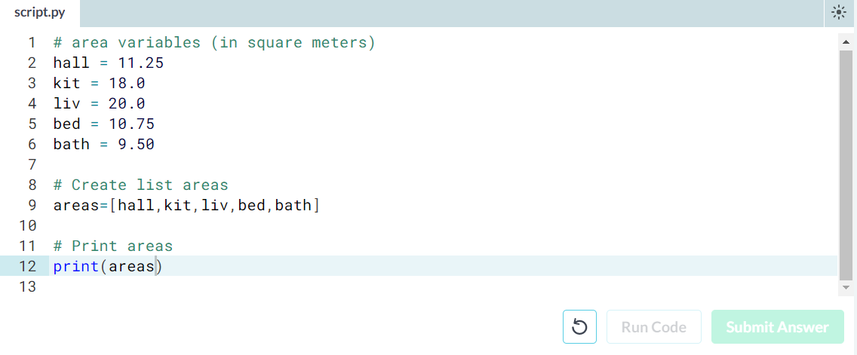

Slide 30
Subset and conquer
Subsetting Python lists is a piece of cake. Take the code sample below, which creates a list x and then selects "b" from it. Remember that this is the second element, so it has index 1. You can also use negative indexing.
x = ["a", "b", "c", "d"]
x[1]
x[-3] # same result!
Remember the areas list from before, containing both strings and floats? Its definition is already in the script. Can you add the correct code to do some Python subsetting?

Slide 31
Instructions
100 XP
Print out the second element from the areas list (it has the value 11.25).
Subset and print out the last element of areas, being 9.50. Using a negative index makes sense here!
Select the number representing the area of the living room (20.0) and print it out.

Slide 32
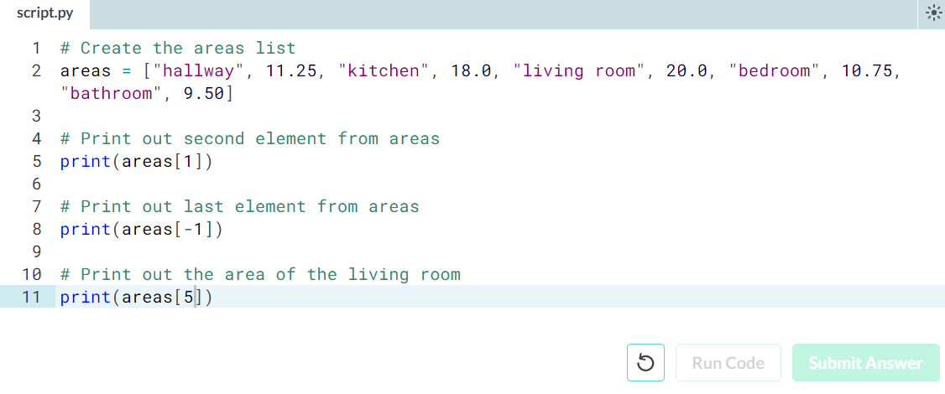

Slide 33
Subset and calculate
After you've extracted values from a list, you can use them to perform additional calculations. Take this example, where the second and fourth element of a list x are extracted. The strings that result are pasted together using the + operator:
x = ["a", "b", "c", "d"]
print(x[1] + x[3])

Slide 34
Instructions
100 XP
Using a combination of list subsetting and variable assignment, create a new variable, eat_sleep_area, that contains the sum of the area of the kitchen and the area of the bedroom.
Print the new variable eat_sleep_area.

Slide 35
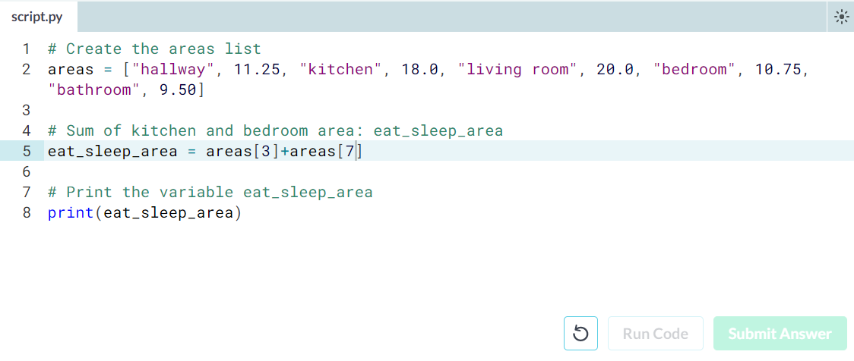

Slide 36
Slicing and dicing
Selecting single values from a list is just one part of the story. It's also possible to slice your list, which means selecting multiple elements from your list. Use the following syntax:
my_list[start:end]
The start index will be included, while the end index is not.
The code sample below shows an example. A list with "b" and "c", corresponding to indexes 1 and 2, are selected from a list x:
x = ["a", "b", "c", "d"]
x[1:3]
The elements with index 1 and 2 are included, while the element with index 3 is not.

Slide 37
Instructions
100 XP
Use slicing to create a list, downstairs, that contains the first 6 elements of areas.
Do a similar thing to create a new variable, upstairs, that contains the last 4 elements of areas.
Print both downstairs and upstairs using print().

Slide 38
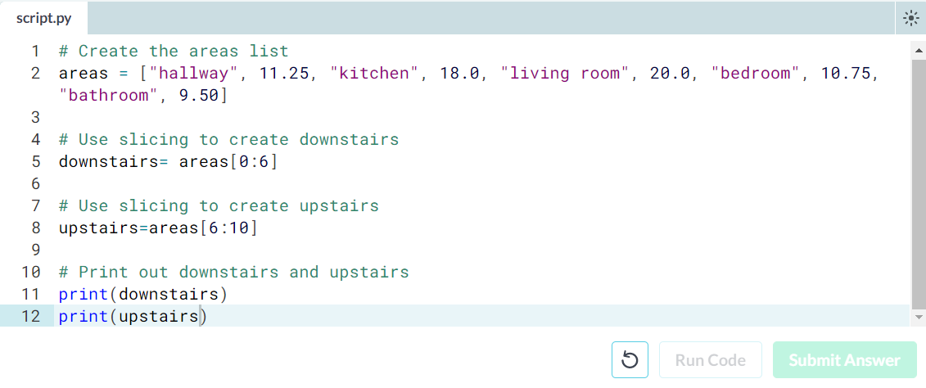

Slide 39
Slicing and dicing (2)
In the video, Filip first discussed the syntax where you specify both where to begin and end the slice of your list:
my_list[begin:end]
However, it's also possible not to specify these indexes. If you don't specify the begin index, Python figures out that you want to start your slice at the beginning of your list. If you don't specify the end index, the slice will go all the way to the last element of your list. To experiment with this, try the following commands in the IPython Shell:
x = ["a", "b", "c", "d"]
x[:2]
x[2:]
x[:]

Slide 40
Instructions
100 XP
Create downstairs again, as the first 6 elements of areas. This time, simplify the slicing by omitting the begin index.
Create upstairs again, as the last 4 elements of areas. This time, simplify the slicing by omitting the end index.

Slide 41
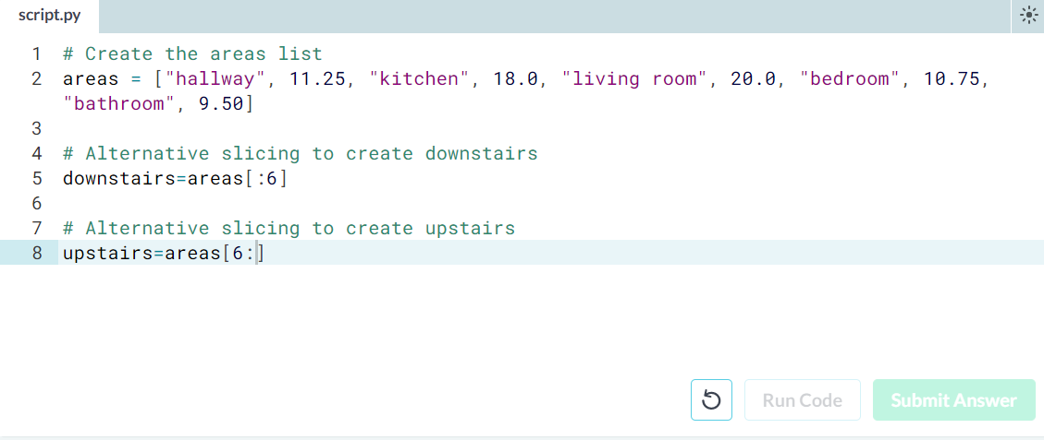

Slide 42
Replace list elements
Replacing list elements is pretty easy. Simply subset the list and assign new values to the subset. You can select single elements or you can change entire list slices at once.
Use the IPython Shell to experiment with the commands below. Can you tell what's happening and why?
x = ["a", "b", "c", "d"]
x[1] = "r"
x[2:] = ["s", "t"]
For this and the following exercises, you'll continue working on the areas list that contains the names and areas of different rooms in a house.

Slide 43
Instructions
100 XP
Update the area of the bathroom area to be 10.50 square meters instead of 9.50.
Make the areas list more trendy! Change "living room" to "chill zone".

Slide 44
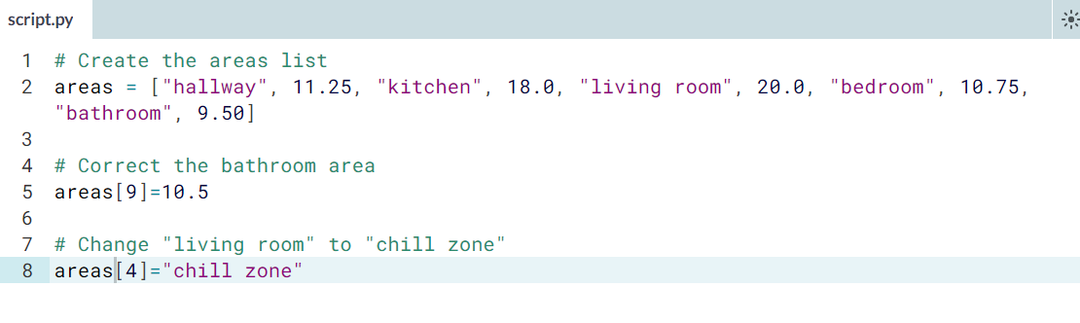

Slide 45
Extend a list
If you can change elements in a list, you sure want to be able to add elements to it, right? You can use the + operator:
x = ["a", "b", "c", "d"]
y = x + ["e", "f"]
You just won the lottery, awesome! You decide to build a poolhouse and a garage. Can you add the information to the areas list?

Slide 46
Instructions
100 XP
Use the + operator to paste the list ["poolhouse", 24.5] to the end of the areas list. Store the resulting list as areas_1.
Further extend areas_1 by adding data on your garage. Add the string "garage" and float 15.45. Name the resulting list areas_2.
Take Hint (-30 XP)

