Slide 1

Perfume Sales
Analysis

Slide 2
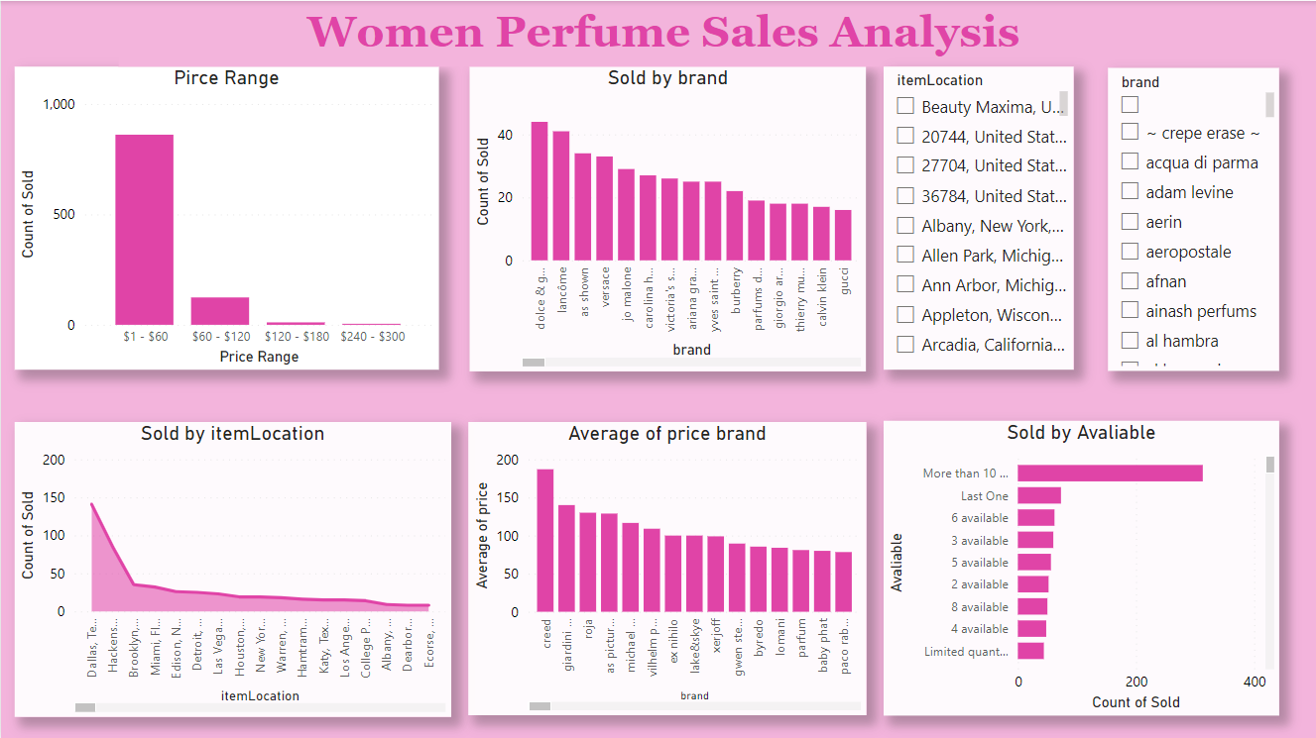

Slide 3
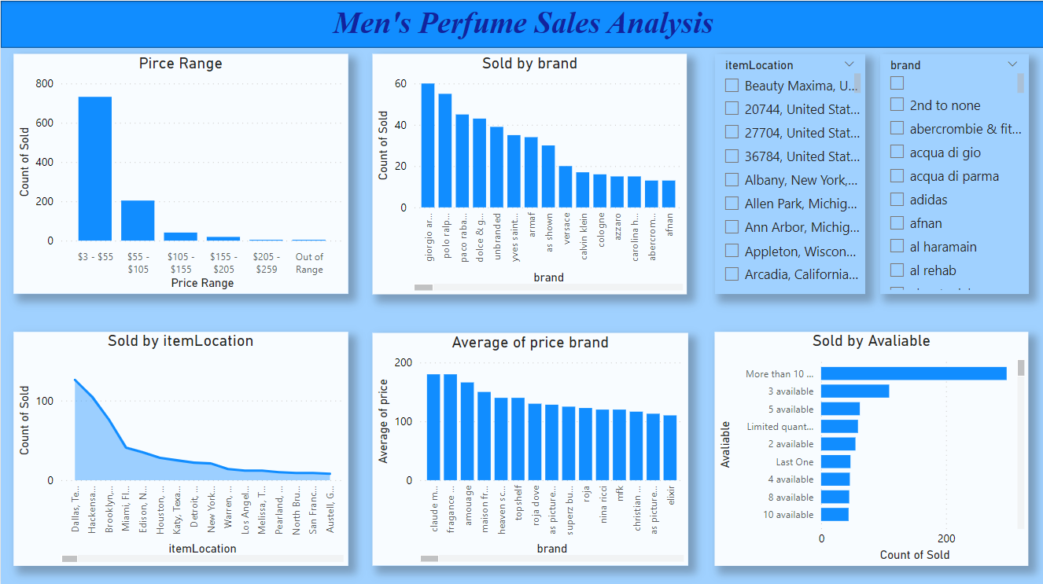

Slide 4

Insights through both Dashboards
Women's Perfume Analysis
The women's perfume dashboard highlighted several key findings:
Brands vs. Sales: Certain brands demonstrated higher sales volumes, indicating strong consumer loyalty and brand recognition in the market.
Location vs. Sales: Sales distribution varied by location, suggesting regional preferences and potential areas for targeted marketing efforts.
Average Price of Each Brand: The price analysis revealed a wide range of brand pricing strategies, from affordable to high-end luxury products.
Availability vs. Sold: Products with higher availability tended to have increased sales, highlighting the importance of stock management.
Sales by Price Range: A significant portion of sales occurred within mid-range prices, although there was also notable interest in premium products, suggesting diverse consumer purchasing behaviors.
Men's Perfume Analysis
The men's perfume dashboard revealed distinct trends:
Brands vs. Sales: Similar to the women's segment, specific brands consistently achieved higher sales, reflecting strong brand positioning.
Location vs. Sales: Regional sales data indicated certain areas with higher demand, providing insights for location-specific marketing strategies.
Average Price of Each Brand: Men's perfumes also showed a broad price spectrum, catering to various consumer segments.
Availability vs. Sold: There was a direct correlation between product availability and sales, underscoring the need for effective inventory management.
Sales by Price Range: Mid to high-end products were popular among male consumers, indicating a preference for quality and brand prestige.

Slide 5
Comparative Insights
Across both segments, several insights emerged:
Brand Popularity: Some brands were top performers in both men's and women's categories, suggesting strong overall brand appeal.
Location-Based Sales: Both dashboards showed location-specific sales trends, which could be leveraged for more precise marketing.
Price Range Preferences: While mid-range products were popular in both segments, there was also a substantial market for high-end luxury perfumes.
Recommendations
Based on these findings, the following strategies are recommended:
Targeted Marketing: Develop marketing campaigns that focus on high-sales regions and align with consumer preferences for specific brands and price ranges.
Product Development: Introduce new products that resonate with the identified fragrance preferences and explore cross-segment opportunities for popular brands.
Inventory Management: Ensure optimal product availability to meet consumer demand and maximize sales potential.
Pricing Strategy: Maintain a balanced pricing strategy that offers both affordable and premium products to cater to diverse consumer groups

