Slide 1
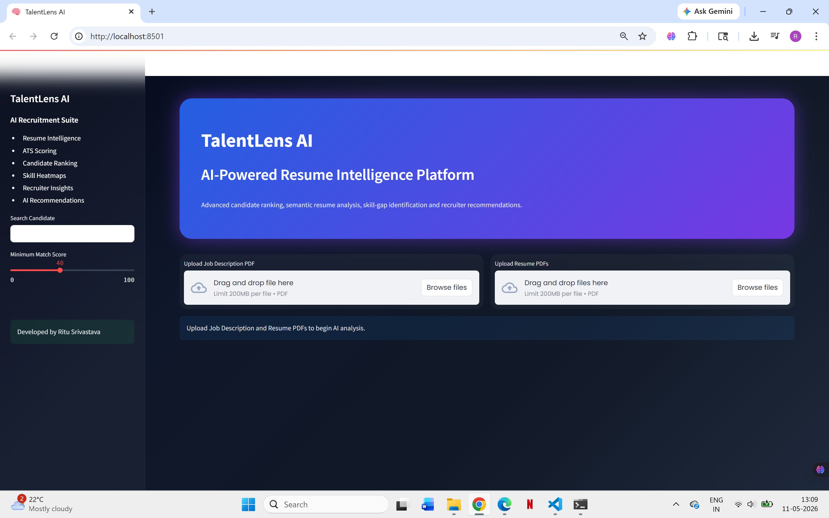
TalentLens
AI
AI Resume Shortlisting System
Name:
Ritu Srivastava
Branch:
B.Tech AIML
Univ.:
UPES Dehradun
Application — live deployment at Streamlit Cloud

Slide 2




Problem Statement
Challenges in traditional resume screening
High Volume of Applications
Time-Consuming Screening
Recruiters receive hundreds of resumes per job posting. Manual review of each is neither practical nor scalable.
On average, a recruiter spends 6–7 seconds per resume. The entire shortlisting process can take days or weeks.
Skill Mismatch
Limitations of Traditional ATS
Candidates are often shortlisted or rejected based on keyword matches rather than actual skill relevance.
Rule-based ATS systems fail to understand context, synonyms, or semantically related skills in resumes.
2 / 10

Slide 3




Project Objective
What TalentLens AI is built to do
TalentLens AI automates the resume evaluation pipeline using NLP and semantic matching to help recruiters identify the most suitable candidates quickly and objectively.
01
Resume Parsing —
Automatically extract text content from uploaded PDF resumes using PyPDF2.
02
Skill Extraction —
Identify and list technical and domain skills from each resume.
03
Candidate Ranking —
Score and rank candidates based on JD-resume alignment.
04
Semantic Matching —
Use Sentence-BERT embeddings for deep contextual similarity scoring.
05
AI Recommendation —
Generate hire / consider / reject recommendations automatically.
3 / 10

Slide 4



Technology Stack
Libraries and tools used in the project
Python
Streamlit
Sentence Transformers
Pandas
Core language
Web UI framework
Semantic NLP matching
Data handling
Scikit-learn
Plotly
PyPDF2
GitHub
ML utilities
Charts & heatmaps
PDF text extraction
Version control
All tools are open-source. Deployed on Streamlit Community Cloud.
4 / 10

Slide 5

System Workflow
End-to-end pipeline from upload to ranking
Step 1
Step 2
Step 3
Step 4
Step 5
›
›
›
›
Upload PDF
Extract Text
Match with JD
Calculate Score
Generate Rank
JD + Resumes
PyPDF2 parsing
Semantic similarity
ATS + SBERT score
Ranked dashboard
How it works:
The recruiter uploads a Job Description PDF and multiple resume PDFs. The system extracts text, identifies relevant skills, computes cosine similarity using Sentence-BERT embeddings, calculates an ATS keyword score, and combines them into a weighted overall score. Candidates are ranked and displayed on an interactive dashboard.
5 / 10

Slide 6
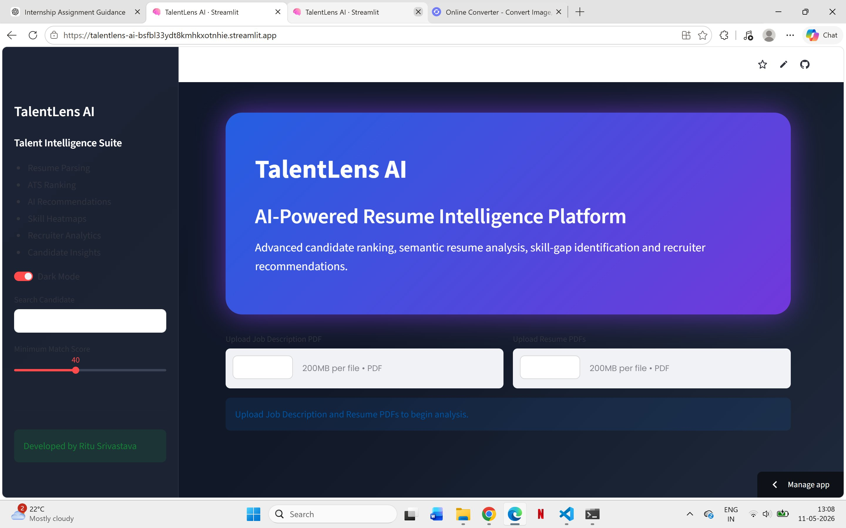
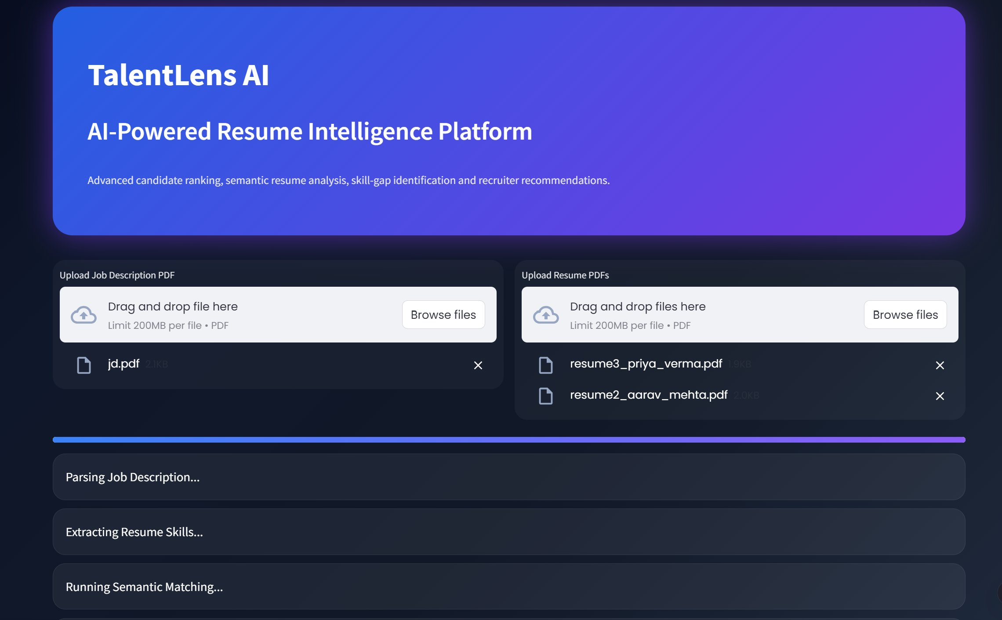
Application UI
Screenshots of the TalentLens AI interface
Recruiter dashboard with match scores
Dark mode UI with sidebar navigation
Candidate ranking by overall score
Skill heatmap and gap analysis
6 / 10

Slide 7
Key Features
Core capabilities of the system
ATS Scoring
Resume Ranking
Skill Heatmaps
Keyword-based scoring against job description requirements to simulate applicant tracking systems.
Candidates are automatically ranked by a weighted score combining ATS and semantic similarity.
Visual heatmap showing which skills each candidate has and which are missing for the role.
Candidate Comparison
Recruiter Insights
PDF Upload System
Side-by-side view of top candidates across key skill dimensions.
AI-generated notes — Hire / Consider / Reject — with brief reasoning for each candidate.
Drag-and-drop interface to upload one JD and multiple resume PDFs simultaneously.
7 / 10

Slide 8
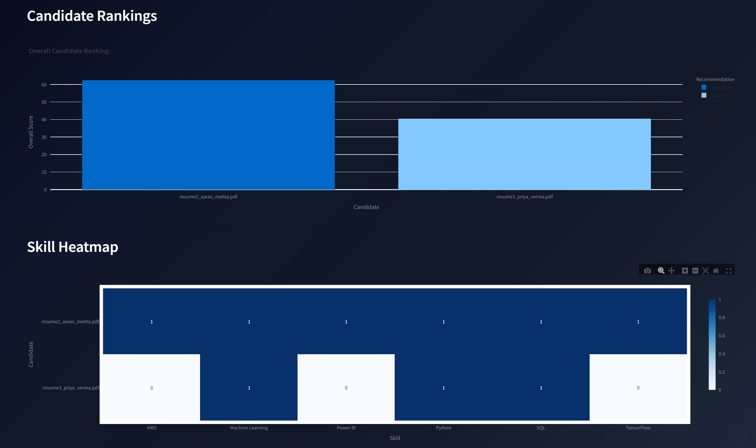
Results
Output from the system on sample data
62.48%
Top match score
51.5%
Average match
2
Candidates analysed
6+
Skills matched (top)
Sample run on 2 test resumes against 1 JD
Candidate Rankings & Skill Heatmap
8 / 10

Slide 9

Future Improvements
Planned enhancements for the next version
1
LinkedIn Integration
Allow recruiters to import candidate profiles directly from LinkedIn, expanding data sources beyond uploaded PDFs.
2
Interview Analysis
Integrate LLM-based question generation and video interview transcript analysis for end-to-end screening.
3
AI Chatbot Recruiter
Build a conversational interface so recruiters can query candidate data using natural language questions.
4
Multilingual Resume Support
Extend parsing and matching to support resumes in Hindi and other regional languages using multilingual models.
These enhancements are scoped for future development beyond the current internship project.
9 / 10

Slide 10
Conclusion
TalentLens AI
Thank You
This project demonstrates how AI and NLP can significantly improve the recruitment process. By combining Sentence-BERT semantic matching with ATS keyword scoring, TalentLens AI delivers fast, objective and ranked candidate shortlisting.
for your time and attention
Name:
Ritu Srivastava
Skills Applied:
Branch:
B.Tech AIML
Python
NLP / SBERT
Streamlit
University:
UPES Dehradun
Pandas
Plotly
Project:
TalentLens AI — AI Resume Shortlisting System
Built with Python · Streamlit · Sentence Transformers · PyPDF2 · Plotly

