Slide 1
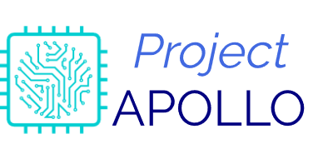
APplication OF Learning to Levitate Opportune
Project APOLLO - 1

Slide 2
Agenda
Overview of Apollo
Apollo-1
Available resources
Potential applications
Timeline
Roles

Slide 3
Overview of Apollo
Enhance the existing technology
Application of our knowledge to build open source solutions
A series of projects that target one or several problem areas

Slide 4
Apollo-1
Using deep learning to solve the common problem(s) and build a python-based app.
Target areas:
Agriculture
Production
Documentation
Medicinal

Slide 5
Apollo-1 (Tasks)
Common problem identification
Solution feasibility debate
Implementation and development of solution using python
Build, test and release.
Notes:
Release with installer

Slide 6
Available resources
Computational resources
One system at Fraunhofer
One Fraunhofer cloud access, Carme
Microsoft cloud
(MindGarage?)
GitHub for project and repository management.

Slide 7
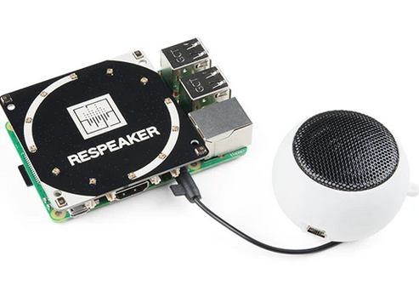
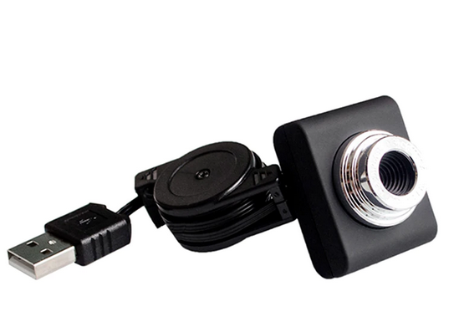
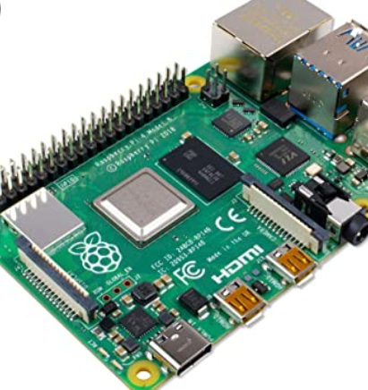
Available resources (continued)

Slide 8
Potential applications
Access webcam to detect face and apply modifications (glasses, etc)
Person detection at door
Number of persons
Identity using face detection
Identity using audio detection

Slide 9
Timeline
Duration: 16th May to 31st May 2020
For complete release of app.
Including installer
1-2 days: feasibility debate,

Slide 10
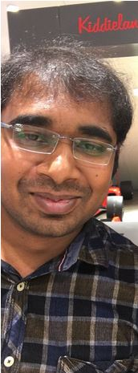

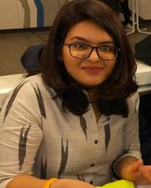

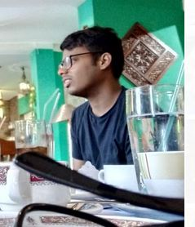
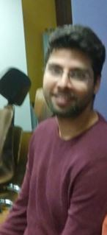
Roles
Developers
Supervisor

