Slide 1

Summary Extraction along with sentiment analysis.
Group 1.

Slide 2
Business Problem:
To Build a NLP model to extract summary ,categorize summary as positive, negative or neutral.
Business Objective:
The Objective is to extract E-books of your choice and build a NLP model extract summary, categorize summary as positive, negative or neutral.

Slide 3
Project Architecture / Project Flow
Data Gathering
Data Extraction
Data Pre-processing
Summary Extraction
Model Deployment
Model Building
Summary
EDA

Slide 4
Data set details
Any pdf of E-Book is data for Project
Here we are taking “7-Habits of Highly Effective People.”

Slide 5
Data Extraction
Import PDF using pdfminer & convert it into text.
Removing punctuation, symbols, stop wards from text.
Tokenizing of text.
As per frequency of words sentence is created from it best sentence is created which is get connected to make summary.

Slide 6
EDA on data
Removing all special characters, punctuation and numerical from summary.
Word tokenization and removing stop-wards from summary.
Word stemmer of tokens and lemmatize of summary.
By joining lemmatize words to create clean summary.

Slide 7
Model Building

Slide 8
Sentimental analysis using TextBlob
Sentimental subjectivity and polarity is determine using TextBlob.
The sentimental analysis is determined on the value of polarity, if the value is less than 0 then it is negative, the value is 0 then it is neutral and if the value is greater than 0 then the it become positive analysis.
Here the value of sentimental analysis become greater than 0 hence sentimental analysis become positive.

Slide 9
Sentimental analysis using VADERSentiment
Sentimental subjectivity and polarity is determine using VADER model.
The sentimental analysis is determined on the compound value, if the value is less than -0.05 then it is negative, the value is between -0.05 to 0.05 then it is neutral and if the value is greater than 0.05 then the it become positive analysis.
Here the compound value of sentimental analysis become greater than 0.05, Hence sentimental analysis become positive.

Slide 10
Model Deployment

Slide 11
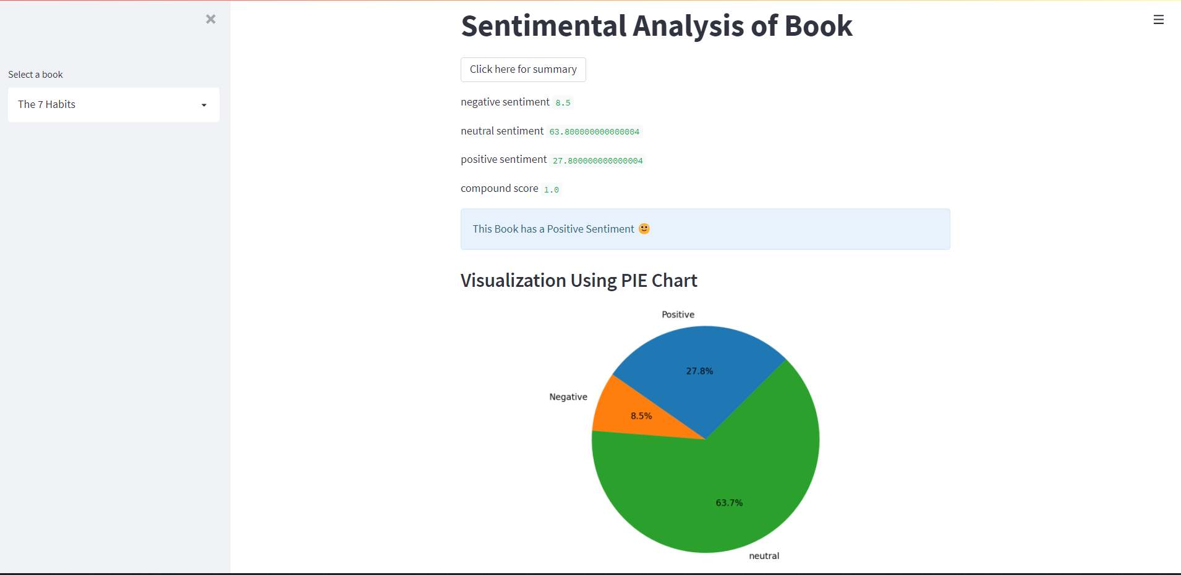
Model Deployment using Streamlit

Slide 12
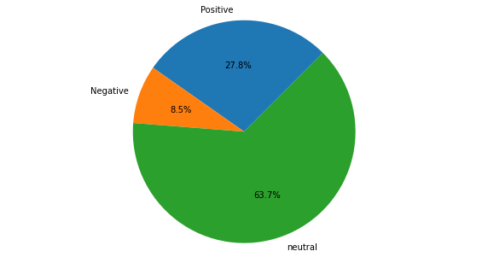
Visual Representation using PIE Chart
This is PIE chart representation on the 7 Habits book

Slide 13
Challenges faced?
The challenges were in the deployment part where the pdf file is uploaded in pdf converter to work on text.
How did you overcome?
Here we use condition if, elif condition to overcome the challenge and import the pdf in text converter.

Slide 14
Thank you

