Slide 1
Inheritance

Slide 2
INHERITANCE
Types of inheritance
Single inheritance
Multilevel inheritance
Hierarchical inheritance
Multiple Inheritance(interface )

Slide 3
Introduction
In Java inheritance is achieved by extends keyword .
Inheritance allows to derive a new class from an existing one
The existing class is called the parent class, or super class, or base class
The derived class is called the child class or subclass

Slide 4
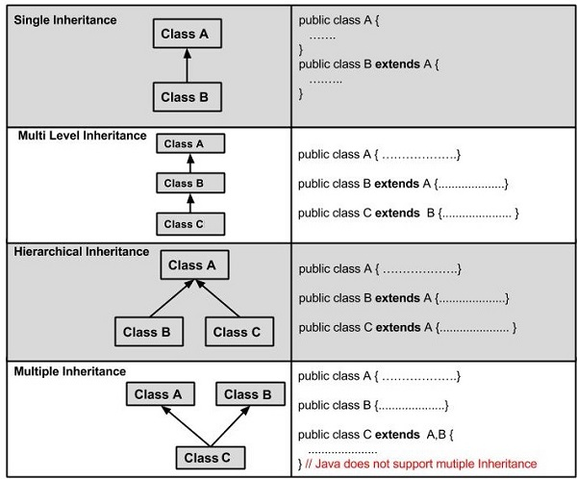
TYPES OF:-

Slide 5
Inheritance
Vehicle
Car
  we use the reserved word extends to establish an inheritance relationship.
  Uses :For Method Overriding (so runtime polymorphism can be achieved)
  For Code Re-usability
class Subclass-name extends Superclass-name
{
//methods and fields
}

Slide 6
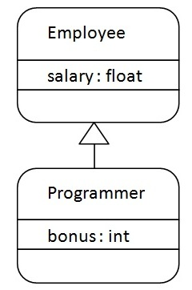
Syntax :
class <subclass name> extends <superclass name>
{
variable declarations;
method declarations;
}
single inheritance: derived class can have only one parent class
class Employee {
float salary=400; }
class Programmer extends Employee {
int bonus=100; }
Class TestMain {
public static void main(String args[]) {
Programmer p=new Programmer();
System.out.println("Programmer salary is:"+p.salary);
System.out.println("Bonus of Programmer is:"+p.bonus);
} } }
public class Student extends Person

Slide 7
EXAMPLE OF INHERITANCE
class Parent
{
public void p1()
{ System.out.println("Parent method"); }
}
public class Child extends Parent {
public void c1()
{ System.out.println("Child method"); }
}
Class Tests
public static void main(String[] args)
{
Child cobj = new Child();
cobj.c1(); //method of Child class
cobj.p1(); //method of Parent class
} }

Slide 8
Example for Hierarchical Inheritance

Slide 9
Class Bank{
Int getRateOfInterest() {return 0;}
}
Class SBI extends Bank{
Int getRateOfInterest() {return 8;}
}
Class ICICI extends Bank{
Int getRateOfInterest() {return 7;}
}
class Test2 {
public static void main(String args[]){
SBI s=new SBI();
ICICI i=new ICICI();
System.out.println("SBI Rate of Interest: "+s.getRateOfInterest());
System.out.println("ICICI Rate of Interest: "+i.getRateOfInterest());
} }

Slide 10
Multi-level inheritance
public class Inherit_Multilevel { protected String str; Inherit_Multilevel() { str = "J"; } } class SubClass1 extends Inherit_Multilevel { SubClass1() { str = str.concat("A"); } } class SubClass21 extends SubClass1 { SubClass2() { str = str.concat("V"); } } | class SubClass3 extends SubClass2 { SubClass3() { str = str.concat("A"); } void display() { System.out.println(str); } } class MainClass { public static void main(String args[]) { SubClass3 obj = new SubClass3(); obj.display(); } }

Slide 11
Super keyword
In Java super keyword is used by a subclass whenever it need to refer to its immediate super class .
super() to access all (non-private) superclass methods and it must be first statement executed inside subclass constructor.
Super can be used to refer to parent class's methods, instance variables, constructors to call them
Super keyword is useful when overriding and you want to keep the old behavior but add new behavior to it
Syntax:
super(); //to call default constructor
super(args); // call parent’s constructor
super.fieldName // access parent’s field
super.methodName(args); // method

Slide 12
Example of super keyword
class Vehicle {
int speed=50; }
class Bike4 extends Vehicle{
int speed=100;
void display(){
System.out.println(super.speed);//will print speed of Vehicle now
}
public static void main(String args[]){
Bike4 b=new Bike4();
b.display(); } }

Slide 13
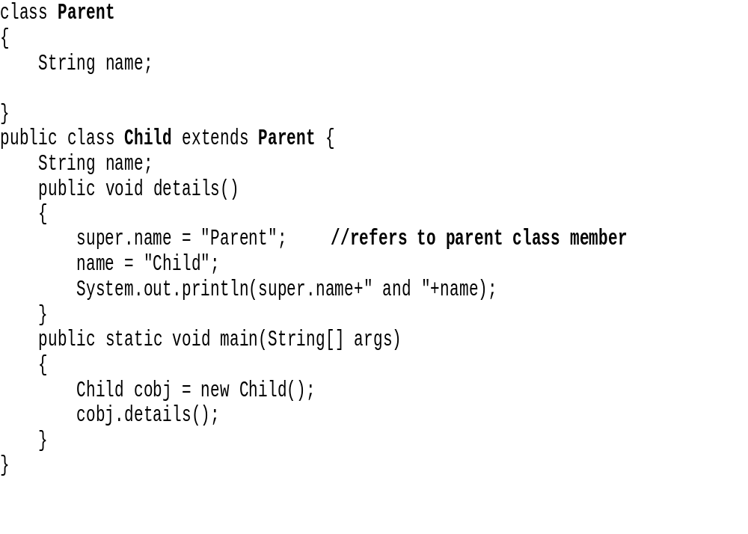
Example of super keyword

Slide 14
No use of Super keyword
class Person { void message() { System.out.println("welcome"); } } class Student extends Person { void display() { message(); //will invoke parent class message() method } | public static void main(String args[]) { Student s=new Student(); s.display(); } } Output: welcome

Slide 15
Example for Super keyword
class student { int roll_no; String name; student(int a,String b) { roll_no=a; name=b; } } Class sub_student extends student { Stirng branch; sub_student(int x,Stirng y,String z) { super(x,y); branch=z; } Void display() { System.out.println(roll_no+name+branch); }} | Class demo { public static void main(String args[]) { sub_student s=new sub_student(1,”neeta”,”CSE”); s.display(); } }

Slide 16
Example for inheritance
class Rect { Int l,b; Rect(int x, int y) { l=x; b=y; } Int area() { return(l*b); } } class tringle extends Rect { Int h; tringle(int x,int y int z) { super(x,y); h=z; } | Int volume() { Return(l*b*h); }} Class inherit { PSVM(String args[]) { tringle s1= new tringle(2,2,2); Int area1=s1.area(); // Superclass method Int volume1 =s1.volume();//subclass method System.out.println(area1); System.out.println(volume1); } } Output: Area1=4 volume=8

Slide 17
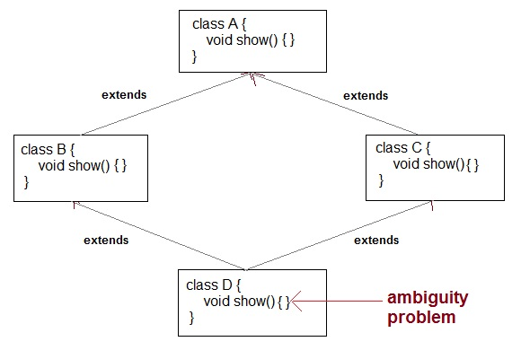
Multiple inheritance
To remove ambiguity.
To provide more maintainable and clear design.

Slide 18
Multiple inheritance
Multiple inheritance allows a class to be derived from two or more classes, inheriting the members of all parents
Collisions, such as the same variable name in two parents, have to be resolved
Java does not support this directly, rather it uses Interfaces

Slide 19
Overriding methods
Child class can replace the behavior of its parent's methods by redefining them.
Method with same name having different behavior when they are called.
Methods with same name and Return type must be same for calling and to the called.
method must have same parameter as in the parent class.
must be IS-A relationship (inheritance).
Method overriding is used to provide specific implementation of a method that is already provided by its super class.

Slide 20
Rules :Overriding methods
A method declared final cannot be overridden.
A method declared static cannot be overridden but can be re-declared.
If a method cannot be inherited, then it cannot be overridden.
A subclass within the same package as the instance's superclass can override any superclass method that is not declared private or final.
A subclass in a different package can only override the non-final methods declared public or protected.

Slide 21
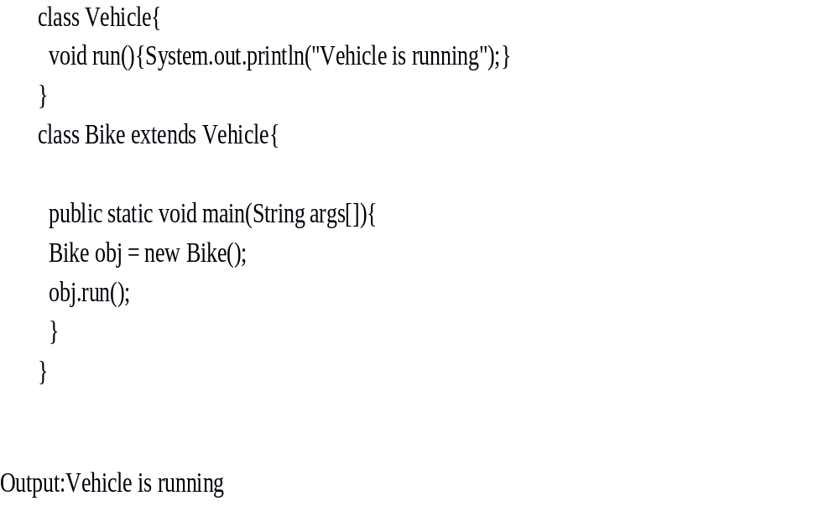
Method definition:

Slide 22
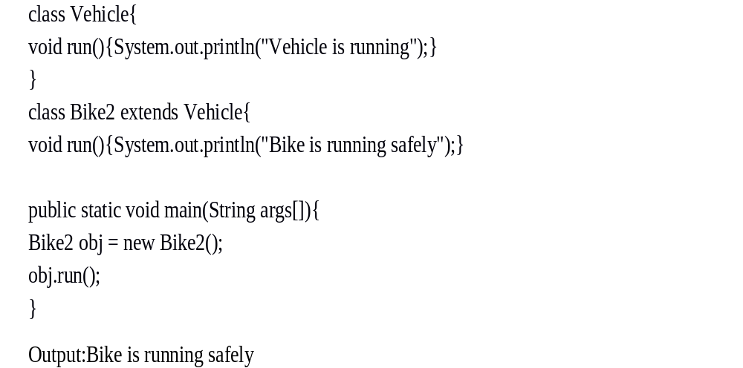
Method overriding example

Slide 23
Method overridden example
Class A { Int x; A(int x) { This.x=x; } void display() { System.out.println(“superclass x=“ +x); } } Class sub extentds A { Int y; Sub(int x,int y) { Super(x); This.y=y; } | Void display() { System.out.println(“superclass x=”+ x); System.out.println(“subclass y=“ + y); } Class mainc { public static void main(String args[]) { Sub s1 = new sub(100,200); s1.display(); } }

Slide 24
Static keyword(variables,methods)
We can apply Java static keyword with variables, methods, blocks and nested class.
The static variable can be used to refer the common property of all objects (that is unique for each object) e.g. company name of employees, college name of students etc.
The static variable gets memory only once in class area at the time of class loading.
It makes your program memory efficient.
A static method can be invoked without the need for creating an instance of a class.
static method can access static data member and can change the value of it.

Slide 25
Static variable example
class Student { int rollno; String name; static String college ="ITS"; Student(int r,String n){ rollno = r; name = n; } | void display () { System.out.println(rollno+"\n"+name+”\n"+college); } } Class mainst { public static void main(String args[]) { Student s1 = new Student(111,"Karan"); Student s2 = new Student(222,"Aryan"); s1.display(); s2.display(); } }

Slide 26
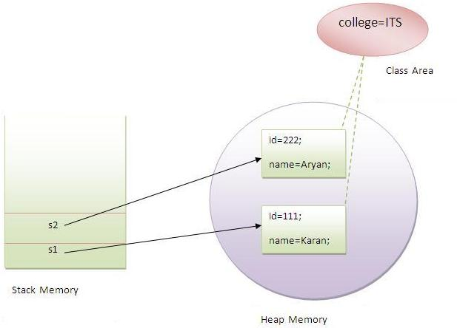
Example

Slide 27
Static keyword(variables,methods)
A static method can be invoked without the need for creating an instance of a class.
static method can access static data member and can change the value of it.
Static method is called by using class name
  Classname.method()
The static method can not use non static data member or call non-static method directly.
class A {
int a=40;//non static
public static void main(String args[]) {
System.out.println(a); } }

Slide 28
Static method
class Calculate
{
static int cube(int x)
{
return x*x*x;
}
public static void main(String args[]){
int result=Calculate.cube(5);
System.out.println(result);
}
}

Slide 29
The final keyword is a non-access modifier used for classes, attributes and methods, which makes them non-changeable (impossible to inherit or override).
The final keyword is useful when you want a variable to always store the same value, like PI (3.14159...).
The final keyword in java is used to restrict the user. The java final keyword can be used in many context. Final can be:
  variable
  method
  class

Slide 30
Final class and methods
Preventing overriding the members of superclass to subclass using final keyword.
Defining method using final keyword the method cannot be changed.
A class cannot have a subclass if class is final class
class FinalExample{
public static void main(String[] args){
final int x=100;
x=200;//Compile Time Error
}}

Slide 31
Final members and methods
public class A { public static final int a = 111; public static final float b = 11.20f; public static final double c = 1.123456789; public static final boolean d = true; public static final String e = "Final String Value"; void display() { System.out.println("The Final Variables"); System.out.println("\nInteger - " + a); System.out.println("Float - " + b); System.out.println("Double - " + c); System.out.println("Boolean - " + d); System.out.println("String - " + e); } } | class MainClass { public static void main(String args[]) { A obj = new A(); obj.display(); } } Ouput The Final Variables Integer - 111Float - 11.2Double - 1.123456789Boolean - trueString - Final String Value

Slide 32
Final class
public class F { protected int a = 10; protected int b = 20; } final class Sub extends F { Sub() { System.out.println("The final Class"); System.out.println("This Class cannot be inherited.."); System.out.println("It's the final class of inherited classes"); } void add() { int c = a + b; System.out.println("\nThe Addition is : " + c); }} | class MainClass { public static void main(String args[]) { Sub obj = new Sub(); obj.add(); } } output The final ClassThis Class cannot be inherited..I t's the final class of inherited classes The Addition is : 30

Slide 33
Runtime Polymorphism in Java Runtime polymorphism or Dynamic Method Dispatch is a process in which a call to an overridden method is resolved at runtime rather than compile-time. In this process, an overridden method is called through the reference variable of a superclass. The determination of the method to be called is based on the object being referred to by the reference variable.

Slide 34
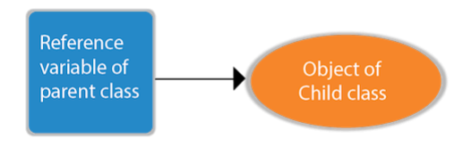
Let's frst understand the upcasting before Runtime Polymorphism. Upcasting If the reference variable of Parent class refers to the object of Child class, it is known as upcasting. For example:

Slide 35
Polymorphism in Java Polymorphism in Java is a concept by which we can perform a single action in different ways. Polymorphism is derived from 2 Greek words: poly and morphs. The word "poly" means many and "morphs" means forms. So polymorphism means many forms. There are two types of polymorphism in Java:
compile-time polymorphism and
runtime polymorphism.
We can perform polymorphism in java by method overloading and method overriding. If you overload a static method in Java, it is the example of compile time polymorphism. Here, we will focus on runtime polymorphism in java

Slide 36
class A{}
class B extends A{}
A a=new B();
//upcasting For upcasting, we can use the reference variable of class type or an interface type.
For Example:
interface I{}
class A{}
class B extends A implements I{}
Here, the relationship of B class would be:
B IS-A A
B IS-A I
B IS-A Object
Since Object is the root class of all classes in Java, so we can write B IS-A Object

Slide 37
Example of Java Runtime Polymorphism In this example, we are creating two classes Bike and Splendor. Splendor class extends Bike class and overrides its run() method. We are calling the run method by the reference variable of Parent class. Since it refers to the subclass object and subclass method overrides the Parent class method, the subclass method is invoked at runtime. Since method invocation is determined by the JVM not compiler, it is known as runtime polymorphism.

Slide 38
class Bike{
void run(){
System.out.println("running");
} }
class Splendor extends Bike{
void run(){
System.out.println("running safely with 60km");
}
public static void main(String args[]){ Bike b = new Splendor();//upcasting
b.run();
}
}

Slide 39
Abstract classes
By using final keyword for Methods which cannot be inherited in subclass
But by using abstract methods redefine methods in subclass, i.e method overriding
Cannot create object for abstract classes.
Abstract method of abstract class must defined in its subclass.
We cannot declare abstract constructor or abstract static methods. Abstract modifier means that the class can be used as a superclass only.
Abstract classes are inherited and abstract methods can be overridden
Used in inheritance hierarchies

Slide 40
Create Abstract Class & Abstract Method
public abstract class A1 {
abstract void f1();
void f2() {
System.out.println("Function - 2");
} }
class B extends A1 {
@Override
void f1() {
System.out.println("Function - 1"); } }
class MainClass {
public static void main(String args[]) {
B obj = new B();
obj.f1();
obj.f2();
} }

Slide 41
INTERFACES

Slide 42
ABSTRACT CLASS AND METHODS
Abstract methods are those methods which are to be redefined in sub class , thus making overriding compulsory.
Example:
abstract class shape
{
………………….
………………….
abstract void draw(); // prototype
…………………
…………………
}
.

Slide 43
Rules
We cannot use abstract classes to instantiate objects directly.
The abstract method of an abstract class must be defined in its sub class.
We cannot declare abstract constructor or abstract methods.

Slide 44
INTERFACES
Multiple inheritance is not possible in java programming language but we can achieve the feature through interfaces. An interface is basically a kind of class. Like class it contain method and variables with the difference that an interface can contain only abstract method and abstract classes. They cannot contain any code. This is the responsibility of the class that implements an interface to define the code for implementation of these methods.

Slide 45
Difference between class and interface.
CLASS
INTERFACE
1.The member of a class can be constant or variables.
2.The class definitions can contain code for each of its methods.
3.It can be instainted by declaring objects.
4.It can use various access specifiers like public , private or protected.
1.The members of an interface are always declared as constant.
2.The methods in an interface are abstract in nature.
3.It cannot be used to declare objects, It can be only inherit by class.
4. It can only use the public access specify.

Slide 46
Defining an Interface
Here interface is a keyword and interface name is any valid java variable .
Syntax:
Interface interfaceName
{
Variable Declaration;
Methods Declaration;
}

Slide 47
Extending Interfaces
Like classes, Interfaces can also be extended. That is an interface can be sub interfaced from other interfaces by using the keyword extends.
Syntax:
Interface name1 extends name2
{
Body of name 2
}

Slide 48
interface A {
void funcA(); }
interface B extends A {
void funcB(); }
class C implements B {
public void funcA() {
System.out.println("This is funcA"); }
public void funcB() {
System.out.println("This is funcB"); } }
public class Demo {
public static void main(String args[]) {
C obj = new C();
obj.funcA();
obj.funcB(); } }

Slide 49
Implementing the interfaces
Interfaces are used as “superclasses” whose properties are inherited by classes by using the keyword implements.
Syntax:
Class classname impements interfacename
{
body of class
}

Slide 50
Example
Interface Area
{
final static float pi=3.14f;
int compute(int x, int y);
}
class Rectangle implements Area
{
public float compute(float x, float y)
{
Return(x*y);
}}

Slide 51
Class circle implements Area
{
public float compute(float x, float y)
{
return(pi*x*x);
}
}

Slide 52
class test
{
public static void main(String arg[])
{
Rectangle r1= new Rectangle();
circle c1= new circle();
Area a;
a=r1;
System.out.println(“Area of a rectangle=“+ a.compute(10,20));
a=c1;
System.out.println(“Area of a square=“+ a.compute(10,0));
}
}

Slide 53
Program to show the multiple inheritance.
interface a // an interface is created
{
Int a=10; //variable declared
}
Interface b {
String str =new string (“hello”);
}
Interface c extends a, b // interface c inherit a and b interface OUTPUT
{ 10
Void show(); Hello
}
Class test implements c {
Public void show() {
System .out. Println (“value of a “+ a) ;
System .out. println (“value of string:” + str) ; } }
Class test
{
Public static void main( String args[])
{
test t1 = new test () ;
t1. show () ;
} }

Slide 54
PACKAGES

Slide 55
Packages
Packages are Java’s way of grouping a number of related classes and/or interfaces together into a single unit. That means, packages act as “containers” for classes.
The benefits of organising classes into packages are:
- The classes contained in the packages of other programs/applications can be reused.
- In packages classes can be unique compared with classes in other packages. That two classes in two different packages can have the same name. If there is a naming clash, then classes can be accessed with their fully qualified name.
- Classes in packages can be hidden if we don’t want other packages to access them.
- Packages also provide a way for separating “design” from coding.

Slide 56
Java Foundation Packages
Java provides a large number of classes groped into different packages based on their functionality
The six foundation Java packages are:
- java.lang :
Contains classes for primitive types, strings, math functions, threads, and exception.
- java.util :
Contains classes such as vectors, hash tables, date etc.
- java.io :
Stream classes for I/O .
- java.awt :
Classes for implementing GUI – windows, buttons, menus etc.
- java.net :
Classes for networking .
- java.applet :
Classes for creating and implementing app.

Slide 57
Using System Packages
The packages are organised in a hierarchical structure .For example, a package named “java” contains the package “awt”, which in turn contains various classes required for implementing GUI (graphical user interface).
    Java “java” Package containing
    “lang”, “awt”,.. packages;
    Can also contain classes.
    awt package containing classes. Classes containing methods
lang
awt
graphics
font
image

Slide 58
Accessing Classes from Packages
There are two ways of accessing the classes stored in packages:
Using fully qualified class name
java.lang.Math.sqrt(x);
Import package and use class name directly
import java.lang.Math
Math.sqrt(x);
Selected or all classes in packages can be imported:
Implicit in all programs: import java.lang.*;
package statement(s) must appear first
import package.class;
import package.*;

Slide 59
Creating Packages
Java supports a keyword called “package” for creating user-defined packages. The package statement must be the first statement in a Java source file (except comments and white spaces) followed by one or more classes.
package myPackage;
public class ClassA {
// class body
}
class ClassB {
}
Package name is “myPackage” and classes are considered as part of this package; The code is saved in a file called “ClassA.java” and located in a directory called “myPackage”.

Slide 60
Accessing a Package
As indicated earlier, classes in packages can be accessed using a fully qualified name or using a short-cut as long as we import a corresponding package.
The general form of importing package is:
import package1[.package2][…].classname
Example:
import myPackage.ClassA;
import myPackage.secondPackage
All classes/packages from higher-level package can be imported as follows:
import myPackage.*;

Slide 61
Using a Package
Let us store the code listing below in a file named“ClassA.java” within subdirectory named “myPackage”within the current directory (say “abc”).
package myPackage;
public class ClassA {
// class body
public void display()
{
System.out.println("Hello, I am ClassA");
}
}
class ClassB {
// class body
}

Slide 62
Using a Package
Within the current directory (“abc”) store the following code in a file named“ClassX.java”
import myPackage.ClassA;
public class ClassX
{
public static void main(String args[])
{
ClassA objA = new ClassA();
objA.display();
}
}

Slide 63
Compiling and Running
en ClassX.java is compiled, the compiler compiles it and places .class file in current directly. If .class of ClassA in subdirectory “myPackage” is not found, it comples ClassA also.
Note: It does not include code of ClassA into ClassX ✞
When the program ClassX is run, java loader looks for ClassA.class file in a package called “myPackage” and loads it.

Slide 64
Using a Package
Let us store the code listing below in a file named“ClassA.java” within subdirectory named“secondPackage” within the current directory (say“abc”).
public class ClassC {
// class body
public void display()
{
System.out.println("Hello, I am ClassC");
}
}

Slide 65
Using a Package
Within the current directory (“abc”) store the following code in a file named“ClassX.java”
import myPackage.ClassA;
import secondPackage.ClassC;
public class ClassY
{
public static void main(String args[])
{
ClassA objA = new ClassA();
ClassC objC = new ClassC();
objA.display();
objC.display();
}
}

Slide 66
Output
Hello, I am ClassA
Hello, I am ClassC

Slide 67
Static Keyword

Slide 68
What is static
The static keyword is used when a member variable of a class has to be shared between all the instances of the class.
All static variables and methods belong to the class and not to any instance of the class

Slide 69
When can we access static variable
When a class is loaded by the virtual machine all the static variables and methods are available for use.
Hence we don’t need to create any instance of the class for using the static variables or methods.
Variables which don’t have static keyword in the definition are implicitly non static.

Slide 70
Class staticDemo{
public static int a = 100; // All instances of staticDemo have this variable as a common ` variable
public int b =2 ;
public static showA(){
System.out.println(“A is “+a); } }
Class execClass{
public static void main(String args[]){
staticDemo.a = 35; // when we use the class name, the class is loaded, direct access to a without any instance
staticDemo.b=22; // ERROR this is not valid for non static variable
staticDemo demo = new staticDemo();
demo.b = 200; // valid to set a value for a non static variable after creating an instance.
staticDemo.showA(); //prints 35 } }

Slide 71
Static and Non-static
We can access static variables without creating an instance of the class
As they are already available at class loading time, we can use them in any of our non static methods.
We cannot use non static methods and variables without creating an instance of the class as they are bound to the instance of the class.
They are initialized by the constructor when we create the object using new operator.

Slide 72
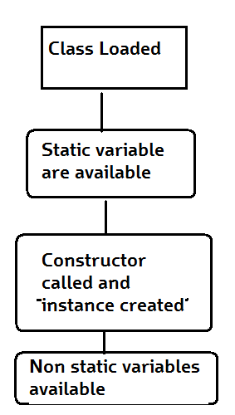
How it works
Basic Steps of how objects are created
Class is loaded by JVM
Static variable and methods are loaded and initialized and available for use
Constructor is called to instantiate the non static variables
Non static variables and methods are now available
As all the non static variable are available only after the constructor is called, there is a restriction on using non static variable in static methods.

Slide 73
Why do we need this
Static methods are identified to be mostly used when we are writing any utility methods.
We can also use static variables when sharing data.
When sharing data do keep in mind about multithreading can cause inconsistency in the value. (synchronize the variable)

