Slide 1

A Cycle-Level Evaluation of Pipelined In-SRAM Execution
Presented by
MCCA course 5290
Department of Computer Science and Engineering
IIT Guwahati
Notes:
[~0:30] Introduce the paper: a cycle-level (C++17) simulator study of pipelined in-SRAM execution. Four execution configurations, three kernel-inspired traces. Total talk ≈ 15 min; timings in each slide's notes are cumulative guides.

Slide 2
Table of Contents
1
Introduction & Motivation
The paper in brief
1.07–1.18×
2
Simulator Architecture & Designs
separate memory & calculation ports
3
Trace Workloads
1.53×
fine-grained Port 0 use (matmul only)
4
Experimental Methodology
No change
5
Results & Analysis
from register renaming on these traces
6
Limitations & Conclusion
Project
Notes:
[~0:30 | cumulative ~1:00] Roadmap of six parts. One-line story: in-SRAM operations have several phases that compete for shared resources; separating memory and calculation ports helps all three traces; fine-grained Port 0 use helps matmul only; renaming changes nothing for these traces.

Slide 3
Introduction & Motivation
Modeled phase latencies are highly uneven (cycles)
1
Data movement dominates
Data-intensive workloads repeatedly move operands between memory and processing logic.
2
In-SRAM computing
Performs selected operations close to, or within, SRAM arrays to cut that movement.
3
Scheduling matters
An operation has several phases (setup, array access, calculation, writeback) that reserve shared resources, so their order sets execution time.
*Branch latency is a trace-generator assumption.
Project
Notes:
[~1:30 | cumulative ~2:30] Motivation. Operands move between memory and logic; in-SRAM computing reduces that. But one operation has several phases. Point at the chart: a memory phase is only 20 cycles while a multiply is 105 — so how memory and calculation share resources decides total time.

Slide 4
Research Questions & Contributions
Research questions
Q1
Q2
Q3
What cycle reduction comes from separating memory and calculation resources?
Does physical-register renaming change performance for the generated traces?
Does fine-grained use of the memory-side port help beyond ordinary pipelining?
Contributions
Deterministic C++17 simulator: memory phases, calculation events, 16-entry operation table, dependency checks, optional renaming, in-order retirement
Four execution configurations evaluated on three repeated kernel-inspired operation traces
Per-iteration cycle-accounting model compared against the simulator’s reported totals
Scope: a simulator-based microarchitectural study. No new SRAM cell, circuit, fabrication result or full application is claimed.
Project
Notes:
[~1:30 | cumulative ~4:00] Three questions drive the study; three contributions answer them. Emphasise the scope statement: this is a trace-driven simulator study, not silicon.

Slide 5
Simulator Architecture
Port 0 · memory
Setup 2 → visit 16 → writeback 2; one active memory task
Trace generator
Operation table
Scheduler
3 templates × 256 iterations
16 entries · dependency checks
Dispatches phases to ports
Port 1 · calculation
ADD 9 · SUB 17 · MUL 105 cycles
Register renaming (D3, D4)
In-order retirement
RAT + free list · 32 architectural → 64 physical registers
A BRANCH stalls trace fetch until it commits
Conceptual organization of the model: modeled resources and scheduling paths, not a physical SRAM circuit.
Project
Notes:
[~1:30 | cumulative ~5:30] Walk left to right: generated trace → 16-entry operation table → scheduler → two ports. In D1 both phase types share Port 0; in D2–D4 calculation has its own Port 1. Bottom: renaming (D3, D4) and in-order retirement; a branch stalls fetch until commit — this matters later for the renaming result.

Slide 6
Four Execution Configurations
D1
D2
D3
D4
In-order baseline
Pipelined
Pipelined + renaming
Fine-grained issue
Only the oldest operation is eligible for dispatch. Memory and calculation phases share Port 0.
Memory uses Port 0, calculation uses Port 1. Independent phases overlap when dependencies permit.
Same two-port model as D2, plus a register alias table mapping architectural to physical registers.
Prefers Port 1. If busy, calculation may use Port 0 during the memory visit if it finishes before reserved writeback.
Fine-grained = calculation scheduling in a free Port 0 interval, not concurrent issue of multiple memory requests: only one memory task is ever active.
Project
Notes:
[~1:30 | cumulative ~7:00] The four designs use identical traces. D2 adds the second port; D3 adds renaming; D4 lets a calculation borrow Port 0 during the array-visit interval, subject to finishing before the reserved writeback. Stress the bottom banner: no concurrent memory requests.

Slide 7
Trace Workloads
One iteration of each template, repeated 256 times
Matrix multiplication
MUL
2 loads
MUL
2 loads
ADD
ADD
+ store
BR
Trace ops
5 × 256 = 1,280
2-D stencil
ADD
2 loads
ADD
2 loads
ADD
MUL
+ store
BR
Trace ops
5 × 256 = 1,280
K-Means distance
SUB
2 loads
MUL
square
ADD
+ store
BR
Trace ops
4 × 256 = 1,024
MUL: 105 cycles
SUB: 17 cycles
ADD: 9 cycles
BR: 13 cycles (assumed)
Trace-entry counts only: no grid, boundary, centroid assignment or numerical output is modeled.
Project
Notes:
[~1:00 | cumulative ~8:00] Each trace is a simplified operation template. Matmul has two independent 105-cycle multiplies per iteration, which becomes important in the results. Operation counts are trace entries, not scalar ops of a full application.

Slide 8
Experimental Methodology
Parameter | Configured value
Address/setup · visit · writeback | 2 · 16 · 2 cycles
One memory phase | 20 cycles
ADD · SUB · MUL | 9 · 17 · 105 cycles
Branch (trace assumption) | 13 cycles
Operation table | 16 entries
Architectural · physical registers | 32 · 64
Active memory tasks | 1
Setup
• C++17 simulator, built with g++ -O3 -Wall -Wextra
• 256 iterations per workload
• One trace per workload, run under all four modes
• Event logs written to a results directory
Speedup
S(d,w) = Cbase,w / Cd,w
Cycle reduction
R(d,w) = (Cbase − Cd) / Cbase × 100%
No power, energy, area, frequency or physical-design metric is inferred from cycle counts.
Project
Notes:
[~1:00 | cumulative ~9:00] Configured parameters (Table I of the paper), the run setup, and the two metrics used: speedup against the in-order D1 baseline and percentage cycle reduction. Cycle counts only — no power or energy claims.

Slide 9
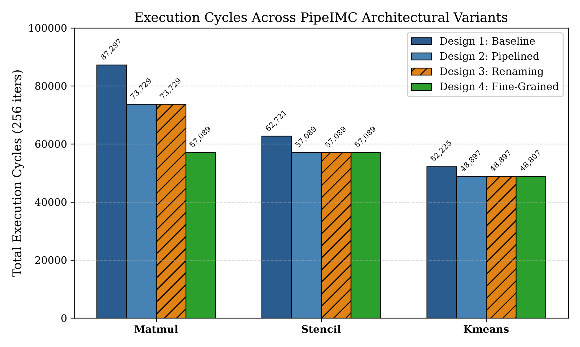
Results: Cycle Counts
Workload | D1 | D2 | D3 | D4
Matmul | 87,297 | 73,729 | 73,729 | 57,089
Stencil | 62,721 | 57,089 | 57,089 | 57,089
K-Means | 52,225 | 48,897 | 48,897 | 48,897
• D1 is the in-order reference for every trace
• D2 and D3 are identical on all three traces
• D4 differs from D2 only on matmul: 73,729 → 57,089
Project
Notes:
[~1:30 | cumulative ~10:30] Table II and Fig. 2 of the paper. Every pipelined design is at or below the baseline. D2 equals D3 everywhere. D4 only separates from D2 on matmul.

Slide 10
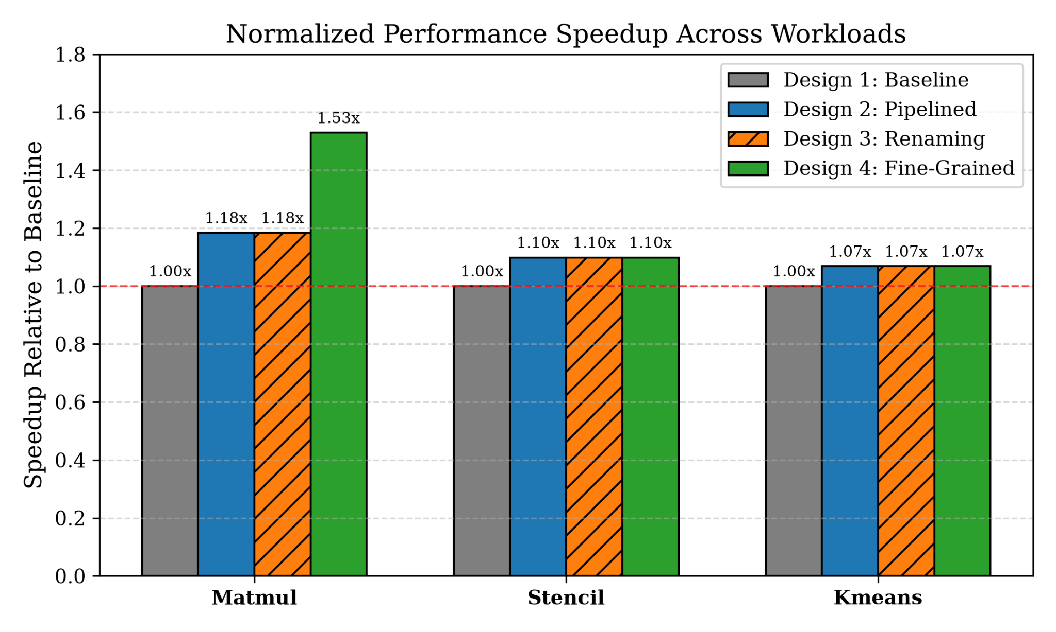
Results: Speedup over In-Order Baseline
1.53×
Matmul, D4
34.60% fewer cycles
1.10×
Stencil, D2–D4
8.98% fewer cycles
1.07×
K-Means, D2–D4
6.37% fewer cycles
Project
Notes:
[~1:30 | cumulative ~12:00] Matmul: D2 gives 1.18x; D4 reaches 1.53x, a 34.60% cycle reduction — the maximum observed. Stencil gets 1.10x and K-Means 1.07x from D2 onwards, with no extra gain from D3 or D4.

Slide 11
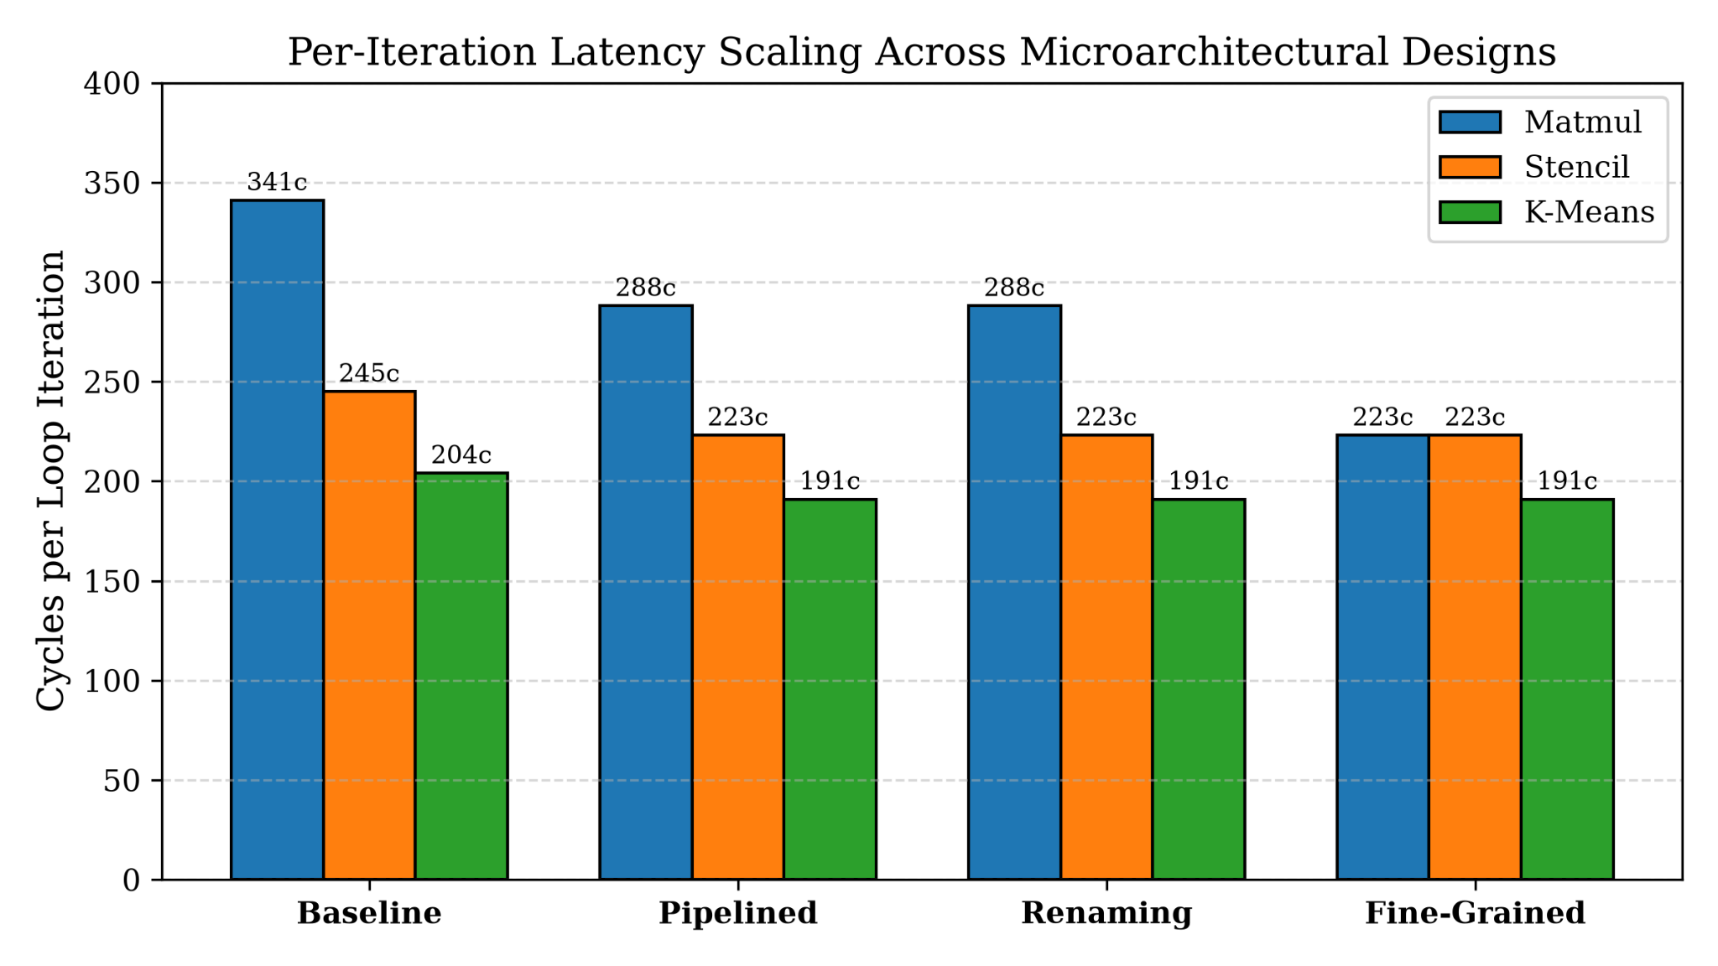
Per-Iteration Latency Across Designs
Fine-grained issue reduces Matmul from 341 to 223 cycles/iteration; Stencil and K-Means remain unchanged versus pipelining.
PipeIMC Project

Slide 12
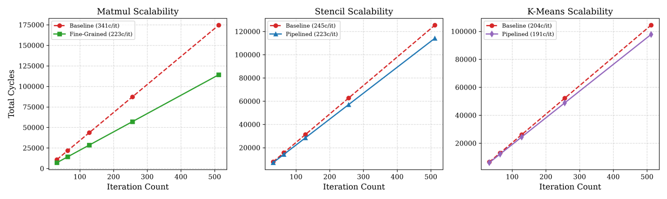
Scalability with Increasing Iteration Count
Cycle growth is approximately linear with iteration count; the observed per-iteration advantage persists in the plotted ranges.
PipeIMC Project

Slide 13
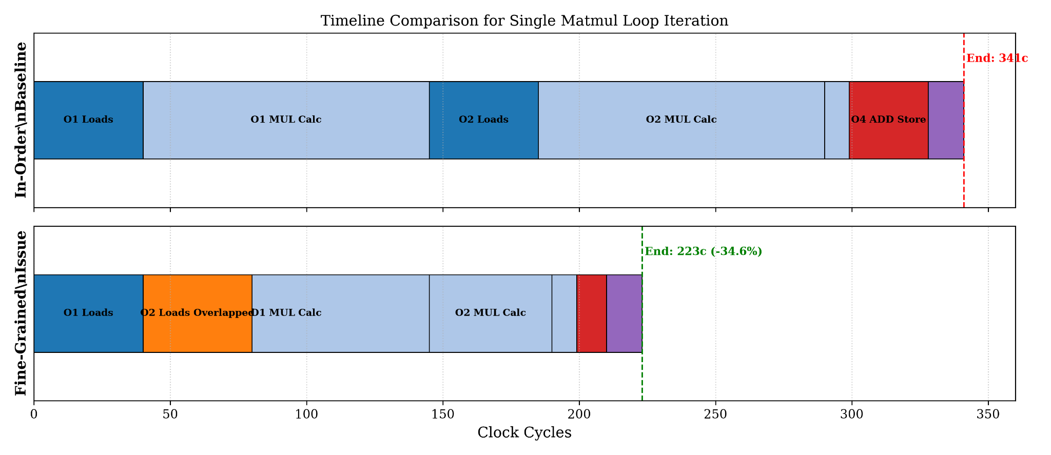
Why Fine-Grained Scheduling Helps: Matmul Timeline
The schedule fills otherwise idle memory-port intervals with calculation work, shortening the modeled iteration from 341 to 223 cycles.
PipeIMC Project

Slide 14
Why the Results Differ
Register renaming
Matmul benefits most
D2 = D3
1.53×
• Identical cycle counts on all three traces
• Each iteration ends with a branch that stalls fetch until it commits
• So no cross-iteration overlap exists for renaming to unlock
• Applies to these traces; does not show renaming is ineffective in general
• Two independent 105-cycle multiplies per iteration, each after two loads
• In D4, a calculation can use Port 0 in a free memory-visit interval when Port 1 is busy
• Stencil and K-Means: D2–D4 counts are identical, so the fallback adds nothing
Project
Notes:
[~1:00 | cumulative ~13:00] Two explanations. Left: renaming removes false dependencies, but the per-iteration branch serialises fetch, so there is nothing to overlap. Right: matmul has two long independent multiplies, so the Port 0 fallback pays off; the other traces do not exercise it.

Slide 15
Analytical Cycle Accounting
Ctotal = Niter × Citer + 1
Per-iteration periods (cycles)
Workload | D1 | D2 | D3 | D4
Matmul | 341 | 288 | 288 | 223
Stencil | 245 | 223 | 223 | 223
K-Means | 204 | 191 | 191 | 191
N_iter = 256; C_iter is the effective period implied by the schedule. The +1 follows the simulator’s cycle-counter convention, not a measured pipeline fill.
256 × 341 + 1 = 87,297 (matmul, D1)
Internal consistency check only
The model shares the simulator’s assumptions, so it is not validation against RTL, a circuit model, a physical macro or a second simulator.
256 × 223 + 1 = 57,089 (matmul, D4)
Project
Notes:
[~1:00 | cumulative ~14:00] The simulator totals equal 256 times the per-iteration period plus one for every workload and design (e.g., 256×341+1 = 87,297). This confirms internal consistency but is not independent validation.

Slide 16
Limitations
1
2
3
4
Traces are hand-made templates, not full Matmul, Stencil or K-Means runs on datasets
All operations use one warp and one subarray
One active memory task; no banks, channels, cache misses or DRAM traffic
No data values, so numerical correctness is not verified
5
6
7
Read results as cycle-level findings for generated traces, not application or hardware speedups.
No power, energy, area, timing-closure or circuit-level SRAM estimates
Fine-grained Port 0 rule is a scheduling assumption, not validated on a physical SRAM
Only 256 iterations: scaling to larger problem sizes is not established
Project
Notes:
[~1:00 | cumulative ~15:00] Be explicit about scope. The navy tile is the take-home on interpretation: these are trace-level cycle results under the implemented resource model.

Slide 17
Conclusion
Decoupling ports
Separate memory and calculation resources give 1.07×–1.18× over the in-order baseline.
1
Fine-grained Port 0
Calculation in free Port 0 intervals reaches up to 1.53× on matrix multiplication.
2
Register renaming
No cycle reduction on the current traces.
3
Cycle accounting
C_total = N_iter × C_iter + 1 reproduces simulator totals as an internal check.
4
Findings are limited to the trace generator and resource model implemented in the project.
Project
Notes:
[~0:45 | cumulative ~15:45] Four takeaways. Close with the limitation: findings apply to this trace generator and resource model.

Slide 18
References & Questions
Thank you
Questions?
References
[1] PipeIMC: A Pipelined In-SRAM Computing Architecture, project-provided reference manuscript, 2026.
[2] J. L. Hennessy and D. A. Patterson, Computer Architecture: A Quantitative Approach, 6th ed. Morgan Kaufmann, 2017.
Project
Notes:
[Q&A] Open for questions. Reference [1] bibliographic details are noted in the paper as still to be verified.

