Slide 1

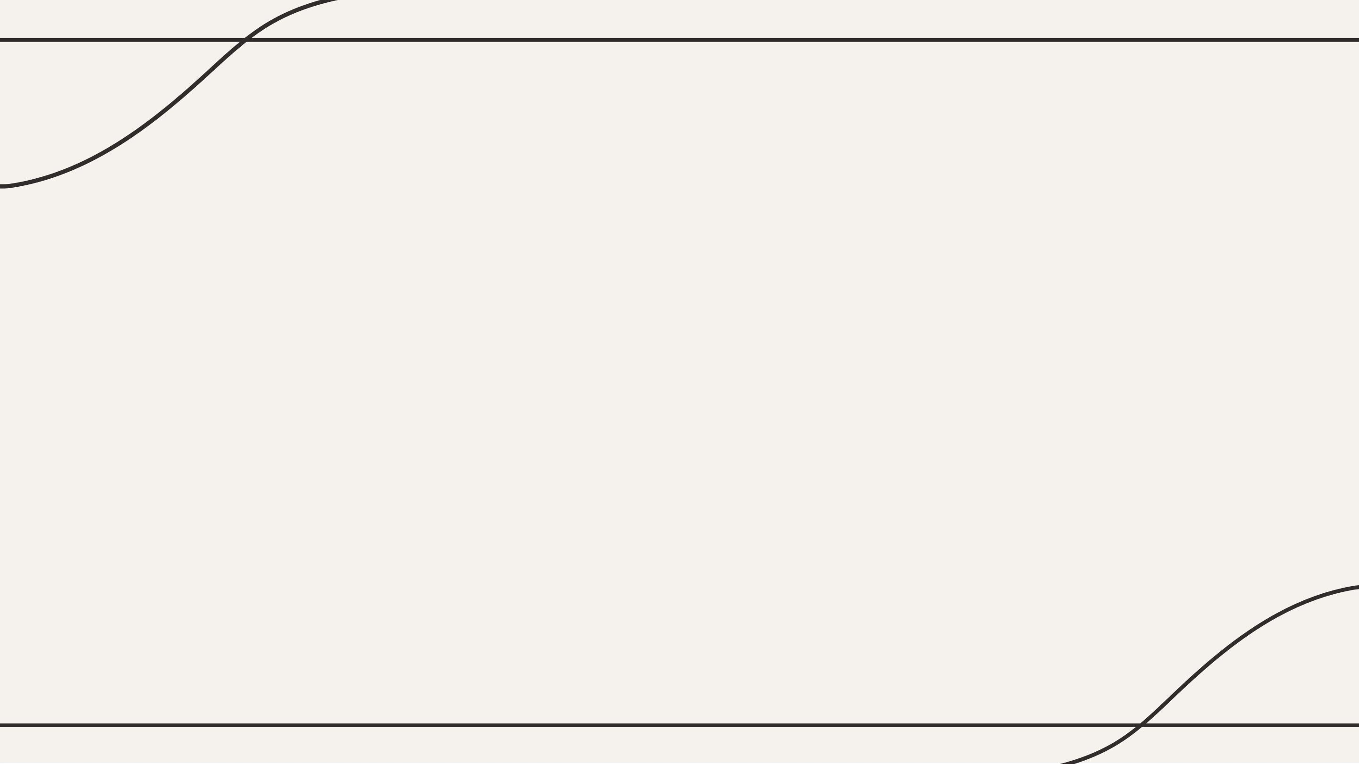
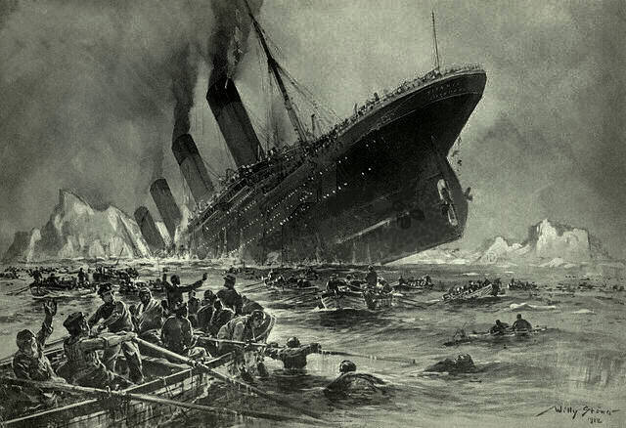
EDA Project on
The tragedy of titanic
By:- Rituraj Sharma

Slide 2

Dataset overview
The Titanic incident refers to the tragic sinking of the RMS Titanic, a British passenger liner, on its maiden voyage from Southampton to New York City. The ship, renowned for its luxurious accommodations and advanced safety features, was considered "unsinkable." However, on the night of April 14, 1912, the Titanic struck an iceberg in the North Atlantic Ocean.
The collision caused severe damage to the ship's hull, and it began to flood. Due to an insufficient number of lifeboats and a lack of preparedness, many passengers and crew were unable to escape. Out of the 2,224 people on board, over 1,500 lost their lives, making it one of the deadliest peacetime maritime disasters in history.
The tragedy highlighted flaws in maritime safety regulations and led to significant changes, including the establishment of the International Convention for the Safety of Life at Sea (SOLAS) in 1914. The story of the Titanic has since become a symbol of human ambition, engineering, and the catastrophic consequences of underestimating nature.

Slide 3

Objective
Understanding Survival Patterns:
Investigate how different factors (e.g., age, gender, ticket class, fare) influenced survival rates.
Identify groups of passengers who had higher or lower chances of survival.
Feature Exploration:
Examine the dataset to understand the distribution of features like age, class, fare, and embarkation points.
Identify missing or inconsistent data and address them appropriately for accurate analysis.
Hypothesis Testing:
Test hypotheses, such as whether women and children were more likely to survive or whether first-class passengers had a higher survival rate.
Insights for Predictive Modeling:
Use EDA to identify key features that could be useful for building a predictive model for survival.
Visualizing Data:
Create visualizations to communicate insights effectively, such as survival rates by gender or class.
Would you like suggestions for specific analyses or visualizations for the project?

Slide 4

Steps done in the project
Understand the Dataset and Objectives
Load and Inspect the Data
Handle Missing Data
Perform Univariate Analysis
Perform Bivariate and Multivariate Analysis
Data Cleaning
Visualize the data
Conclusion

Slide 5
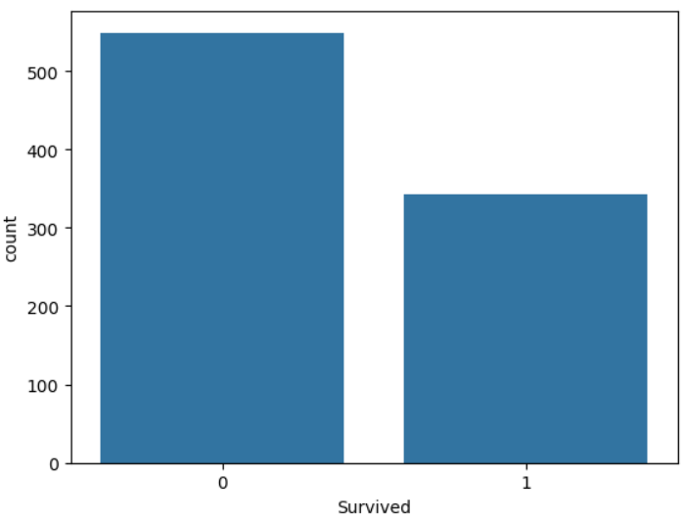
Q.1 Finding the people survived and not survived
The number of survived and not survived people in the tragedy of titanic
549 passengers (62%) did not survive the Titanic disaster.
342 passengers (38%) survived, reflecting the tragedy's high mortality rate.

Slide 6
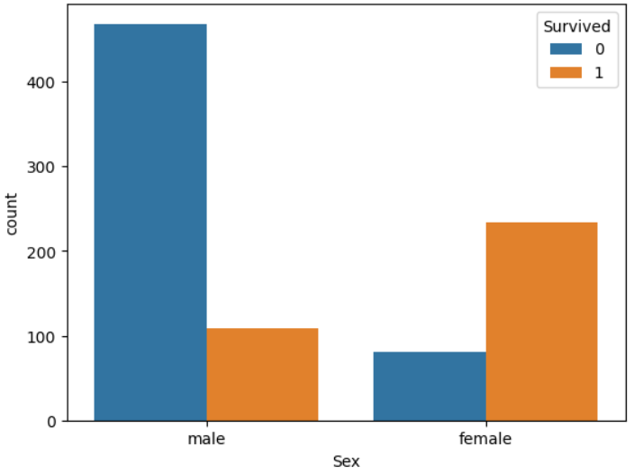
Q.2 Number of survived and not survived gender wise
The number of the survived and not survived people survived and not survived in the titanic incident
A higher proportion of women survived (233 out of 314) compared to men (109 out of 577).
Most male passengers did not survive, reflecting the "women and children first" rescue policy.

Slide 7
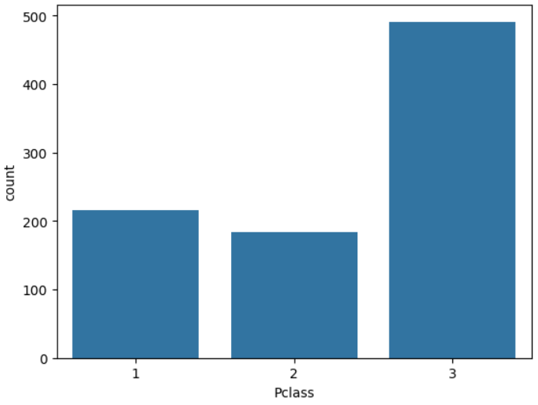
Q.3 Number of survivor and not survivor in Pclass
According to data from the Titanic passenger the survived and non survived people in passenger class (Pclass)
First Class (Pclass 1): A significantly higher number of survivors compared to other classes, with most data sets showing around 60% survival rate.
Second Class (Pclass 2): A moderate survival rate, generally around 40%.
Third Class (Pclass 3): The lowest survival rate, with only around 25% of passengers surviving.

Slide 8

Conclusion:-
Analysis of the Titanic dataset overwhelmingly concludes that being female significantly increased a passenger's chance of survival, with women having a much higher survival rate compared to men; additionally, passenger class played a major role, with first-class passengers having better survival odds than those in lower classes, indicating that socioeconomic status was a key factor in the tragedy; other contributing factors to survival included age (children generally had higher survival rates) and family size (smaller family units tended to have better outcomes)

