Slide 1
EXPLORATORY DATA ANALYSIS
Consumer Shopping Behavior Survey
How 500 shoppers across 25+ countries decide where, how, and why they buy
500
25+
30
Survey responses
Countries represented
Variables analyzed
Prepared for LinkedIn & GitHub • September 2026

Slide 2
EXECUTIVE SUMMARY
Eight things this data tells us
Young & budget-conscious
Mobile is the default
Median age in the low-20s; half are students; 54% earn under $1,000/month.
63% shop primarily on smartphone — mobile-first is not optional.
Online leads, but loyalty is soft
Discounts beat ads
49% prefer online, yet 25% say "equal / both" — channel switching is common.
Discount importance (3.82 avg) outranks review and ad influence (~3.0 each).
Wallets are the top payment choice
BNPL is mainstream, not niche
38% prefer digital wallets vs. 27% debit, 23% credit, 13% cash.
41% use Buy-Now-Pay-Later at least occasionally.
Satisfaction runs high
No single "super-signal"
Avg. satisfaction 7.1/10 vs. avg. regret 2.2/10.
Influence, satisfaction & impulse scores barely correlate — segment on several signals, not one.
Consumer Shopping Behavior Survey • EDA • n = 500
1

Slide 3
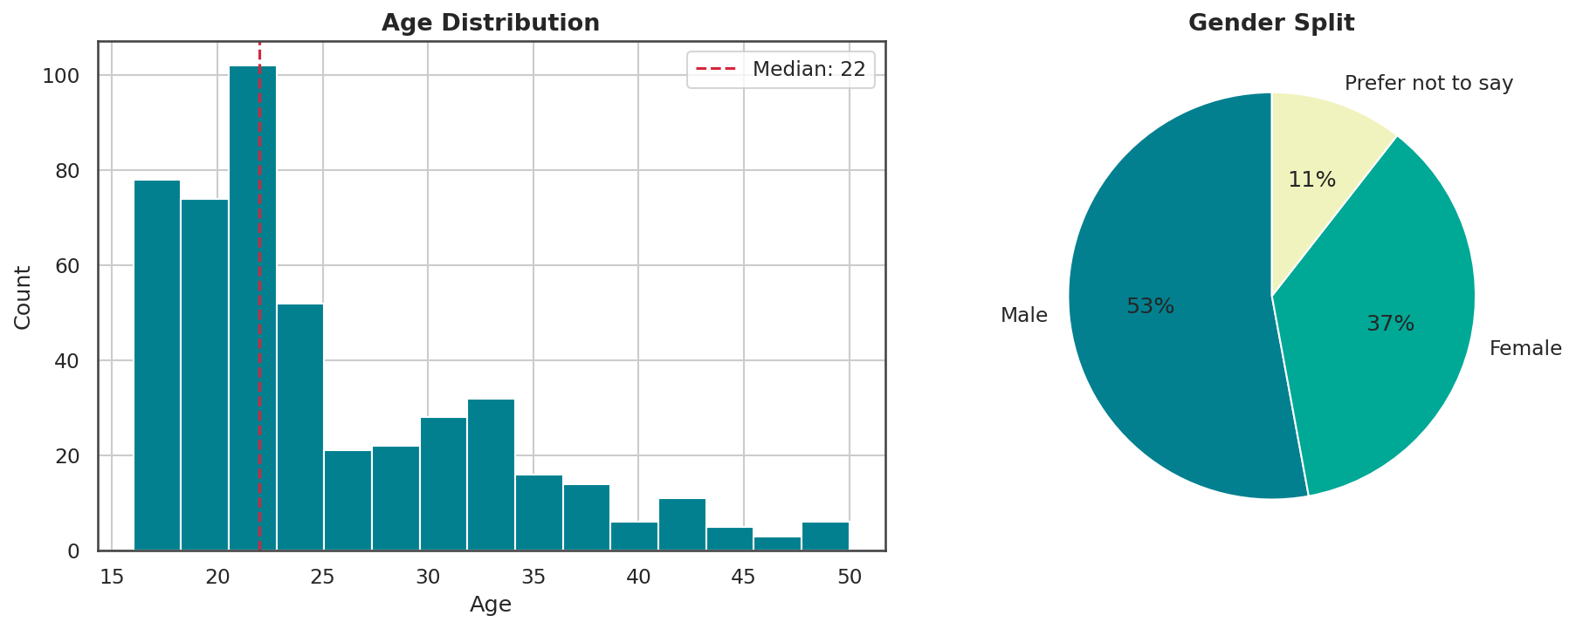
WHO ARE THE RESPONDENTS — PART 1
A young, gender-mixed audience
Ages cluster heavily in the late teens through late 20s.
Male respondents lead at 53%, female at 37%, with 11% preferring not to say.
This skew shapes every downstream number — treat findings as most representative of younger shoppers.
Consumer Shopping Behavior Survey • EDA • n = 500
2

Slide 4
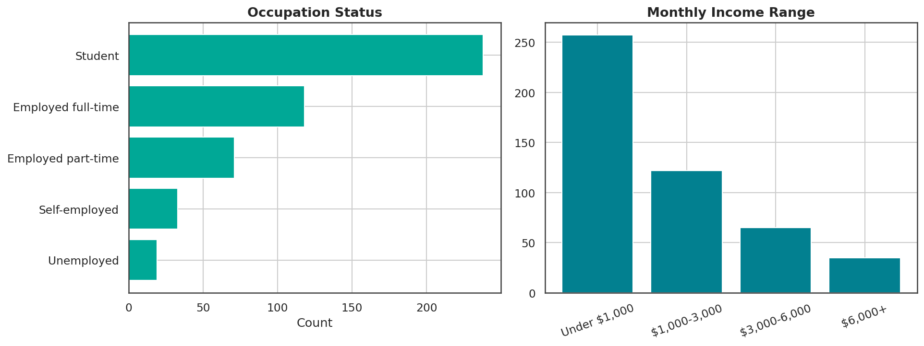
WHO ARE THE RESPONDENTS — PART 2
Students dominate, budgets are tight
Half of respondents (50%) are students; another 25% are employed full-time.
54% report monthly income under $1,000 — only 7% earn $6,000+.
A young, income-constrained base explains high discount-sensitivity later in the deck.
Consumer Shopping Behavior Survey • EDA • n = 500
3

Slide 5
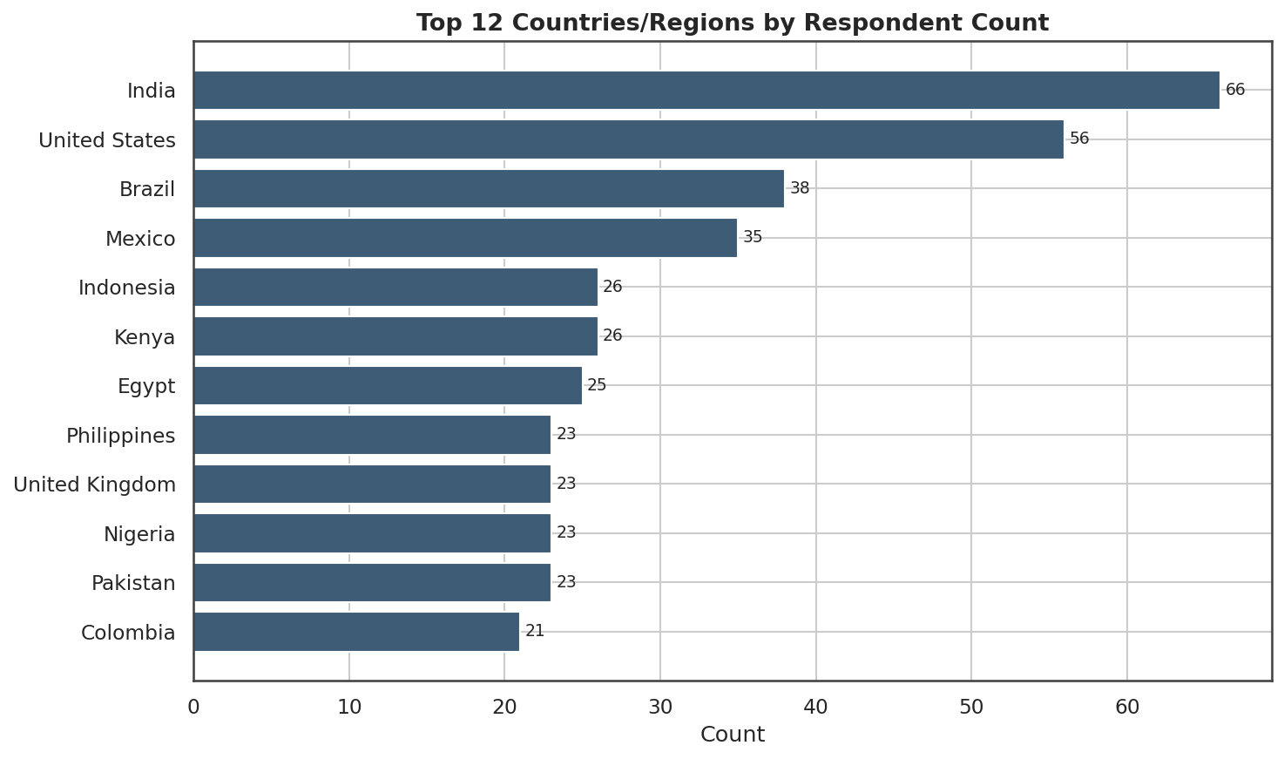
WHO ARE THE RESPONDENTS — PART 3
Broad reach across emerging & mature markets
India, the U.S., and Brazil lead in respondent count.
Strong representation from Latin America, Africa, and South/Southeast Asia alongside the U.S. and U.K.
The mix supports comparing behavior across mature vs. emerging e-commerce markets.
Consumer Shopping Behavior Survey • EDA • n = 500
4

Slide 6
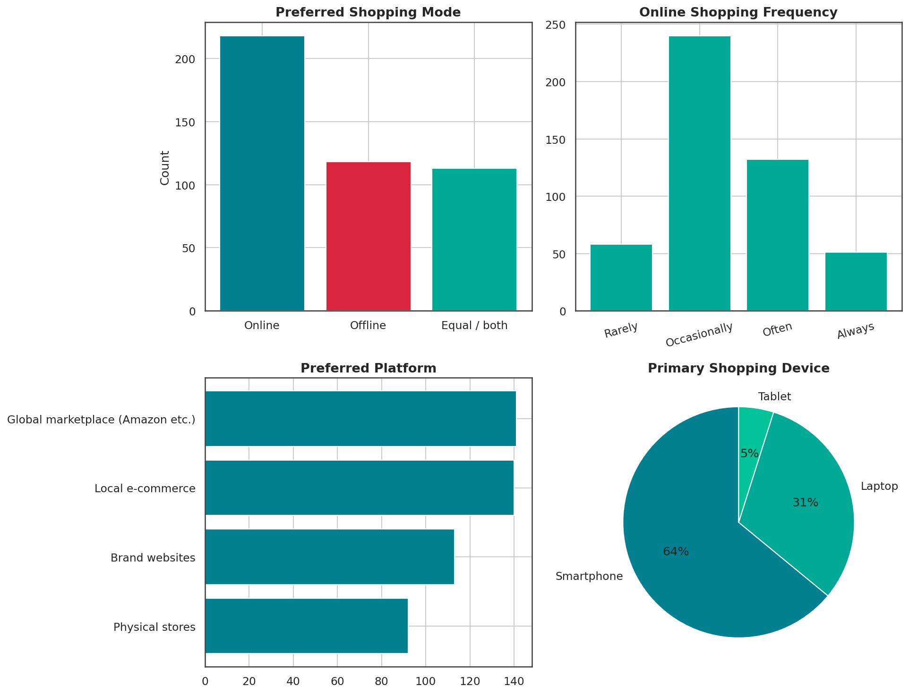
HOW THEY SHOP
Mobile-first, online-leaning, loyalty is soft
49% prefer online, 26% offline, 25% say "equal / both."
Global marketplaces (29%) and local e-commerce (29%) are tied as top platforms, ahead of brand sites (23%) and physical stores (19%).
63% shop primarily on smartphone — mobile UX is the top priority, not desktop.
Consumer Shopping Behavior Survey • EDA • n = 500
5

Slide 7
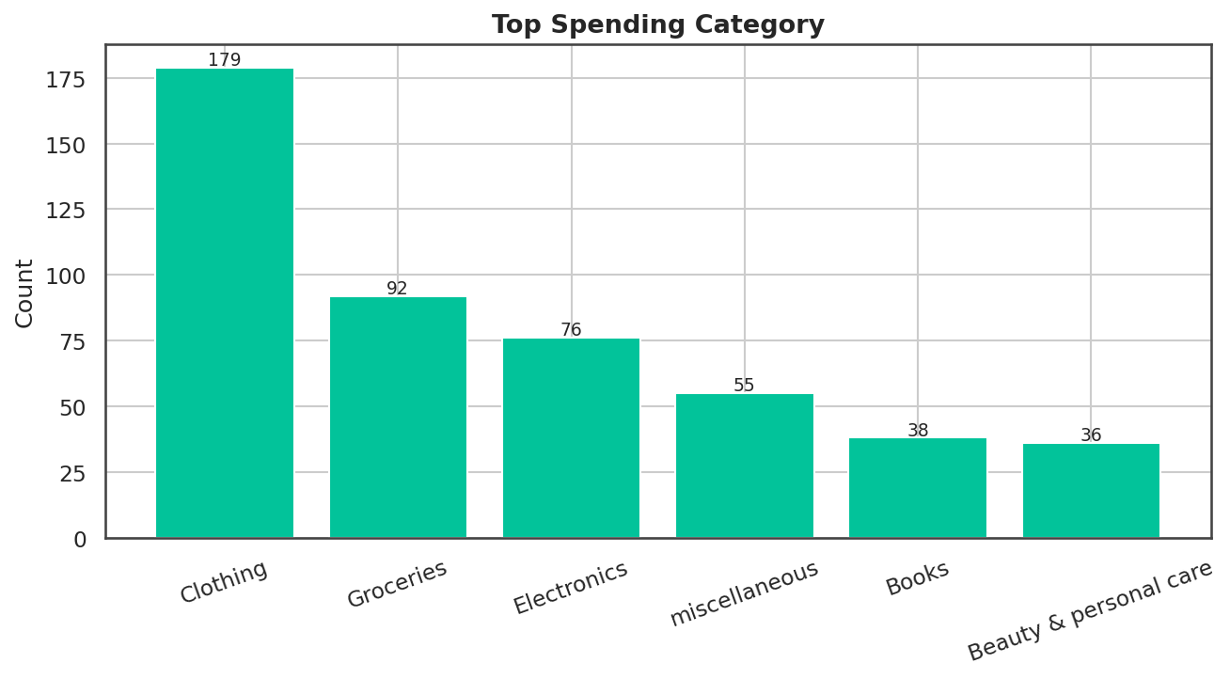
HOW THEY SHOP
Clothing is the runaway top spending category
Clothing leads at 38%, more than double the next category.
Groceries (19%) and Electronics (16%) follow.
Books and Beauty & Personal Care each sit around 8%, rounding out a long tail of niche spend.
Consumer Shopping Behavior Survey • EDA • n = 500
6

Slide 8
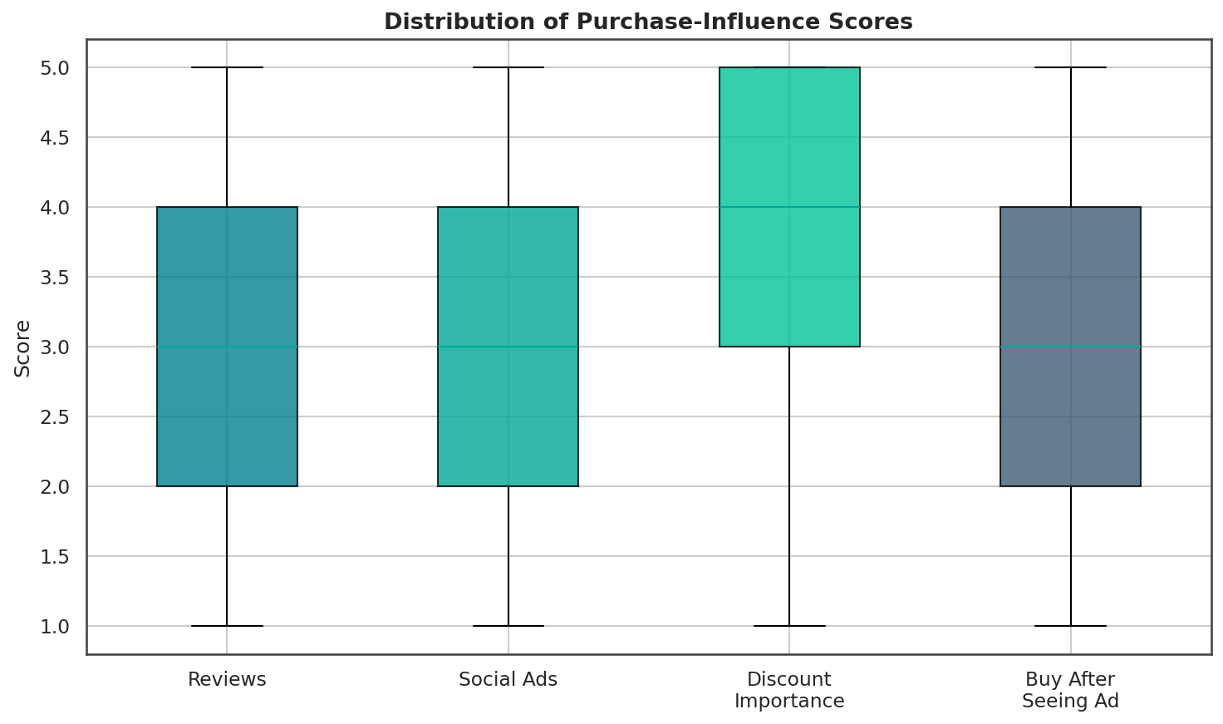
WHAT DRIVES PURCHASES
Discounts outrank reviews and ads
Discount importance averages 3.82 — the highest of all influence scores measured.
Review influence and "likely to buy after seeing an ad" both average ~3.0.
Price promotion is the single strongest lever across this audience, regardless of income band (see slide 12).
Consumer Shopping Behavior Survey • EDA • n = 500
7

Slide 9
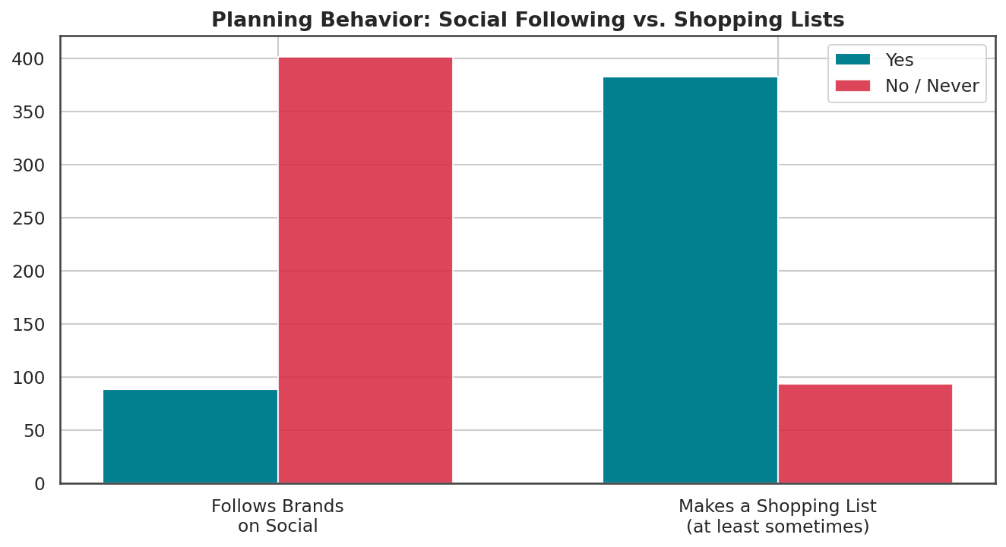
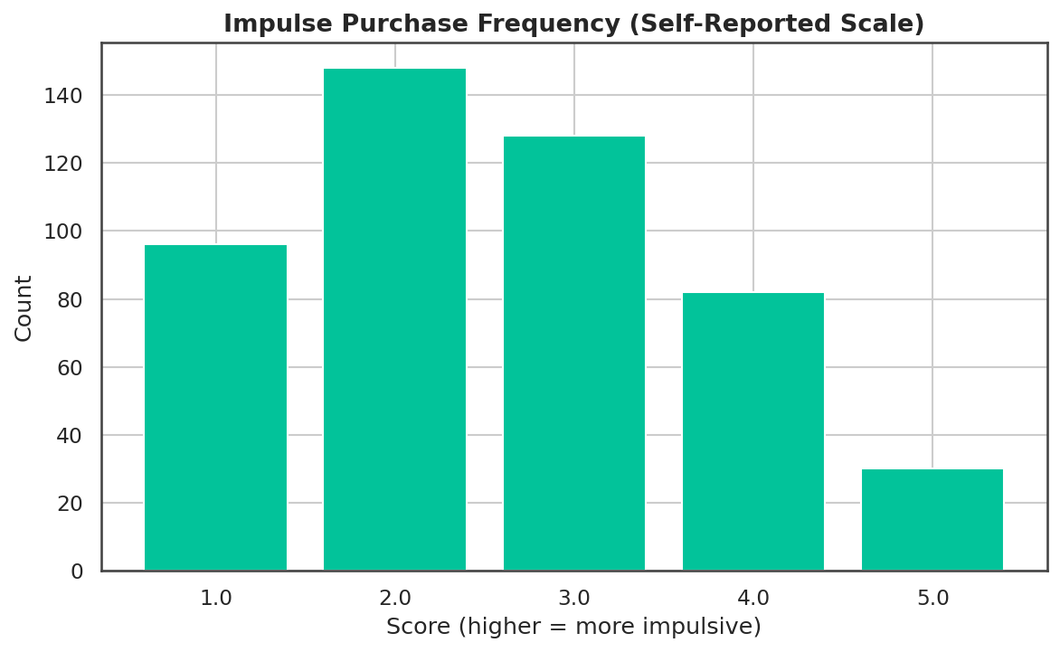
WHAT DRIVES PURCHASES
Planners and impulse buyers coexist
Only 18% follow brands on social media, but 82% make a shopping list at least sometimes — planning beats social-driven discovery. Yet impulse-purchase scores are spread broadly across the scale, showing a meaningful share of frequent impulse buyers alongside disciplined planners.
Consumer Shopping Behavior Survey • EDA • n = 500
8

Slide 10
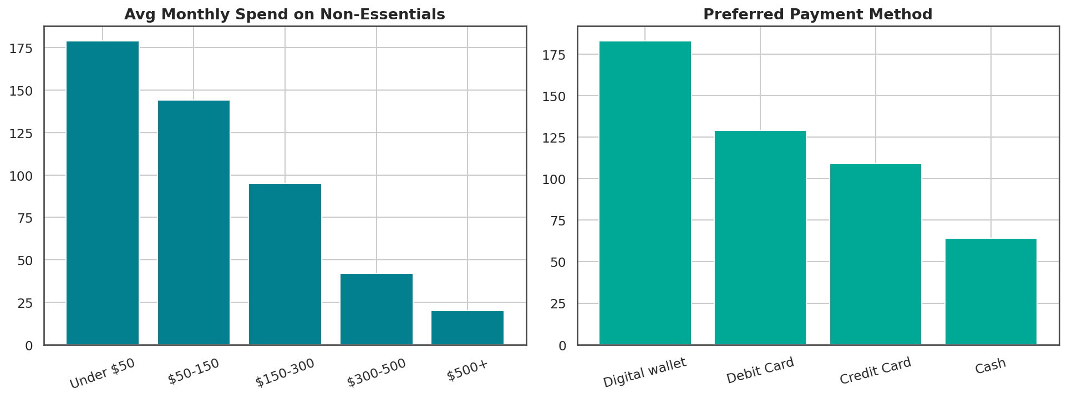
MONEY & SATISFACTION
Wallets are winning at checkout
Most non-essential spend is modest: 65% spend under $150/month.
Digital wallets lead payment preference at 38%, ahead of debit (27%), credit (23%), and cash (13%).
Wallet-based checkout (Apple Pay, Google Pay, regional wallets) should be a default option for this audience.
Consumer Shopping Behavior Survey • EDA • n = 500
9

Slide 11
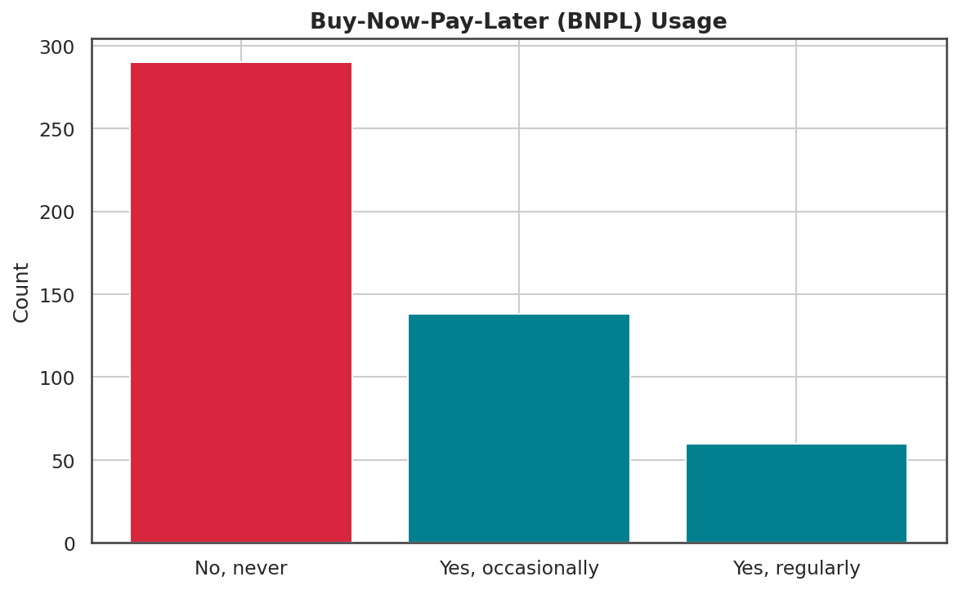
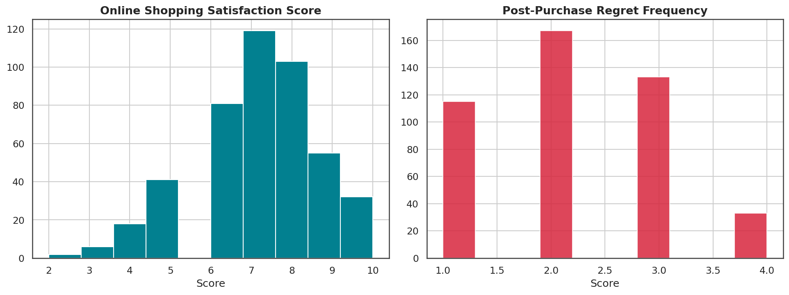
MONEY & SATISFACTION
Installment plans are mainstream; satisfaction is high
41% use Buy-Now-Pay-Later at least occasionally, despite a budget-conscious sample. Satisfaction with online shopping runs high (avg. 7.1/10) while post-purchase regret runs low (avg. 2.2/10) — though these two questions had the most missing responses in the survey.
Consumer Shopping Behavior Survey • EDA • n = 500
10

Slide 12
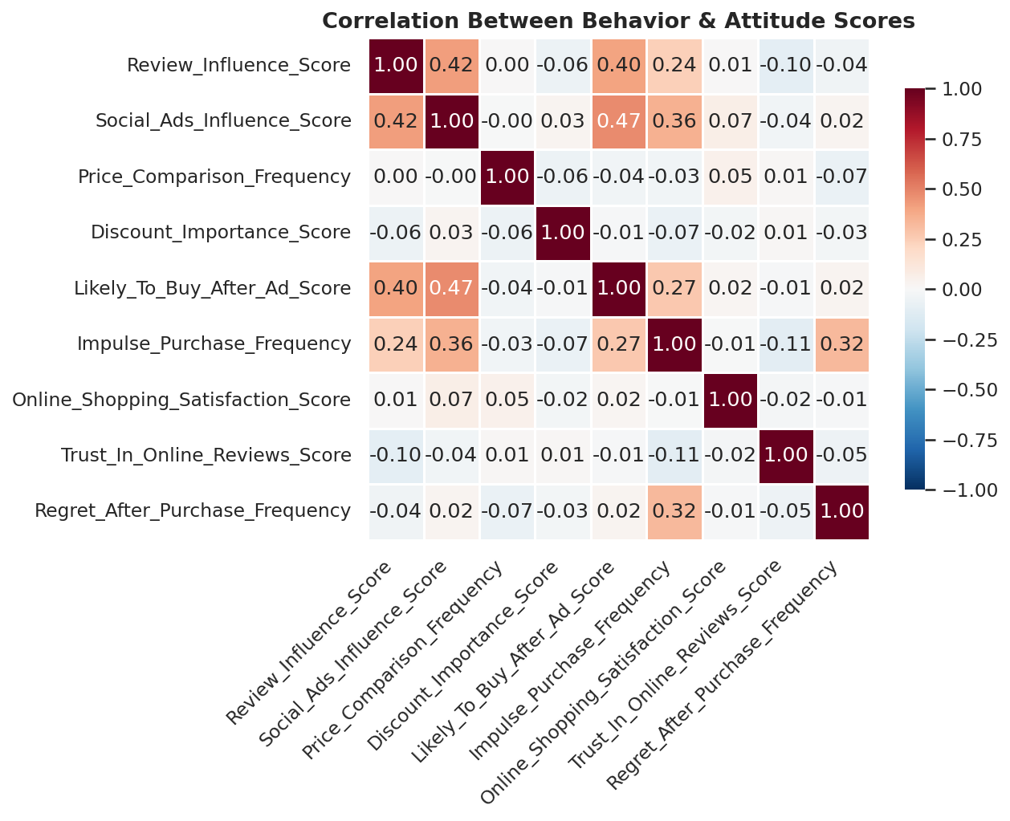
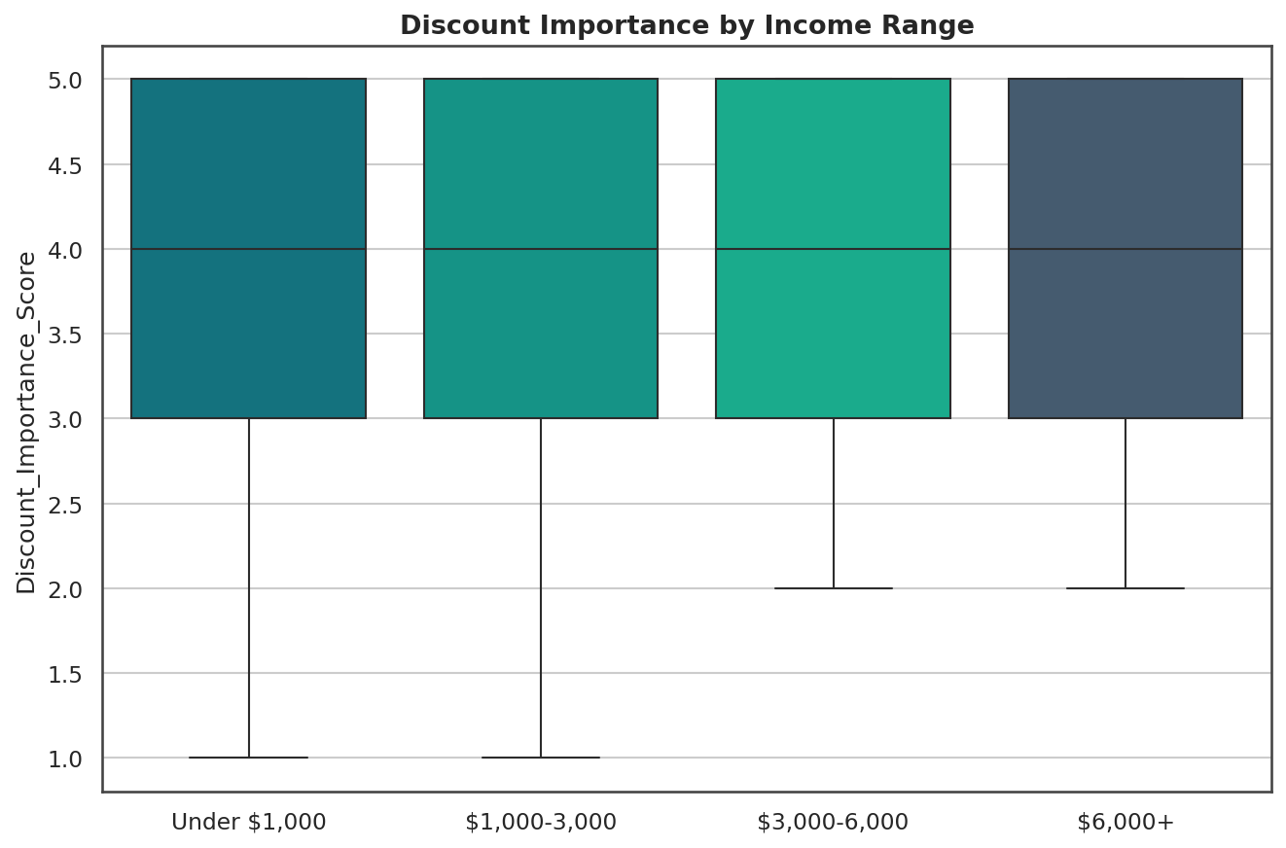
CROSS-CUTTING PATTERNS
No single score predicts behavior on its own
Influence, satisfaction, and impulse scores correlate weakly with each other (mostly -0.2 to 0.2) — segmentation needs multiple signals, not one proxy. Discount sensitivity stays elevated across every income band, including the wealthiest respondents.
Consumer Shopping Behavior Survey • EDA • n = 500
11

Slide 13
KEY TAKEAWAYS
What we'd act on first
1
Design mobile-first, always
63% shop primarily on smartphone — anything less is a secondary experience.
2
Lead promotions with price, not just ads
Discount importance beats ad and review influence across every income band.
3
Make wallets & BNPL first-class
38% prefer digital wallets; 41% use installment plans — both need to be frictionless.
4
Don't build a single "engagement score"
Influence, satisfaction, and impulse behavior move independently — use multi-signal segmentation.
Consumer Shopping Behavior Survey • EDA • n = 500
12

Slide 14
Thanks for reading
Full code, cleaned dataset, and the complete Jupyter notebook (with every chart above and the analysis behind it) are available in the accompanying repository.
Python
Pandas
Matplotlib / Seaborn
Jupyter
Open the notebook → EDA_Consumer_Shopping_Behavior.ipynb
Feedback and forks welcome — this is a small survey sample, so treat findings as directional, not definitive.
Consumer Shopping Behavior Survey • EDA • n = 500
13

