Slide 1

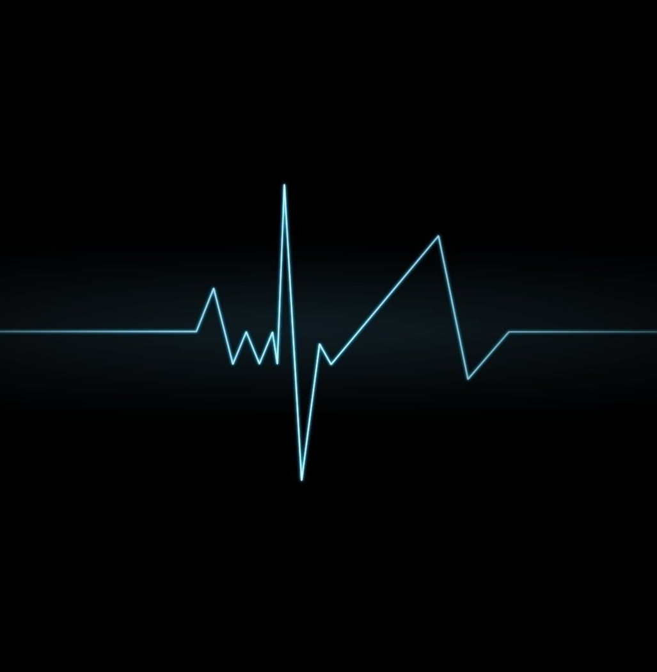
Arrhythmia Discrimination using
ECG

Slide 2

Problem Statement:
Identifying possible diseases by analysis of different ECG samples using Fourier transform.

Slide 3
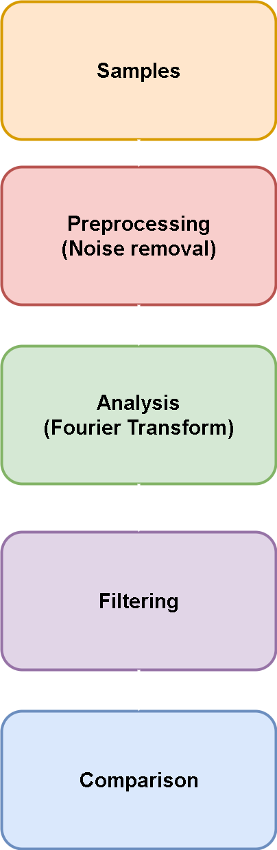

Slide 4
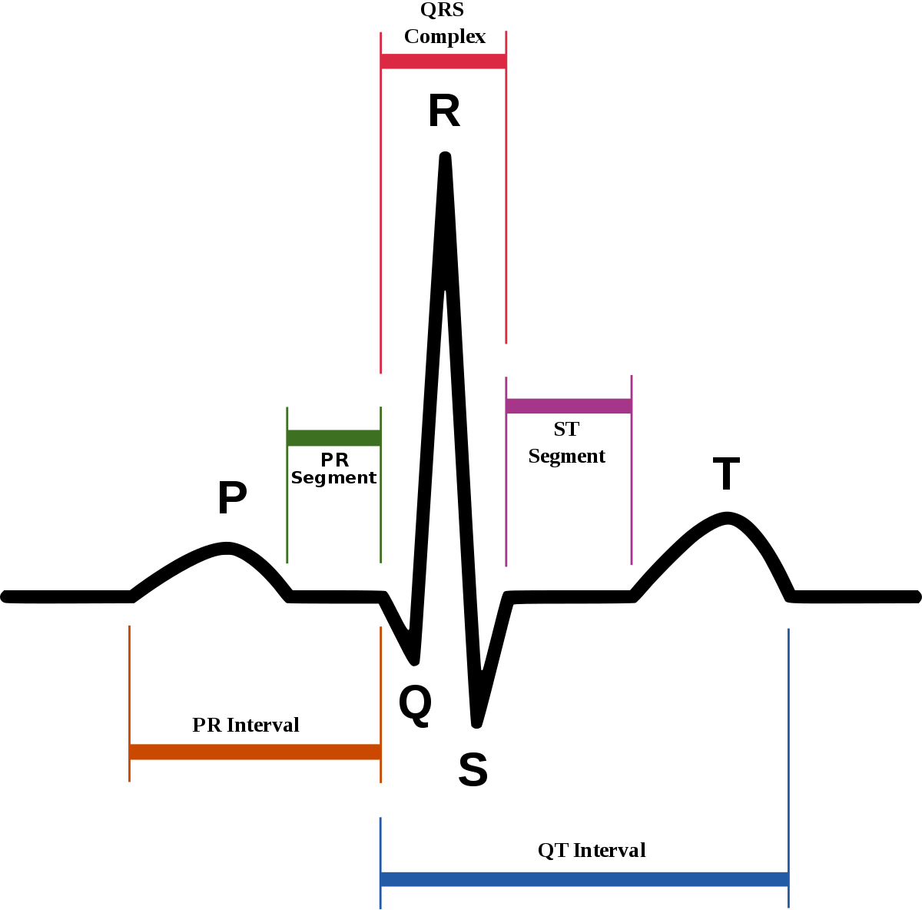

Slide 5
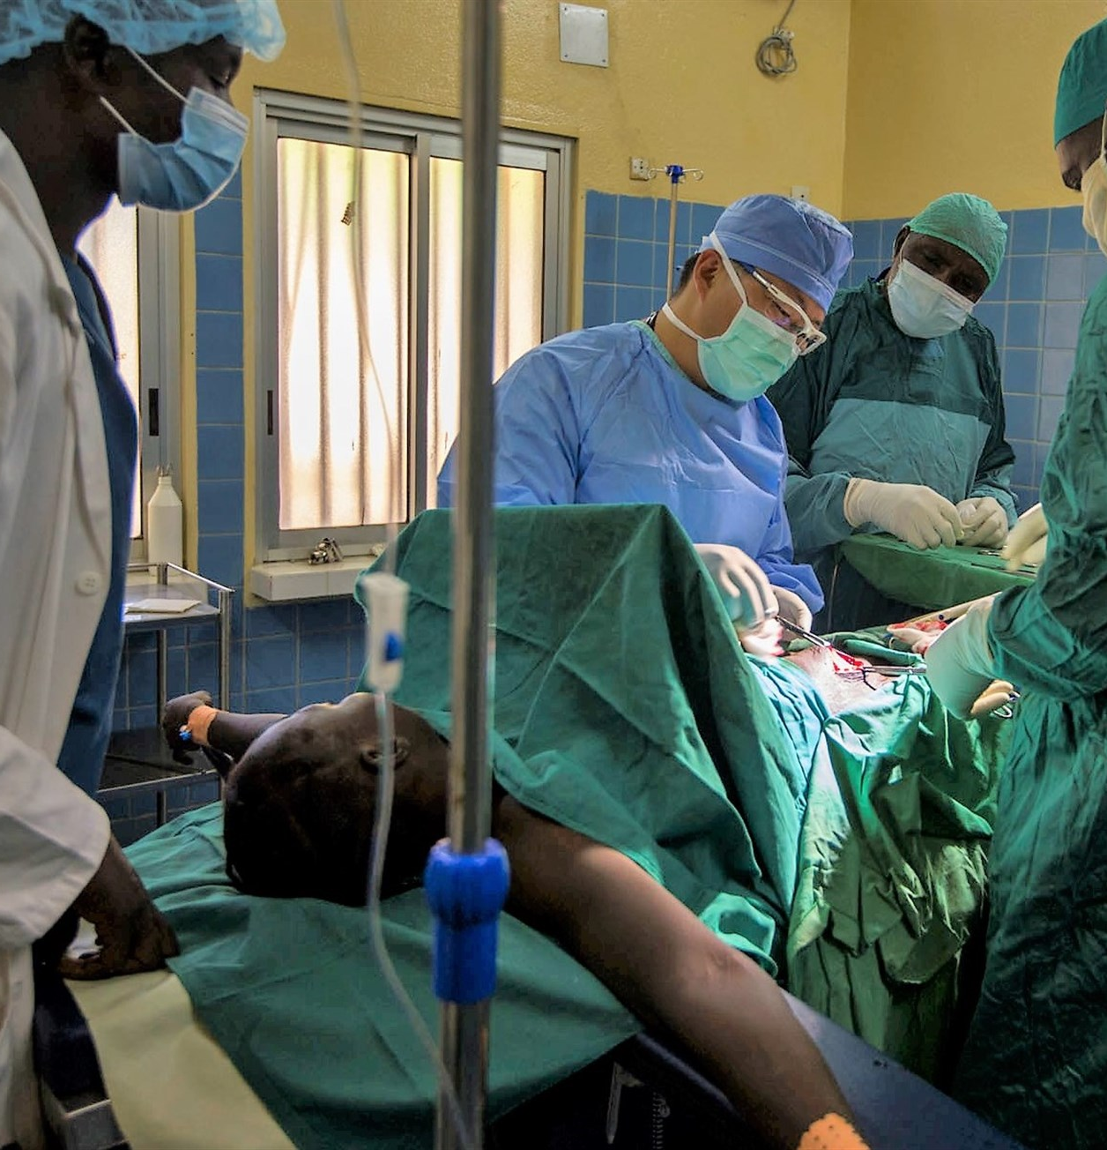
Applications :
Structure of heart.
Damage detection.
Differentiate arrythmia.
Detect diseases.

Slide 6

Team Members :
Bharat Bhishu
Pallav Sharma
Raksham Tiwary
Rituraj Kulshresth

