Slide 1

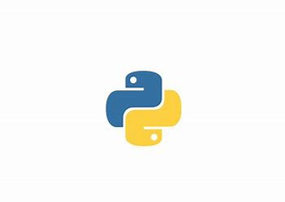




Rituraj
Python
Start Slide

Slide 2
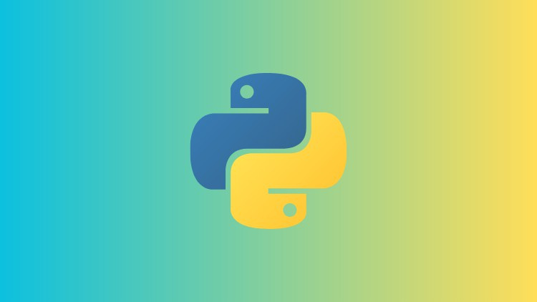
Description About Python
Welcome
Python is widely used general-purpose, high level programming language. It was created by Guido Van Rossum in 1991.
Why Python ?
Readable and Easy to Learn
Object Oriented
Interpreted
High-Level Language
Dynamic Typing
Cross-platform
Large Standard Library
Open source

Slide 3

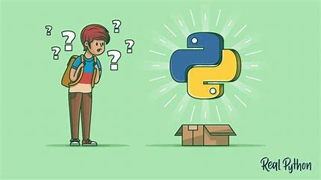
Python Datatypes
01
Integer(int)
02
Floating(Float)
03
String(str) and Booleans
04
List
05
Tupple
06
Set
07
Dictionary

Slide 4

01
Dig into
02
01
Initializations
02
Operators
03
Built in Functions
04
Type Conversion

Slide 5
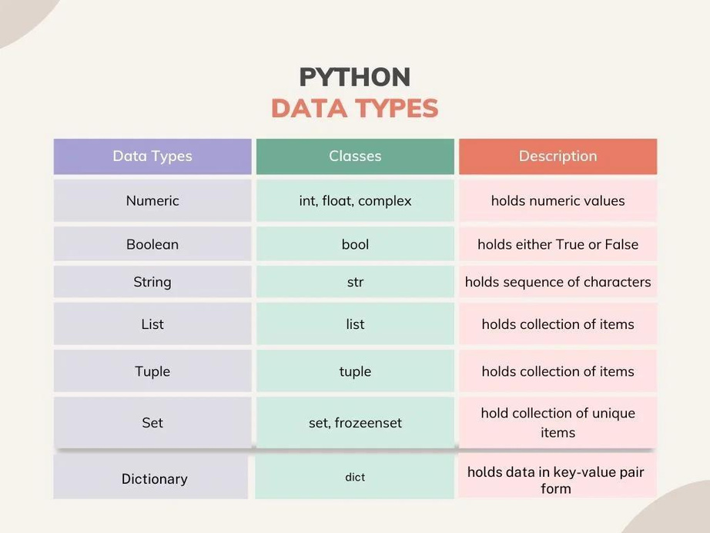
Initialization
Rules for Python variables:-
A Python variable name must start with a letter or the underscore character.
A Python variable name cannot start with a number.
A Python variable name can only contain alpha-numeric characters and underscores (A-z, 0-9, and _ ).
Variable in Python names are case-sensitive (name, Name, and NAME are three different variables).
The reserved words(keywords) in Python cannot be used to name the variable in Python.
variable_name = initial_value
To check the type of datatype:
type(variable_name)

Slide 6
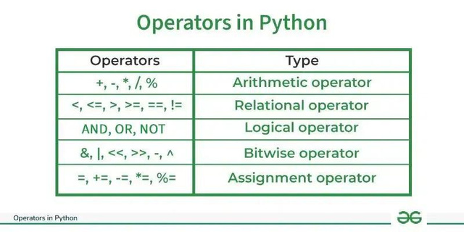
Operators
In Python programming, Operators in general are used to perform operations on values and variables. These are standard symbols used for logical and arithmetic operations. In this article, we will look into different types of Python operators.
OPERATORS: These are the special symbols. Eg- + , * , /, etc.
OPERAND: It is the value on which the operator is applied.
01
01
In Python Arithmetic operators are used to perform basic mathematical operations like addition, subtraction, multiplication, and division.
02
In Python Comparison of Relational operators compares the values. It either returns True or False according to the condition.
03
Python Logical operators perform Logical AND, Logical OR, and Logical NOT operations. It is used to combine conditional statements.
04
Python Bitwise operators act on bits and perform bit-by-bit operations. These are used to operate on binary numbers.
05
Python Assignment operators are used to assign values to the variables.
In Python, is and is not are the identity operators both are used to check if two values are located on the same part of the memory. Two variables that are equal do not imply that they are identical.
06

Slide 7
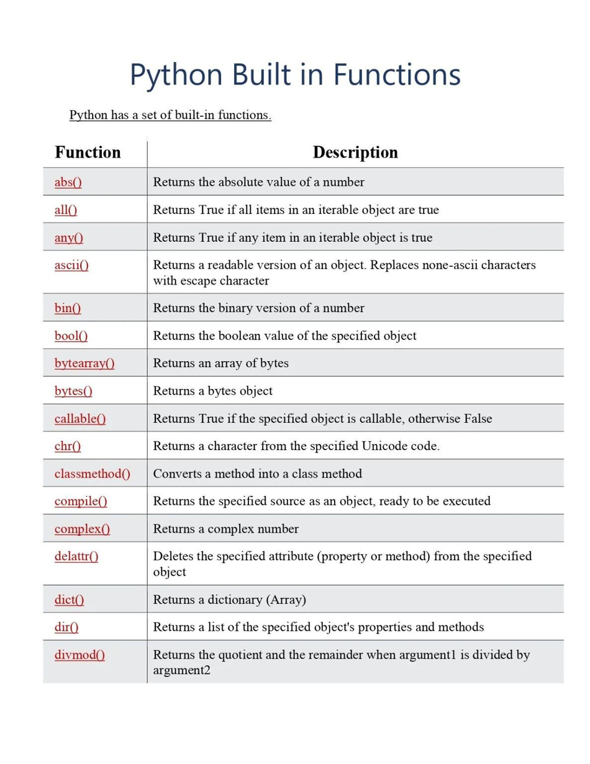
Built-in Functions
Built-in functions in Python are pre-defined functions provided by the Python language that can be used to perform common tasks.

Slide 8
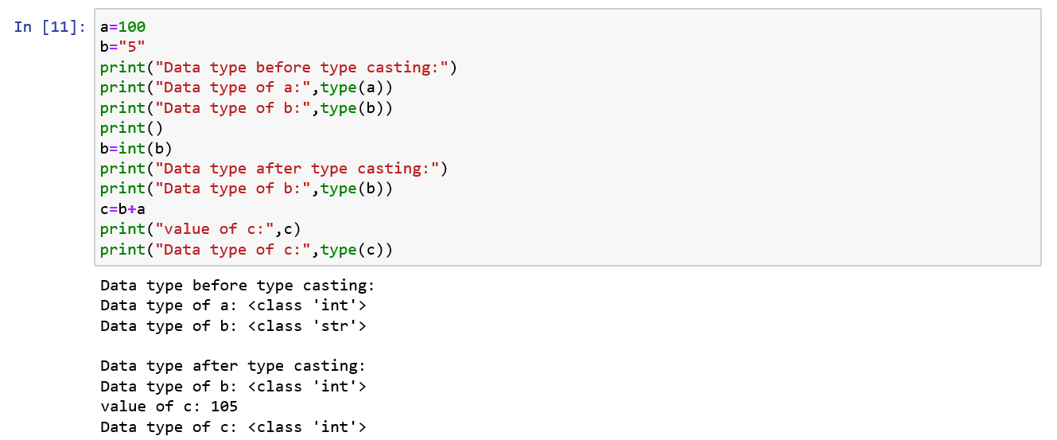
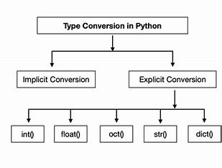
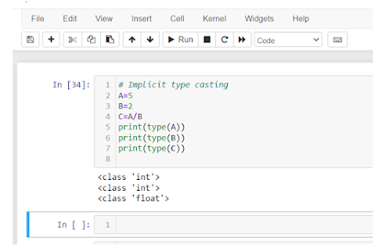
Type Conversion
In Explicit Type Conversion in Python, the data type is manually changed by the user as per their requirement. With explicit type conversion, there is a risk of data loss since we are forcing an expression to be changed in some specific data type.
Python defines type conversion functions to directly convert one data type to another which is useful in day-to-day and competitive programming.
There are two types of Type Conversion in Python:
Python Implicit Type Conversion
Python Explicit Type Conversion
In Implicit type conversion of data types in Python, the Python interpreter automatically converts one data type to another without any user involvement.

Slide 9

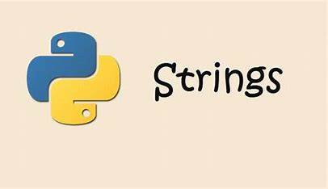
Strings
A String is a data structure in Python Programming that represents a sequence of characters. It is an immutable data type, meaning that once you have created a string, you cannot change it. Python String are used widely in many different applications, such as storing and manipulating text data, representing names, addresses, and other types of data that can be represented as text.
Python does not have a character data type, a single character is simply a string with a length of 1.
Square brackets can be used to access elements of the string.
You can return a range of characters by using the slice syntax. Specify the start index and the end index, separated by a colon, to return a part of the string.
We can combine strings and numbers by using f-strings or the format() method!

Slide 10
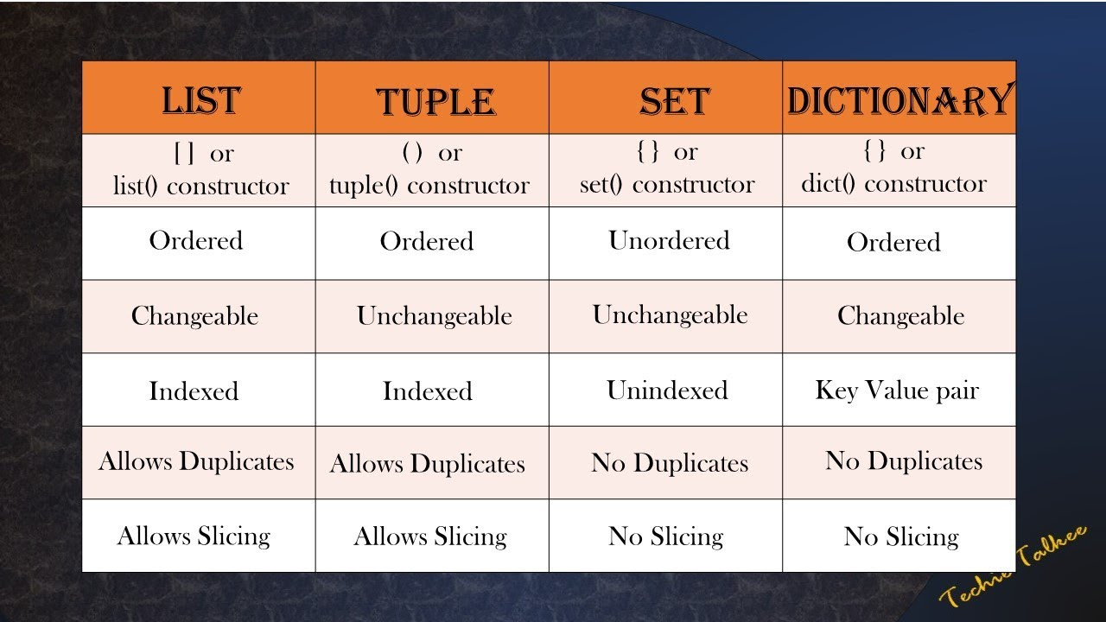
List, Tuple, Set
Lists are ordered collections that can hold multiple elements.
Tuples are similar to lists but are immutable (cannot be changed after creation).
Sets are unordered collections of unique elements.

Slide 11
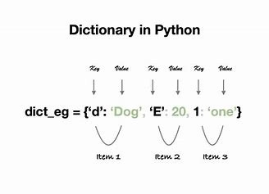
Dictionary
Dictionaries are used to store data values in key:value pairs. A dictionary is a collection which is ordered*, changeable and do not allow duplicates.
Creation: Dictionaries can be created using curly braces {} with key-value pairs, or using the dict() function.
Accessing Values: Values can be accessed using their keys.
Modifying Values: You can add new key-value pairs or update existing ones.
Deleting Items: Items can be removed using the del statement or the pop() method.
Checking Keys: You can check if a key exists using the in keyword.
Iteration: You can iterate over keys, values, or key-value pairs.
Dictionary Methods: Common methods include get(), keys(), values(), items(), update(), and clear().

Slide 12

Thank You

