Slide 1

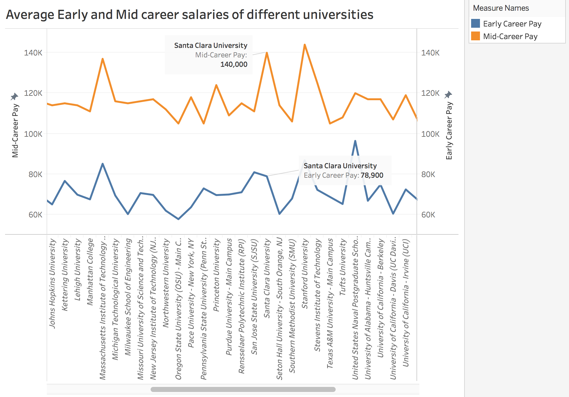

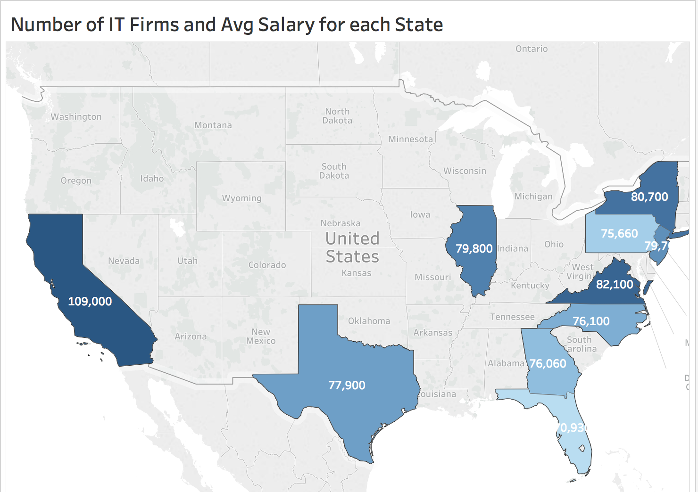
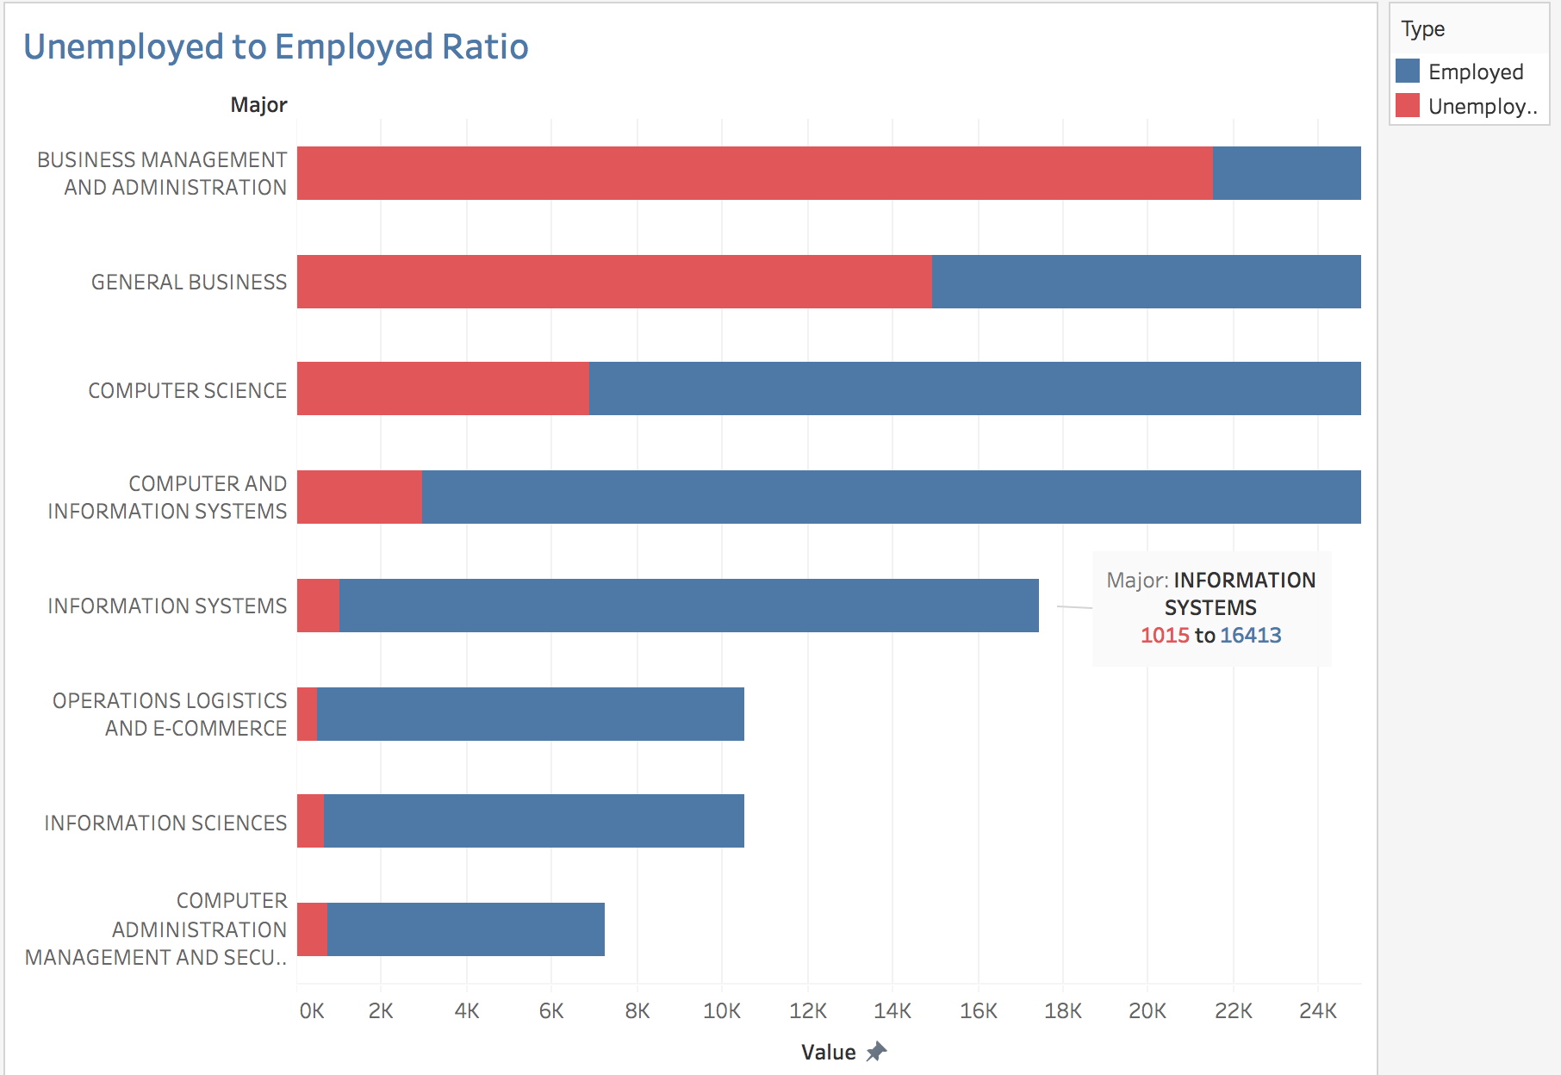

Avg Early and Mid career salaries of SCU graduates(MSIS) are pretty high.
MSIS @ SCU – Fact Sheet
Why MSIS at SCU?
The ratio of unemployed to employed for the major Information systems is very low – which is a good thing.
Location of SCU is the best!- California has max no. of IT firms and most of these are in the bay area (where SCU resides). Secondly, MSIS related job roles have max. average salary.
I feel MSIS @ SCU is a 10/10 - I have put my explanations in the document submitted along with the slides.

