Slide 1
File Management System
Akshat Mittal – RA2211003010790
Ritvik Rajvanshi – RA2211003010792
Yugam Shah – RA2211003010796

Slide 2
Abstract
A File Management System (FMS) is a pivotal component of modern computing infrastructure, facilitating the organization, accessibility, and security of digital data. FMS streamlines file creation, access control, backup, recovery, and versioning, offering a user-friendly interface to manage files and directories while ensuring data integrity. In an era marked by escalating data volumes, FMS technology plays a crucial role in optimizing storage resources through compression, deduplication, and automated archiving. As data continues to grow exponentially, the FMS remains an indispensable tool for users, ensuring data reliability, accessibility, and efficient storage management in both personal and professional contexts.

Slide 3
Introduction
A file management system, also known as a file system, is a software component integral to computer systems, enabling users to create, organize, store, and access digital files efficiently. It encompasses functions such as file creation, organization through directories, storage on various media, access control for security, retrieval, and file manipulation. Files are structured hierarchically within directories, identified by unique names and extensions, while metadata stores essential information like file size and permissions. File systems manage user access and enable critical operations while adhering to distinct file system types, with backup and recovery capabilities, as well as the potential for compression and encryption, ensuring seamless data organization and accessibility in computing environments.

Slide 4
Advantages of File Management System
Organization: File management systems provide a structured and hierarchical way to organize files and directories, making it easy for users to categorize and locate their data efficiently.
Efficient Data Access: Users can quickly access and retrieve files, reducing the time and effort required to find and work with their data.
Data Integrity: File systems ensure data integrity by managing file operations, like reading, writing, and deletion, while safeguarding against data corruption.
Security: Access control mechanisms, such as file permissions and access lists, help protect sensitive data by controlling who can read, write, or delete files.
Data Backup and Recovery: Many file management systems include backup and recovery features, reducing the risk of data loss due to hardware failures or accidental deletions.

Slide 5
Files Operation
List all Files and Directories
Create New Files
Delete Existing Files
Rename Files
Edit Files Content
Search Files
Details of Particular File
View Content of File

Slide 6
Files Operation
Sort File Content
List only Directories(Folders)
List Files of Particular Extension
Count Number of Directories
Count Number of Files
Sort Files in a Directory

Slide 7
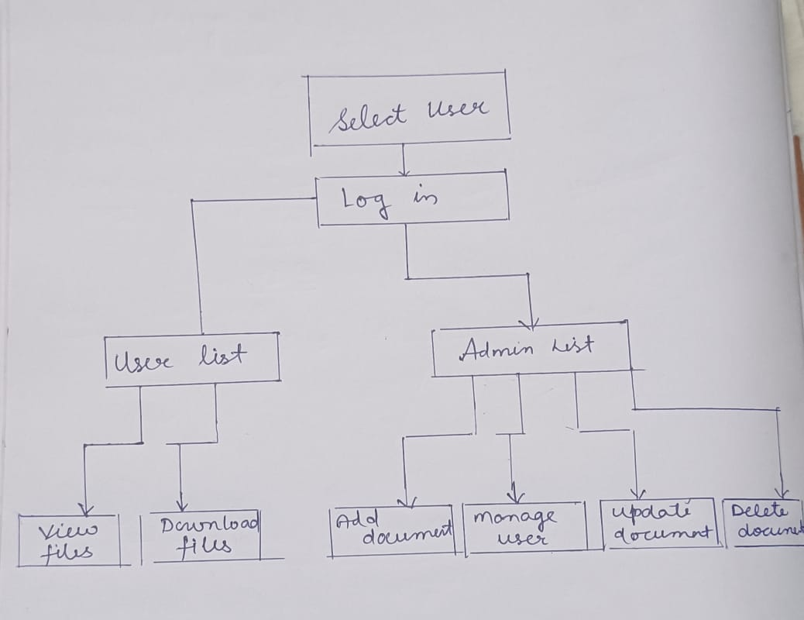
Architectural Diagram

Slide 8
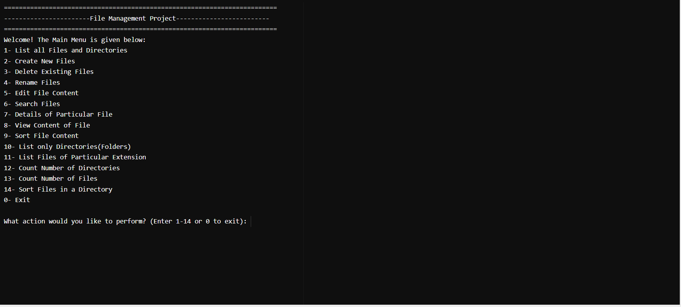
OUTPUT SCREEN

