Slide 1
Hate Speech and Counter-Speech Generation
PRESENTED BY GROUP 18: RITVIK SAI, NISHANTH BHOOMI
Objective: to develop a system capable of detecting hate speech and generating effective counter-speech, based on datasets and methodologies designed for hate speech detection.

Slide 2
Week 1 & 2 Progress
Completed initial data preprocessing:
• HARE Dataset: Cleaned and structured for implicit hate speech detection.
• CONAN Dataset: Organized for counter-speech generation.
Conducted exploratory data analysis to understand data distribution and characteristics.
Generated initial visualizations to represent dataset statistics.

Slide 3
Dataset Samples
HARE Dataset Sample:
• starvation and barrel bombs. | implicit_hate
• #cville welcome to police state america of the ussa . next they'll imprison our people in the gulags for our ideas .| not_hate
• Friend: how dark is your humor? Me: If you whip it enough, it will start picking cotton.| implicit_hate
CONAN Dataset Sample:
• Muslim folks are invading Europe and we should stop them..| You're right, ocean pollution is one... | The media would have us believe that there are huge influx of Muslims into Europe. The true number is around 25.7 million Muslims living in the EU (2016), corresponding to the 4,9%. | MUSLIMS|V6_sbf • ‘Juice (Jews) are worse than nukes.’ | You'd rather be nuked then? | JEWS | V1

Slide 4
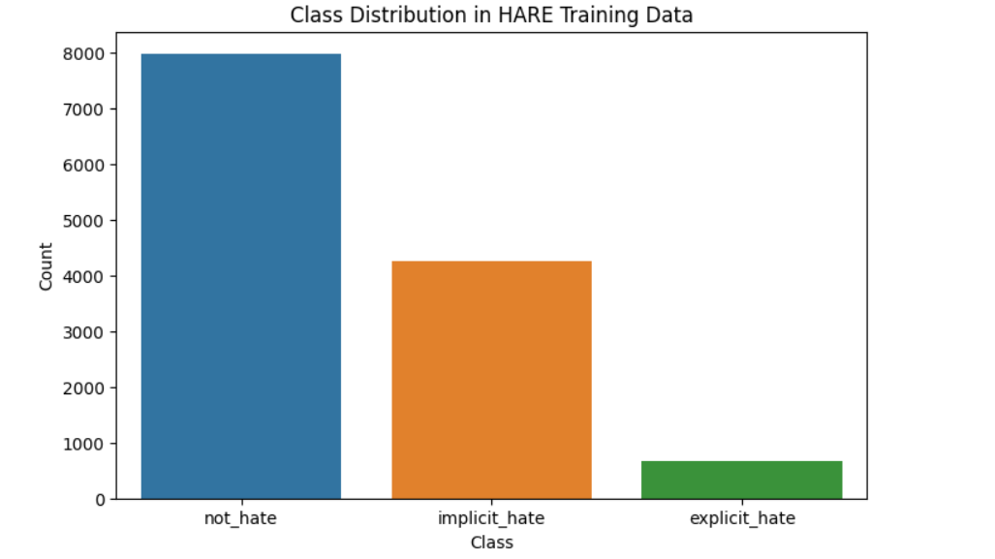
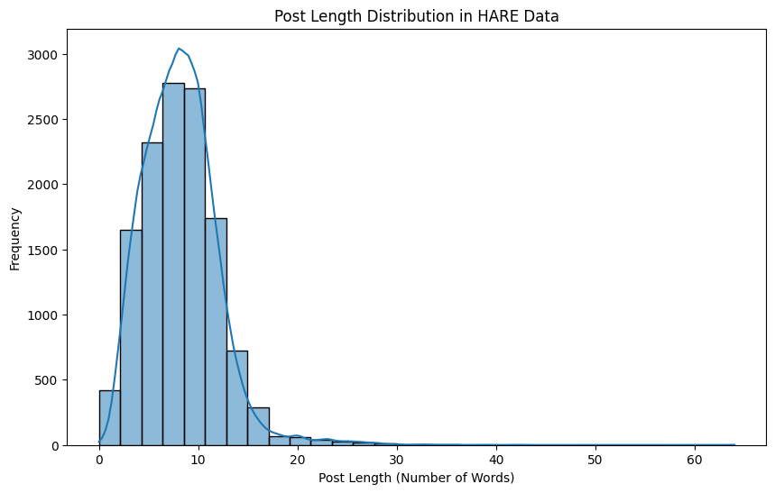
Graphs and Visualizations
Preprocessing Graphs:

Slide 5
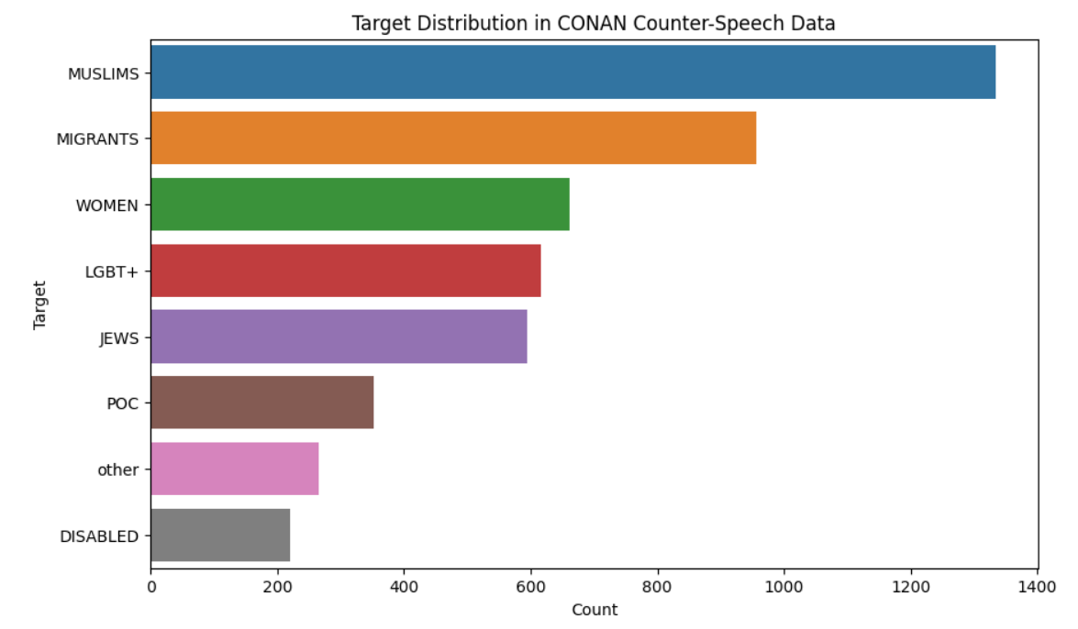
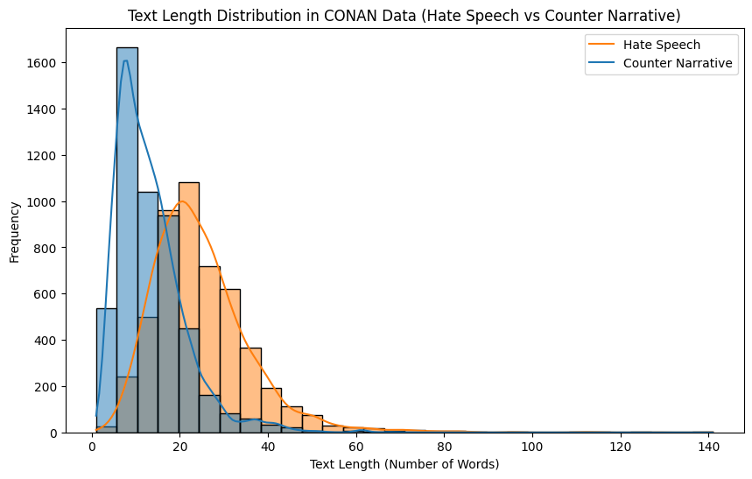
Preprocessing Graphs:

Slide 6
Week 3 Progress
Developed and trained both Complex Model and Simple Model for hate speech detection.
Implemented model architectures:
• Complex Model: Utilized transformers for enhanced contextual understanding.
• Simple Model: Basic neural network for baseline performance.
Achieved initial evaluation results:
• Complex Model: Evaluation Loss: 0.7428, Accuracy: 70.44%, F1 Score: 68.11%, Precision: 66.14%, Recall: 70.44%.
• Simple Model: Accuracy: 69.01%, F1 Score: 66.21%, Precision: 67.92%, Recall: 69.01%.

Slide 7
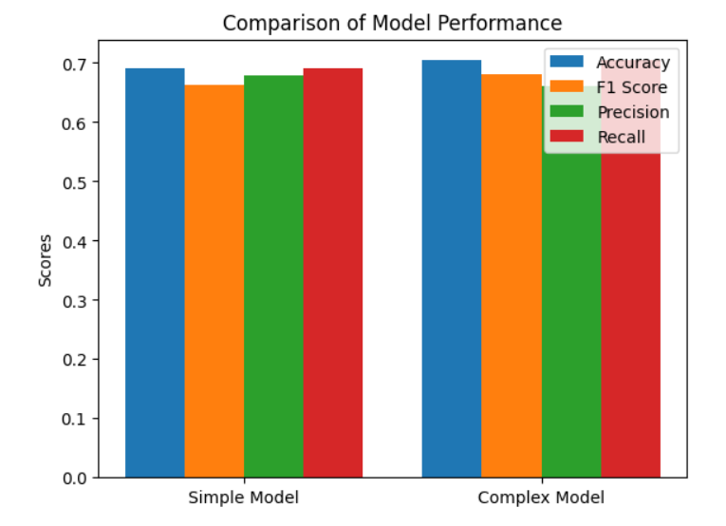
Model Performance Comparison:

Slide 8
Week 4 Plans (Fine-tuning)
Focus on fine-tuning the Complex Model and Simple Model:
• Adjust hyperparameters for optimization.
• Implement regularization techniques to prevent overfitting.
• Experiment with learning rate schedules and batch sizes.
Begin evaluation of model performance on validation datasets.

Slide 9
Week 5 & 6 Plans (Counter-Speech Model)
Develop and fine-tune the Counter-Speech Generation Model:
• Leverage CONAN dataset for model training.
• Implement advanced techniques for generating effective counter-narratives.
Aim to integrate insights from hate speech detection into counter-speech model design.

Slide 10
Observations and Next Steps
Observations:
• The complex model performs better than the simple model on most metrics.
• Higher precision in the complex model indicates better prediction accuracy for hate speech cases.
Next Steps:
• Focus on fine-tuning both models in Week 4.
• Start developing the counter-speech model in Weeks 5 and 6.

