Slide 1

DEPARTMENT COMPUTER SCIENCE ENGINEERING
TUTORIAL WEBSITE
GUIDED BY:-
Prof. KANCHAN PANDEY
PREPARED BY:-
RITVIK BANDEWAR
-

Slide 2
-:index:-
INTRODUCTION.
FLOW CHART.
WORKING.
FEATURES.
TECHNOLOGY.
IMAGE VIEW.
OBJECTIVE.

Slide 3
-:INTRODUCTION:-
My Website {DEVELOPMENT - WORLD} is about tutorial of all software and web developing languages , which help’s to learn all topic’s of languages easily and free.. In this website user can get all theories , example of code , video link etc.

Slide 4
-:flow chart:-
Login/Signin Account
Development-World
Click on a text
Select Language
Get the Courses

Slide 5
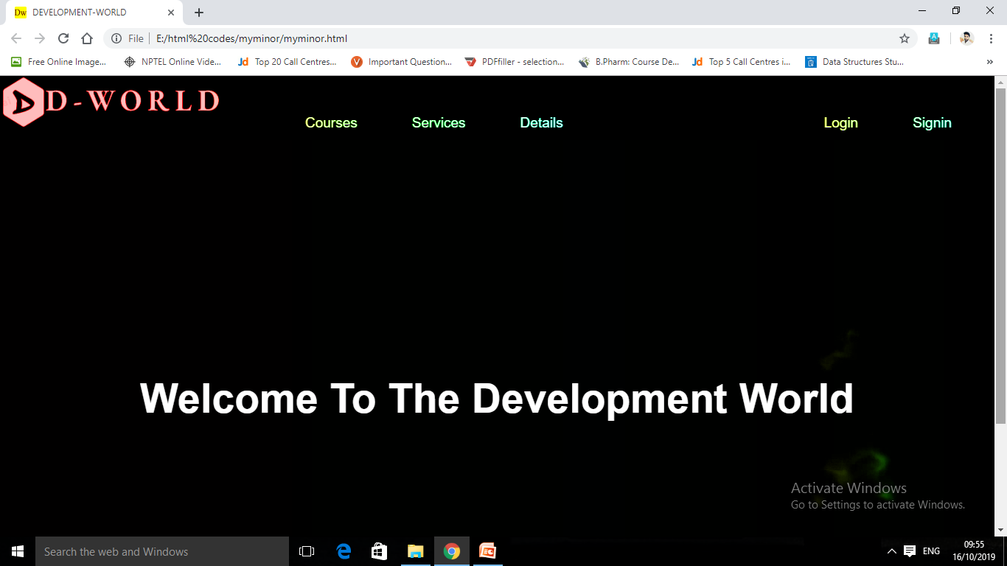
-:WORKING:-
Firstly when user enter in website then this is front view & after this ,user have to click on the main text then user will go next page...

Slide 6
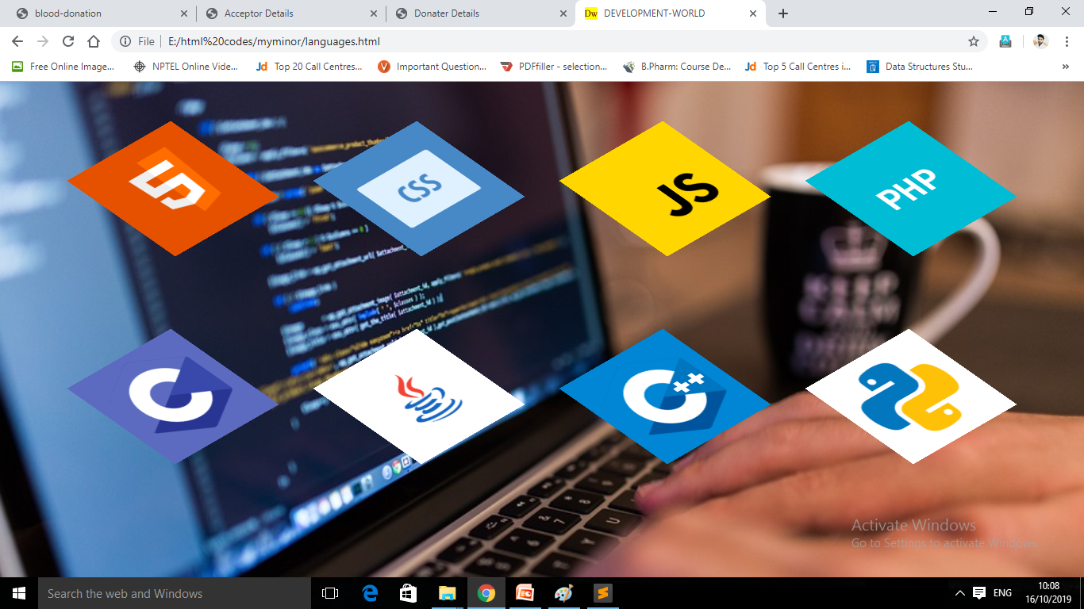
-:WORKING:-
This is a 2nd page of my website ,from here user can select their language which he/she want to learn e.g. User want to learn “HTML” then user will click on “HTML” icon & next page will be open...

Slide 7
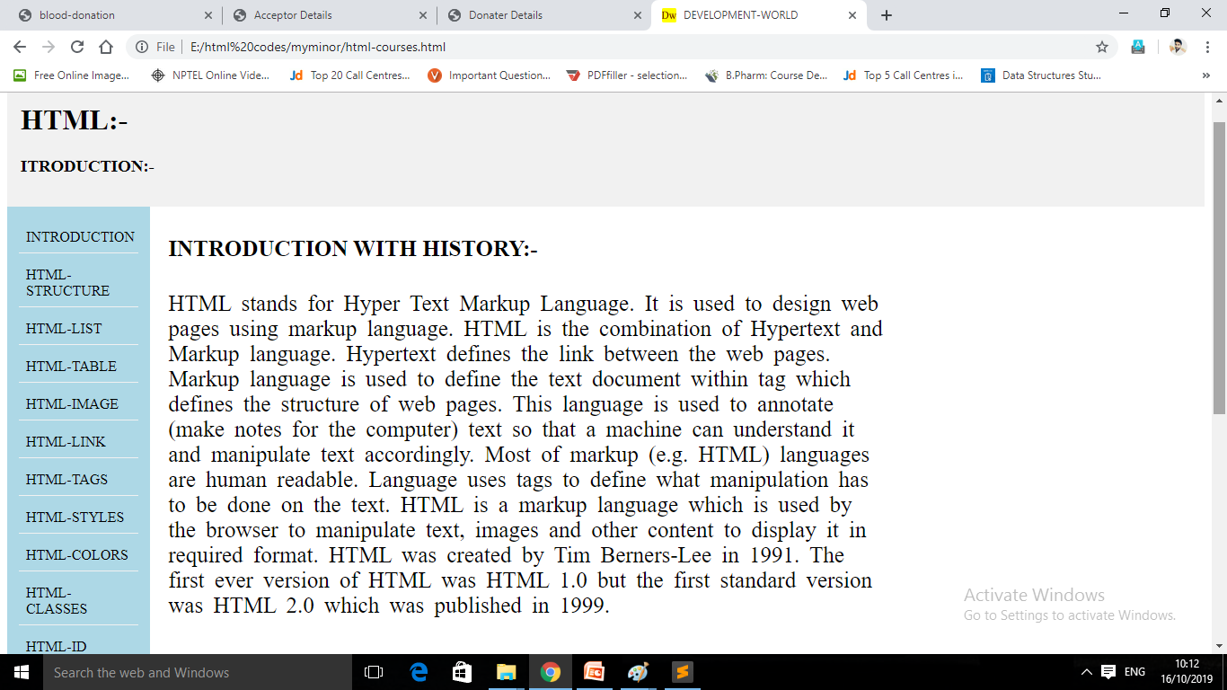
-:WORKING:-
From here , user can get all information about HTML and also from side list....

Slide 8
-:features:-
All theory of courses..
Example of codes..
Video lecture’s link..
Online editor & compiler...

Slide 9
-:technology:-
For developing structure of my website I used
{HTML} ..
And some tags of JS...
And for styling I used {CSS}...
For developing I used {Subline text edtor}

Slide 10
-:Front-end work:-

Slide 11
-:image view:-
1.

Slide 12
-:image view:-
2.

Slide 13
-:image view:-
3.

Slide 14
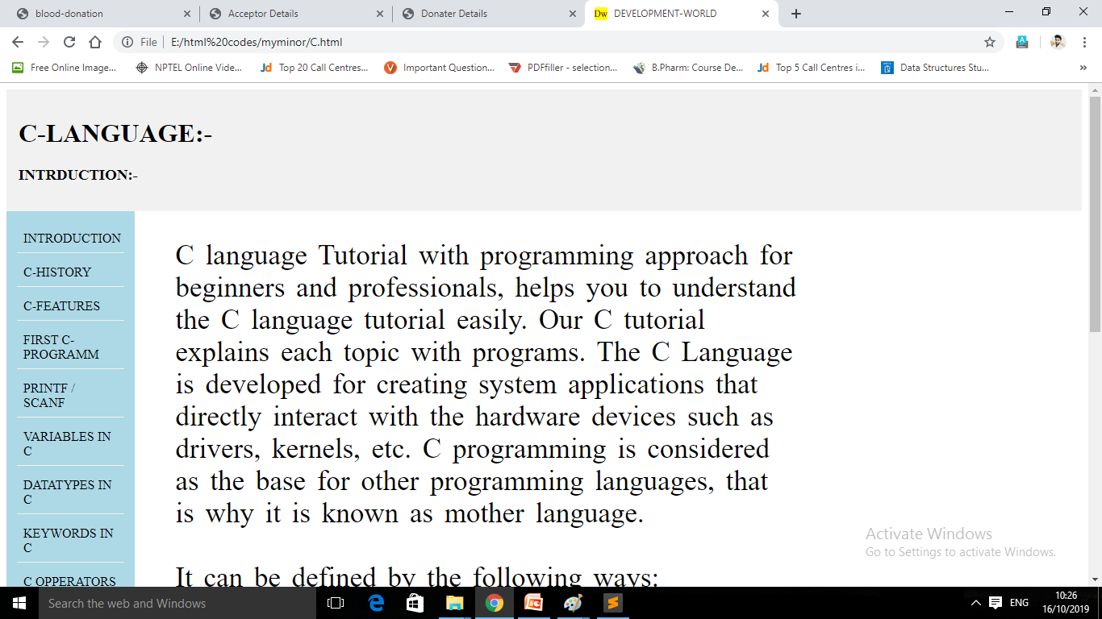
-:image view:-
4.

Slide 15
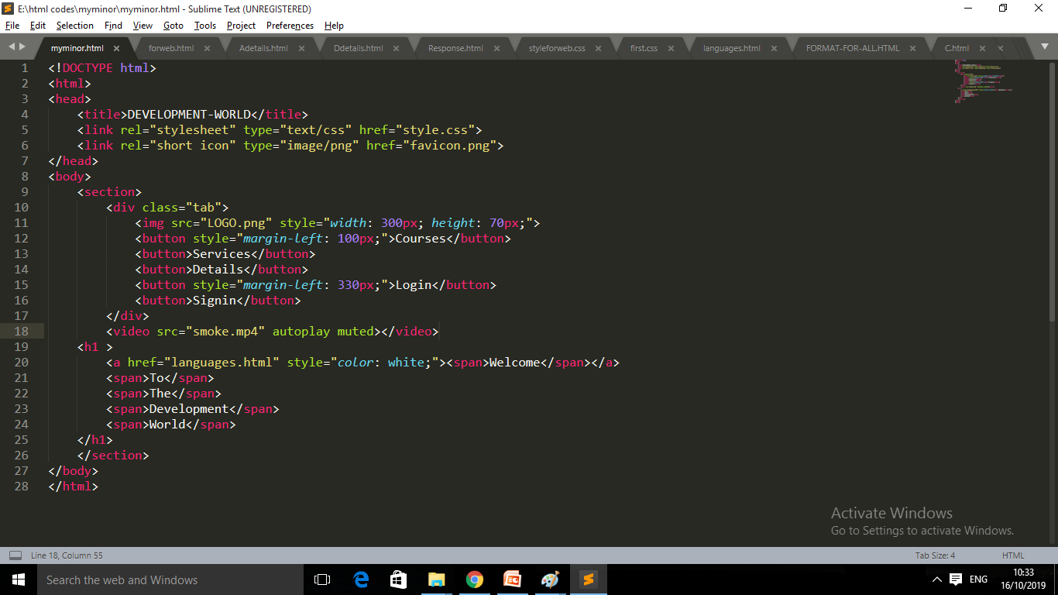
-:image view:-
5.

Slide 16
-:Back-end work:-
.User’s account details.
online Editor & compiler.

Slide 17
-:objective:-
The conclusion of our site is that a user can get all courses of software/web development
languages with all theories , some good example of code , link’s of video lectures and
Editor’s & compiler etc. At a single platform..

Slide 18
-:thank you:-

