Slide 1


Minor Project - II
Contextualized Data Processing with LangChain and Vector Databases
SUBMITTED BY:-
Name | SAP ID | Roll. No.
Debanjana Pal | 500101914 | R2142220062
Ritvik Gupta | 500106977 | R2142220280
Milind Vishwakarma | 500105627 | R2142221227
Under Guidance of:
Dr. Sahinur Rahman Laskar

Slide 2
Table Of Contents
Abstract
1. Introduction
1.1 Problem Statement
2. Objectives
3. SWOT Analysis
4. Methodology
5. Project Plan
6. Website Design

Slide 3
Abstract
This project brings together Large Language Models (LLMs), LangChain, vector databases, and LLM APIs to provide an intelligent system for efficient data retrieval, processing, and analysis. The system improves the responses by using NLP to do semantic searches, resulting in more organised and context-sensitive results. LangChain coordinates LLM duties, text embeddings enable semantic search, and vector databases enable quick, context-aware searches. The APIs used will provide for greater flexibility in external integrations. The system seeks to provide real-time insights, improve human-machine interactions, and increase reliability.

Slide 4
1. Introduction
Objective: Develop a user-friendly web application for efficient text and document processing.
Core Features:
1. Text summarization
2. Grammar correction
3. Sentiment analysis
4. Dynamic question-answering
Input Support: Direct text entry and PDF uploads for flexible use.
Impact: Enhances productivity by consolidating multiple text-processing tools into a single platform.
Future Scope: Potential expansion with additional features and integrations to meet evolving user needs.

Slide 5
1.1 Problem Statement
Traditional text-processing systems face scalability and adaptability challenges due to the rapid increase in textual data and evolving contexts.
These limitations lead to inefficiencies in processing, retrieving, and analyzing information with accuracy.
Handling diverse tasks such as text summarization, grammatical correction, sentiment analysis, and question-answering becomes complex.
Existing solutions often lack context awareness and real-time adaptability, making them less effective for dynamic user needs.
A more intelligent, efficient, and context-aware approach is needed to enhance text processing and information retrieval.

Slide 6

2. Objectives
This project aims to achieve the following key objectives:
User-Friendly Web Interface:
Creating an intuitive and accessible web interface for seamless interaction with the application’s functionalities. The interface will be easy to navigate, allowing users to effortlessly input text and PDF documents, select desired functions, and view processed output.

Slide 7
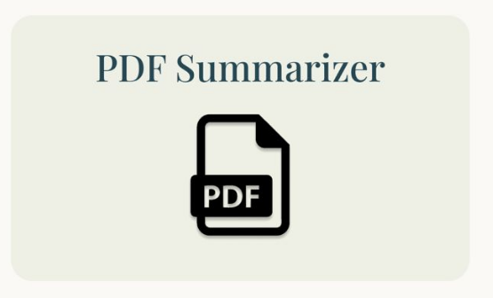
2. Objectives
Robust Text Summarization:
Develop a text summarization feature that accurately condenses input text and PDF content into concise summaries. The summarization process will preserve key information while eliminating redundancy, aiming to provide users with a quick overview of the main points.

Slide 8

2. Objectives
Accurate Grammatical Error Correction:
Incorporate a grammar correction tool that effectively identifies and corrects grammatical errors and stylistic issues in the input text. The tool should handle a wide range of errors, including spelling, punctuation, and grammar, enhancing the overall quality of the writing.

Slide 9
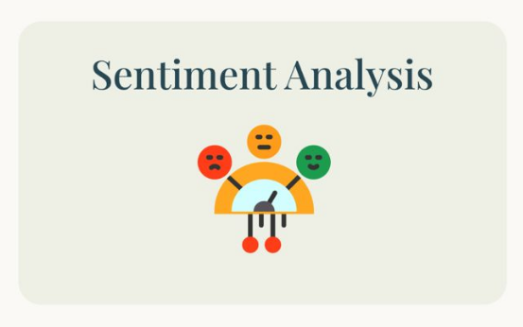
2. Objectives
Comprehensive Sentiment Analysis:
Implement a sentiment analysis feature that accurately assesses the sentiment expressed in the input text, classifying it as positive, negative, or neutral. The analysis should provide users with valuable insights into the emotional tone of the text.

Slide 10

2. Objectives
Dynamic Q&A System:
Create a question-answering system powered by a LLM, enabling users to ask questions in natural language and receive relevant answers. This would provide comprehensive support and information within the application, addressing user queries about the platform’s functionalities.

Slide 11
3. SWOT Analysis
Strengths (S):
Advanced NLP Capabilities
Efficient Data Retrieval
User-Friendly Interface
Automation & Real-Time Insights
Opportunities (O):
Growing Demand for AI-based NLP Tools
Expansion to Multiple Domains
Integration with Other AI Systems
Cloud-Based Deployments
Weaknesses (W):
Computational Costs
Dependency on APIs
Data Privacy Concerns
Integration Complexity
Threats (T):
Competition from Established AI Models
Rapid Technological Changes
Regulatory & Compliance Risks
Potential Ethical Concerns

Slide 12
4. Methodology
An outline for a systematic approach to developing an advanced text and PDF processing system has been created. This workflow is designed to follow a linear progression through clearly defined stages:
Requirement Analysis and System Design
LLM Orchestration with LangChain
Data Storage and Retrieval
API Integration (e.g., Gemini API)
Testing and Optimization
Deployment (Cloud/On-Premise)
Continuous Monitoring and Feedback
Each stage contributes to building a robust and efficient system capable of handling complex text processing tasks, with a focus on delivering high-quality final outputs aligned with the user’s needs.

Slide 13
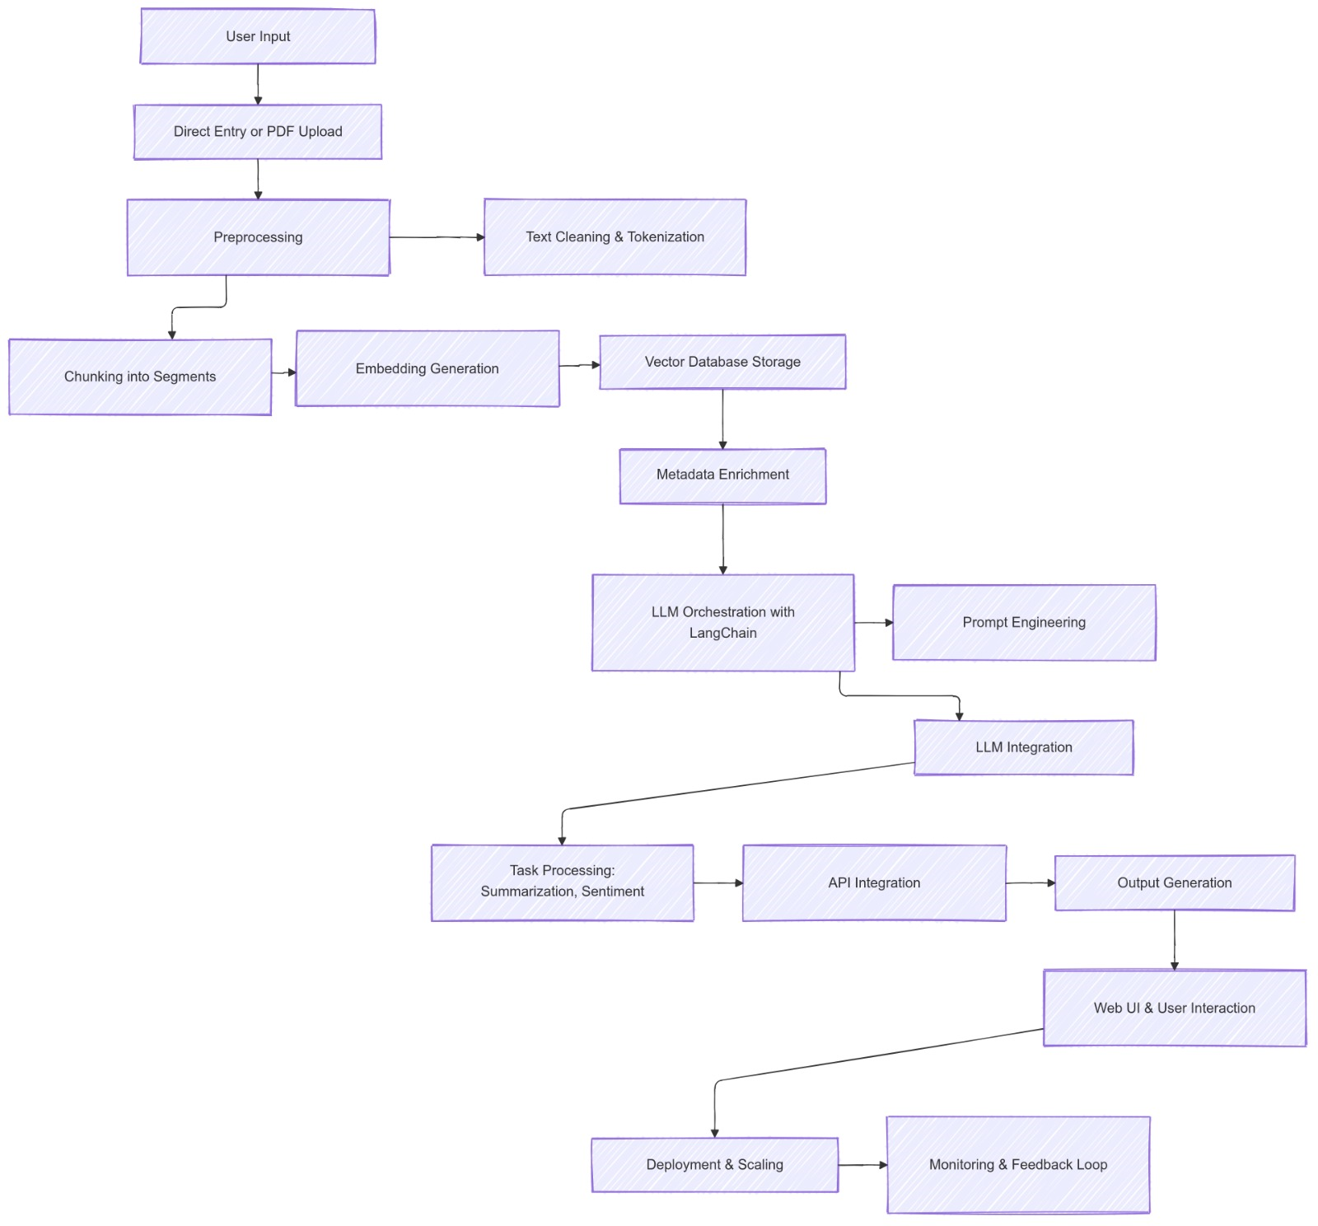

Slide 14
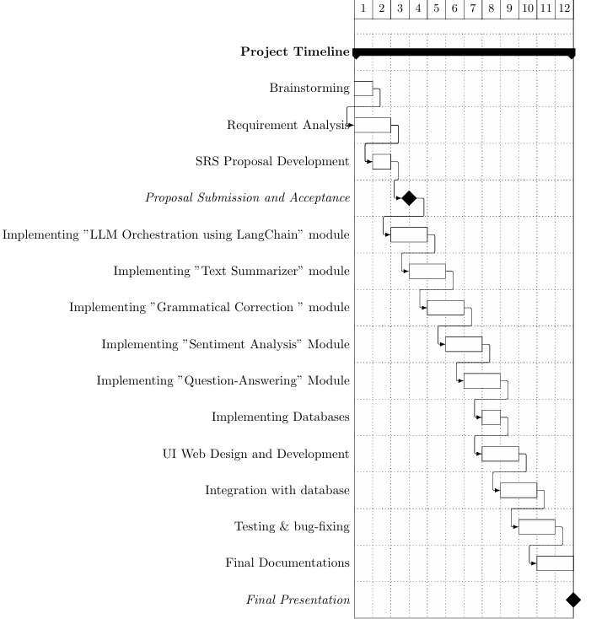
5. Project Plan
(in weeks)

Slide 15
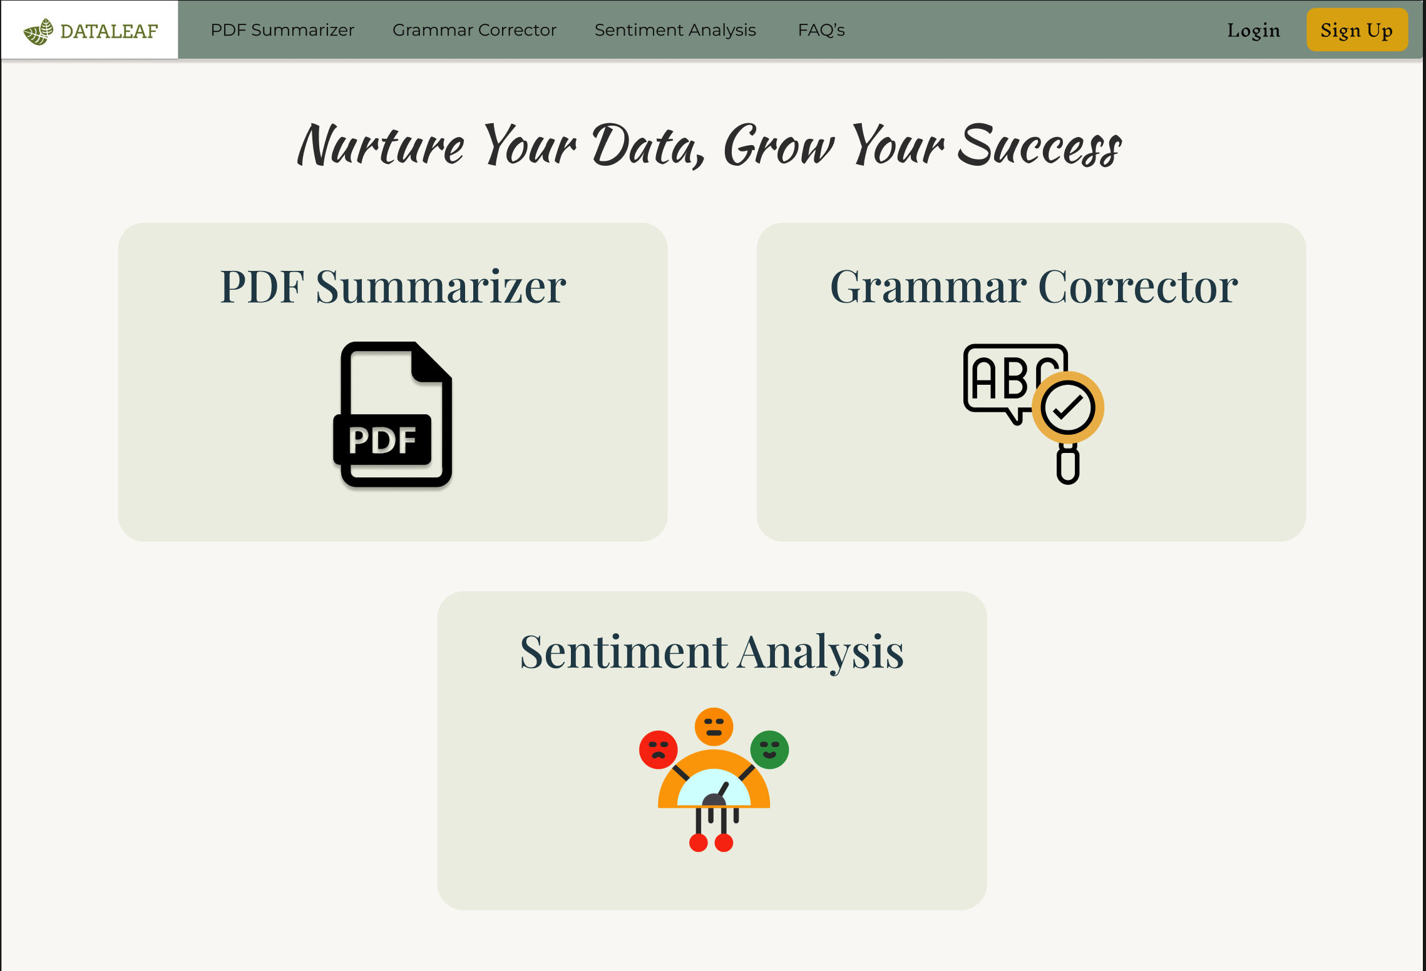
6. Website Design

Slide 16
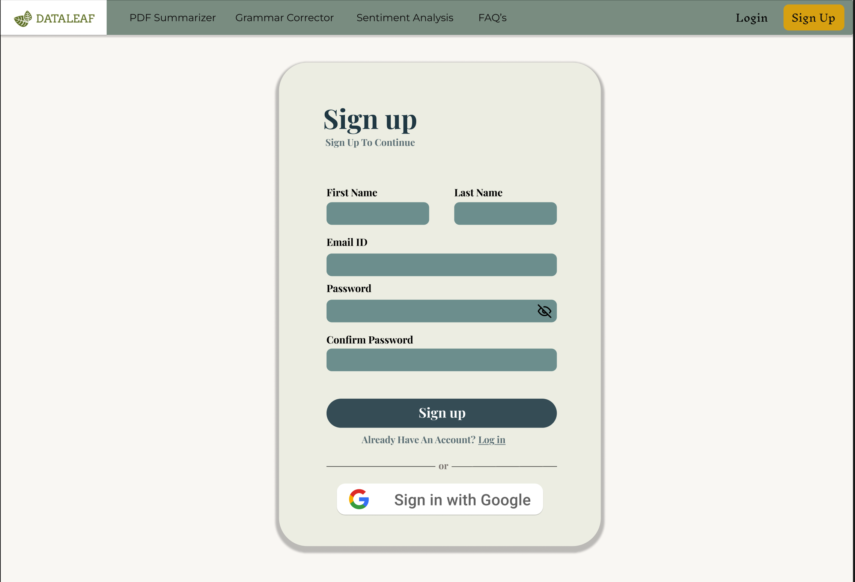

Slide 17
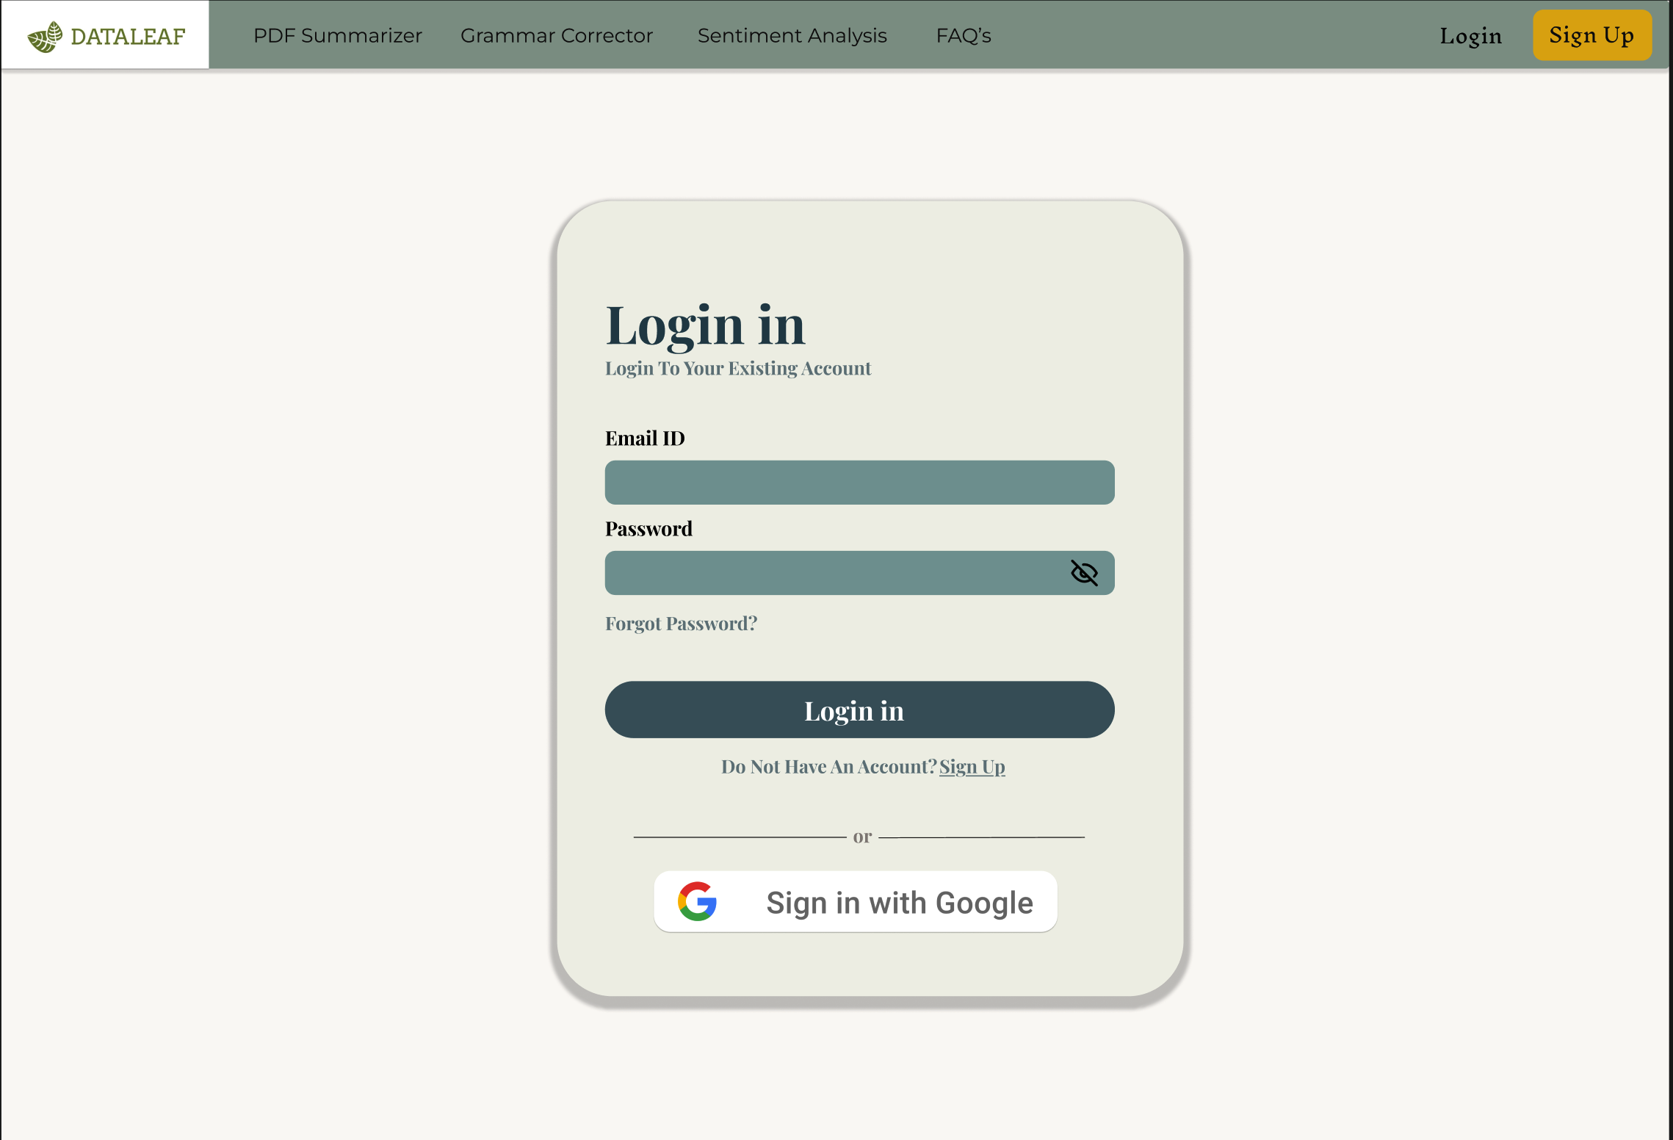

Slide 18
Thank You

