Slide 1
Parallel and distributed computing (UCS-645) Project
Aryan Sirohi-(102303832)
Ritvik Bajaj - (102303821)

Slide 2
PARALLELISATION OF BELLMAN FORD
(why do we need parallelization?)
Bellman-Ford is a classical shortest-path algorithm capable of handling negative edge weights
Used in real-world applications such as network routing, financial systems and transportation networks
Sequential execution becomes impractically slow for large graphs due to O(V × E) complexity
Parallel computing offers a solution by executing independent operations simultaneously
This project explores and compares four approaches to solve this problem

Slide 3
an Analysis of SEQUENTIAL Bellman ford
Sequential Bellman-Ford checks every edge one by one, making it slow for large graphs
The inner edge relaxation loop has no data dependency — edges in the same iteration are independent of each other
This independence is the key opportunity for parallelization
The challenge is to exploit this parallelism effectively using different computing paradigms
Goal: Reduce execution time while maintaining correctness of the algorithm

Slide 4
Objectives
Develop a parallel OpenMP version using shared memory across multiple CPU threads
Develop a parallel MPI version using distributed memory across multiple processes
Develop a Hybrid OpenMP + MPI version combining both paradigms
Benchmark all four versions and measure speedup, parallel efficiency and scalability

Slide 5
Some abbreviations
V = Total number of vertices (nodes) in the graph
E = Total number of edges (connections) in the graph
T = Number of OpenMP threads running in parallel
P = Number of MPI processes running in parallel

Slide 6
ALGORITHM 1 (SEQUENTIAL)
Single CPU thread processes all edges across V−1 iterations
Serves as the performance baseline
Time Complexity: O(V × E)

Slide 7
ALGORITHM 2 (using OPEN-MP)
Inner edge relaxation loop parallelized using #pragma omp parallel for
Multiple threads share a common distance array
Atomic operations prevent race conditions
Threads synchronize at a barrier after each iteration
Approximate Time Complexity: O(V × (E/T))

Slide 8
Algorithm 3 (USING MPI)
Edge list partitioned equally across P independent processes
Each process relaxes its local edges independently
MPI_Allreduce synchronizes shortest distances across all processes after every iteration
Approximate Time Complexity: O(V × (E/P)) + O(V × log P)

Slide 9
ALGORITHM 4 ( HYBRID, OPEN MP+MPI)
MPI distributes edge list across processes
OpenMP threads further parallelize relaxation within each process
Best overall performance among all four implementations
Approximate Time Complexity: O(V × (E/(T×P))) + O(V × log P)

Slide 10
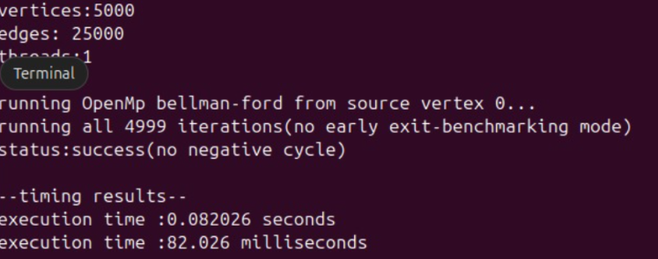
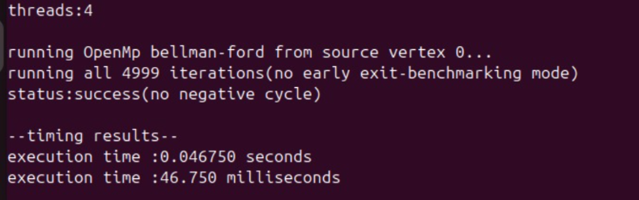
RESULTS ,OUTPUTS and some key considerations
Desirable speedup is attained for large graphs:
→
→
→

Slide 11
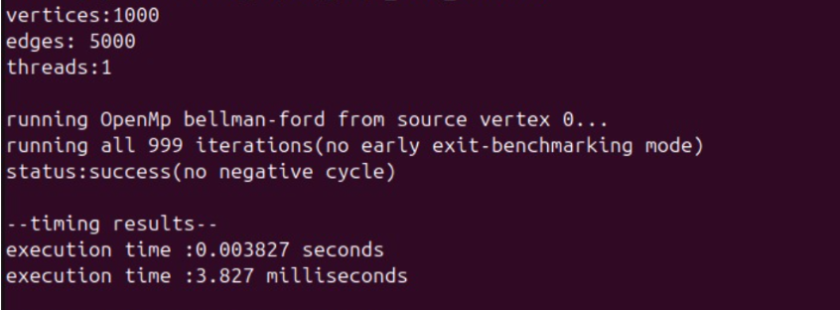
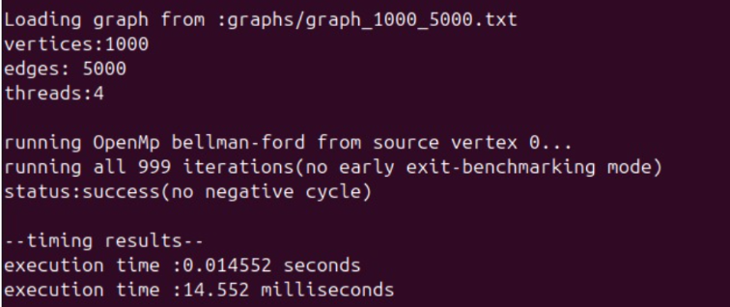
Desired speedup was not achieved for small graphs ( in fact increasing the threads
increased the execution time)
→
→
→

Slide 12
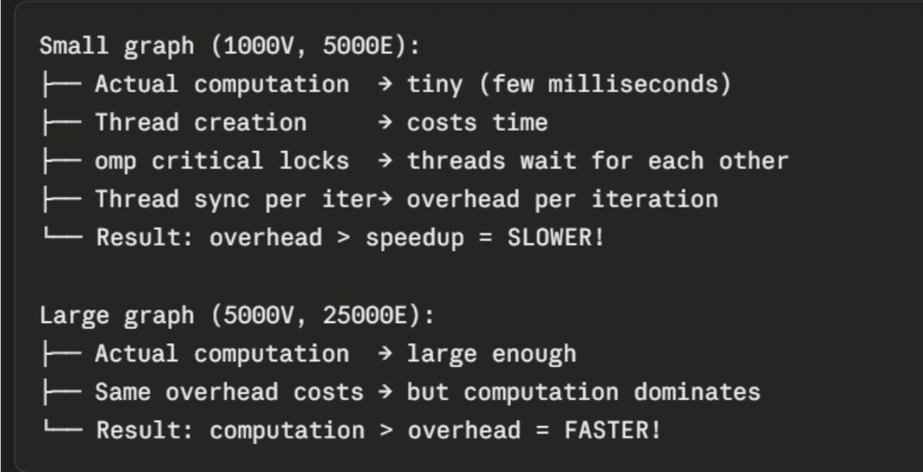
Why this happens?
It happens because of Amdahl’s law, parallelism will only help if the problem is large enough to justify the overhead costs

Slide 13
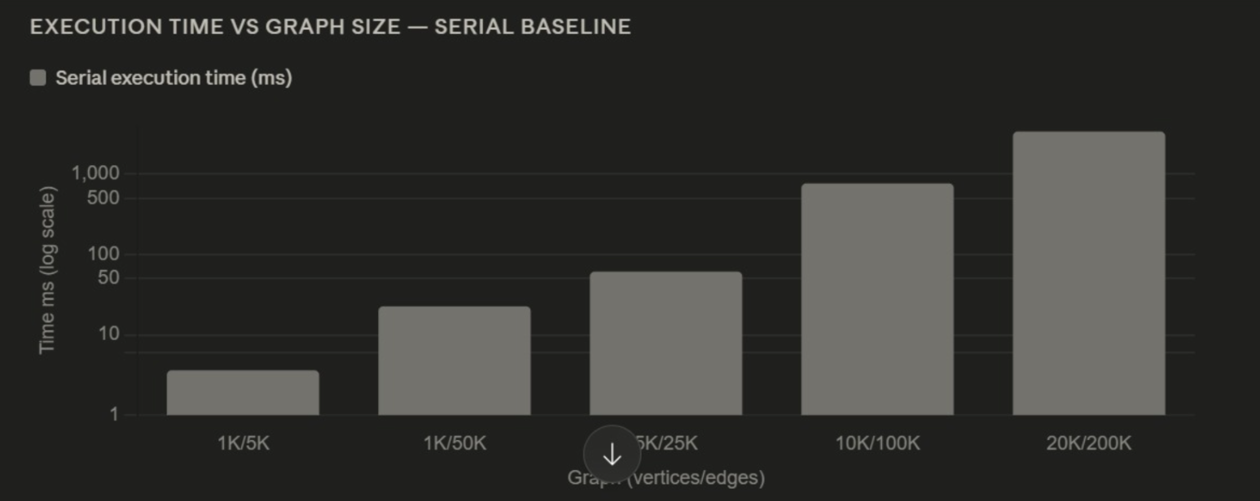
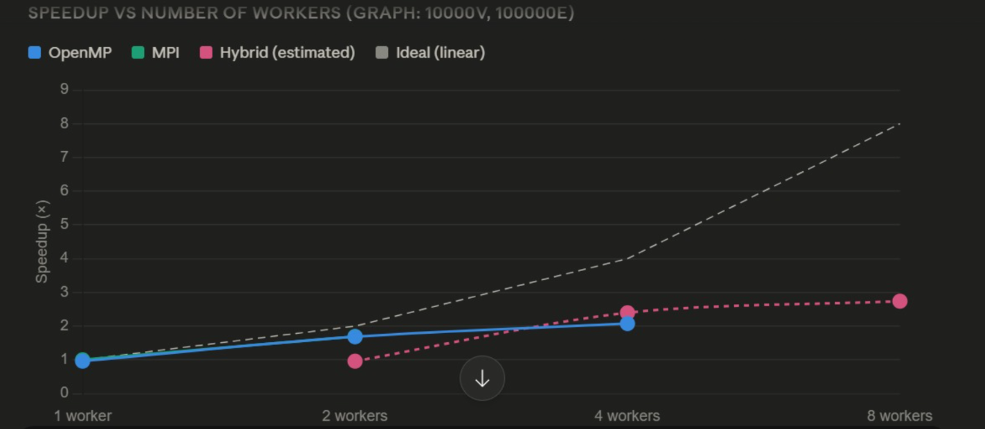
Some more findings
Execution time for various graph sizes
Speedup variation for varying number of threads

Slide 14
CONCLUSION
The Bellman-Ford algorithm can be effectively parallelized using OpenMP, MPI and Hybrid approaches
All three parallel implementations deliver meaningful speedup over the sequential baseline
Speedup gains increase with graph size, confirming that parallelization is most beneficial for large-scale problems
Amdahl's Law accurately predicts the performance ceiling, highlighting the importance of minimizing the sequential fraction

Slide 15


