Slide 1
Review 2
OS Fault-Prediction Daemon
risk rising → alert
Predicts system faults before they happen, and explains them in plain English.
Ritvik Battula (24BAI0156)
Shaurya Kumar (24BCE0876)
VIT Vellore
Notes:
Product demo for Review 2. Owners: Ritvik Battula and Shaurya Kumar.

Slide 2
The problem
4,713,493
log lines in one supercomputer system log (BGL)
585
distinct message types in the training period alone
After
SYSTEM FAILURE - noticed only now
the fault: that is when operators usually find out

Slide 3
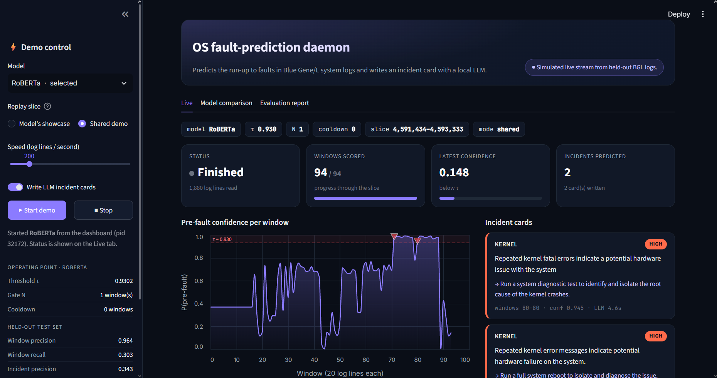
Meet the product
Watch
Live dashboard - simulated live stream from held-out BGL logs
reads the system log as a live stream
Predict
spots the run-up to a fault early
Explain
writes a plain-English incident card

Slide 4
Live demonstration
1
2
3
4
Replay
Confidence climbs
Incident fires
Card appears
held-out log lines stream in, 20 lines per window
the model scores every window; watch it cross the threshold
the alert gate turns a run of flagged windows into one incident
the local LLM writes summary, component, severity, action
Simulated live stream from held-out BGL logs.
Notes:
Before starting: make sure Ollama is running and pre-warm the model (the daemon sends a 1-token warm-up call at start; run the demo once beforehand so llama3.2:3b is loaded). Start from the dashboard sidebar: model RoBERTa, 'Model's showcase' slice, speed 200 lines/s.

Slide 5
One fault, start to finish
59 lines
warning before the first fault line (9 s of log time)
2 incidents
1 before the fault, 1 once it had started, 0 false alarms on this slice

Slide 6
System architecture
Dashboard
Streamlit
live log feed
confidence chart
incident cards
demo launcher
Daemon
Python service
stream loop
windowing
alert gate
incident builder
Models
PyTorch + Ollama
RoBERTa detect()
Llama 3.2 3B incident writer
Data
BGL + Drain3
BGL system log
Drain3 templates
20-line windows
saved models

Slide 7
System design
OFFLINE
Held-out BGL log
RUNTIME
Preprocess logs
Replay held-out log
streams
Cut 20-line windows
Train 4 models
Model store
loads
detect()
Evaluate on validation
Alert gate
LLM incident card
Select the best
writes
Dashboard

Slide 8
How it decides
conf ≥ τ (0.930)?
Start
Read next window
detect() → confidence
no
yes
streak ≥ N (1) and cooldown OK?
Dashboard + start cooldown
LLM incident card
Aggregate the episode
yes
no
One fault episode = one alert: a run of flagged windows becomes a single incident.

Slide 9
Dataset pipeline
4,713,493
raw log lines
How a window is labelled
20-line window
look-ahead: next 100 lines
fault
585
Drain3 templates (from training lines)
Pre-fault if a fault line follows within 100 lines.
Windows that already contain a fault line are excluded.
112,331
labelled 20-line windows
Split | Windows | Pre-fault | Pre-fault rate
Train | 47,311 | 4,301 | 9.09%
Validation | 20,896 | 1,087 | 5.20%
Test (held out) | 44,124 | 1,250 | 2.83%
2.83%
pre-fault windows in held-out test
Chronological split 70 / 10 / 20. Train negatives sampled 10:1; validation and test keep the real rate.

Slide 10
Module identification
1
Data preprocessing
2
Model training & selection
3
Daemon / stream loop
Operational
Operational
Operational
4
Alert gate (τ / N / cooldown)
5
Incident reporting (LLM)
6
Dashboard
Operational
Operational
Operational
Planned upgrades
Detector explainability
Drift monitor
Incident correlation
Live journalctl monitoring
Operational
Pending
Planned

Slide 11
Module completion
Operational (7)
Pending (0)
Planned (4)
• Data preprocessing
• Model training & selection
• Daemon / stream loop
• Alert gate (τ / N / cooldown)
• Incident reporting (LLM)
• Dashboard
• 4-model comparison with the best deployed
• None: every core module runs end to end on the held-out stream
• Detector explainability
• Drift monitor
• Incident correlation
• Live journalctl monitoring

Slide 12
Choosing the brain: 4 models tested
Model | Window precision | Window recall | Window F1 | Test PR-AUC | Val PR-AUC | ms / window
RoBERTa ✓ Selected | 96.4% | 30.3% | 0.461 | 0.473 | 0.259 | 14.0
DistilBERT | 94.6% | 17.0% | 0.288 | 0.378 | 0.240 | 8.5
ELECTRA | 95.4% | 15.0% | 0.259 | 0.431 | 0.217 | 14.3
Gradient-boosted trees | 100.0% | 1.2% | 0.024 | 0.363 | 0.213 | 1.4
How to read this
Window-level metrics on unseen test data, each model at its own threshold (lowest threshold reaching 80% precision on validation). Selection metric: validation PR-AUC.

Slide 13
How each model performs
RoBERTa ✓ Selected
DistilBERT
 | Predicted normal | Predicted pre-fault
Actually normal | 42,860 | 14 false alarms
Actually pre-fault | 871 missed | 379 caught
 | Predicted normal | Predicted pre-fault
Actually normal | 42,862 | 12 false alarms
Actually pre-fault | 1,038 missed | 212 caught
ELECTRA
Gradient-boosted trees
 | Predicted normal | Predicted pre-fault
Actually normal | 42,865 | 9 false alarms
Actually pre-fault | 1,063 missed | 187 caught
 | Predicted normal | Predicted pre-fault
Actually normal | 42,874 | 0 false alarms
Actually pre-fault | 1,235 missed | 15 caught
False positives = false alarms; each model's threshold was set to keep them low. Window-level counts on held-out test data.

Slide 14
Alerts that matter: incident-level
Model | Gate (N, cooldown) | Alerts fired | Before the fault | During a fault | False alarms | Incident precision | Faults warned
RoBERTa ✓ Selected | 1, 0 | 105 | 36 | 62 | 7 | 34.3% | 35 / 218
DistilBERT | 2, 30 | 52 | 30 | 17 | 5 | 57.7% | 30 / 218
ELECTRA | 1, 0 | 115 | 52 | 58 | 5 | 45.2% | 51 / 218
Gradient-boosted trees | 1, 5 | 17 | 12 | 5 | 0 | 70.6% | 12 / 218
Incident-level, held-out test data
One incident = one alert to an operator. Incident precision counts only alerts that came before a fault started (within 100 lines); alerts during a fault are not credited.

Slide 15
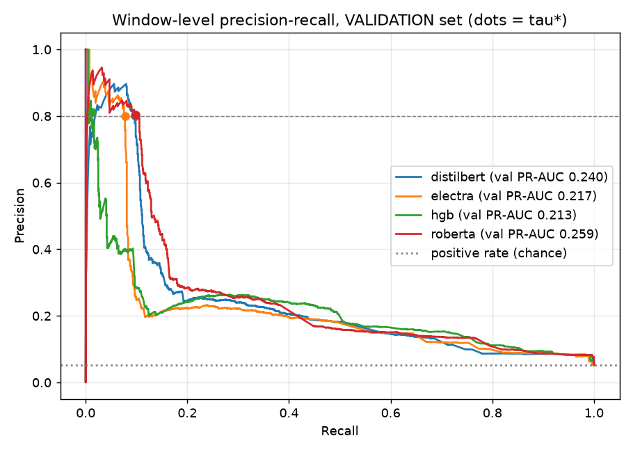
Why we chose RoBERTa
Best at ranking risk
highest PR-AUC of the 4: validation 0.259, test 0.473
Fast enough for live use
14.0 ms to score a 20-line window
Runs locally
3.7 GB peak VRAM while training on a 6 GB laptop GPU; no cloud needed
Picked on the validation set, confirmed on unseen test data.

Slide 16
Built for precision
34%
of alerts arrive before a real fault starts (incident-level)
93%
of alerts coincide with a real fault, before or during it (incident-level)
Whole windows kept: 1.1% truncated at 512 tokens
Ambiguity buffer: 200 lines
Tuned gate: τ 0.930, N 1, cooldown 0

Slide 17
What drives precision
Configuration | Val PR-AUC | Window precision | Window recall | Train time
RoBERTa, all design choices (full training) | 0.259 | 96.4% | 30.3% | 48 min
All choices on, 1-epoch retrain (reference) | 0.247 | 95.8% | 16.2% | 15 min
Without whole-window text rendering | 0.196 | 94.7% | 1.4% | 8 min
Without the ambiguity buffer | 0.217 | 97.7% | 27.0% | 15 min
Without overlapping training windows | 0.219 | 95.7% | 23.0% | 8 min
Without negative downsampling | 0.262 | 95.8% | 25.8% | 84 min
Biggest lever
Whole-window text rendering
switching it off drops validation PR-AUC by 0.050
How it was tested
Each choice switched off in turn and the model retrained for one epoch; compare with the 1-epoch reference row.
Window-level precision and recall on held-out test data.

Slide 18
Tuning the alert gate
Threshold τ
0.930
lowest score reaching 80% window precision on validation
Streak N
1 window
best balance of incident precision and faults caught on validation
Cooldown
0 windows
flagged runs already merge into one incident
Tuned on validation, never test.

Slide 19
What the operator gets
34%
16%
12 s
2.5 s
14 ms
incident precision: alerts that came before a fault
of faults warned in advance (35 of 218)
median warning before the fault's first line
to write the incident card (llama3.2:3b, local)
to score a 20-line window

Slide 20
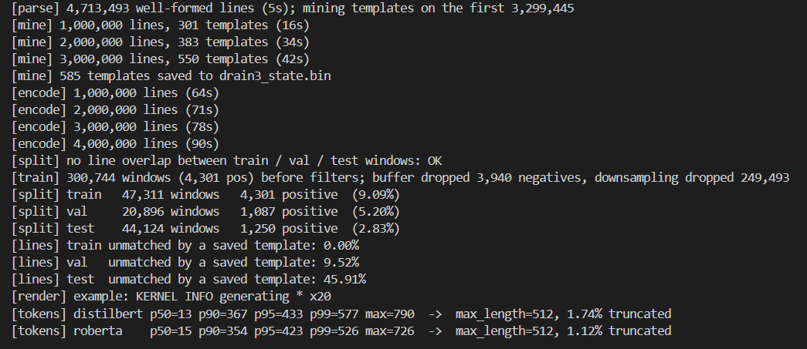
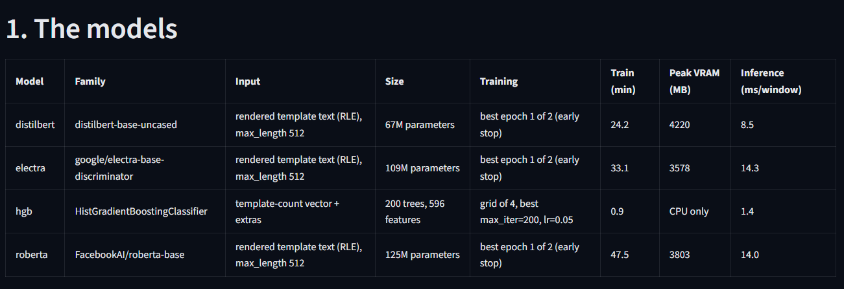
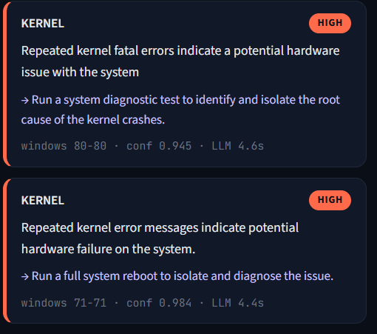
Screenshots of all outputs
Preprocessing: templates, windows, splits
Model comparison: the four models
Incident card written by the local LLM
Live dashboard

Slide 21
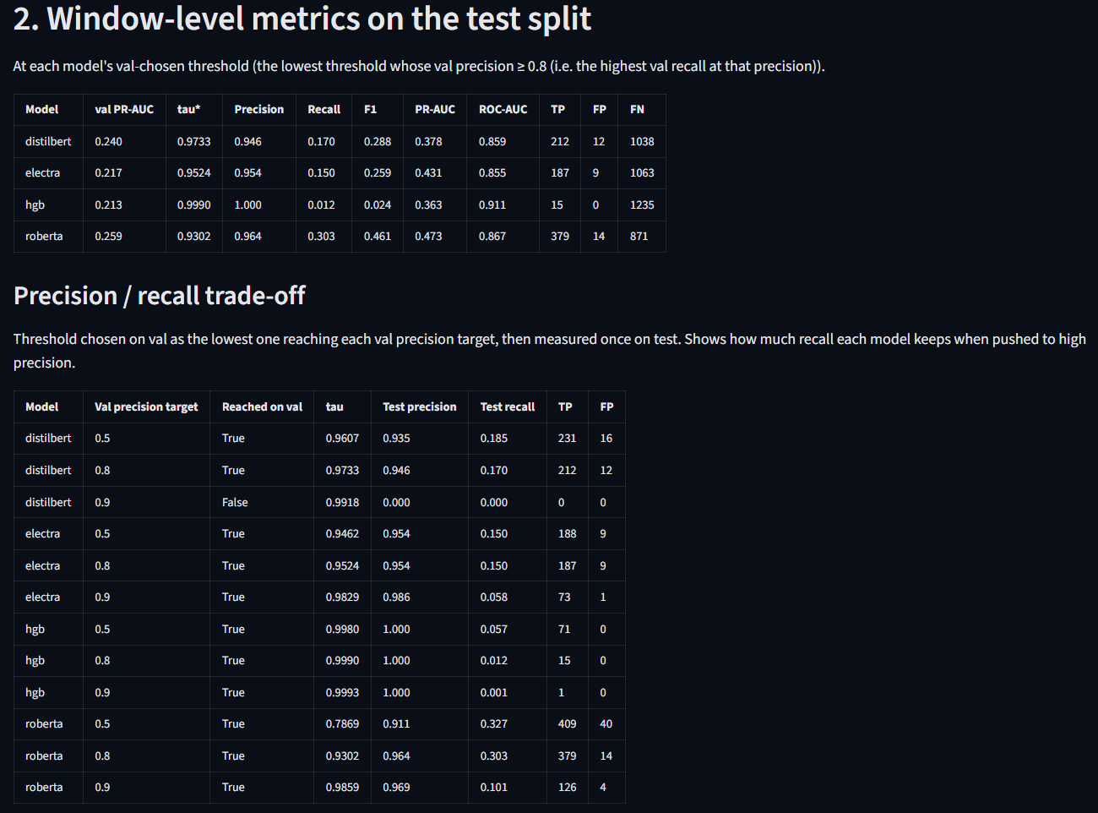
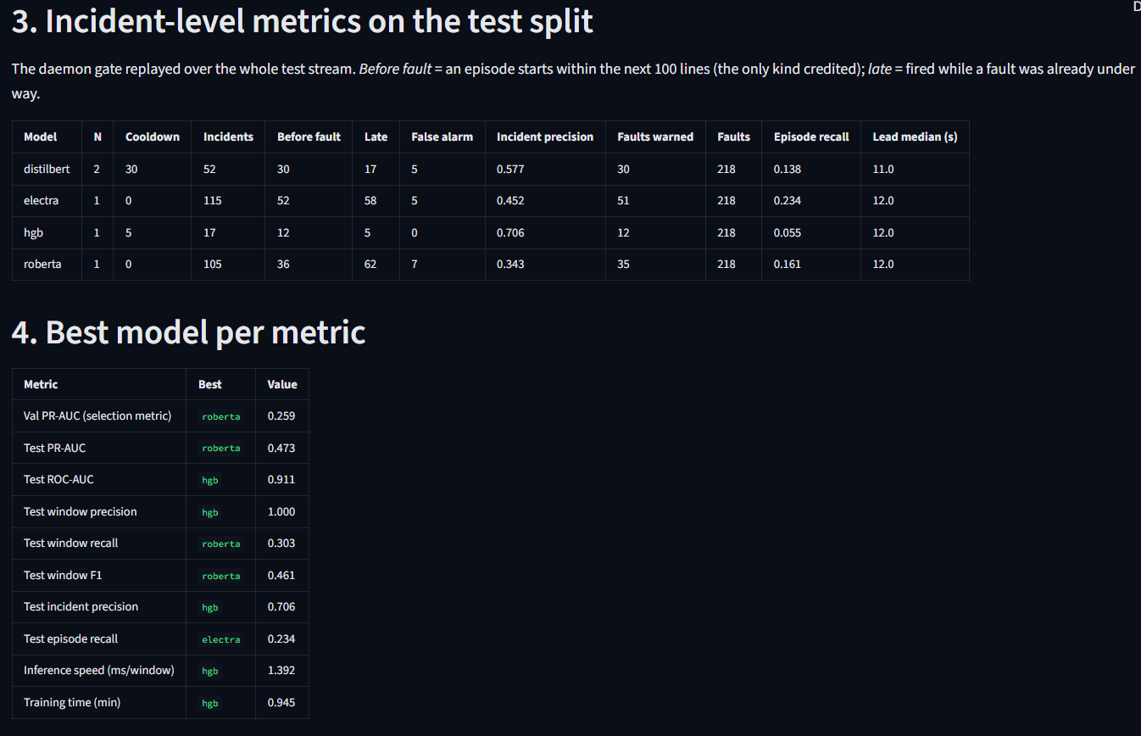
Screenshots (cont.)
Model comparison: window-level metrics on held-out test data
Model comparison: incident-level metrics and best model per metric

Slide 22
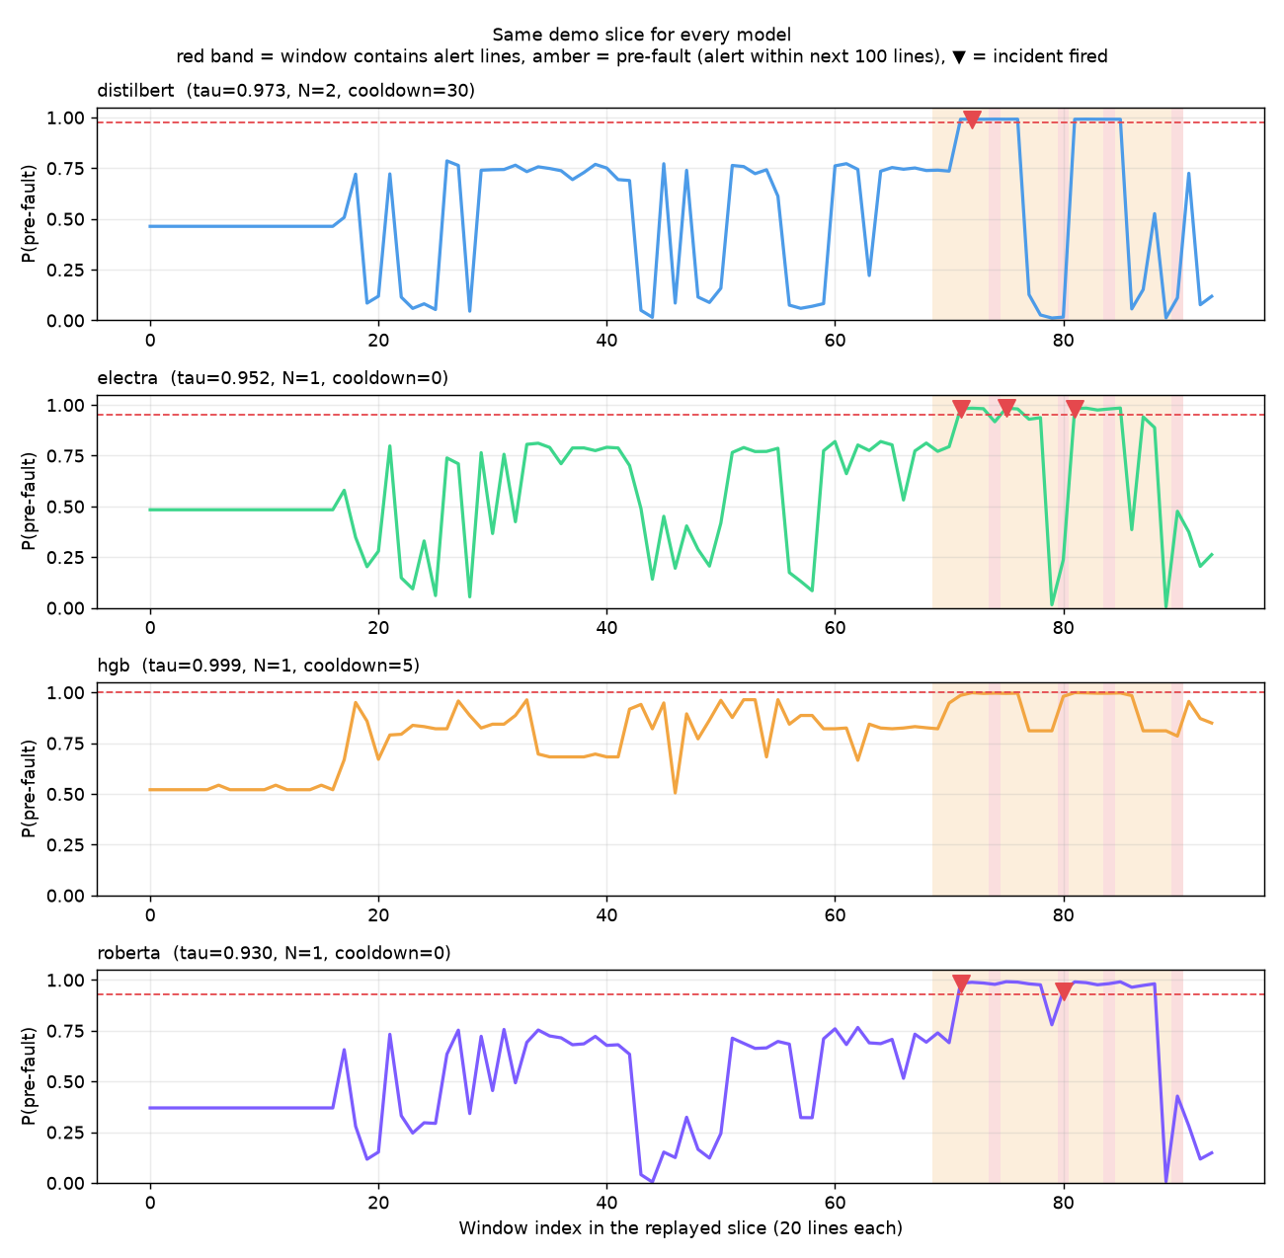
Screenshots (cont.)
All four models replaying the same held-out slice (evaluation view: bands mark where faults occurred)

Slide 23
What's next
1
Detector explainability
show which log lines pushed the confidence up
2
Drift monitor
flag when new, unseen message types start to dominate the stream
3
Incident correlation
link related incidents across nodes into one story
4
Live journalctl
run the daemon on a real Linux machine's system journal

Slide 24
Delivered
✓
✓
✓
✓
Public dataset
BGL system log from Loghub
Fine-tuned models
3 transformers fine-tuned on a 6 GB GPU
OS functionality
a daemon consuming a log stream
4 models compared
best one (RoBERTa) deployed
RoBERTa warns ahead of 35 faults on unseen data; 34% of its alerts arrive before the fault starts (incident-level).
Thank you

Slide 25
Backup: training setup
Model | Setup | Best epoch | Train time | Peak VRAM
RoBERTa | batch 8×4, lr 2e-05, max length 512, fp16 | 1 of 2 | 48 min | 3.7 GB
DistilBERT | batch 32×1, lr 5e-05, max length 512, fp16 | 1 of 2 | 24 min | 4.1 GB
ELECTRA | batch 8×4, lr 2e-05, max length 512, fp16 | 1 of 2 | 33 min | 3.5 GB
Gradient-boosted trees | 200 trees, lr 0.05, 596 features | - | 0.9 min | CPU only
Same data for every model
47,311 training windows; early stopping on validation PR-AUC; class weight 2 on pre-fault windows.

Slide 26
Backup: window vs incident precision
W1
W2
W3
W4
W5
W6
W7
W8
W9
W10
W11
W12
flagged windows (confidence ≥ τ) in amber
1 incident card
windows 3-6 are one episode
a new incident
only after the run breaks and the cooldown has passed
Window-level precision scores every flagged window; incident-level precision scores each alert an operator actually receives. Many flagged windows collapse into one alert.

