Slide 1

Apis Insight for Phenotype Classification and Hive Health Forecasting using IoT and Deep Learning
SRM INSTITUTE OF SCIENCE AND TECHNOLOGY
SCHOOL OF COMPUTING
DEPARTMENT OF COMPUTING TECHNOLOGIES
18CSP109L - MAJOR PROJECT
Student 1 Reg. No: RA2011003010231
Student 1 Name: TANYA SINGH
Student 2 Reg. No: RA2011003010228
Student 2 Name: RITVIK KUMAR SINGH
Guide name: Dr. Arulmurugan A
Designation: Assistant Professor Department: Computing Technologies

Slide 2
Abstract
This project features image recognition technology for individual bee health, subspecies identification, and pollen type prediction along with beehive assessment with live monitoring.
User-friendly interface with distinct webpages for bee and beehive analyses along with real time monitoring.
Real-time analysis and instant feedback through integration of deep learning .
Empower beekeepers with tools for informed decision-making in hive management and contribute to bee conservation efforts, fostering biodiversity and meeting Sustainable Development Goals.
Addressing the imminent threat of CCD to pollination services and agricultural ecosystems and enable beekeepers to monitor and manage the hive.
Develop and compare various models for image recognition and analysis as well as temperature and humidity detection levels within the beehive for comprehensive assessment.

Slide 3
Introduction
Colony Collapse Disorder (CCD) poses a significant threat to the global bee population, with profound implications for agriculture and ecosystems. In the context of the beekeeping industry in India, this project emerges as a cutting-edge solution to address the challenges associated with CCD. By harnessing the power of image recognition and deep learning and provides a user-friendly platform for the assessment of individual bee health, subspecies identification, and prediction of the types of pollen a bee can carry.
The project consists of two distinct webpages, each catering to a specific aspect of beekeeping. The first webpage allows users to upload images of individual bees, wherein advanced algorithms analyze the features to provide insights into the bee's health, subspecies, and potential pollen types. The second webpage is dedicated to the assessment of beehive health based on uploaded images. This comprehensive approach enables beekeepers to monitor and manage their colonies effectively as well as monitor the beehive temperature.
This project can act as vital tool for beekeepers and researchers working towards mitigating the impact of CCD. This project aims to empower beekeepers with the knowledge and tools necessary to make informed decisions for the well-being of their colonies, ultimately contributing to the conservation of bee populations and the sustainability of ecosystems in India.

Slide 4
Motivation
Conservation Impact: Promote the well being of individual bees contributes to overall conservation of bee populations as well as empowering beekeepers with actionable insights to enhance hive management.
Sustainable Agriculture: Supporting pollination ensures sustainable agricultural practices and increased crop yields as well as aligning efforts with global initiatives for a greener, more sustainable future.
Educational Outreach: Fostering awareness and education about the importance of bees and their role in ecosystems and inspiring communities to actively participate in bee conservation efforts.
Technological Innovation: Utilizing advanced image analysis, our system assesses the health of individual bees based on uploaded images as well as real-time data from Arduino sensors provide live updates on beehive temperature and humidity conditions.
Data-Driven Decisions: Harnessing technology to collect and analyze data enables informed decisions for bee health management as well as facilitating early intervention in cases of diseases or adverse environmental conditions.

Slide 5
Literature Review
S.No.\ | Author Name | Title of the Paper | Journal Name/Year | Merits | Demerits
1 | Mohammed Torky | Recognizing Beehive’s health Abnormalities Based on Mobile Net Deep Model | International Journal of Computational Intelligence Systems - April 2023 | Descriptive Knowledge Performance Enhancement Optimized Model | Expensive Setup Time taking Research Foreign Dataset
2 | Alan Dorin | A framework for better sensor-based beehive health monitoring | Computers and Electronics in Agriculture - July 2023 | Sensor assisted hive monitoring Cost efficiency Adaptability | Lack of Operational Monitoring Ambiguous Accuracy
3 | Ahmed A. Elngar | Image Classification Based On CNN: A Survey | ResearchGate - July 2021 | Diversity in algorithms Good versatility | Very expensive setup High Complexity

Slide 6
Challenges and Limitations in Existing System
Smart Beekeeping Monitoring system for beekeepers in India
-> Features a live sensor in order to detect bee swarming activities.
-> Studies invasion of foreign species in beehives.
-> Requires expensive hardware suite and constant monitoring for devices.
Design and Implementation of Sustainable Smart Beehive Monitoring
-> Features simple theoretical study for Beehive Monitoring.
-> Specific to Apic cerana Indica bee species only.
Monitoring Energy Efficiency in India through Energy Efficiency Indicators
-> Collaborative research work between government bodies.
-> Analyses various aspects on various flora and fauna diversity.
-> Comprehensive study into bee swarming activities.

Slide 7
Objectives
The problem statement of this project is to study the global decline of the bee population, exacerbated by factors such as Colony Collapse Disorder(CCD), which in turn pose a significant threat to ecosystems and food security. This project aims to focus on the vital role of bees in the environment as pollinators and aim to increase awareness about bees by technology driven approach of incorporating a web application and machine learning model.
The objectives of the project are as follows:-
Develop an innovative web-based platform addressing various bee parameters and performing analysis on beehive.
Employ image recognition analysis and deep learning using various models for precise predictions.
Tackle the critical issue of Colony Collapse Disorder (CCD) in the Indian beekeeping sector.
Bring into spectrum, the Indian ecological flora and fauna and help in conservation of indigenous bee species for sustainability.
Using IoT in order to perform live time monitoring using Arduino and DHT sensors.

Slide 8
Innovation Idea of the Project
Integrated Image Analysis: Employ advanced computer vision algorithms for precise assessment of individual bee health and identification of subspecies based on uploaded images and enhancing accuracy in detecting diseases, abnormalities, and subspecies characteristics to tailor interventions accordingly.
Beehive Health Imaging: Develop an image recognition system capable of evaluating the overall health of beehives through uploaded images and enable beekeepers to remotely monitor hive conditions, identifying potential threats and implementing proactive measures.
Arduino Sensor Integration: Integrate Arduino sensors to monitor real-time temperature and humidity conditions within beehives and establish a live data feed for immediate analysis, allowing beekeepers to respond promptly to environmental changes and optimize hive conditions.
User-Friendly Web Interface: Design an intuitive and user-friendly web interface for seamless image uploads, data visualization, and comprehensive bee health reports and ensure accessibility for both beekeepers and researchers, fostering widespread adoption and data-driven decision-making.
Data-Driven Conservation Strategies: Aggregate and analyze collected data to identify patterns and trends in bee health, subspecies distribution, and hive conditions.

Slide 9
Scope and Application of the Project
Individual Bee Health Monitoring: Provide beekeepers with a tool to assess the health of individual bees, enabling early detection of diseases and abnormalities.
Subspecies Identification: Assist beekeepers in identifying different subspecies, aiding in breeding programs and targeted hive management.
Optimized Hive Management: Improve efficiency and productivity in commercial pollination services by ensuring the health and well-being of bees in large-scale operations.
Data-Driven Decision-Making: Enable data-driven decisions for resource allocation, leading to enhanced pollination outcomes.
Arduino Sensor Integration: Integrate Arduino sensors to monitor live temperature and humidity conditions within beehives and establish a real-time data feed for continuous monitoring, allowing beekeepers to respond promptly to environmental changes and optimize hive conditions.
IoT Communication Protocols: Implement efficient communication protocols for seamless data exchange between the image recognition system, Arduino sensors, and the web interface.

Slide 10
Proposed Architecture
The proposed system for the project is an integrated web application that employs deep learning and real time interactivity.
User Interface: User uploads an image of the bee using Predict function
Flask Module: Flask Module routes the GET Request to the DL Module and returns the Pollen type, subspecies, health of the bee additionally it features a web page that on uploading the image of beehive predicts the status of beehive.
DL Module: Does preprocessing and image analysis on the provided image and performs feature extraction.
H5 file: All the consolidated findings are compiled in an H5 file format and stored to contain the analysis on training and testing data.
JSON Conversion: H5 file is considered into JSON Format to route to flask module.
Arduino Module: Features DHT11 sensor for live temperature and humidity detection

Slide 11
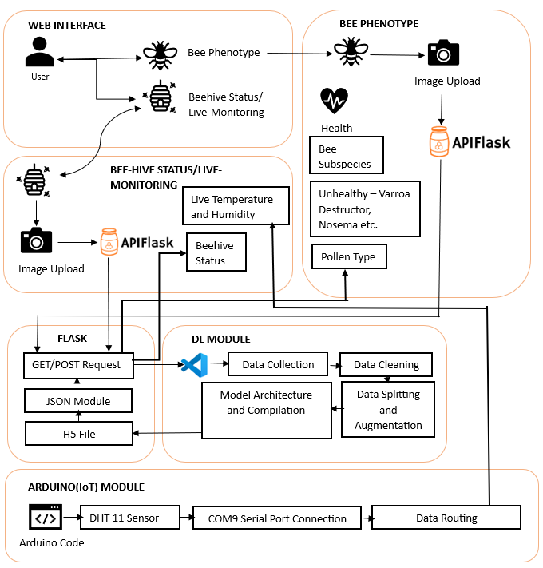
Architecture Diagram

Slide 12
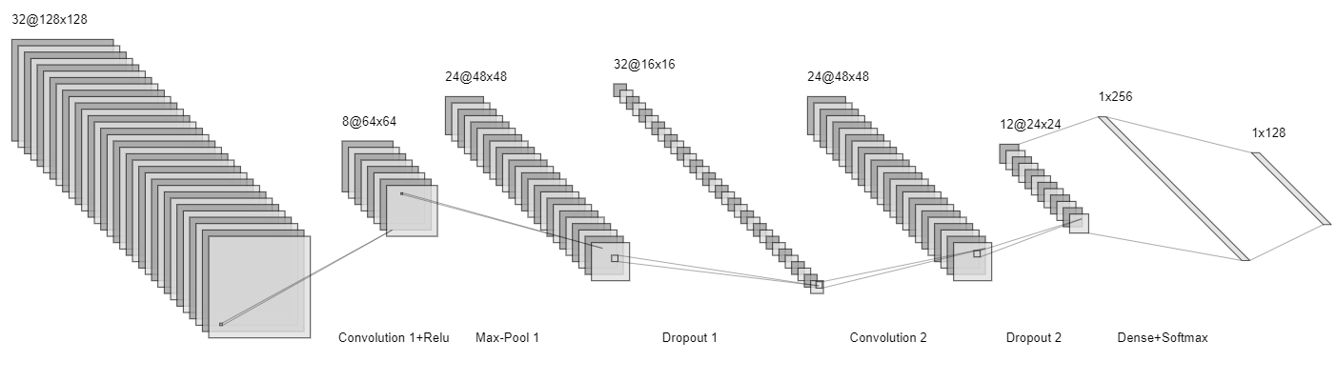
Architecture Diagram

Slide 13
Proposed Modules
Dashboard and User Interface Module: This module provides the user interface for uploading bee images and receiving predictions.
Image Upload and Inference Module: This module is used to process user-uploaded bee image and obtain new predictions.
Deep Learning Module: This module defines and trains the deep learning model for bee attributes classification.
Bee attributes and Beehive Assessment Module: This module defines the species, health, category of pollen of the uploaded bee images and assess the bee image using different attributes like contrast, normalization of values and various gray level transformations.
Arduino Sensor Module(IoT): This module is used for live temperature and humidity conditions of the beehive.
Flask Module: This module is used as Web server for routing the requests.

Slide 14
Algorithm Description
1) Mobile Net Deep Learning Model:-
MobileNet relies heavily on depthwise separable convolutions, which split the standard convolution into two separate operations: depthwise convolution and pointwise convolution.
The primary goal of MobileNet is to provide an efficient and compact architecture suitable for mobile and embedded devices with limited computational resources.
MobileNet architecture typically includes depthwise separable convolutions, inverted residuals, linear bottlenecks, global average pooling, fully connected layers, activation functions, normalization layers, and optional skip connections.
2) Sequential Model:-
The Sequential Model in Keras is a linear stack of layers, allowing for the easy construction of neural networks by adding one layer at a time in a sequential manner.
The Sequential Model is suitable for straightforward linear stack architectures, but it may not be sufficient for more complex models with multiple inputs or shared layers.
3) Arduino DHT:-
DHT sensors come in various versions, such as DHT11, DHT21, and DHT22, and they can measure both humidity and temperature.
The DHT library supports various DHT sensor models, including DHT11, DHT21, and DHT22. Different sensor models may have different levels of accuracy and capabilities.

Slide 15
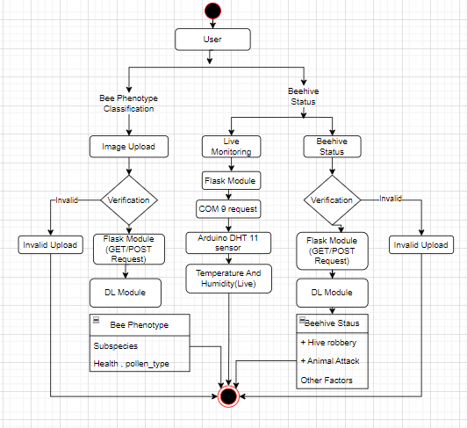
UML Diagrams
1) Activity Diagram

Slide 16
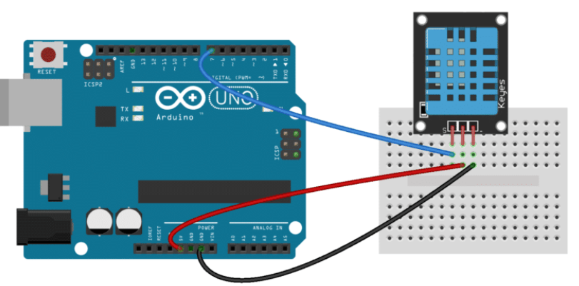
UML Diagrams
2) Arduino Architecture

Slide 17
Demo
#include "DHT.h"
#define DHTPIN 4// you can use
#define DHTTYPE DHT11//#define DHTTYPE DHT21
//#define DHTTYPE DHT22
DHT dht(DHTPIN, DHTTYPE);//you can also use pins 3, 4, 5, 12, 13 or 14
// Pin 15 can work but DHT must be disconnected during program upload
#include <LiquidCrystal_I2C.h>
LiquidCrystal_I2C lcd(0x27, 16, 2);
void setup() {
dht.begin();// initialize the sensor
lcd.backlight();// turn on lcd backlight
lcd.init();// initialize lcd
}
void loop() {
lcd.clear();
lcd.setCursor(0,0);// set the cursor on the first row and column
lcd.print("Humidity=");
lcd.print((float)dht.readHumidity());//print the humidity
lcd.print("%");
lcd.setCursor(0,1);//set the cursor on the second row and first column
lcd.print("Temp=");
lcd.print((float)dht.readTemperature());//print the temperature
lcd.print("Celsius");
delay(2000);
lcd.clear();
}

Slide 18
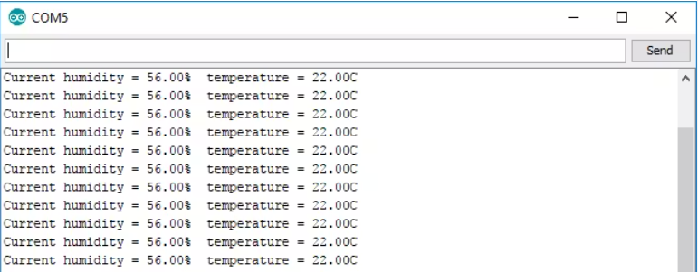
Demo
#include <dht.h>
dht DHT;
#define DHT11_PIN 7
void setup(){
Serial.begin(9600);
}
void loop(){
int chk = DHT.read11(DHT11_PIN);
Serial.print("Temperature = ");
Serial.println(DHT.temperature);
Serial.print("Humidity = ");
Serial.println(DHT.humidity);
delay(2000);
}
//Arduino Code

Slide 19
Demo
# Data augmentation
generator = ImageDataGenerator(
rotation_range=180,
zoom_range=0.1,
width_shift_range=0.2,
height_shift_range=0.2,
horizontal_flip=True,
vertical_flip=True
)
generator.fit(train_X)
earlystopper = EarlyStopping(monitor='val_accuracy', patience=25, verbose=1)
checkpointer = ModelCheckpoint('best.h5',
monitor='val_accuracy',
verbose=1,
save_best_only=True,
save_weights_only=True)
# Load MobileNet base model without top (fully connected) layers
base_model = MobileNet(input_shape=(img_width, img_height, 3), include_top=False, weights='imagenet')
# Freeze the layers of the base model
for layer in base_model.layers:
layer.trainable = False
# Create your own model on top of MobileNet
model = Sequential()
model.add(base_model)
model.add(GlobalAveragePooling2D())
model.add(Dense(128, activation='relu'))
model.add(Dropout(0.5))
model.add(Dense(train_y.columns.size, activation='softmax'))

Slide 20
References
[1] Fei-Fei, L., Karppaathy, AL., Leung, T., Sharma, L., Sukthankar, R., & Loderici, G. (2021). IEEE Conference on Computer Vision Pattern Recognition Research(citation 80 time, HIC: 25 , CV: 110).
[2] M. Elissa., Laragatham, G., Sundaramoorthy, K., Mahheswari, K., Sajna, and Kumar, A., 2023, January. The Prediction Architecture Using ML. In 2023 International Conference on Artificial Intelligence and Knowledge Discovery in Concurrent Engineering (ICECONF) (pp. 1-6).IEEE.
[3] Jaayapraddha J. IEEE Conference on “Dissertation on hive wood types honey bee Apis Cerana Indica(Indian Honey Bee)” June 2022 pp 442-445
[4] Food and Agricultural Org. of the UN. (June 21, 2021). FAO—News Article: Bees Protection must for the Future of food security. Accessed: Oct 23,2023.[Online]. “Fine particles, thin anisotropy,” in Magnetism, vol. III, G. T. Rado and H. Suhl, Eds. New York: Academic, 2021, pp. 271–350.
[5]Jayapradha J. IEEE Conference on “Evalution of hive wood types honey bee Apis Cerana Indica” June 2022 pp 442-445
[6]European Commission. (Jan. 2015). Final Report Summary—STEP (Status and Trends of European Pollinators) | Report Summary | STEP | FP7. Accessed: Oct. 21, 2020. [Online].
[7]Erdoğan Y. Comparison of colony performances of
honeybee (Apis mellifera L.) housed in hives made of
different materials. Italian Journal of Animal Science.
2019.

Slide 21
Questions?

