Slide 1
AUTOMATIC LIGHT-POST HEALING SYSTEM
Embedded Systems Design Project
Ritvik Anish
Akshaya N

Slide 2
Problem Statement
Traditional street lighting systems lack fault intelligence.
  Single lamp failure can disrupt entire street segments.
  Manual detection causes delayed maintenance.
  Increased downtime and public safety risks.
  Need for autonomous fault detection and recovery.

Slide 3
Objectives
Design intelligent street lighting system.
  Implement automatic fault detection.
  Ensure uninterrupted lighting.
  Reduce maintenance delays.
  Enable scalable smart-city integration.

Slide 4
Introduction
Smart cities require resilient infrastructure.
  Each light post acts as an intelligent node.
  Real-time monitoring of voltage and current.
  Automatic fault detection and isolation.
  Ensures uninterrupted lighting.

Slide 5
Components Required
ESP32 Microcontroller
Current Sensor (INA219 / ACS712)
Voltage Sensor Module
Relay / MOSFET Switching Circuit
LED Light Module – Street Light Models (3 Nos)
Backup Battery
WiFi Module (Optional)

Slide 6
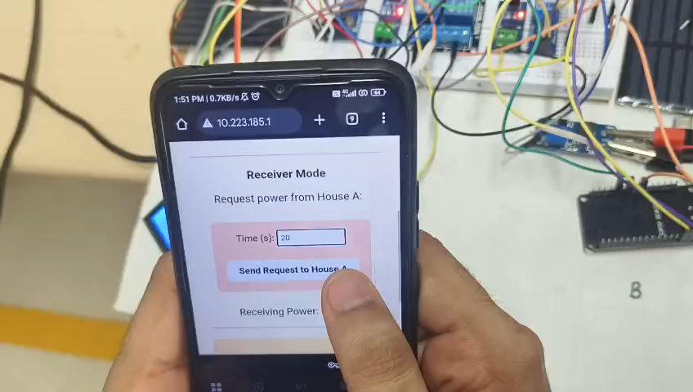
Inspiration

Slide 7
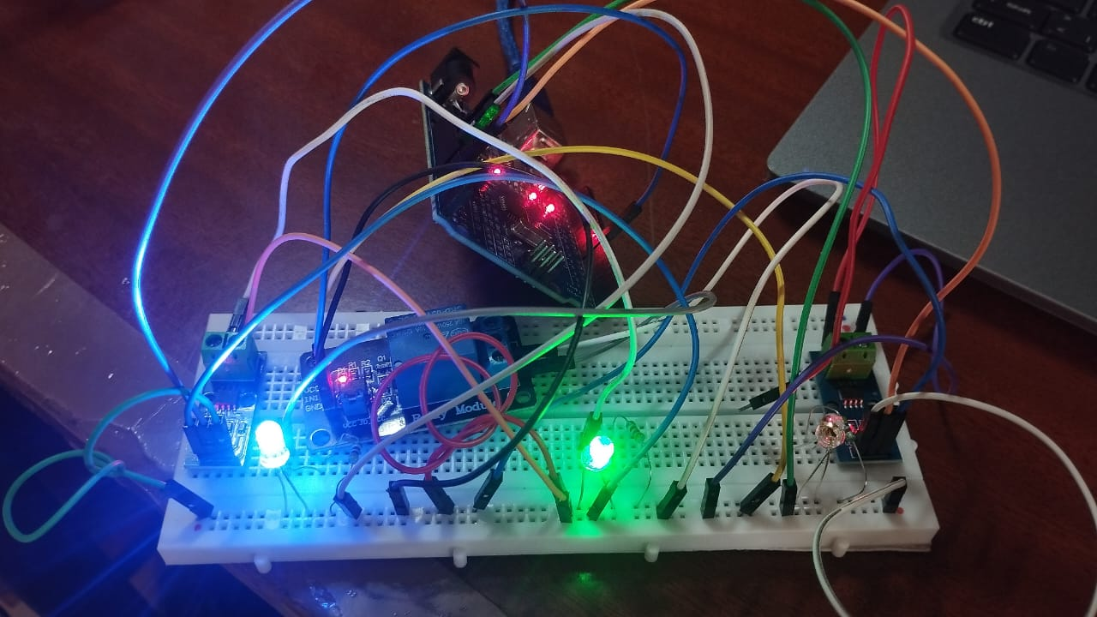
Hardware prototype

Slide 8
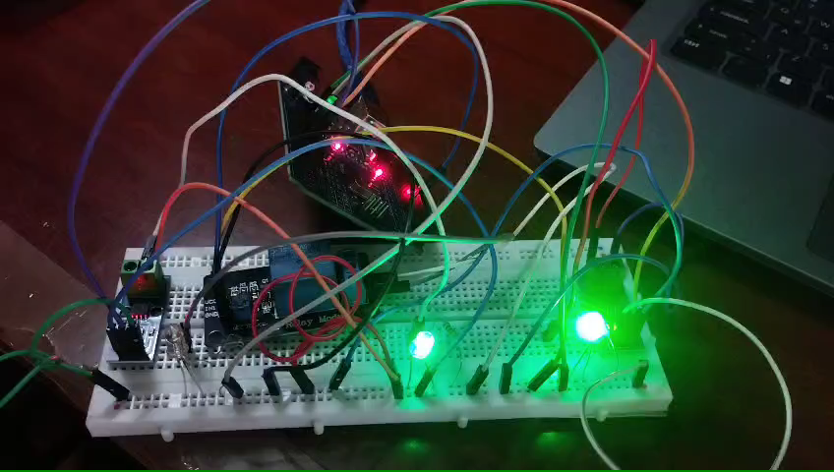
Working model

Slide 9
Proposed Work
Scaled-down hardware prototype with 3–5 nodes.
  Fault detection and isolation logic.
  Automatic power rerouting.
  Embedded firmware with watchdog reliability.
  Live fault demonstration.

Slide 10
Plan of Action
System planning and architecture design.
  Define failure scenarios.
  Component selection and procurement.
  Control logic flowchart development.
Hardware assembly of light nodes.
  Sensor integration.
  Embedded programming for fault detection.
  Relay control implementation.
  Testing communication module.

Slide 11
Testing & Demonstration
Normal operation testing.
  Single node failure simulation.
  Multiple failure testing.
  Measure detection & recovery time.
  Live healing demonstration.

Slide 12
Scope
Small-scale prototype network.
  Fault detection and recovery analysis.
  Performance metrics evaluation.
  Optional IoT dashboard integration.
AI-based predictive maintenance.
  Solar-powered autonomous poles.
  City-wide smart lighting integration.
  Centralized monitoring system.

