Slide 1
Problem Statement
In many real-world scenarios such as assistive robotics, industrial training, and human–robot collaboration, robotic arms must respond to human intent in real time. However, current control methods depend on fixed programming or wearable sensors, making interaction unnatural and inflexible.
The problem is to design a computer-vision–based gesture-controlled robotic arm that can understand user-defined hand gestures and gesture sequences without physical contact or reprogramming, allowing rapid task adaptation and intuitive robot control.

Slide 2
Literature Survey
Recent research in vision-based gesture control has increasingly focused on enabling natural and intuitive human–robot interaction without wearable sensors. Angelidis and Bampis (2025) developed a gesture-controlled robotic arm for small assembly lines by mapping 3D joint estimates from RGB-D cameras to robot poses, highlighting the potential of AI-based vision systems in industrial contexts.
A comprehensive review by Qi et al. (2023) details vision-based hand gesture recognition methods for human–robot interaction, emphasizing the importance of hand detection, segmentation, and classification as fundamental components of effective control systems.
Paterson and Aldabbagh (2021) demonstrated a practical implementation of a vision-controlled robotic arm using OpenCV and a single camera, showing how visual gesture recognition can replace physical controllers in real-time robotic manipulation.

Slide 3
Objectives
Develop a real-time computer vision system to detect and track human hand gestures
Map recognized gestures and sequences to high-level robotic actions
Enable adaptive robot behaviour based on gesture order and context
Execute actions with minimal latency using an embedded controller
Maintain a modular architecture separating vision, logic, and actuation

Slide 4
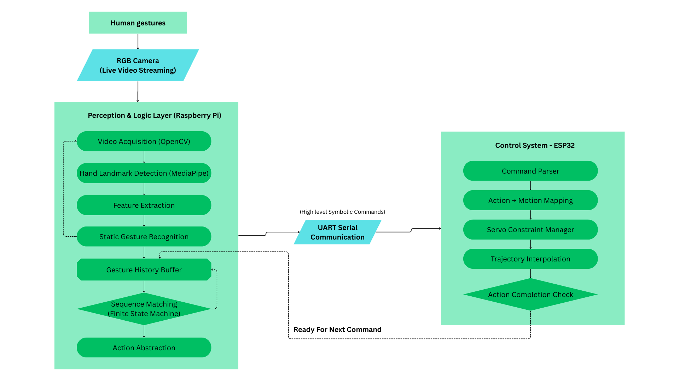
Proposed Methodology

Slide 5
Working progress
Components:
Camera (Webcam / CSI Camera) for image capturing and gestures.
Raspberry Pi handles computationally intensive perception and decision-making, while ESP32 ensures deterministic real-time actuation, PWM control and Bluetooth handling.
For video acquisition, we integrate OpenCV software with Media pipe, which extracts gesture control modules to help in recognition patterns.
The gesture recognition and sequencing logic depends of the FSM integrated and the corresponding gesture buffer.
UART/ USB Serial Communication between Raspberry Pi and ESP32 making it simple and reliable.
Reliable Servo motors (SG90/ MG996R) for robotic joints or entire 3d-printed or ready-made body of robotic arm.
External power supply like a battery (5V, 5-10 A) or SMPS is required to ensure no current is taken from the microcontrollers

Slide 6
Timeline
Work | Date
Background Study and Tool Familiarization – OpenCV and Media Pipe | Dec 25 – Jan 26
Gesture Analysis and Control Strategy Design | Jan 26
System Architecture and Block Diagram Design | Jan 26
Software Development – Vision and Logic Layer | Jan 26 – Feb 26
Component Selection and Procurement | Feb 26
Hardware Integration and Embedded Control | Feb 26 – March 26
Testing, Calibration, and Validation | March 26

