Slide 1




REGENERATIVE BRAKING SYSTEM USING 3-PHASE IINDUCTION MOTOR
-A HARDWARE MODEL DEMONSTRATION

Slide 2

01
02
03
OBJECTIVE
COMPONENTS
WORKING
PRINCIPLE
OVERVIEW
04
05
06
FLOWCHART
CONCLUSION
TEAM

Slide 3
The project's objective is to build a hardware model demonstrating regenerative braking in a 3-phase induction motor, showing its ability to convert kinetic energy into usable electrical energy.
01
PROJECT
OBJECTIVE

Slide 4



SHOW POWER REVERSAL
The main goal is to show the motor's power flow reversing. We'll use a meter to prove that the motor takes power to run and then sends it back to the power supply when braking.
01
USE A VFD
TECHNICAL
GOALS
A Variable Frequency Drive (VFD) is key. It lets us control the motor's speed and initiate braking on command by adjusting its output frequency.
DISPLAY KEY DATA
The model will include a display to show important data like the motor's speed and the direction of power flow, providing clear evidence of the braking process.

Slide 5

  3-Phase Induction Motor: A small-scale, low-power motor (e.g., 0.25 HP or less) to represent the system.
  Variable Frequency Drive (VFD): This is the most critical component, as it controls the motor's speed and enables regenerative braking by varying the output frequency. The VFD must be a regenerative type or have a built-in braking resistor to handle the back-fed energy.
  3-Phase Power Supply: A suitable power source for the VFD and motor.
  Mechanical Load: Something to attach to the motor's shaft to simulate an external force or inertia.
  Microcontroller: (e.g., Arduino or Raspberry Pi) to control the VFD, manage sensor inputs, and display data.
  Current and Voltage Sensors: To measure the power flowing to and from the motor. A
  bi-directional energy meter is highly recommended.
  Speed Sensor: A tachometer or Hall effect sensor to measure the motor's rotational speed.
  Display: An LCD screen or a simple LED display to show key parameters like motor speed, power consumption, and power return.
02
KEY
COMPONENTS

Slide 6
03
WORKING PRINCIPLE
  The model demonstrates regenerative braking by showing a 3-phase induction motor acting as a generator.
  The project uses a Variable Frequency Drive (VFD) to control the motor.
  To initiate braking, the VFD rapidly reduces the frequency of the electricity it's providing.
  This makes the motor's actual speed faster than the new, lower synchronous speed.
  When this happens, the motor's role flips: it stops consuming power and starts generating it.
  The kinetic energy from the motor's rotation is converted back into electrical energy and sent through the VFD, which feeds it back to the power supply.
  A bi-directional energy meter is used to visually prove this. It shows positive power flow when the motor is running and negative power flow when it's braking, confirming that energy is being regenerated.

Slide 7
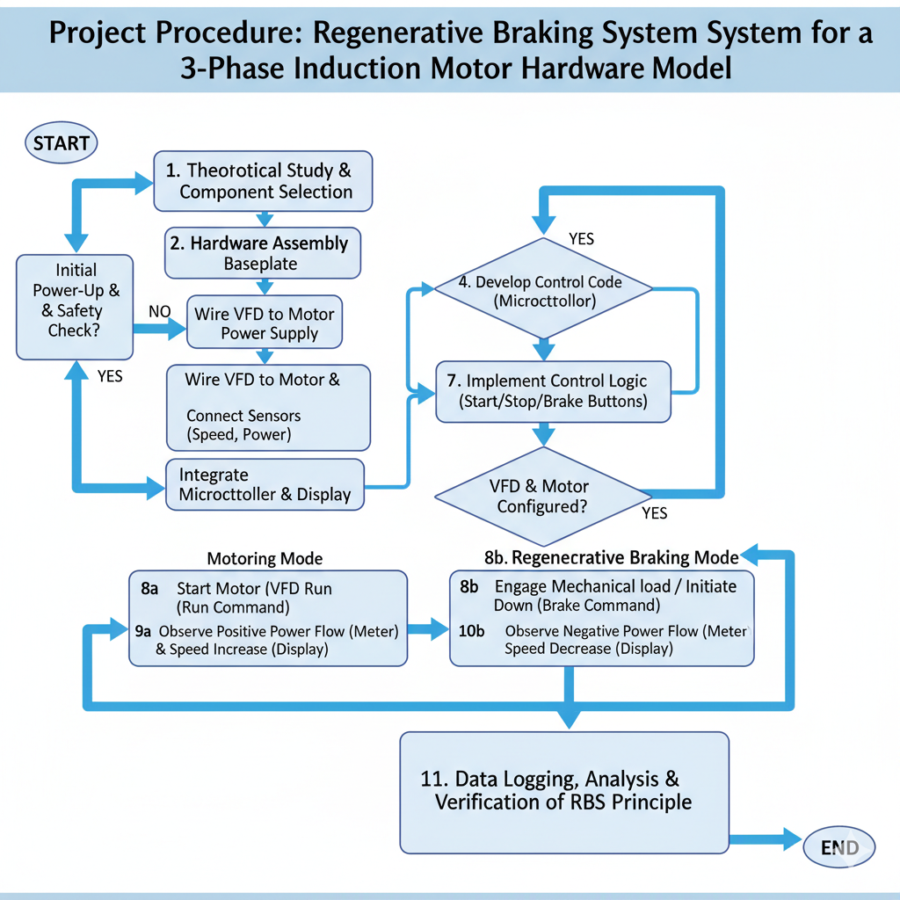
04
FLOWCHART: PROJECT IMPLEMENTATION

Slide 8
05
CONCLUSION
01
The project successfully demonstrates the principle of regenerative braking in a 3-phase induction motor.
02
  It provides a tangible model that proves the motor can function as a generator, converting kinetic energy back into electrical energy.

Slide 9
03
KEY TAKEAWAYS
  Energy Efficiency: Regenerative braking is a highly efficient method of deceleration, as it conserves energy instead of dissipating it as heat.
  Control with a VFD: The hardware model validates the critical role of the Variable Frequency Drive (VFD) in enabling controlled regenerative braking by manipulating frequency to force the motor into a generating state.
  Real-World Application: This project highlights the core technology used in electric vehicles, hybrid cars, and industrial applications like elevators and cranes, where braking energy can be recovered and reused.
  Educational Value: The model serves as an excellent educational tool, providing a clear visual representation of complex electro-mechanical principles, including slip and power flow reversal.

Slide 10

TEAM
SANJH YADAV - 23BEE1043
RITVIK ANISH - 23BEE1018
ADITHYAN D AJAY - 23BEE1009

