Slide 1
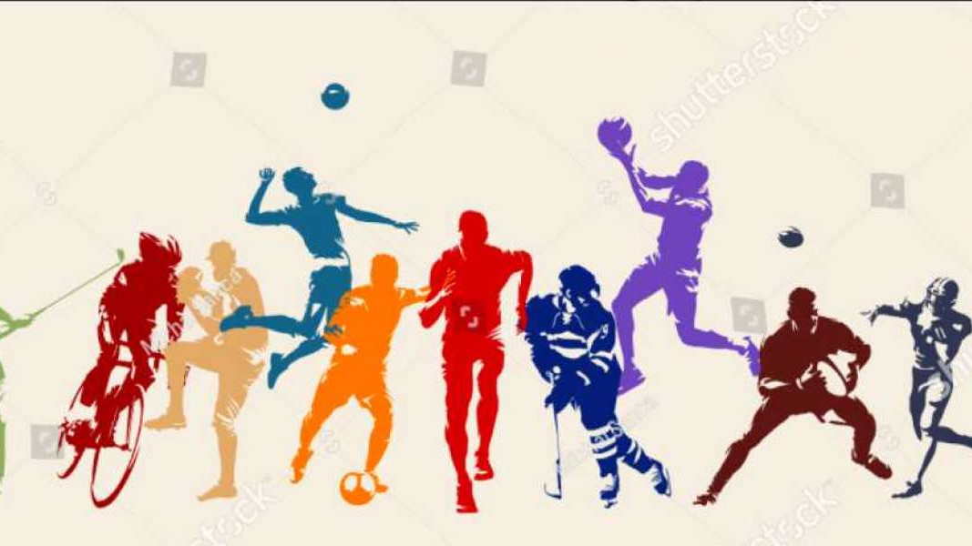
Sports Person Image Classifier

Slide 2
Introduction
Combining ML + CV + Web Dev
Using openCV managed various Computer vision for various tasks like:
Image preprocessing which involved resizing of the image
Normalizing
Augmenting the data to enhance the training set diversity and robustness
In the machine learning phase, I experimented with SVM, Random Forest, and Logistic Regression models, tuning their hyperparameters for optimal performance.
Evaluating the models involved assessing their accuracy and performance metrics to ensure the best outcomes.
Finally completed the work with flask server which is still in testing purpose.

Slide 3
Problem statement
Develop an automated sports celebrity recognition system using advanced computer vision and machine learning for real-time image classification and a user-friendly web application.

Slide 4
Objectives
Image Preprocessing: Implement robust image preprocessing techniques, including resizing, normalizing, and augmenting, to enhance the quality and diversity of the training dataset.
Model Training and Optimization: Experiment with and fine-tune multiple machine learning models, such as SVM, Random Forest, and Logistic Regression, to determine the best-performing model for sports celebrity image classification.
Performance Evaluation: Conduct thorough evaluation of the trained models using appropriate performance metrics to ensure high accuracy and reliability in predictions.
Real-Time Prediction: Develop a user-friendly web application using Flask that allows users to upload images and receive real-time predictions of the sports celebrity depicted in the image.
Seamless Integration: Ensure a seamless integration of computer vision, machine learning, and web development to provide an interactive and efficient user experience.

Slide 5
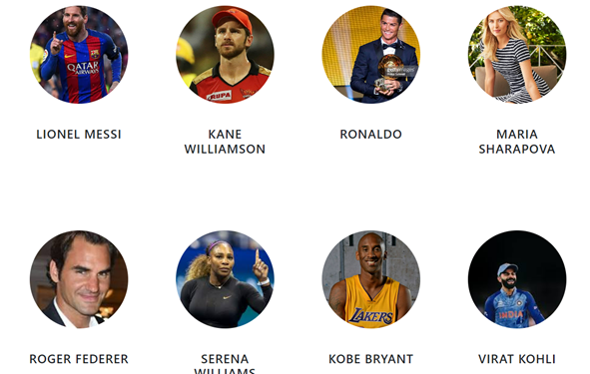
Dataset Description
Dataset is taken from:
Kaggle - https://www.kaggle.com/datasets/yaswanthgali/sport-celebrity-image-classification
Other resources
Hugging Face
Git

Slide 6
Sports Celebrity image Classifier
Flowchart
datasets
HaarCascades
Data Preprocessing
Data Cleaning
SVM
GridSearch
Logistic Regression
Random Forest
Evaluation

Slide 7
HaarCascades
HaarCascades are used for detecting faces, eyes, and various objects in images.
This method is highly efficient in identifying specific features within an image, making it ideal for tasks requiring precise object recognition.
By employing Haar cascades, we can accurately detect and focus on regions of interest, which significantly improves the quality and relevance of the data used for training our machine learning models.
Additionally, Haarcascades are widely utilized due to their robustness and speed, making them suitable for real-time applications.

Slide 8
Why not CNN only Haarcascades
I chose to use Haar cascades over CNNs for the initial face and eye detection stage primarily due to the following reasons:
Speed and Effciency
Simplicity
Resource Management
Historical performance

Slide 9
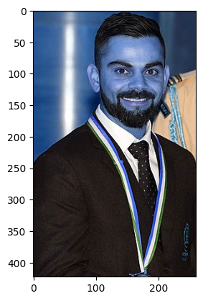
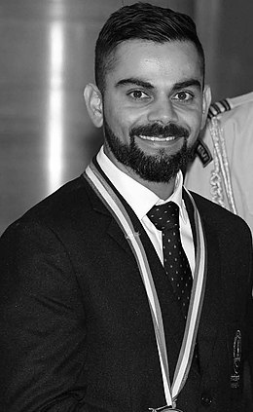
GrayScaling of Image converting an image from color to grayscale.

Slide 10
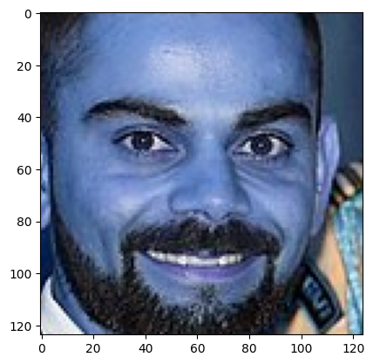
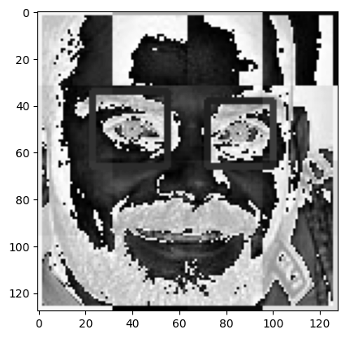
Differentiating all the facial features such as eyes nose and mouth etc.
Region of Interest
Wavelet Transformation

Slide 11
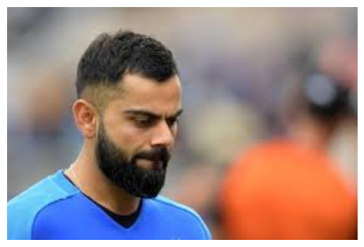
Preprocessing
Load image, detect face. If eyes >=2, then save and crop the face region
No eyes are matched from the previous images
Above image 2 eyes is None which means we should ignore this image and we will not use such image for model training

Slide 12
Data Cleaning
Made the folders automatically with some lines of code
Created a script to automatically generate the necessary folder structure for organizing the image dataset into main directories and subdirectories for different categories, ensuring consistency and efficiency.
Manually examine cropped folder and delete any unwanted images
Reviewed the automatically cropped images, identified and removed any misaligned or irrelevant images to maintain the quality of the dataset.

Slide 13
Grid Search
GridSearch is a technique used in machine learning for hyperparameter tuning.
It helps in finding the best combination of hyperparameters for a given model by exhaustively searching over a specified parameter grid.
This ensures that the model performs optimally by selecting the set of hyperparameters that results in the highest performance metric on the validation set.

Slide 14
Methods used
Linear Regression isn't used directly for classification but can assist with feature selection or reducing data complexity.
Random Forest is an ensemble method that captures patterns in image data, making it effective for distinguishing players.
SVM optimizes the margin between classes, enhancing accuracy by effectively separating different player categories.

Slide 15
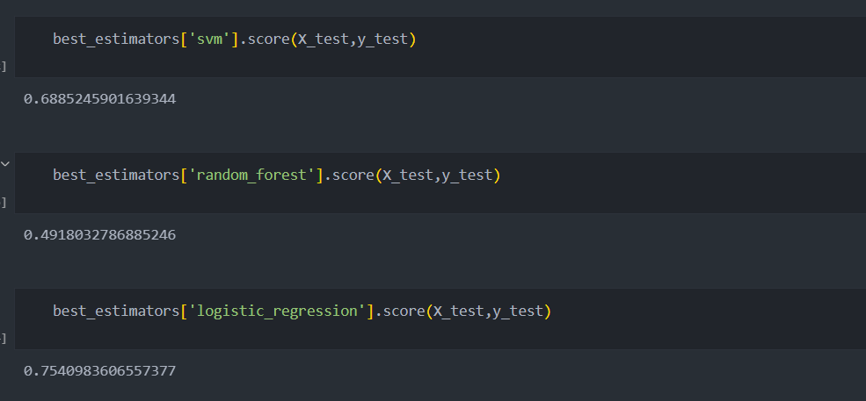
Outcomes for Gridsearch

Slide 16
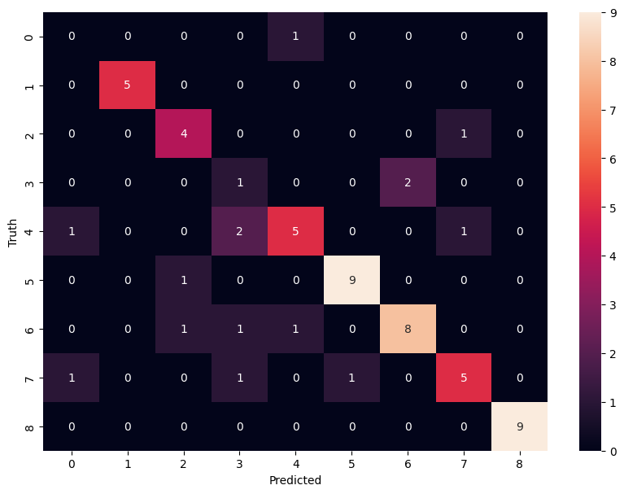
Confusion Matrix
Serena Williams (0):
Misclassified all instances. Not a single correct prediction.
1 misclassified as Cristiano Ronaldo (7).
Virat Kohli (1):
5 correct predictions.
No misclassifications.
Lionel Messi (2):
4 correct predictions.
1 misclassified as Cristiano Ronaldo (7).
Kane Williamson (3):
1 correct prediction.
2 misclassified as Maria Sharapova (5).
Roger Federer (4):
5 correct predictions.
2 misclassified as Lionel Messi (2).
1 misclassified as Serena Williams (0).
1 misclassified as Maria Sharapova (5).
Maria Sharapova (5):
9 correct predictions.
1 misclassified as Kane Williamson (3).
Kobe Bryant (6):
8 correct predictions.
1 misclassified as Lionel Messi (2).
1 misclassified as Kane Williamson (3).
Cristiano Ronaldo (7):
5 correct predictions.
1 misclassified as Serena Williams (0).
1 misclassified as Lionel Messi (2).
1 misclassified as Roger Federer (4).

Slide 17
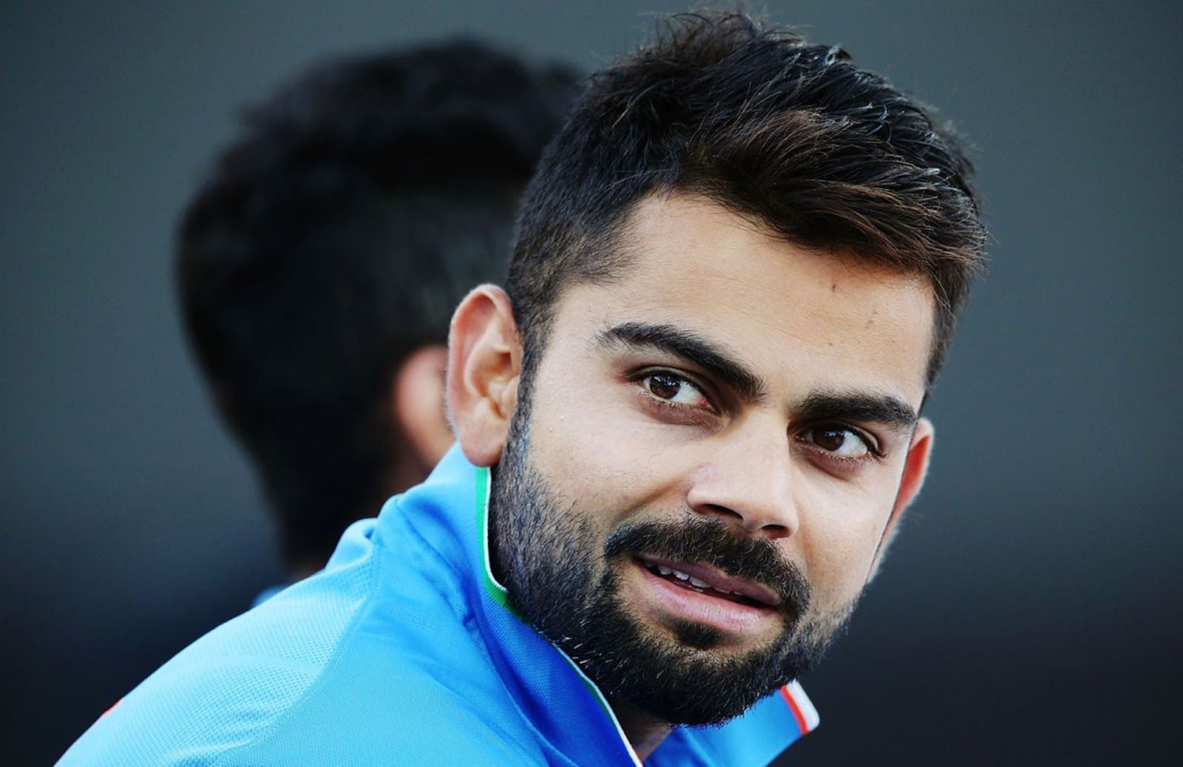
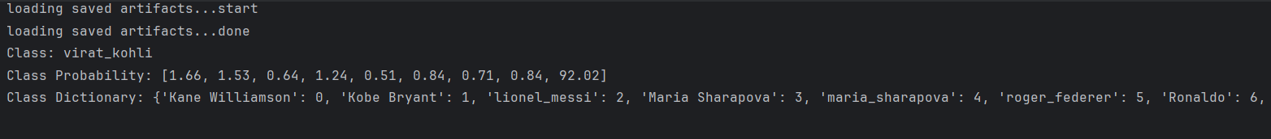
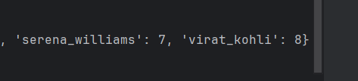
Results
This is the b64 decoded image

Slide 18


