Slide 1
VIDEO + MPEG
By Nandam Tejas
USN: 1MV18EC057
Sir MVIT

Slide 2
What is MPEG?
Full form – Moving Picture Expert Group.
Standard format for compressing and storing digital video and audio.
Any file use the MPEG format
It is an alliance of working groups of ISO and IEC that sets standards for media coding, including compression coding of audio, video, graphics and genomic data, and transmission and file formats for various applications.

Slide 3
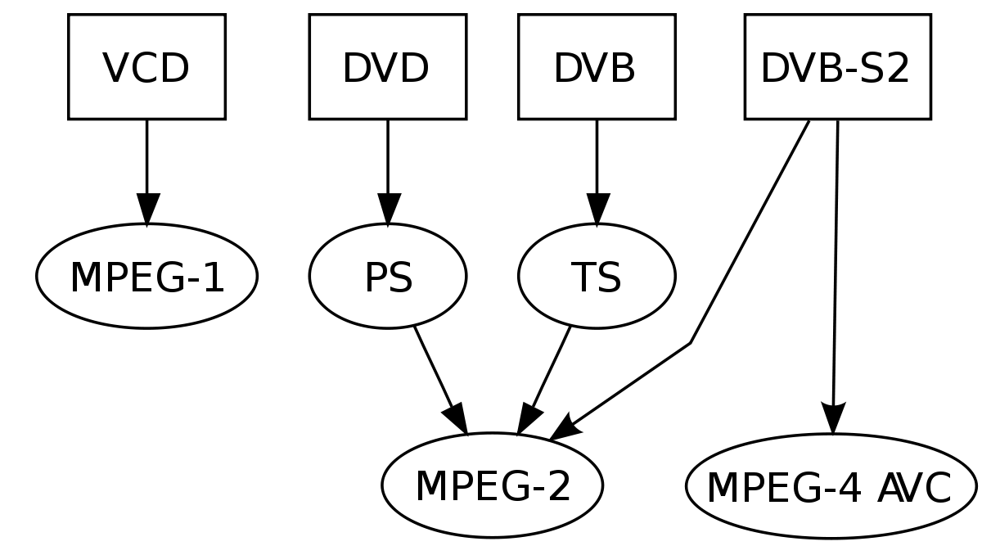
Standard Block Diagram of MPEG

Slide 4
Where MPEG is used?
MPEG formats are used in various multimedia systems.
The most well known older MPEG media formats typically use MPEG-1, MPEG-2, and MPEG-4 AVC media coding and MPEG-2 systems transport streams and program streams.

Slide 5
Examples of MPEG
MPEG-1 – Audio/video standards designed for digital storage media (such as an MP3 file). It provide a video resolution of 352-by-240 frames per second (fps). This produces video quality slightly below the quality of convenctional VCR videos.
MPEG-2 – Standards for digital television and DVD video. It offers resolution of 720x480 and 1280x720 at 60 fps with full CD quality. This is sufficient for all major TV standards, including NTSC and even HDTV. MPEG-2 is used by DVD ROM's. It can compress a 2 hour long video into few gigabytes.

Slide 6
Examples of MPEG
MPEG-4 – Multimedia standards for the computers, mobile devices, and the web. A graphic and video algorithm standard that is based on MPEG-1 and MPEG-2 and Apple QuickTime Technology. Wavelet-based MPEG-4 files are smaller than JPEG and QuickTime files, so they are designed to transmit video and image over a narrow bandwidth and can mix video with text, graphics and 2D and 3D animation layer
MPEG-7 – Standards for the description and search of multimedia content. Formally it can be called as Multimedia Content Description Interface. It provide a tool for describing multimedia content..
MPEG-MAR – A mixed reality and augmented reality reference model.

Slide 7
Examples of MPEG
MPEG-DASH – Which is also known as Dynamic Adaptive Streaming over HTTP (DASH) which is an adaptive bitrate streaming technique that enables high quality streaming of media content over the Internet delivered from conventional HTTP web servers. MPEG-DASH works by breaking the content into a sequence of small segments, which are served over HTTP. Each segment contains a short interval of playback time of content that is potentially many hours in duration, such as a movie or the live broadcast of a sports event. The content is made available at a variety of different bit rates, i.e., alternative segments encoded at different bit rates covering aligned short intervals of playback time. While the content is being played back by an MPEG-DASH client, the client uses a bit rate adaptation (ABR) algorithm^{[1]} to automatically select the segment with the highest bit rate possible that can be downloaded in time for playback without causing stalls or re-buffering events in the playback

Slide 8
Examples of MPEG
MPEG-21 – Unlike other MPEG standards that describe compression coding methods, MPEG-21 describe a standard that defines a description of content and also processes for accessing, searching, storing and protecting the copyrights of content.

Slide 9
File extensions formats used in MPEG
.MP3
.MP4
.M4V
.MPG
.MPEG
.MPE

