Slide 1

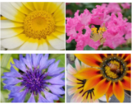
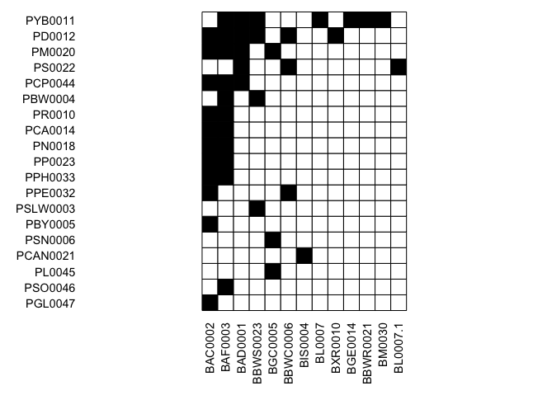
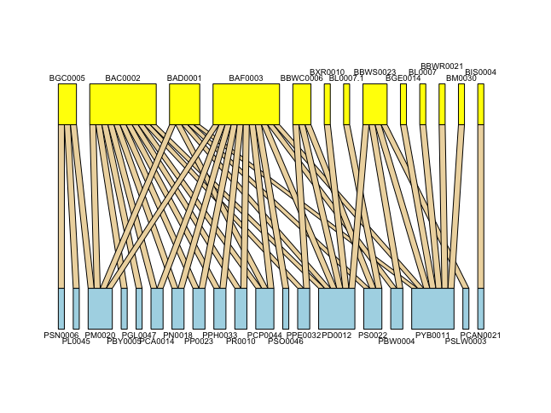
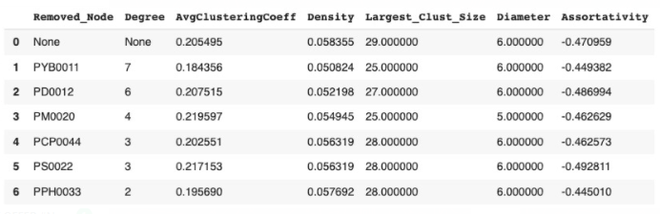
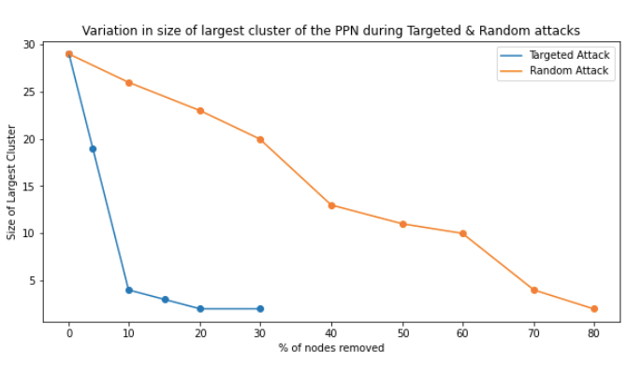


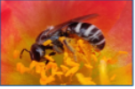
INVESTIGATING RESILIENCE OF A PLANT-POLLINATOR NETWORK IN A TROPICAL URBAN ECOSYSTEM
Bhavik Agarwal, Ritvik Gupta, Dr. Swapna R. Purandre (Advisor)
Indraprastha Institute of Information Technology, Delhi
Introduction
Methodology
Intellectual Merit
Plant Pollinator Interactions are mutualistic in nature. Insect pollinators depend on nectar and pollen from plants for food while plants rely on the pollinators for reproduction via pollination. A plant-pollinator network (PPN) is a bipartite nested network composing many such plant-pollinator interactions. The interactions only exist between two distinct, non-overlapping sets i.e. the plants and the animals. Our goal is to explore the consequences of random and targeted attacks (removal of hubs) on the network. We will further analyse the network by studying the change in network properties such as degree density, diameter, size of the largest cluster, assortativity, etc. from the original network structure by removing plant nodes . We will study if the PPN follows the properties that other scale-free Networks or random Networks follow ( like WWW, Internet, etc.). Our study will help in understanding the stability and resilience of this plant-pollinator network after the attacks.
Adjacency Matrix: We created an adjacency matrix with plant species as rows and bee species as columns. We used a ‘1’ to indicate an interaction between the species and a ‘0’ to indicate no interaction.
(refer to Fig. black is ‘1’ and white is ‘0’)
Graph: We used Python modules - networkx and
matplotlib to create a bipartite graph from the interactions in the adjacency matrix. We generated unique IDs for each plant and bee species and included a legend along with the graph mapping each of the IDs to the corresponding name of the plant/bee species name.
Insect pollinators play a vital role in the sustainability of ecosystems by pollinating and regenerating flowering plants. However, insect pollinators are declining rapidly due to human-induced factors such as the use of pesticides and changes in land use. Our research investigates the interactions between plants and bees using a network analysis approach. Our findings can be used to design strategies for the conservation of the pollinator species and the plants they pollinate.
Fig. 3: Plant-bee network: yellow nodes are bees and blue nodes are plants
Fig. 2: Adjacency Matrix representing
interactions between plants and bees
Future Work
Results
We plan to explore other network properties such as robustness, interaction strength, specialization, degree of complementary specialization etc.
We plan to expand the network to include more species of plants and pollinators to create a more complex mutualistic network.
Modelling of cascading effect of extinctions in the network
Data
We collected over 500 images of plant-bee interactions (30 plants and 26 bee species) to create a bipartite plant-bee network in a tropical urban ecosystem.
Fig. 5: Properties after removing plants one at a time
Fig.6: Variation in cluster size
After performing targeted attacks and random attacks on PPN, we find that the network disintegrates much faster in case of targeted attacks, while it disintegrates a lot slower in case of random attacks. It takes just 5% of targeted node deletion for the PPN to disintegrate completely, while it requires over 80% of random node deletions to disintegrate the whole network.
We found the assortativity coefficient of the network to be -0.47, which indicated that the network is disassortative in nature, a property that’s observed in many of the other biological networks.
When we observed network properties by taking out every plant node one at a time, we find :
The average clustering coefficient and degree density reduces the most when PYB0011 is removed, which as expected is also the plant node with highest degree.
But many of the properties don’t follow trends where removing the highest degree node makes the highest impact. For instance, the size of the largest cluster is the least when we removed PM0020. Similarly the coefficient of assortativity increases the most when PPH0033 is removed, while it reduces the most when PS0022 is removed. These nodes are not the nodes with the highest degree yet they’re making more impact on the network properties than the hub node.
References
[1] Albert, R., Jeong, H. & Barabasi, A.-L. Error and attack tolerance of complex networks. Nature 406, 378–382 (2000)
[2] R. Heleno, M. Devoto, and M. Pocock, “Connectance of species interaction networks and conservation value: Is it any good to be well connected?,” Ecological Indicators, vol. 14, pp. 7–10, Mar. 2012, doi: 10.1016/j.ecolind.2011.06.032.
Fig. 1: Sample images of bees and flowers visited by them
Network Properties
Clustering Coefficient: Measure of the degree to which nodes in a graph tend to cluster together.
Degree Density: The portion of the potential connections in a network that are actual connections.
Assortativity: If high degree nodes tend to attach to low degree nodes, the network is assortative else it is disassortative.
Largest Cluster Size: Number of nodes in the largest connected component in the network
Significance
We can say that the PPN is highly vulnerable to targeted attacks, while it’s quite robust to random attacks. The network won’t disintegrate easily unless we deliberately start removing the hub plants and bees.
The negative assortative coefficient explains that a new bee species when introduced in a network, would prefer interacting with a plant with lesser degree, rather than a plant already interacting with a large variety of bee types. This helps maintain the natural balance of the ecosystem..
We can also say that nodes with the highest degree need not necessarily affect the network level properties the most.
Acknowledgements
Ramanujan Fellowship (SB/S2/RJN-063/2015) from Science and Engineering Research Board, Department of Science and Technology, Government of India (to Dr. Swapna R. Purandare)
Indraprastha Institute of Information Technology-Delhi.

