Slide 1

BANGALORE INSTITUTE OF TECHNOLOGY
Department of Information Science and Engineering
FILE STRUCTURE LABORATORY WITH MINI PROJECT (18ISL67)
BUS RESERVATION SYSTEM
Presented by:
Roshan Kumar(1BI18IS065)
Ritviz Ranjan (1BI18IS067)
Under the guidance of:
K C Anupama mam
Asst. Professor, Dept. of ISE

Slide 2
BUS RESERVATION SYSTEM

Slide 3
TABLE OF CONTENTS
1. OVERVIEW
2. PROBLEM STATEMENT
3. SOFTWARE & HARDWARE REQUIREMENTS
4. UML DIAGRAM
5. FLOWCHARTS

Slide 4
OVERVIEW
1

Slide 5
Traveling is a large growing business across all countries. The bus reservation system that is used at the counter of bus stations currently is an internal system and is just used to sell the bus tickets at the counter only. The customer has to go to the counter to buy bus tickets or ask for a bus schedule. The existing system is totally on a book hence a significant amount of manual work increases exponentially with a rise in bus service.

Slide 6
Offline ticket booking reduced the scope of customers to choose different options based on their travel criteria. It also increased the franchising cost for the bus operators. At the same time, the bus operators were also finding it difficult to monitor their bus seat filling information. Many small and medium bus service organizations do not have their own online bus ticket booking system.

Slide 7
PROBLEM STATEMENT
2

Slide 8
Bus Reservation System is a C++ language-based reservation system . It manages the reservation of seats in various buses having different routes, the login and account creation facility being provided for the reservation of seats. The customer can also modify their account details after finishing the process of registration and if they want to delete their account, it can also be over with to provide data privacy. After booking tickets, customers are provided with the facility of modifying, canceling tickets and they can also check the reservation made by them.

Slide 9
SOFTWARE & HARDWARE REQUIREMENTS
3

Slide 10
SOFTWARE REQUIREMENTS :
1. OS : Windows XP,7,8,10
2. Text Editor : Visual Studio Code/Sublime Text
3. GUI Tool: Qt Creator 6.1.2 (MinGW 8.1.0 64-bit )
The software requirements are the necessary software required to develop the application and run the application.

Slide 11
HARDWARE REQUIREMENTS :
1. Intel CORE i3 , i5 , i7 Processor
2. 8GB RAM
3. 40GB HDD
4. 1024*768 Resolution Color Display
The hardware requirements specified above are the hardware components/capacity of the system in which the application is developed and deployed.

Slide 12
UML DIAGRAM
4

Slide 13
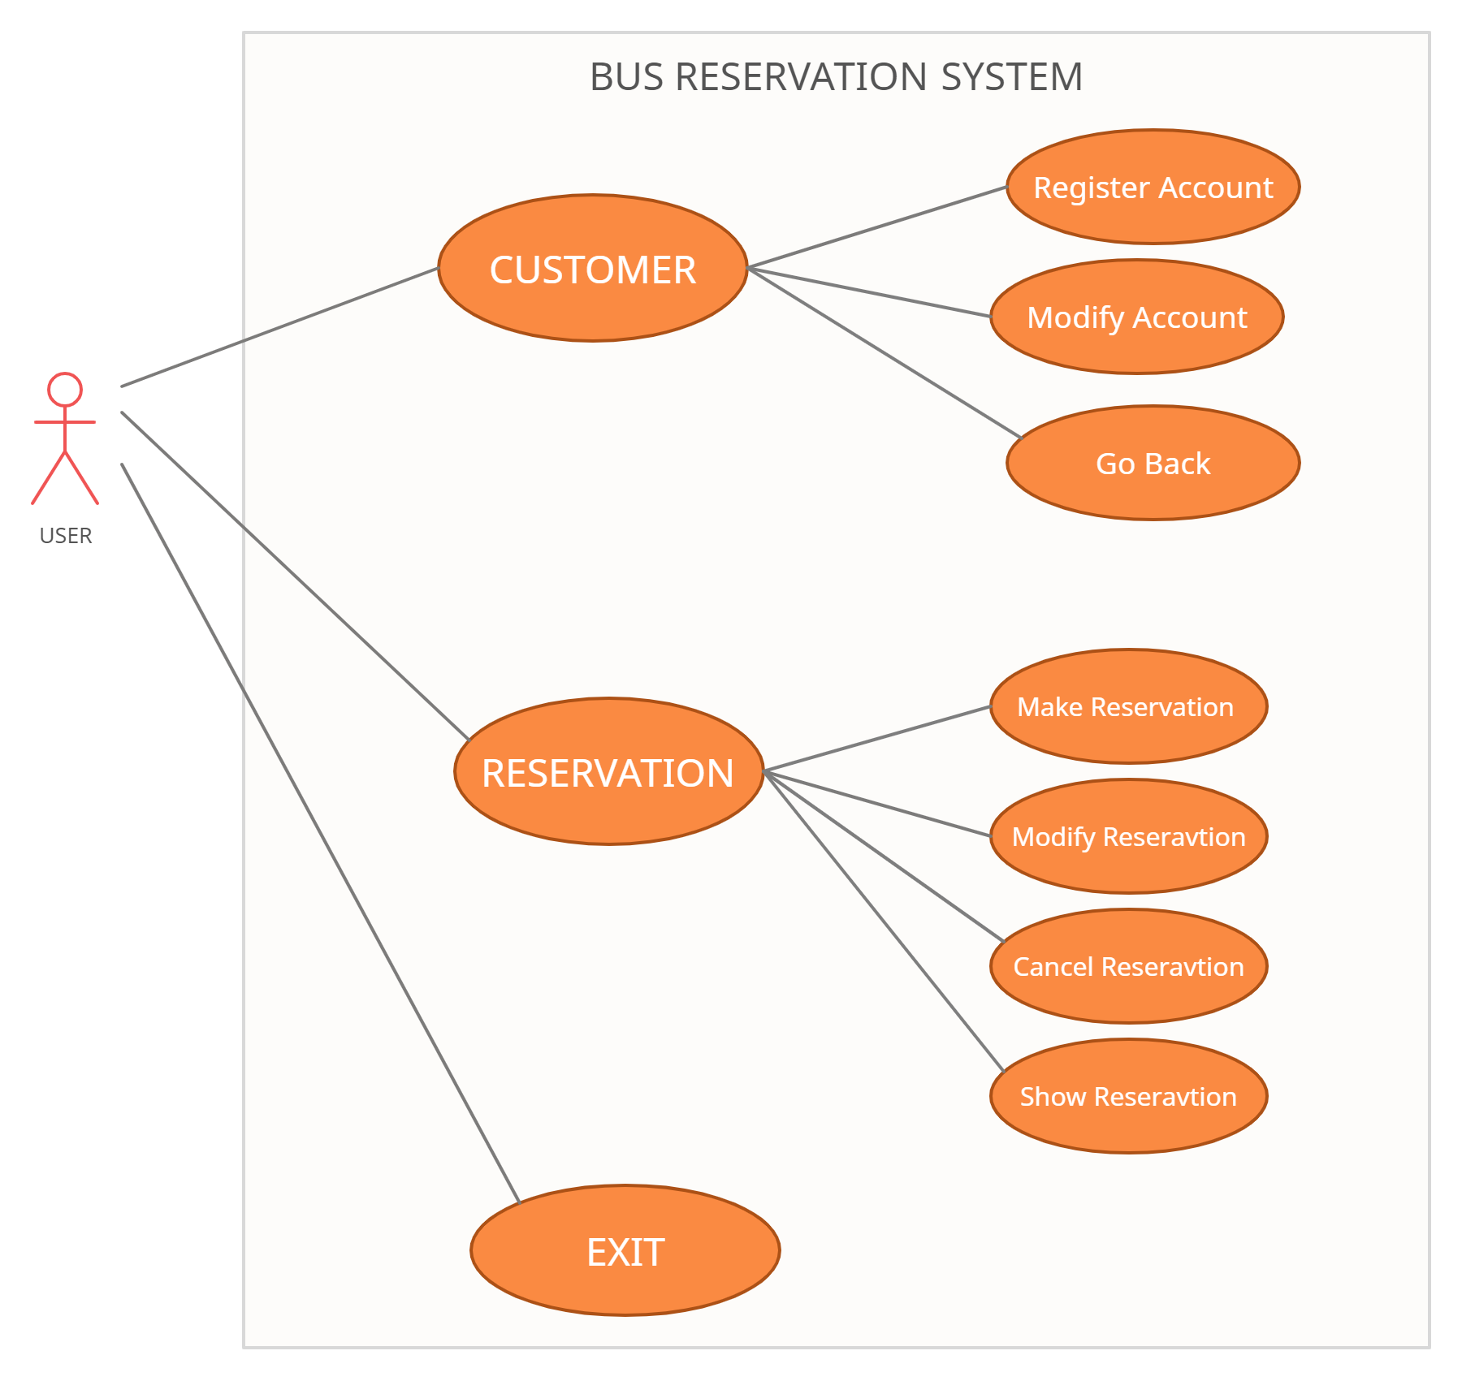
UML Diagram of
BUS RESERVATION SYSTEM

Slide 14
FLOWCHARTS
5

Slide 15
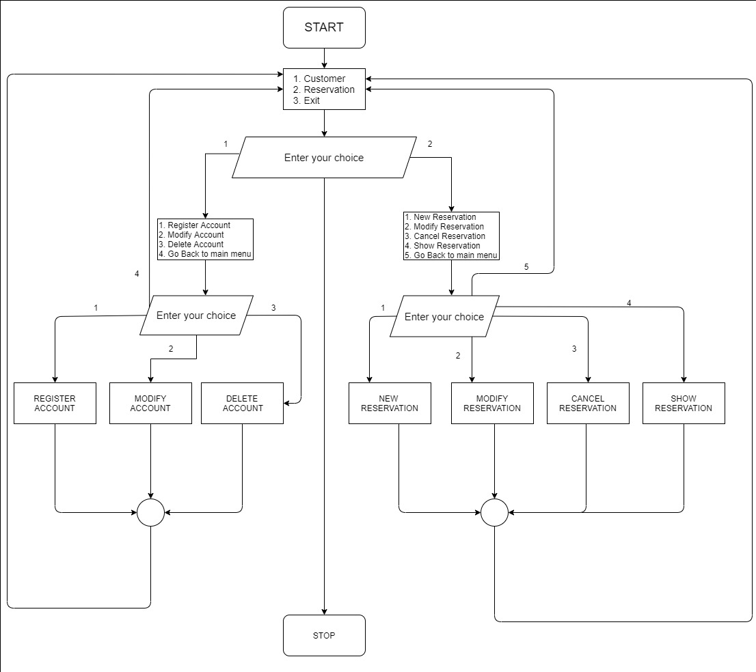
FLOW DIAGRAM
OF BUS RESERVATION SYSTEM

Slide 16
THANK YOU!

