Slide 1
ManoVarta
Final live runtime
Coverage 0.783 Exact 0.639 Macro-F1 0.251 Safety P/R 1.0/1.0
Multilingual conversational mental-health screening
Project Phase 3 submission deck English + Hindi + Hinglish | adaptive screening, hybrid safety, self-hosted runtime
Ritwij and Yash

Slide 2
Problem and objective
Why a conversational screening partner instead of a fixed questionnaire?
Problem
Goal
Constraint
Direct PHQ-9/GAD-7 administration is clinically useful, but it can feel like a test. That can produce survey fatigue, guarded answers, and weaker narrative disclosure.
Build a multilingual, voice-capable agent that holds a natural conversation, then infers questionnaire-grounded symptom evidence and confidence-aware next questions.
The system must stay safe. Item scoring and crisis detection cannot be treated as the same problem, so the runtime separates extraction from safety escalation.
Primary languages: English and Hindi; Hinglish treated as a real robustness condition.
Outputs: PHQ-9 and GAD-7 item scores, evidence, unresolved items, safety label.
Key evaluation axes: discourse effectiveness, disclosure efficiency, safety accuracy, latency.

Slide 3
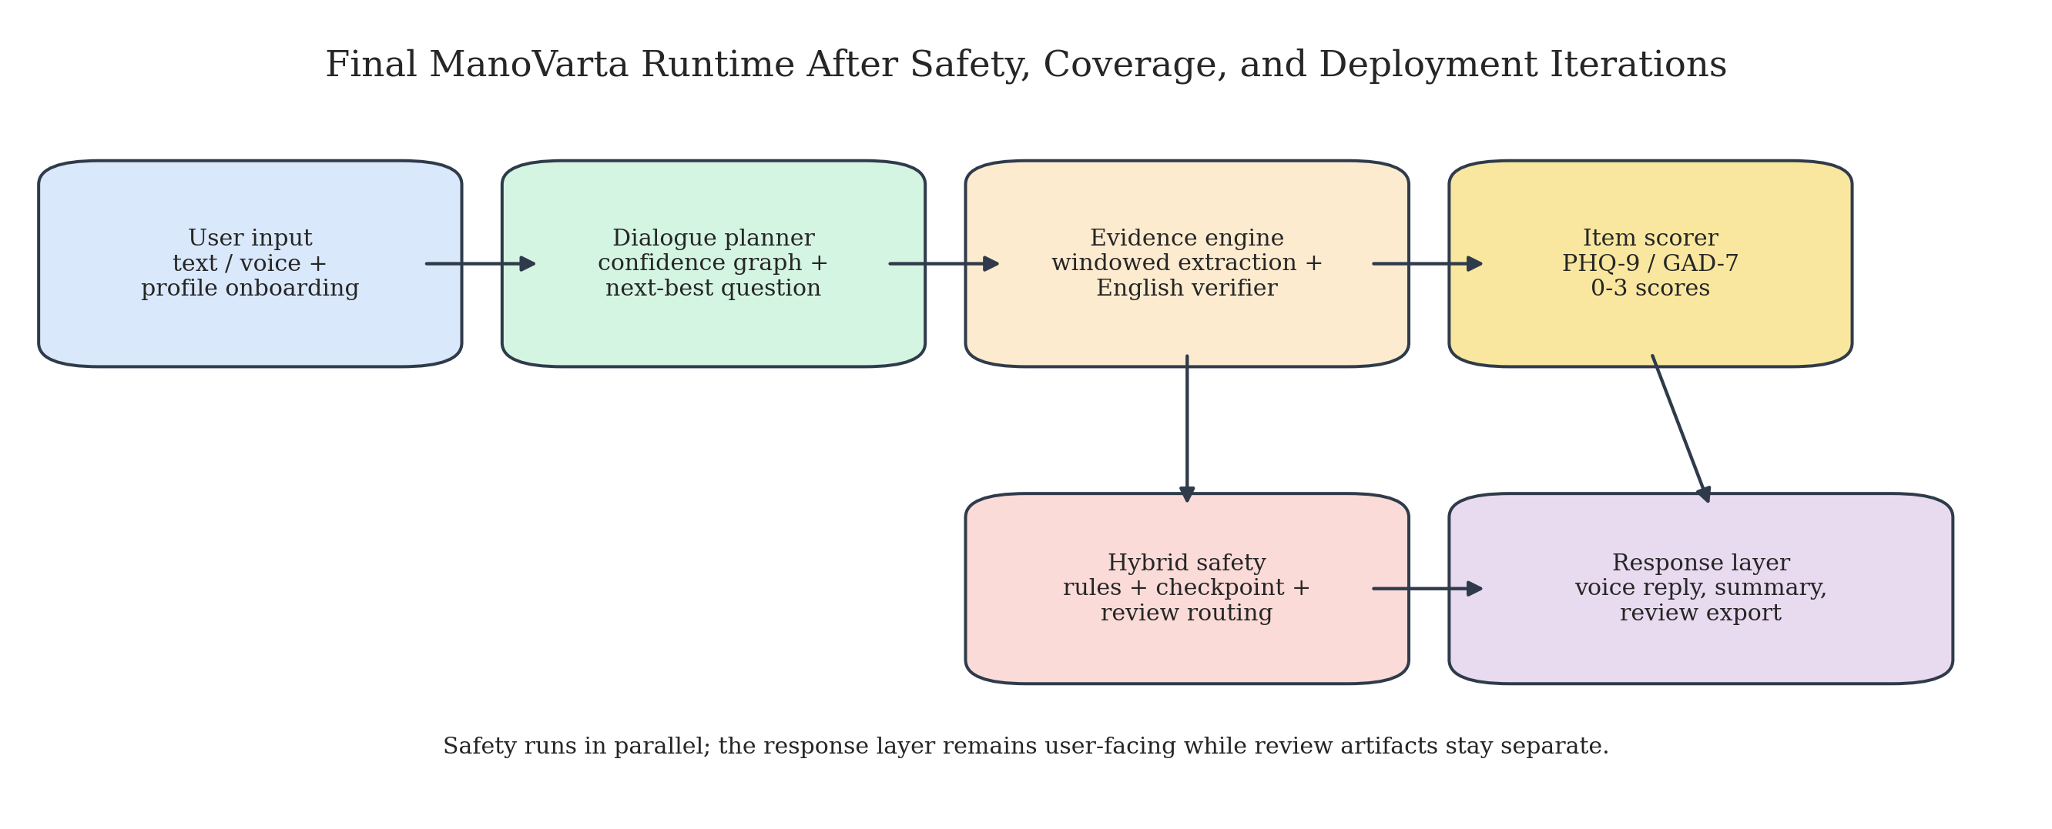
System overview
The final product is a pipeline, not a single-prompt chatbot.
Runtime path
1. Patient-profile onboarding 2. Dialogue planner chooses next topic 3. Evidence extractor fills candidate items 4. Scorer updates PHQ/GAD state 5. Hybrid safety stack checks review/urgent risk 6. Response generator explains the next question in natural language 7. Optional STT/TTS voice loop keeps the interaction hands-free

Slide 4
Data and labels
Seed multilingual screening data with item-level supervision.
Processed repo assets include extractor, safety, and follow-up splits.
Primary scoring target is item-level PHQ-9/GAD-7 values in the 0-3 range.
DAIC-WOZ was used only as auxiliary English supervision, not as the main multilingual benchmark.
Evaluation logic
Exact match alone was misleading early on because sparse systems could score well by abstaining. We therefore tracked coverage completeness, exact match, macro-F1, safety precision/recall, parse failures, turns to stable score, and latency.
Split | Train | Dev | Test
Extractor | 84 / 140 best | 48 | 48
Safety | 126 | 80 | 84
Follow-up | 120 | 96 | 144

Slide 5
Model path and why Aya was chosen
The extractor decision came from measured behavior, not brand preference.
System | Coverage | Exact | Macro-F1
Heuristic seed | 0.022 | 0.635 | 0.058
Raw Aya scoring | 0.009 | 0.4 | 0.006
Qwen 1.5B probe | 0.429 | 0.667 | 0.129
Llama 3.1 8B probe | 0.893 | 0.64 | 0.19
Aya offline baseline | 0.913 | 0.562 | 0.272
Inference
Qwen documented an early compact-model path but broke badly on the Hindi probe. Llama 3.1 8B looked stronger on a tiny retrospective slice, but still trailed Aya on macro-F1 and over-escalated safety on benign examples. Aya remained the first strong archived multilingual extractor result, so it became the backbone for extraction logic.

Slide 6
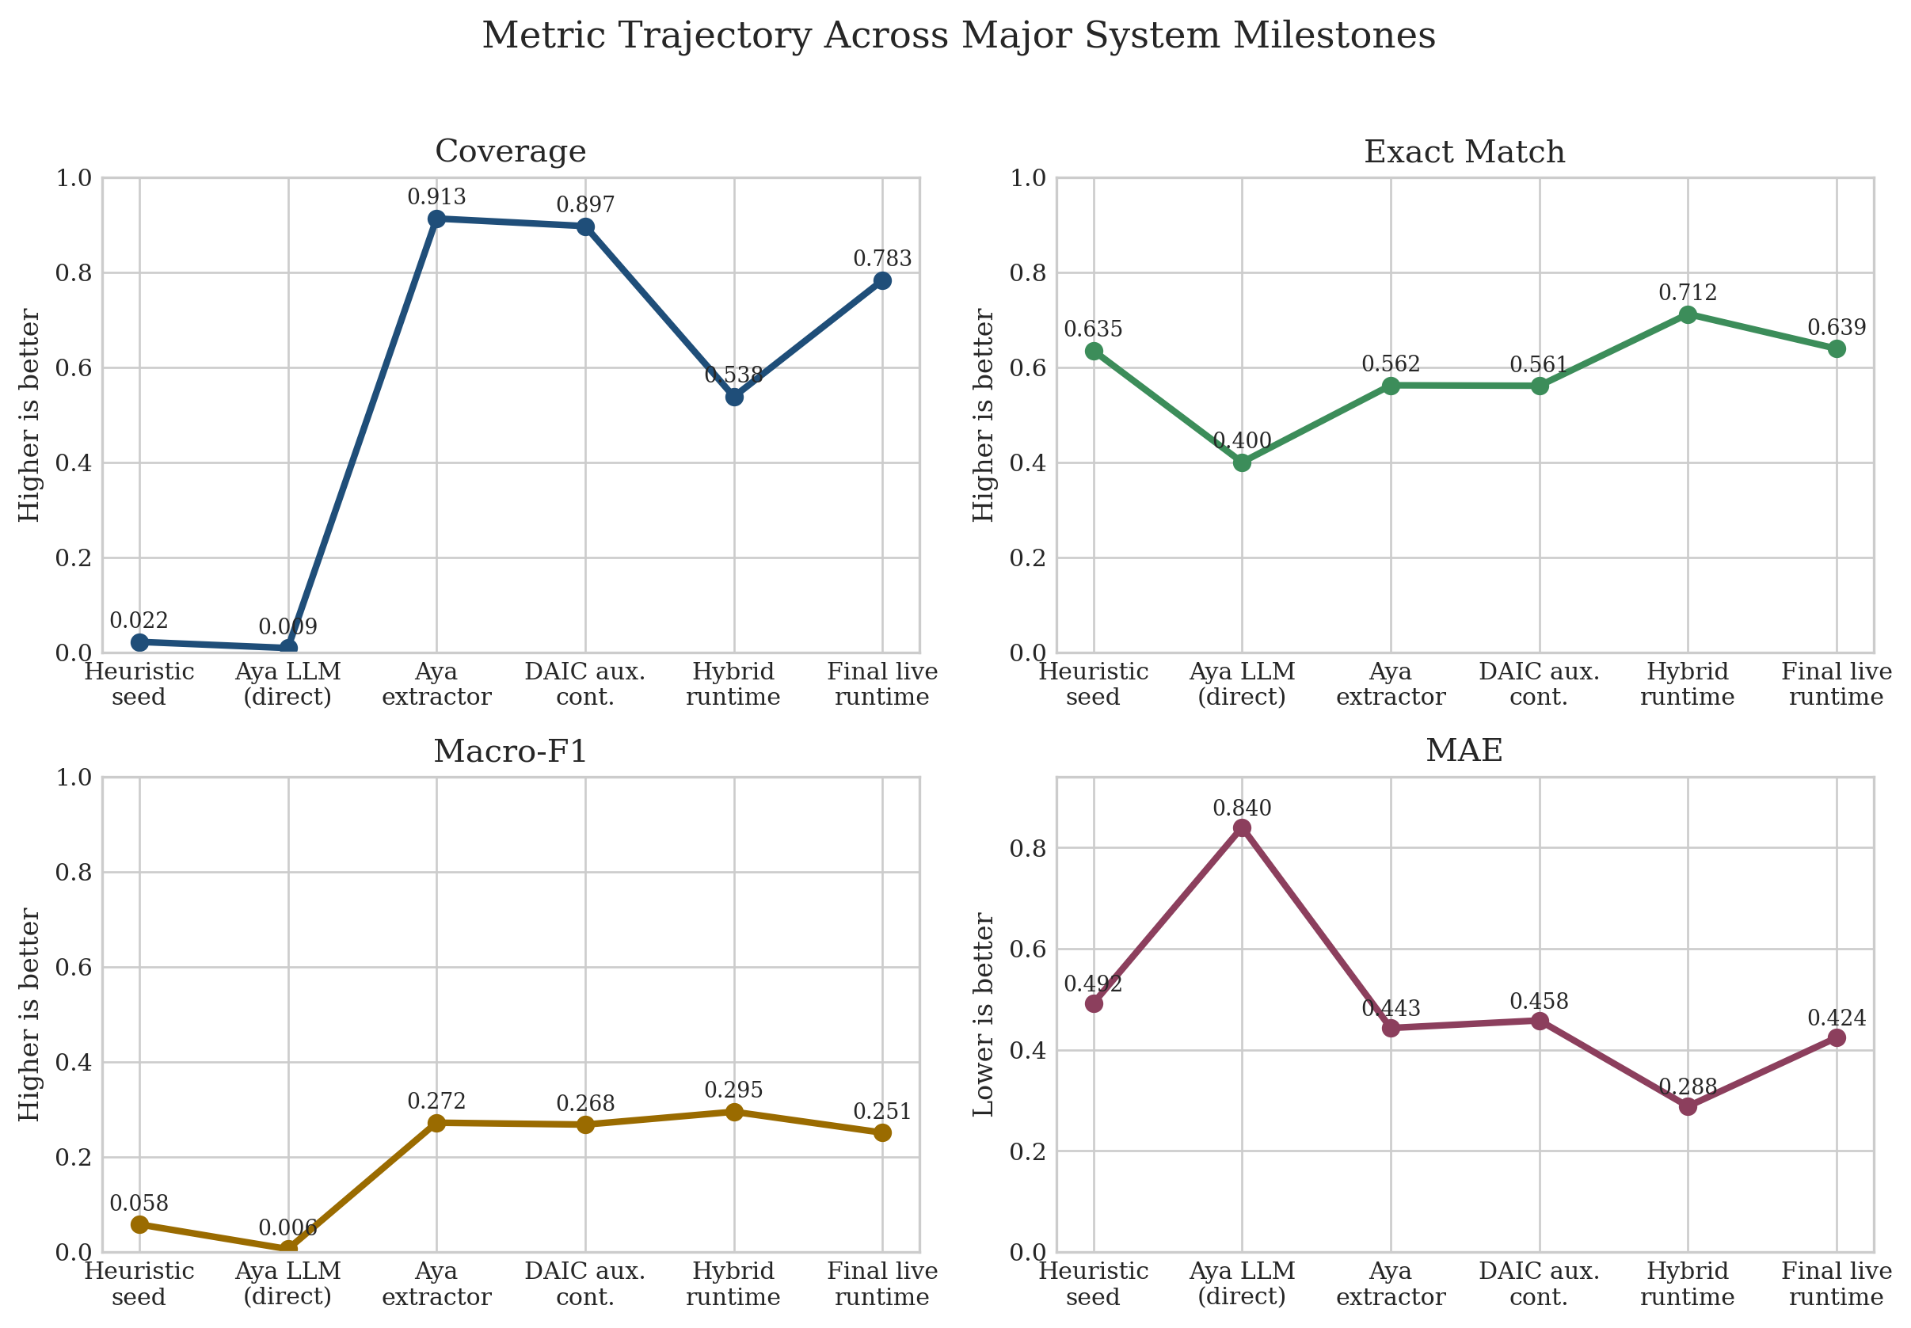
Milestone trajectory
The big jump was evidence-first extraction; the hard part was recovering coverage after adding safety.
Reading the graph
The heuristic and raw-prompt stages were clinically thin. Aya created the first real coverage jump. Hybrid safety then solved the risk problem but temporarily reduced coverage. The final passes recovered coverage through language-specific engineering rather than generic retraining.

Slide 7
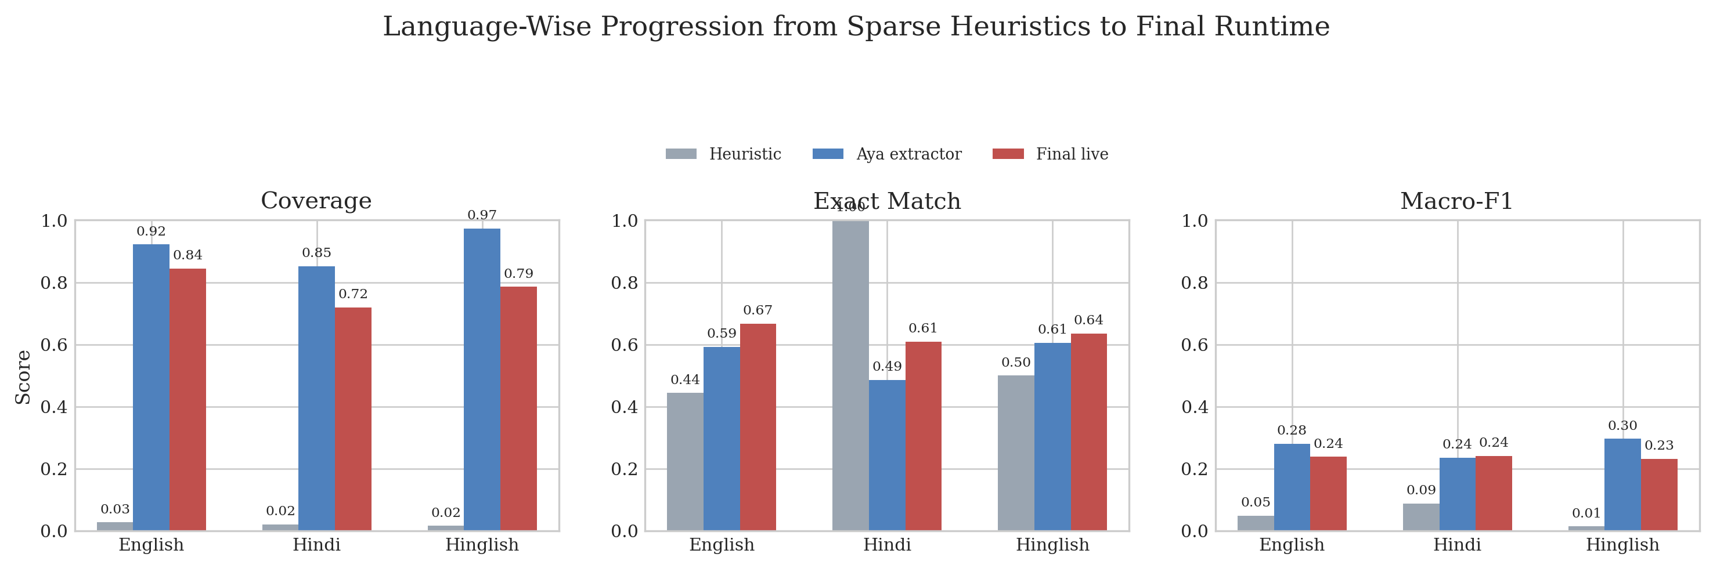
Final results
Strong final operating point for a deployed screening product.
Overall
Safety
Disclosure
Latency
Coverage 0.783 Exact 0.639 Macro-F1 0.251 Parse failures 0
Precision 1.0 Recall 1.0 This fixed the earlier false-positive problem without losing recall.
Avg turns to stable score 2.292
Warm median 32.73 ms Warm p95 32.89 ms
Language-wise takeaway
English: 0.844 coverage Hindi: 0.719 coverage Hinglish: 0.786 coverage English became the strongest slice only after the verifier and anxiety disambiguation passes. Hindi remains the next place to improve.

Slide 8
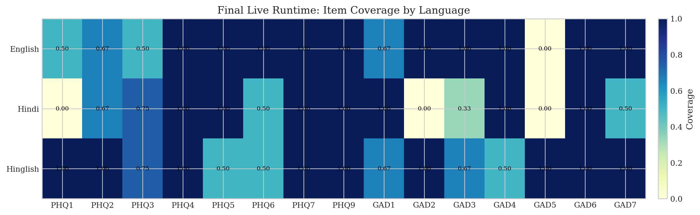
Item-level and safety observations
The remaining misses are concentrated rather than random.
What the heatmap means
The final system is not uniformly strong. Hindi still under-covers a few sparse items, while Hinglish usually finds evidence but can still mis-calibrate severity on some somatic cues. The useful engineering lesson is that broad coverage came from focused repairs, not from another generic full-model retrain.

Slide 9
Deployment, voice, and saved artifacts
The final phase delivered a working product, not only offline experiments.
Live runtime moved from hosted inference to self-hosted local inference.
Backend speech routes support STT/TTS beyond a pure browser wrapper.
Patient-profile onboarding, hybrid safety, and reviewer routing are integrated in the deployed stack.
Saved weights
Extractor artifacts saved under outputs/local_mps/extractor-qwen25-1_5b-best-compact Safety inference checkpoint saved under outputs/local_safety_boost/safety-indicbert-best-infer-fp16
Submission note
The clean submission bundle includes compact relevant weights, current code, the final PDF report, the DOCX report, and this presentation. Heavy historical zips, caches, .DS_Store files, and external DAIC dumps are excluded.

Slide 10
Conclusion
Aya was the right multilingual extractor choice because it was the first strong archived result, not just a good-looking probe.
Hybrid safety changed the optimization target: the best deployed system was not the highest-coverage offline extractor.
The final product is multilingual, voice-capable, self-hosted, and safety-consistent.
Best final live result: coverage 0.783, exact 0.639, macro-F1 0.251, safety precision/recall 1.0/1.0.

