Slide 1
PORTFOLIO PROJECT / END-TO-END DATA ANALYTICS
Customer Shopping
Behavior Analysis
PROJECT PIPELINE
01
Prepare
Clean + engineer data
↓
Turning 3,900 purchase records into business insights
02
Analyze
Answer SQL questions
PYTHON
MYSQL
POWER BI
↓
03
Communicate
Power BI dashboard
PROJECT PRESENTATION
DATA PREPARATION -> BUSINESS QUERIES -> INTERACTIVE DASHBOARD
A practical analytics workflow from raw data to recommendations

Slide 2
PROJECT SNAPSHOT
The project at a glance
A single transaction dataset connected data preparation, SQL analysis and dashboard storytelling.
RECORDS
FIELDS
DATA QUALITY
AVG. PURCHASE
AVG. RATING
3,900
18
37
$59.76
3.75
Purchases in the dataset
Columns before cleanup
Missing review ratings
Power BI KPI
Power BI KPI
CUSTOMER SUBSCRIPTION MIX
BUSINESS QUESTIONS
73%
27%
Who contributes revenue?
Which products rate highest?
not subscribed
subscribed
How do discounts relate to purchases?
Do subscribers spend differently?
Which age groups contribute most?
Source dashboard shows customer subscription status as 27% Yes / 73% No.
Scope: customer segments, product preferences, spending, discounts, shipping and subscriptions.
CUSTOMER SHOPPING BEHAVIOR ANALYSIS
02 / 13

Slide 3
01 / UNDERSTAND
Start with a structured shopping dataset
The source contains customer profile, purchase, shopping-behavior and experience fields.
WHAT THE DATA DESCRIBES
DATA QUALITY CHECK
01
Customer profile
Age, gender, location and subscription status
37
02
Purchase context
Item, category, amount, season, size and color
missing values
Review Rating column
03
Shopping behavior
Discounts, previous purchases and purchase frequency
Handling method
Missing review values were filled using the median rating of each product category.
04
Experience & fulfillment
Review rating and shipping type
3,900 rows
18 columns
CUSTOMER SHOPPING BEHAVIOR ANALYSIS
03 / 13

Slide 4
02 / METHOD
One workflow across three tools
Each tool had a defined role: prepare reliable data, query business questions, then communicate findings.
01
PYTHON
02
MYSQL
03
POWER BI
Prepare the data
Answer business questions
Present insights visually
Load with pandas
->
Revenue by gender
->
KPI cards
Inspect with df.info() and describe()
Average spend by shipping type
Subscription mix
Impute missing ratings
Ratings and discount rates
Revenue and sales by category
Standardize fields + engineer features
Customer segments
Age-group comparisons
Load cleaned DataFrame into MySQL
Subscription and age-group analysis
Interactive slicers / filters
OUTPUT CHAIN
Cleaned DataFrame
->
MySQL analysis table
->
Power BI dashboard
CUSTOMER SHOPPING BEHAVIOR ANALYSIS
04 / 13

Slide 5
03 / PYTHON
Python: clean, standardize and enrich
Pandas was used to prepare the transaction data before it was loaded to MySQL.
01
Load & inspect
02
Handle missing ratings
Read the dataset with pandas. Used df.info() to inspect structure and describe() for summary statistics.
Filled the 37 missing Review Rating values with the median rating for the relevant product category.
03
Standardize columns
04
Create features
Renamed column labels to snake_case for consistent querying and documentation.
Built age_group from customer ages and purchase_frequency_days from purchase data.
05
Check redundancy & load
Checked discount_applied against promo_code_used, dropped the redundant promo_code_used field, then loaded the cleaned DataFrame to MySQL.
DATA HANDOFF
The cleaned pandas DataFrame was written into MySQL for the SQL business analysis phase.
CUSTOMER SHOPPING BEHAVIOR ANALYSIS
05 / 13

Slide 6
04 / SQL
SQL turned the dataset into business questions
Ten analysis tasks explored revenue, products, behavior and customer segments in MySQL.
01
Revenue by gender
06
Discount-dependent products
Compare total revenue from male and female customers.
Identify products with the highest percentage of discounted purchases.
02
High-spending discount users
07
Customer segmentation
Find discount users spending above the average purchase amount.
Classify customers as New, Returning and Loyal using purchase history.
03
Top products by rating
08
Top products by category
Rank the five products with the highest average review ratings.
List the most purchased products within each product category.
04
Shipping type comparison
09
Repeat buyers & subscriptions
Compare average purchase amounts for Express and Standard shipping.
Check subscription status for customers with more than five purchases.
05
Subscriber comparison
10
Revenue by age group
Compare customer counts, average spend and total revenue by subscription status.
Calculate the revenue contribution of each age group.
BUSINESS-FOCUSED SQL
The queries were selected to support decisions, not just demonstrate syntax.
CUSTOMER SHOPPING BEHAVIOR ANALYSIS
06 / 13

Slide 7
05 / FINDINGS
Revenue and average purchase value
The SQL outputs show differences in total revenue by gender and average purchase amount by shipping type.
AVERAGE PURCHASE
$59.76
AVERAGE PURCHASE BY SHIPPING TYPE
Average purchase amount (USD)
Dashboard KPI
Express
$60.48
TOTAL REVENUE BY GENDER
Revenue (USD)
Standard
$58.46
Male
$157,890
+$2.02
Express average purchase amount is $2.02 above Standard in the query output.
Female
$75,191
Male revenue is higher in the reported totals; totals alone do not describe per-customer value.
Comparison is descriptive; the source does not establish causation.
CUSTOMER SHOPPING BEHAVIOR ANALYSIS
07 / 13

Slide 8
06 / FINDINGS
Product ratings and discount dependence
Top-rated items and products most frequently associated with discounts are separate signals to review.
TOP 5 PRODUCTS BY AVERAGE RATING
TOP PRODUCTS BY DISCOUNT RATE
Product
Average rating
Product
Discount rate
Gloves
3.86
Hat
50.00%
Sandals
3.84
Sneakers
49.66%
Boots
3.82
Coat
49.07%
Hat
3.80
Sweater
48.17%
Skirt
3.78
Pants
47.37%
RATING LEADER: GLOVES
DISCOUNT RATE LEADER: HAT
CUSTOMER SHOPPING BEHAVIOR ANALYSIS
08 / 13

Slide 9
07 / FINDINGS
Customer segments and subscription behavior
Segmentation highlighted a large Loyal group; the subscription split shows room to test conversion strategies.
CUSTOMER SEGMENTS
SUBSCRIBERS VS. NON-SUBSCRIBERS
Metric
Yes
No
Loyal
3,116
Customers
1,053
2,847
Returning
701
Average spend
$59.49
$59.87
Total revenue
$62,645
$170,436
New
83
Segments were assigned from purchase history.
REPEAT BUYERS: MORE THAN 5 PURCHASES
Because the groups are different sizes, compare within-group rates before concluding which group is more likely to subscribe.
Subscribers: 958
Non-subscribers: 2,518
CUSTOMER SHOPPING BEHAVIOR ANALYSIS
09 / 13

Slide 10
08 / FINDINGS
Best-selling items and age-group revenue
The SQL output identifies category leaders and shows Young Adults contributing the most revenue among the age groups shown.
TOP PURCHASED PRODUCTS BY CATEGORY
REVENUE BY AGE GROUP
Category
Top item
Orders
Total revenue (USD)
Accessories
Jewelry
171
Young Adult
$62,143
Accessories
Sunglasses
161
Accessories
Belt
161
Clothing
Blouse
171
Middle-Aged
$59,197
Clothing
Pants
171
Clothing
Shirt
169
Adult
$55,978
Footwear
Sandals
160
Footwear
Shoes
150
Footwear
Sneakers
145
Senior
$55,763
Outerwear
Jacket
163
Outerwear
Coat
161
Source lists two Outerwear items in this table.
Young Adult leads the four age groups shown.
CUSTOMER SHOPPING BEHAVIOR ANALYSIS
10 / 13

Slide 11
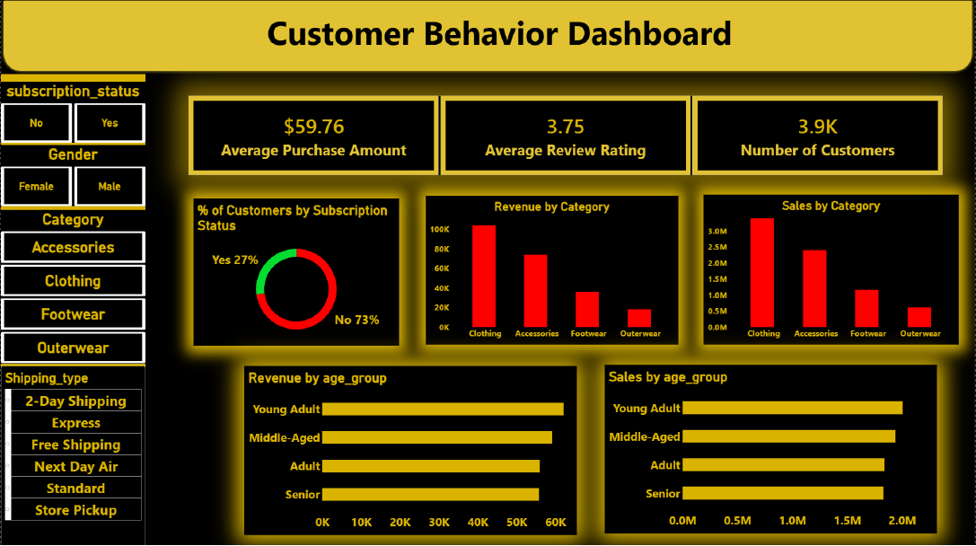
09 / POWER BI
The dashboard brings the analysis together
The report combines headline KPIs, filters and visual comparisons for subscription, category and age-group views.
DASHBOARD
HIGHLIGHTS
$59.76
Average purchase amount
3.75
Average review rating
3.9K
Number of customers
Filters: subscription status, gender, category and shipping type.
CUSTOMER SHOPPING BEHAVIOR ANALYSIS
11 / 13

Slide 12
10 / RECOMMENDATIONS
Turn the findings into focused actions
The source recommendations connect the analysis to subscription growth, loyalty, discount policy and targeting.
01
Grow subscriptions
02
Build loyalty journeys
03
Review discount economics
Test exclusive subscriber benefits and communicate them clearly.
Reward repeat buyers and create steps that help Returning customers become Loyal.
Evaluate sales lift against margin impact before expanding discounts.
Current split: 27% Yes / 73% No
Loyal: 3,116 | Returning: 701 | New: 83
Hat: 50.00% discount rate; Sneakers: 49.66%
04
Promote proven products
05
Target by customer value
Feature highly rated products alongside category best-sellers in campaigns.
Prioritize audiences and fulfillment options that align with stronger observed revenue or spend.
Gloves lead average rating at 3.86
Young Adult revenue: $62,143 | Express avg: $60.48
Recommendation guardrail: treat the results as descriptive until tested against margin, conversion and customer-level rates.
CUSTOMER SHOPPING BEHAVIOR ANALYSIS
12 / 13

Slide 13
PROJECT TAKEAWAY
From transactions to
actionable decisions
NEXT ITERATION
Validate the actions with:
The project demonstrates an end-to-end analytics workflow: preparing data in Python, querying business questions in MySQL, and presenting the findings in Power BI.
Customer-level subscription rates
Discount margin impact
Trends across additional time periods
PYTHON
MYSQL
POWER BI
Data cleaning
Feature engineering
Business analysis
SQL query practice
KPIs and filters
Visual communication
CUSTOMER SHOPPING BEHAVIOR ANALYSIS
PYTHON | MYSQL | POWER BI

