Slide 1
5 Big IT Trends for 2012
…and how Open APIs are a driving force
@rossmason #mulesoft
Notes:
Deck for Webinar

Slide 2
#1: Big Data yin and yang

Slide 3
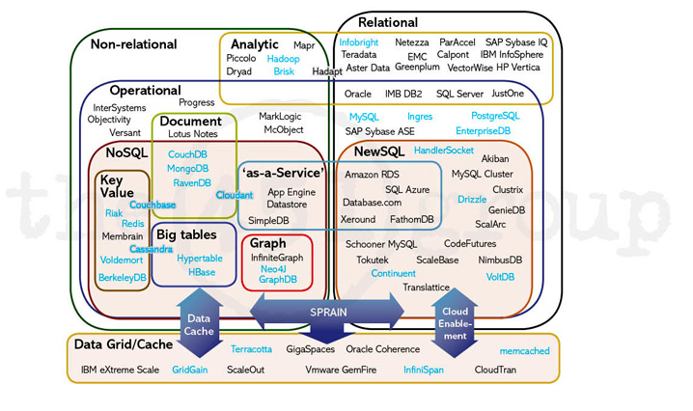
What is big data?
Source: 451 Group
Notes:
“Big Data” was born out of big data
complex joins or ACID requirements = SQL
realtime requirements = HBase, Storm, custom
Process data with many outcomes = Monte Carlo Simulations
supercomputing, MPI or BSP (Message Passing Interface, Batch sync Processing)
graph computing, Google's Pregel or Neo4J
interactive analysis of web-scale data sets, Google's Dremel
to incrementally update the analytics on a massive data set continuously, as Google now have to do on their index of the web, then an architecture like Percolator

Slide 4
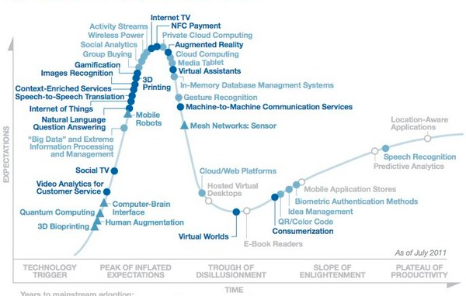
Big Data on the Hype Cycle
Source: Gartner

Slide 5
Impact to your organization
Yin
Realisation that Big Data is not a solution, it’s a set of servers/platforms
Landscape a lot more complicated than RDMS
Need to understand the technology landscape to be able to choose an approach
Yang
New use cases emerge as data increases from web, mobile, sensor, financial, healthcare, etc.
New investment means better tools for analytics, efficient storage and scrubbing

Slide 6
#2: Emergence of Cloud Integration

Slide 7
Integration will make or break SaaS
Source: Forrester

Slide 8
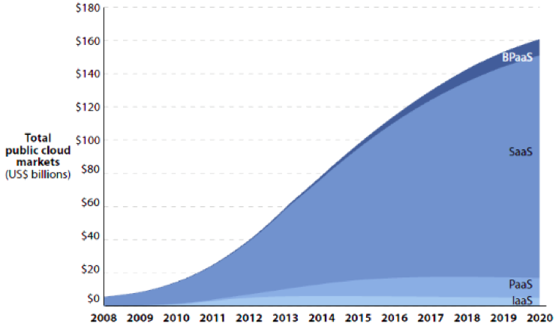
SaaS Tsunami creating a massive
integration wave
Source: Forrester

Slide 9
SaaS Tsunami creating a massive
integration wave
Thousands of new applications
Thousands of siloed data stores
Thousands of new APIs to integrate
Source: Forrester

Slide 10
Impact to your organization
Every organization will need (or already has) a SaaS strategy
Within 5 years, a significant percentage of your data will live outside your firewall
Integration of SaaS to the enterprise is critical

Slide 11
#3: PaaS Mania and Shake Out

Slide 12
What is PaaS?
Cloud
Enterprise
SaaS
(Software as a Service)
Enterprise Apps
(SAP, Oracle EBS)
PaaS
(Platform as a Service)
Middleware
(App server, ESB)
IaaS
(Infrastructure as a Service)
Virtualization / OS / Hardware
Notes:
Lets quickly go over the basics of where PaaS sits. There are 3 defined service layers to the cloud: Infrastructure as a Service (IaaS), Platform as a Service (PaaS) and Software as a Service (SaaS).
Both IaaS and SaaS are easier concepts to understand and have been around longer. IaaS provides a virtualization layer of elastic compute resources that are available on demand, such as Amazon EC2 or Rackspace Cloud. SaaS offers applications consumable over the web with pay as you go pricing, numerous examples include Salesforce, SuccessFactors, WorkDay and Inuit.
You can think of these layers as a stack and PaaS sits in the middle, filling the void between IaaS and SaaS. PaaS is the least well defined because people have very vantage point of what a platform is. Yefim Natis for Gartner is quoted describing PaaS as “Anything that is not a business application or systems infrastructure is PaaS”. To me this is middleware and by this definition the PaaS is going to have a massive impact the way software is built.

Slide 13
PaaS Categories: aPaaS, iPaaS
Application PaaS (aPaaS) — the platform for hosting and managing individual applications
Integration PaaS (iPaaS) — the platform for intermediation and integration of the application services hosted and point-managed by aPaaS
Notes:
aPaaS — the platform for hosting and managing individual application services and data
The services of this platform will include container services for optimized multitenant execution of application software, persistent and in-memory data management, point- management and point-security of services in a homogeneous context, multilingual development tools, programming models, internal orchestration and composition, metadata management, and tracking for billing and optimization purposes. The multitenancy models will differ. Some projects will select the backward compatibility of the shared-hardware model. Others will choose the advanced elasticity and versioning of the shared-everything model (see "Gartner Reference Architecture for Multitenancy").
Integration PaaS (iPaaS) — the platform for intermediation and integration of the application services hosted and point-managed by aPaaS
The service of this platform will include a variety of intermediation applicable to heterogeneous multilocated service environments, including registry and repositories, policy management, security, application and data integration, adapters, composition, orchestration, flow management, partner community management event brokering and more. iPaaS offerings will be used to support integration among SaaS applications, cloud services, aPaaS-based applications, and on-premises custom and packaged applications in internal and B2B integration scenarios.

Slide 14

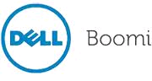
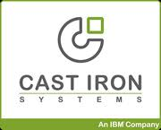








PaaS Landscape
iPaaS
cloud
integration
dPaaS
aPaaS

Slide 15
Impact to your organization
Forrester predicts that by 2015, 35% of application workloads will run on PaaS
PaaS is an opportunity to simplify the infrastructure landscape
PaaS not suitable for all workloads (data compliance, performance requirements)
Need to understand the role of PaaS in your organization by 2013
By 2013 we’ll see the start of aPaaS shake out that will leave 3-4 vendors standing, others will specialize or drop out

Slide 16
#4: The Enterprise Goes Mobile 2.0

Slide 17
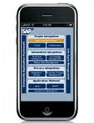


Enterprise Mobile Evolution
HTML
Web Server

Slide 18

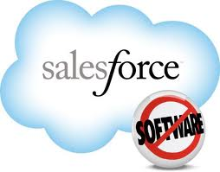

Enterprise Mobile 2.0
Integration
Notes:
InsideView (organisation intelligence)

Slide 19
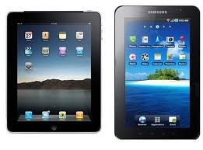

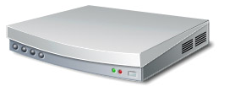
Enterprise Mobile 2.0
Tablets
Mobile
Web / Desktop
Apps
Other devices
REST API (JSON / XML)
Integration
Notes:
InsideView (organisation intelligence)

Slide 20
Impact to your organization
“20-50 billion connected devices by 2020” – Morgan Stanley
“Out of 12 mobile apps surveyed, 54 applications were integrated”
Devices communicate through APIs, need a platform strategy that enables publishing and consumption of many APIs
Notes:
Concerns focus on the device itself and cross compatability, t
Siri

Slide 21
#5: The Web Goes Real Time

Slide 22
Real-time Web
The web is the platform, but it wasn’t built for machines
Real-time means:
Faster processing
Less load on servers
Smarter apps
Better user experience

Slide 23



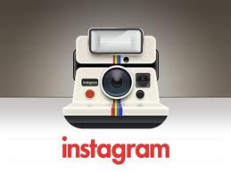
Streaming APIs: Early Movers leading the way
Notes:
Facebook
Social Graph
Twitter
Firehose - analytics
Salesforce
Main Integration partner

Slide 24
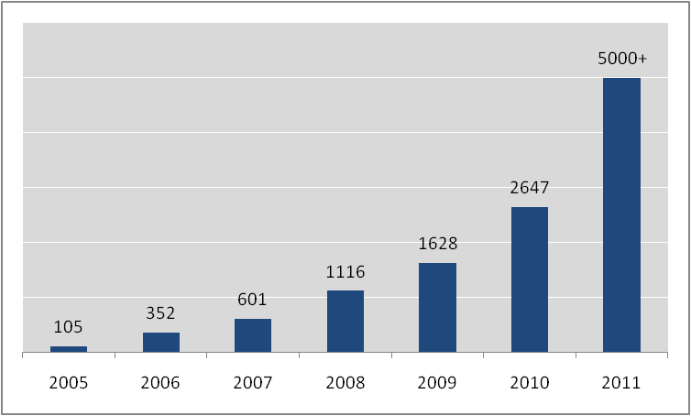
API Explosion, changing the IT landscape
Number of APIs
Source: Programmable Web
Notes:
Center of gravity shifting to the cloud
Rise of the composite app
Less visibility and control
Rapid innovation means middleware must adapt and support change

Slide 25
How we can help take advantage of these trends

Slide 26
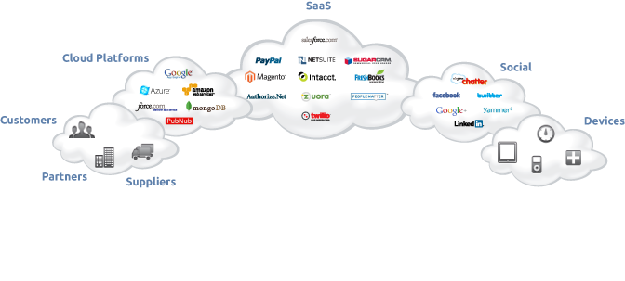
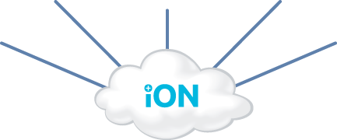
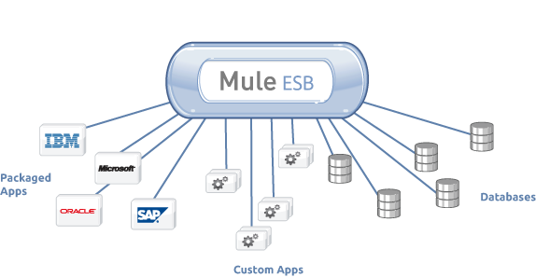
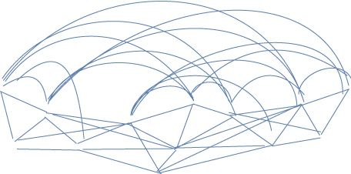
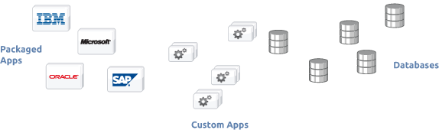
One Platform: Cloud, Enterprise, APIs

Slide 27
Summary
Trend | Action
1. Big Data | Observe, Plan
2. SaaS / Cloud Integration | Plan yesterday
3. PaaS | Trial
4. Enterprise Mobile | Plan
5. Real-time APIs | Watch

Slide 28
Questions? @rossmason #mulesoft

