Slide 1
Implementation of Blockchain in IoT
Presented By
RITWIK RANJAN PATHAK

Slide 2
TABLE OF CONTENTS
Abstract
Introduction
Motivation
Objectives
Word Done So Far
Conclusion And Future Work
References

Slide 3
ABSTRACT
IoT, or, Internet of Things is used to referred to smart devices interconnected in a way which enables them to exchange data with each other. The major drawback of IoT is that it has a centralized architecture, which makes it prone to security threats and compromises the data. Information in such a centralized network can be tampered with or forged, leading to security threats and distrust.
We aim to develop a tamper free environment to prevent attacks on IoT devices. In order to achieve this, we will implement blockchain technology into IoT application. The proposed blockchain platform will constantly validate the transactions and enable the devices to interact with each other in a decentralized fashion. To practically implement it, we will be using technologies like RaspberryPi 4 and Ethereum and find secure, trustworthy solutions.

Slide 4
INTRODUCTION
To practically implement the feasibility of the proposed solution, our project will be conducted using Raspberry Pi to simulate an IoT network. Due to the blockchain network, the data from RaspberryPi 3.0 and sensors the will be synchronized in the blockchain ledger. The transaction between the computer and Raspberry Pi will be recorded in the blockchain.
As for blockchain, it is a distributed ledger with growing lists of records (blocks) that are securely linked together via cryptographic hash. Each block contains a cryptographic hash of the previous block, a timestamp, and transaction data. We will use Python 3 programming language to create the blockchain structure (compared to linked list data structure). We will code a blockchain technology that will take information and data from the sensors and keep storing the sensitive data in secured blocks using hashing technology. As the blocks will keep getting added, our security will grow tighter, protecting it from malicious attacks.

Slide 5
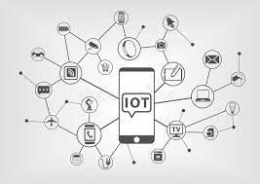

Internet of Things (IOT)

Slide 6
MOTIVATION
Since the security of IoT is oftentimes vulnerable to threats and attacks, our motivation behind this project is to provide a secure and trustworthy solution. Implementing blockchain technology will ensure that our IoT system remains protected from outside threats. Since Blockchain is a completely transparent technology, it will show all the transactions that have been made since its creation, without tampering or fraud. The proposed blockchain based platform will maintain the blockchain network by constantly validating transaction. This will enable IoT devices to interact with each other in a decentralized and trustless network without the need for a third party intermediary.
With the successful implementation of blockchain in IoT, we will allow advanced technologies to become integrated with IoT too. From home security systems to environment surveillance, IoT will be more secure and trustworthy to be used in such fields.

Slide 7
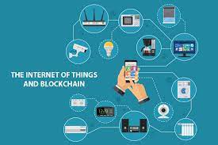
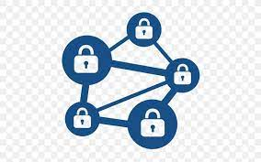
BLOCKCHAIN

Slide 8
OBJECTIVES
Implementation of IoT using Raspberry Pi 3.0
Implementation of Blockchain
Implementation of Blockchain in IoT using Raspberry Pi 3.0

Slide 9
Work Done So Far
Implementation of IoT using Raspberry Pi 3.0
To get started with Raspberry Pi 3, we downloaded the Raspbian Jessie image file from the official website.
After connecting Raspberry Pi to a power source, monitor, keyboard, and mouse, we used the terminal to install Python3.
We used the Thonny Python IDE to write and run code for communicating with the sensors.
To ensure proper working of the sensors, we installed the required libraries using the terminal.
With its GPIO (General Purpose Input Output) pins, Raspberry Pi 3 interface with a variety of sensors and device.

Slide 10
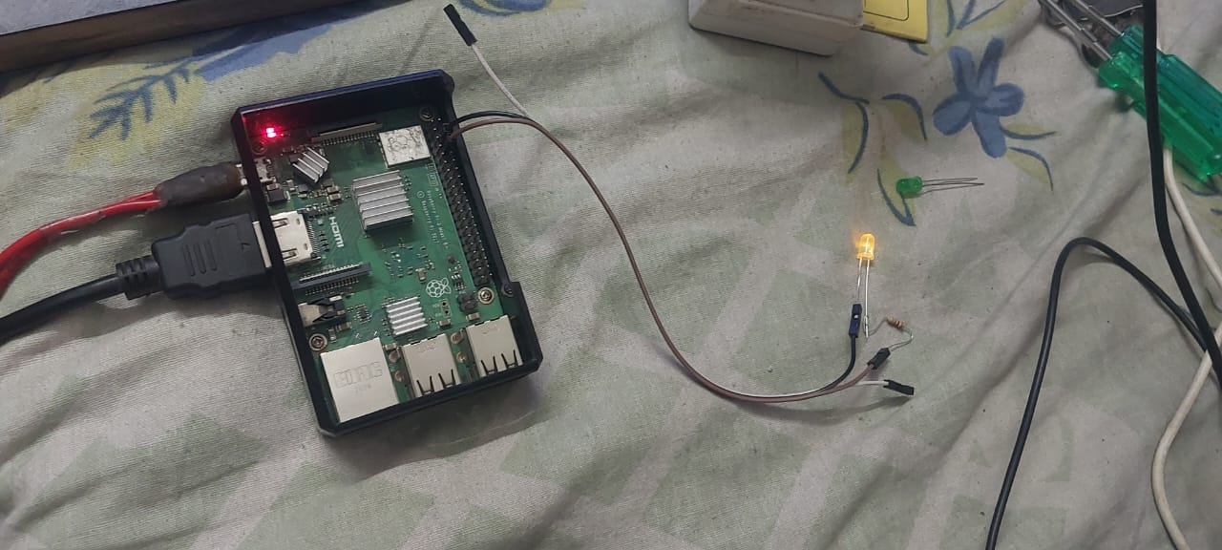
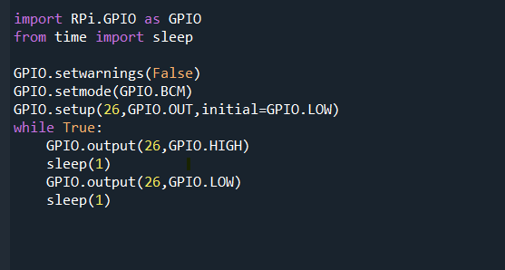
LED BLINKING CODE

Slide 11
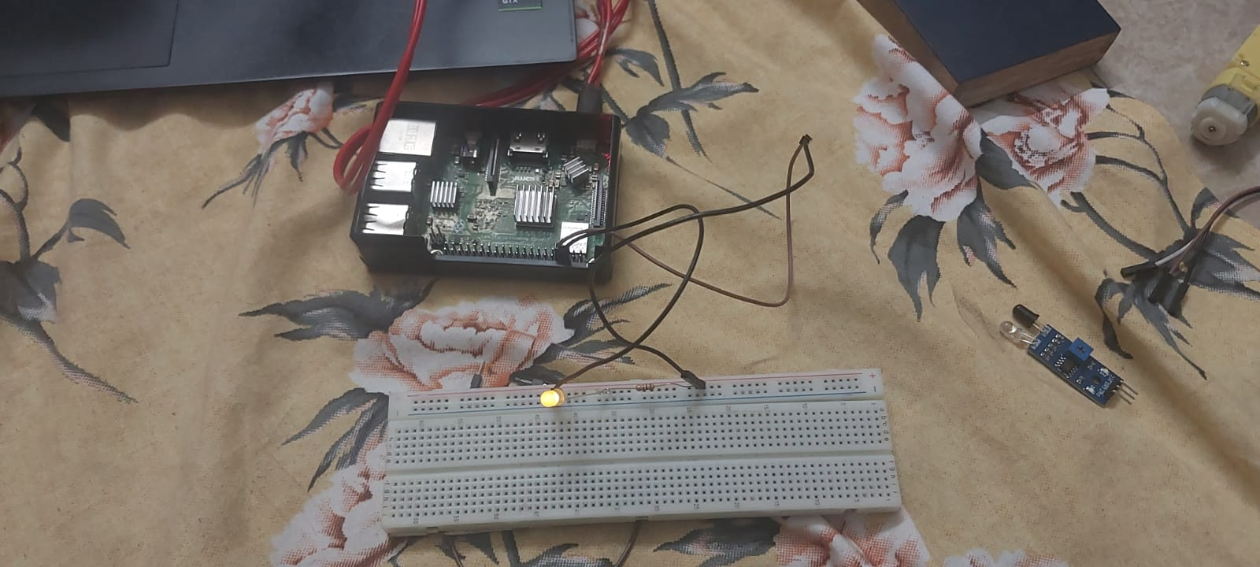
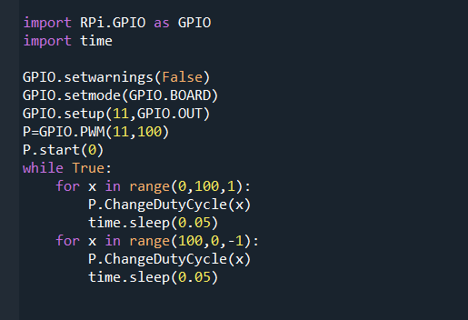
PWM LED Control
CODE

Slide 12
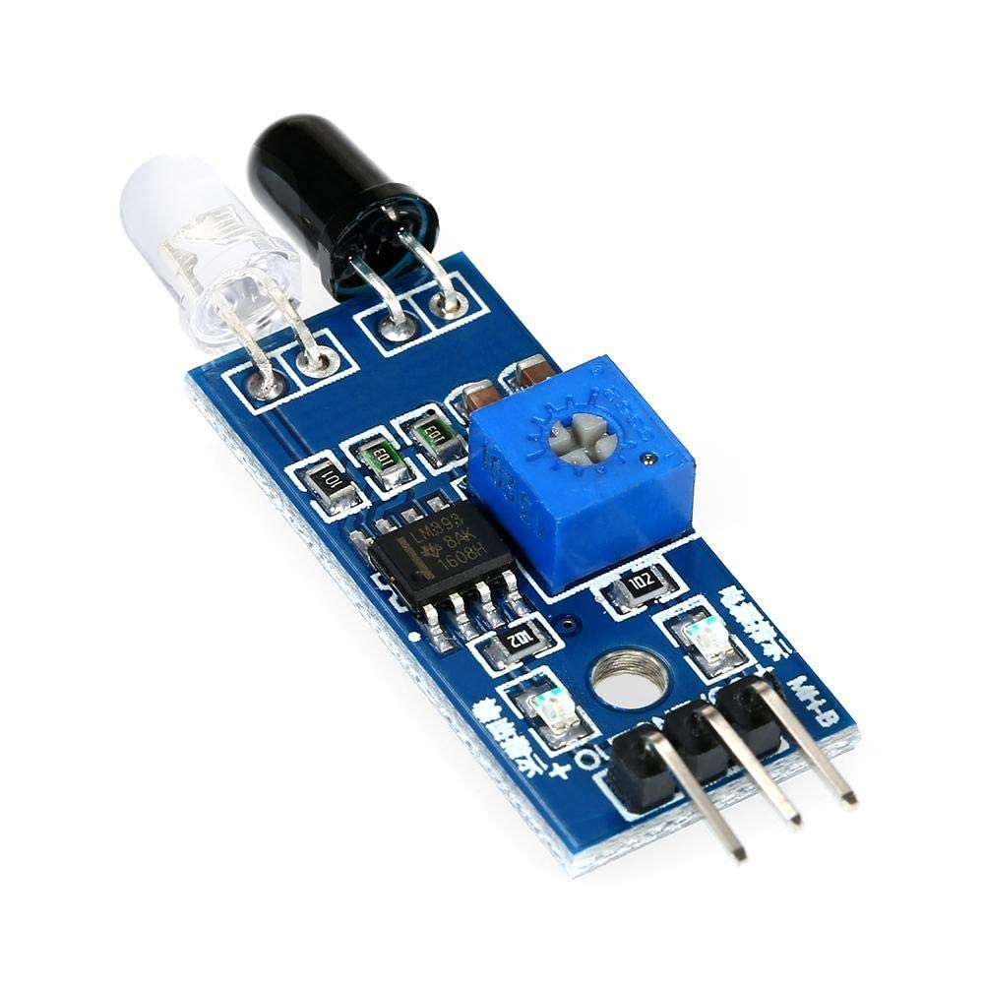
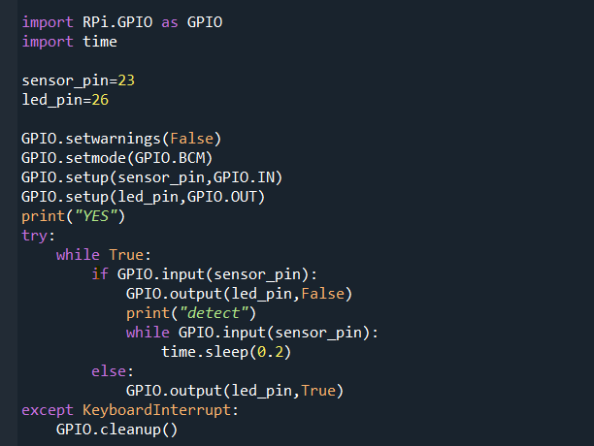
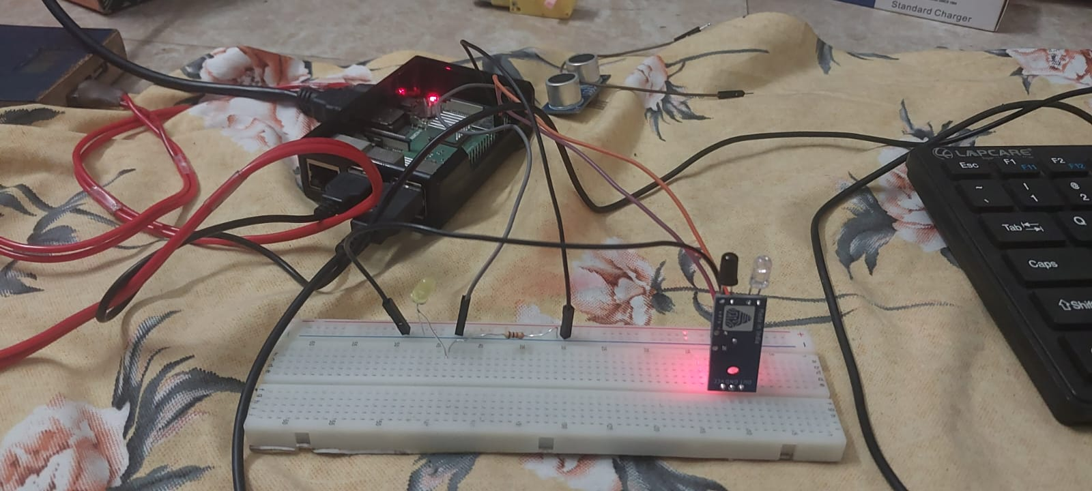
IR SENSOR
CODE

Slide 13
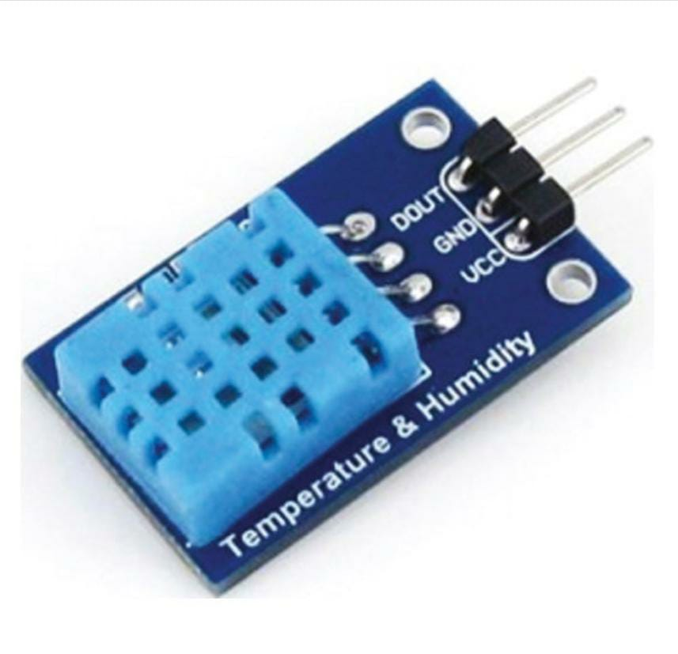
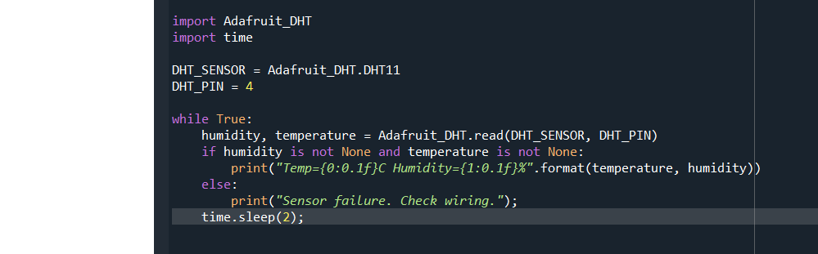
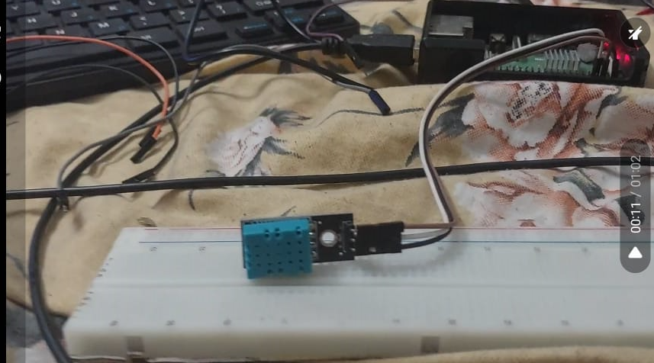
TEMPERATURE AND HUMIDITY SENSOR
CODE

Slide 14
Implementation of Blockchain
At core level, this code creates a basic implementation of a blockchain using Python
We are using sha256 hashing algorithm for creating the hash. The first block called the ‘Genesis Block ‘ is made automatically and it has no previous hash.
All other blocks we create manually by mining and two blocks are linked by including the hash of the previous block in the current block
proof-of-work algorithm is used to calculate a valid proof for the new block, based on the previous block's proof, the current index, and the new block's data.
We have used method that checks the integrity of the chain by iterating over all blocks in the chain, verifying that the previous hash of the current block matches the hash of its previous block, and that the hash of the current block meets the difficulty level of the proof of work.

Slide 15
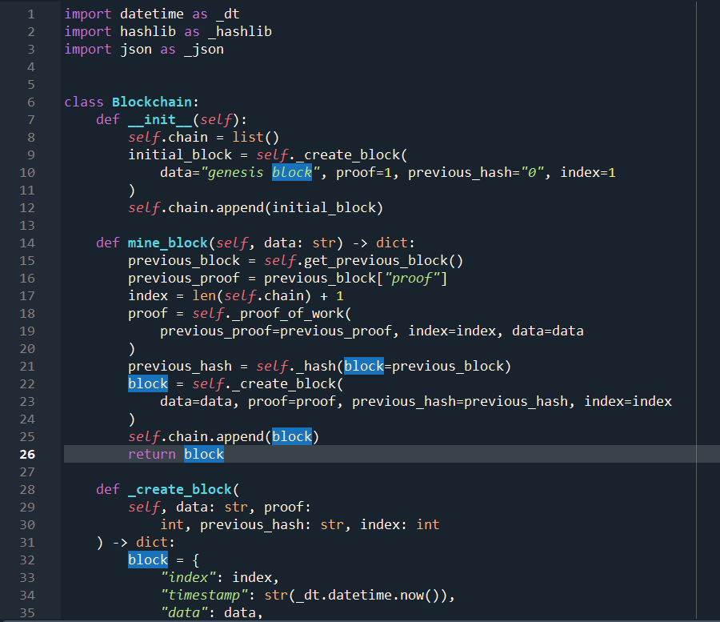
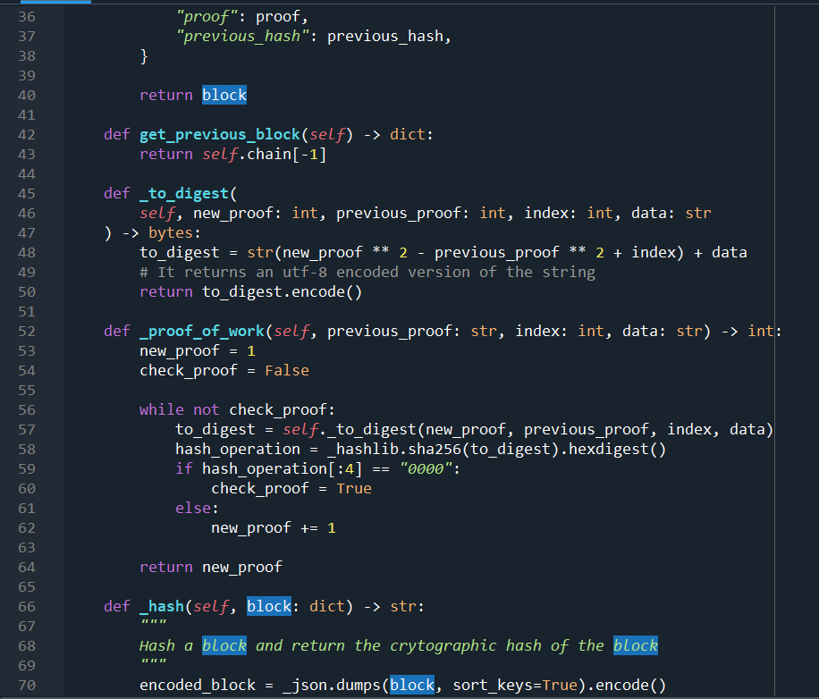
Code

Slide 16
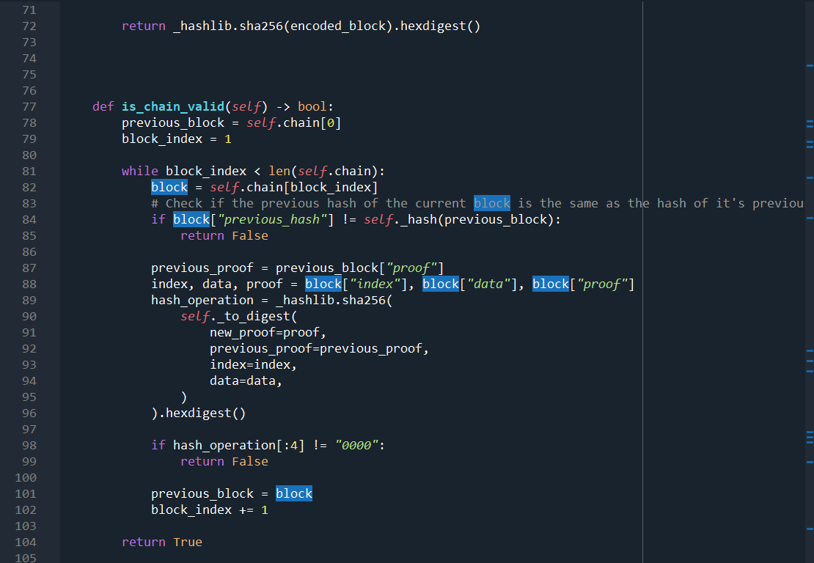

Slide 17
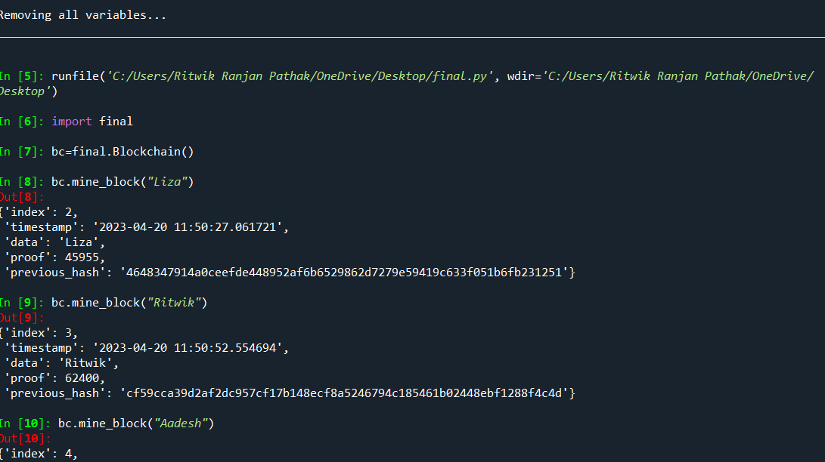
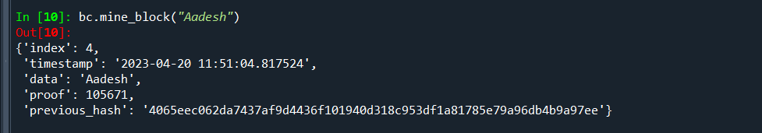
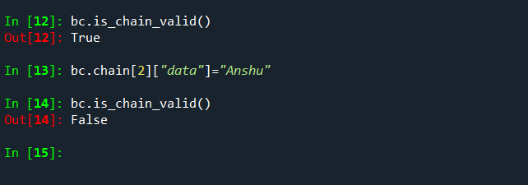
OUTPUT

Slide 18
Future Work
We will implement Consensus algorithm ensure that all nodes on the network agree on the validity of a transaction before it is added to the blockchain.
Improve the proof of work function so that it become more difficult to mine the block and hence our blockchain security will enhance
We will link our blockchain with API’s like Fast API so that we can remotely access our blockchain from anywhere.

Slide 19
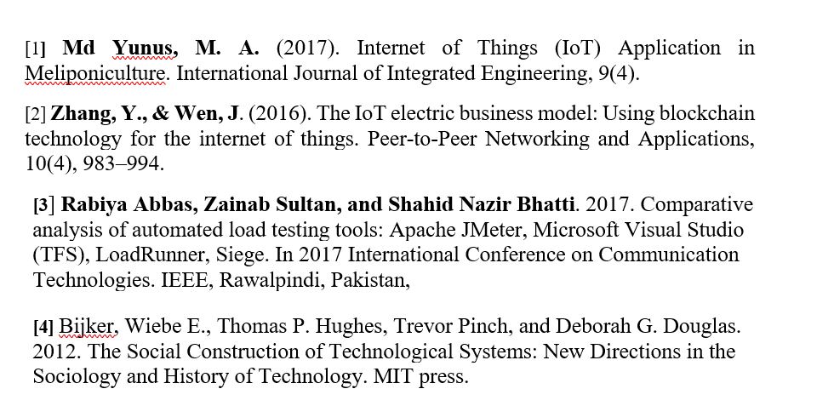
REFERENCES

Slide 20
THANK YOU

