Slide 1
Food View Visualizing insights from Zomato, Swiggy and market trends
Ritwika Das Gupta (2348049)
Sayantan Ray (2348057)
Soham Chatterjee (2348062)
Swarnasish Banaerjee (2348066)
Under the guidance of Dr Senthil Vadivu M

Slide 2

Introduction: Swiggy and Zomato Data Analysis Dashboard
In the competitive food delivery market, Swiggy and Zomato lead with unique offerings. This Power BI dashboard provides a detailed analysis across three main areas:
Individual Dataset Analysis:
Swiggy: Analyzes restaurant names, categories, ratings, costs for two, and locations to identify customer preferences and cost trends.
Zomato: Examines features such as online ordering, table booking, ratings, votes, restaurant types, popular dishes, cuisines, costs, and reviews to assess their impact on customer satisfaction.

Slide 3
Introduction: Swiggy and Zomato Data Analysis Dashboard
Stock Analysis:
Swiggy: Reviews historical stock data and financial metrics to evaluate the influence of business decisions and market events.
Zomato: Analyzes stock trends and financial health to understand market reactions and financial performance.
Sentiment Analysis:
Categorize and quantify sentiments from customer reviews to gauge satisfaction and identify areas for improvement.

Slide 4
What are the objectives?
Individual Dataset Analysis: Uncover patterns in Swiggy's restaurant categories, ratings, pricing, and geographic distribution, and gain insights into Zomato's customer preferences, online orders, table bookings, and popular dishes.
Stock Performance Analysis: Evaluate Swiggy’s and Zomato’s stock performance, identifying key trends and financial indicators.
Comparative Analysis: Compare Swiggy and Zomato on customer ratings, costs, services, and stock performance to assess their competitive positioning and provide actionable insights.
Market Insights: Offer an overview of the food delivery industry, predict future trends, and identify growth areas.
Sentiment Analysis: Analyze customer reviews to categorize sentiments and gauge satisfaction, identifying areas for improvement.

Slide 5
Dataset Description
Restaurant Name: The name of the restaurant (e.g., Jalsa).
Online Order: Indicates whether the restaurant accepts online orders (Yes/No).
Book Table: Indicates whether table booking is allowed (Yes/No).
Rating: The average customer rating of the restaurant, typically on a scale (e.g., 4.1/5)
Votes: The number of votes or reviews the restaurant has received (e.g., 775).
Location: The area or neighborhood where the restaurant is situated (e.g., Banashankari).
Restaurant Type: The type of restaurant, such as Casual Dining, Café, etc. (e.g., Casual Dining).

Slide 6
Dataset Description
Dish Liked: Popular dishes that customers enjoy at the restaurant (e.g., Pasta, Lunch Buffet).
Cuisines: : The types of cuisines offered by the restaurant (e.g., North Indian, Mughlai, Chinese).
Approximate Cost for Two: The estimated cost for two people to dine at the restaurant (e.g., 800).
Reviews List: A list of customer reviews, often including ratings and comments (e.g., multiple reviews with ratings like 'Rated 4.0').
Menu Item: The items listed on the restaurant's menu, which might be an empty list in some cases.
Listed In (Type): The category or type under which the restaurant is listed (e.g., Buffet, Dine-out).

Slide 7
Data Preprocessing
Cleaning the Data:
Rating:
Null/New Ratings: Standardize null or new ratings by categorizing them as "unrated." This ensures consistent handling of incomplete rating information and prevents data skew.
Location:
Missing Location Data: Exclude entries with null or missing location data. This is crucial for accurate geographic analysis and maintaining the validity of spatial insights.
Ratings Imputation:
Missing Ratings: Impute missing ratings with the average rating of the particular restaurant, or based on similar restaurants if specific data is not available. This maintains dataset continuity and accuracy.

Slide 8
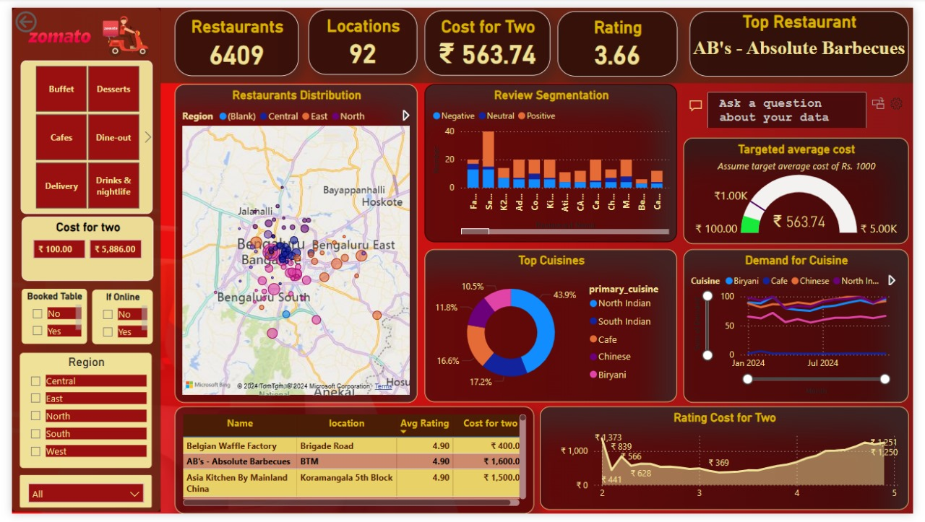
Bangalore Restaurant Dashboard: A Comprehensive Overview of Dining Trends and Preferences
This dashboard visually presents restaurant data in Bangalore, highlighting key metrics such as restaurant distribution, costs, ratings, and popular cuisines. It provides insights into customer preferences and regional dining trends.

Slide 9
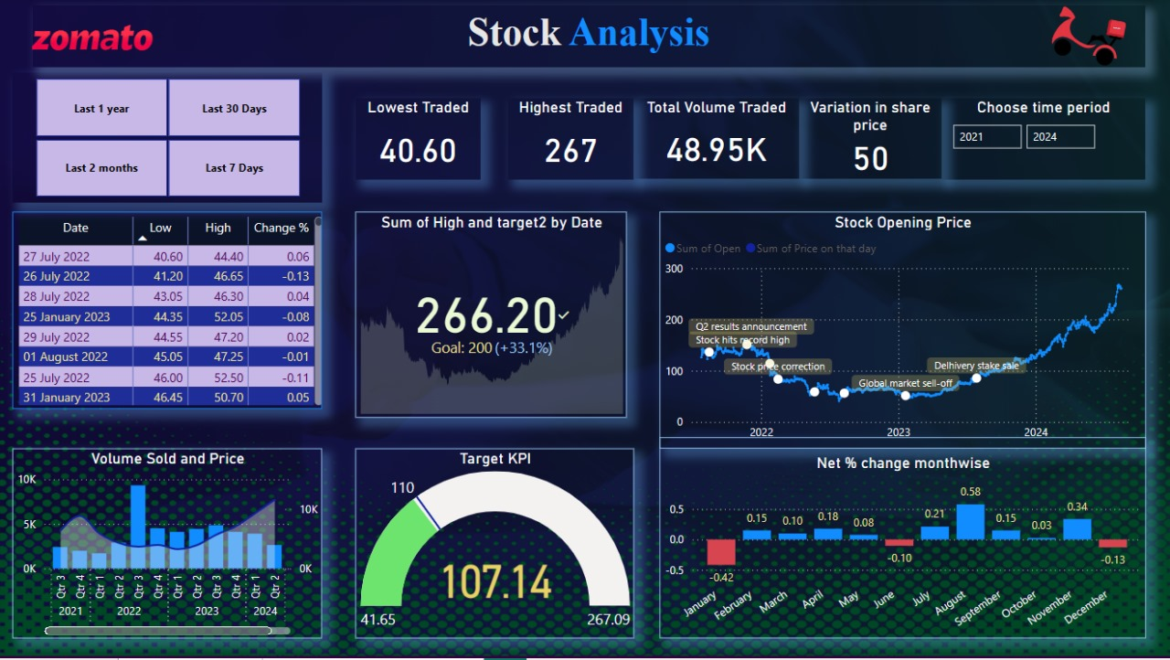
Zomato Stock Performance Analysis Dashboard
This dashboard offers a detailed look at Zomato's stock performance, showcasing key metrics, trading volumes, and price trends from 2021 to 2024, along with visualizations of significant market events.

Slide 10
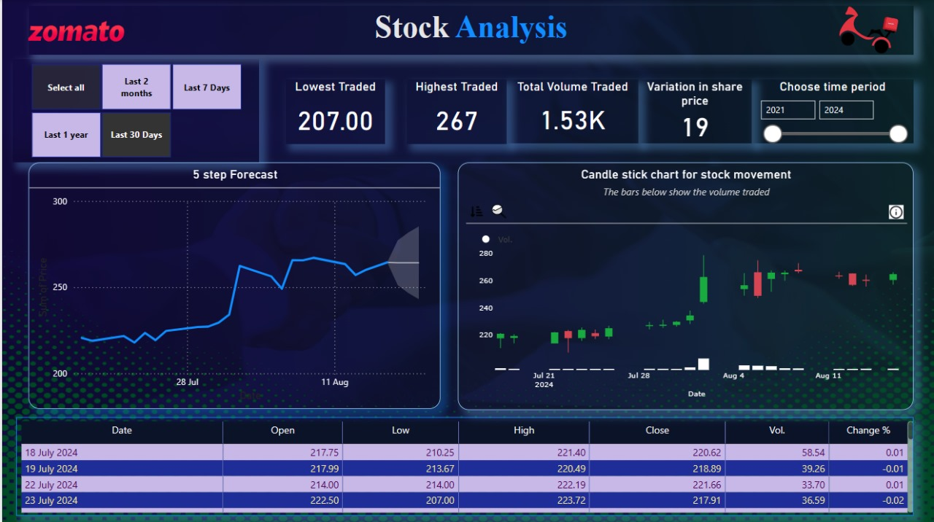
Zomato Stock Analysis Overview
This dashboard provides an analysis of Zomato's stock performance, highlighting key metrics such as lowest and highest traded prices, total volume, share price variations, a five-step price forecast, and candlestick chart for stock movement over a selected period.

Slide 11
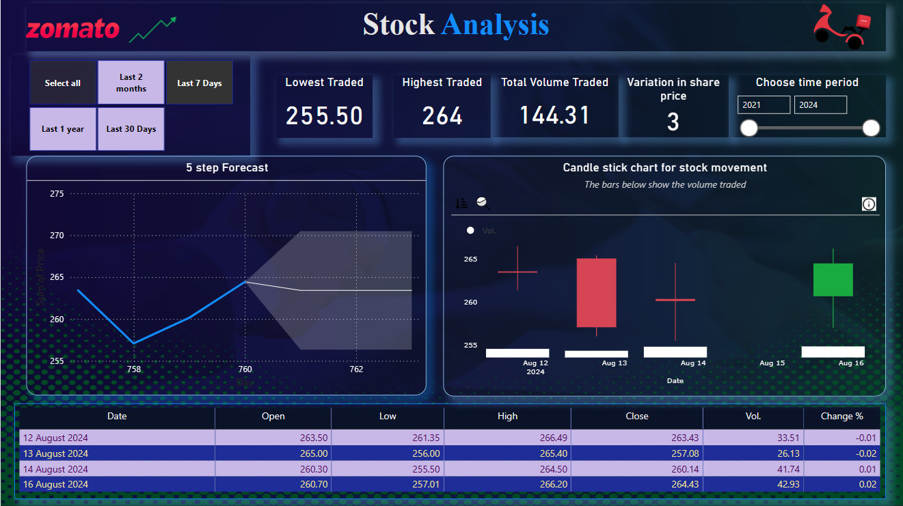
Zomato Stock Analysis - Recent Trends
This dashboard provides a detailed analysis of Zomato's stock activity over the past week, showing key metrics like the lowest and highest traded prices, total volume, share price variation, a five-step price forecast, and candlestick chart illustrating stock movements.

Slide 12
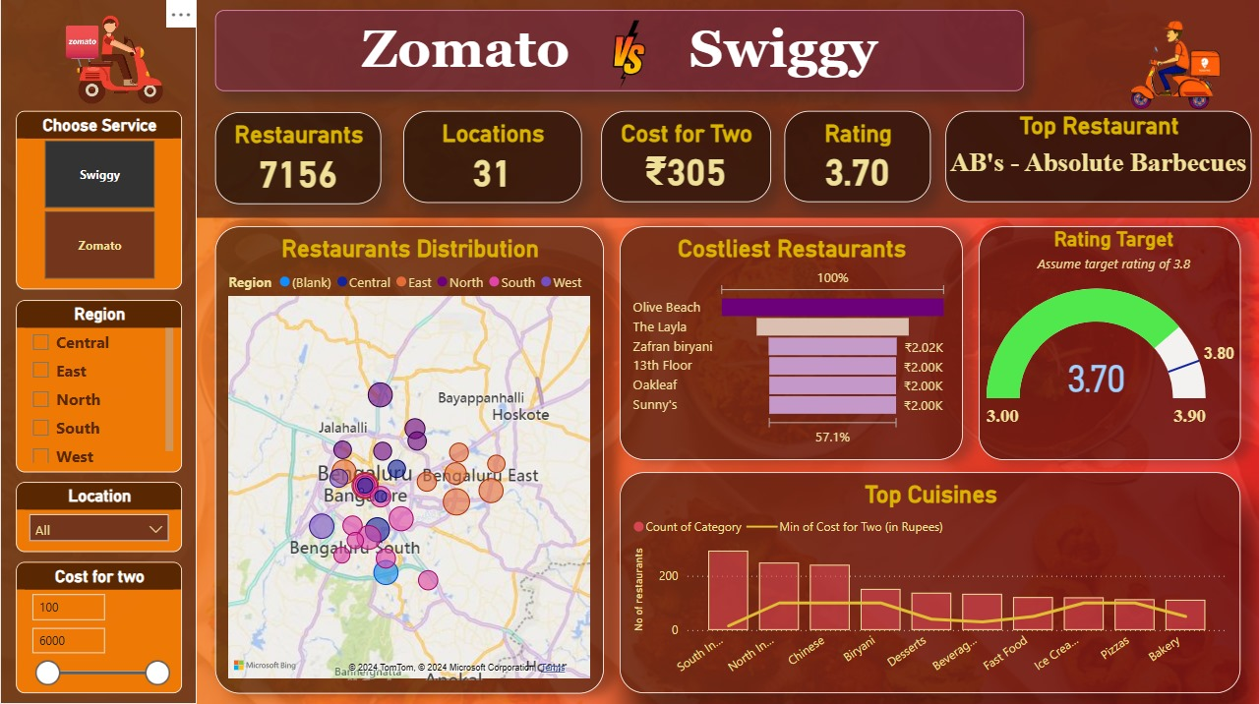
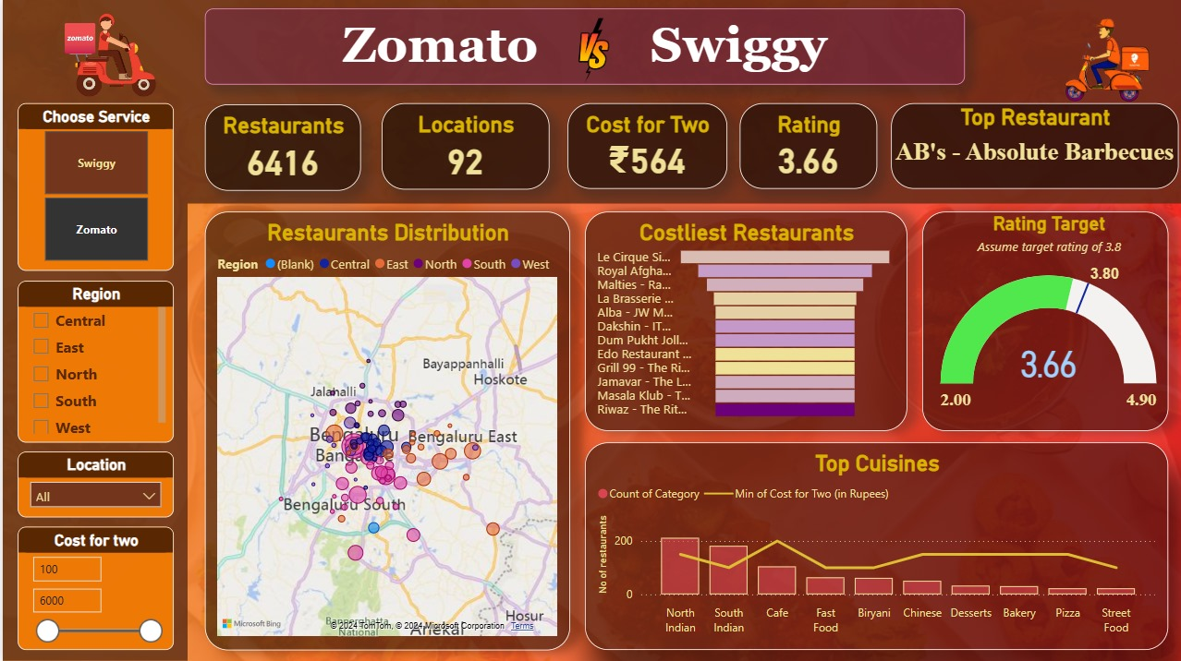
Zomato vs. Swiggy Restaurant Comparison
This dashboard compares Zomato and Swiggy across metrics such as the number of restaurants, locations, cost for two, and ratings, while highlighting restaurant distribution, costliest options, and top cuisines in Bangalore.

Slide 13
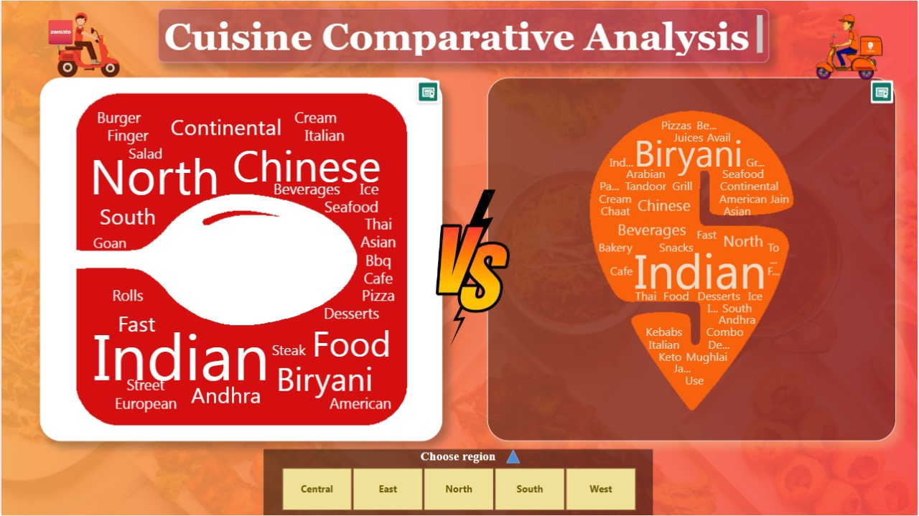
Cuisine Diversity on Zomato vs. Swiggy
Zomato offers a broader selection of global cuisines, while Swiggy emphasizes a stronger focus on Indian regional dishes like Andhra, South Indian, and North Indian.

Slide 14
Zomato vs. Swiggy: A Snapshot of India's Food Delivery Landscape
Market Reach: Zomato operates 6,416 restaurants across 92 locations, while Swiggy covers 7,156 restaurants in 31 locations.
Pricing Strategy: Swiggy targets budget-conscious customers with an average cost for two at Rs. 305, compared to Zomato's Rs. 564.
Customer Satisfaction: Both platforms score high in customer satisfaction, with Swiggy slightly ahead (3.70 vs. 3.66).
Cuisine Spectrum: Zomato excels in international cuisines, while Swiggy focuses more on regional Indian specialties.
Regional Tastes: Northern regions favor international cuisines, while Southern regions show a preference for local dishes.
Stock Insights: Zomato’s stock exhibits volatility, but recent trends suggest possible stabilization.

Slide 15
Limitations
Geographic Scope: The study focuses mainly on Bangalore, which may not fully reflect trends in other cities or rural parts of India.
Platform Bias: The data is sourced from Zomato and Swiggy, potentially excluding restaurants listed exclusively on other platforms or not available on any delivery app.
Limited Time Frame: Zomato's stock performance analysis is constrained by its recent IPO in July 2021, limiting long-term insights.
Data Completeness: Some gaps in the data, such as missing reviews or incomplete restaurant details, could affect the overall accuracy of the analysis.
Data Consistency: Inconsistencies in columns like 'Rating' led to significant data cleaning, suggesting a need for more standardized and reliable data collection practices by the platforms.

