Slide 1
AI Code Generator
From PRD to Production-Ready Code — Powered by LLMs
Proof of Concept • Demo
Ritwika Law
Notes:
Opening line: 'What if writing software started with one paragraph and ended with tested, documented code in minutes — not weeks?' Introduce yourself and the POC.

Slide 2
The Problem
• Translating a PRD into a working codebase is slow and repetitive.
• Architecture, code scaffolding and tests are written by hand — even when patterns are well-known.
• Developers spend significant time on boilerplate instead of business logic.
• Onboarding new engineers to a project is expensive — system context lives in heads, not artifacts.
• Tests are often written last (or skipped) under delivery pressure.
AI Code Generator • Demo
2
Notes:
Set the pain point. Most teams know this. Don't oversell — frame it as a productivity opportunity, not a replacement for engineers.

Slide 3
The Idea
One paragraph in. A full project skeleton out.
• Feed a PRD to an LLM-powered pipeline.
• Auto-generate a system design document — architecture, schema, API contracts.
• Auto-generate a production-grade codebase in your chosen stack.
• Auto-generate unit & integration tests against that code.
• Developers review, refine, and ship — instead of starting from scratch.
AI Code Generator • Demo
3
Notes:
Keep this tight. The whole pitch fits on one slide. Position as a 'first draft generator', not 'auto-pilot'.

Slide 4
How It Works — 4-Stage Pipeline
PRD
Product Requirements
System Design
Architecture · Schema · APIs
Code
Routes · Services · Models
Tests
Unit · Integration · Edge cases
Each stage feeds the next. The LLM gets richer context at every step.
• Stateless: any stage can be re-run with edits to its input.
• Stack-aware: target Node.js / Express, Java / Spring Boot, or Python / FastAPI.
• Output is plain Markdown + code blocks — easy to copy, diff, and commit.
AI Code Generator • Demo
4
Notes:
Walk through left-to-right. Emphasise that each stage's output becomes the next stage's input — that's how we keep LLM hallucinations grounded.

Slide 5
Tech Stack
LLM Layer
Backend
UI
Output Stacks
• OpenAI / OpenRouter API
• Model: gpt-4o-mini (configurable)
• Temperature: 0.3 for determinism
• Python 3.11+
• Prompt templates per stage
• Pluggable target stacks
• Streamlit
• Paste / Upload / Examples
• Live progress + download
• Node.js + Express + Jest
• Java + Spring Boot + JUnit
• Python + FastAPI + pytest
AI Code Generator • Demo
5
Notes:
Keep this fast. The point is: nothing exotic. Standard Python, standard Streamlit, swap the model with one config line.

Slide 6
Live Demo: Step-by-Step
The next slides walk through the application demo using the 'Task Manager' PRD and Node.js stack. Each step is illustrated with real screenshots.
AI Code Generator • Demo
6
Notes:
The following slides show the app in action using the 'Task Manager' PRD and Node.js stack.

Slide 7
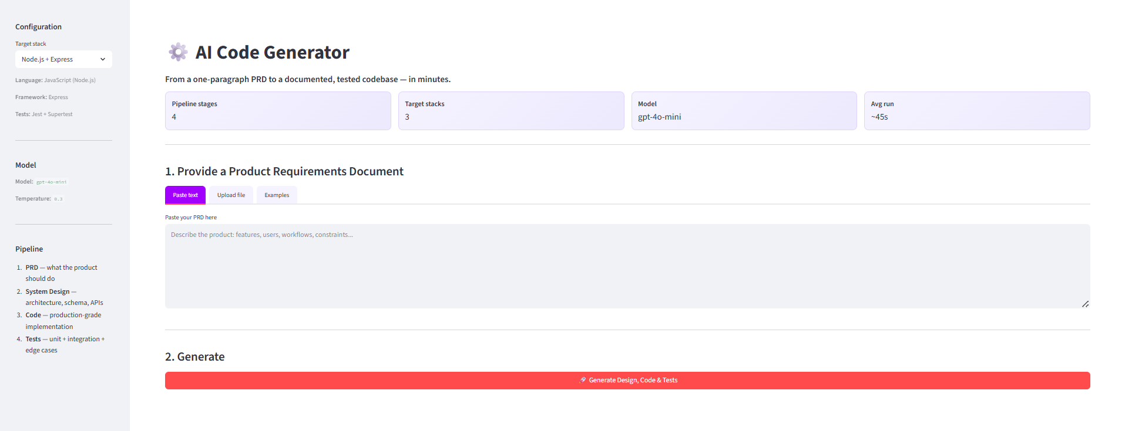
Step 1: Home/Landing Page
The app's landing page where users start the code generation process.
AI Code Generator • Demo
7

Slide 8
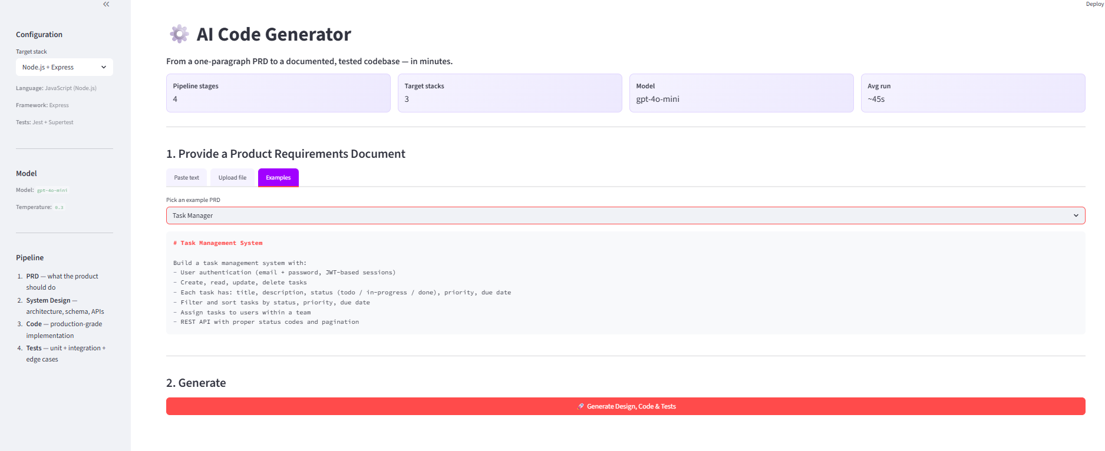
Step 2: Enter PRD Example
Paste the 'Task Manager' PRD into the input area.
AI Code Generator • Demo
8

Slide 9
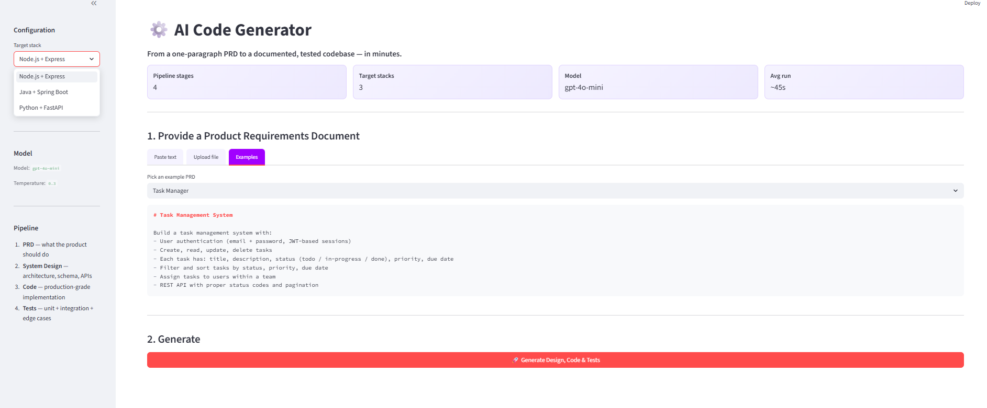
Step 3: Select Node.js Stack
Choose Node.js + Express as the target stack.
AI Code Generator • Demo
9

Slide 10
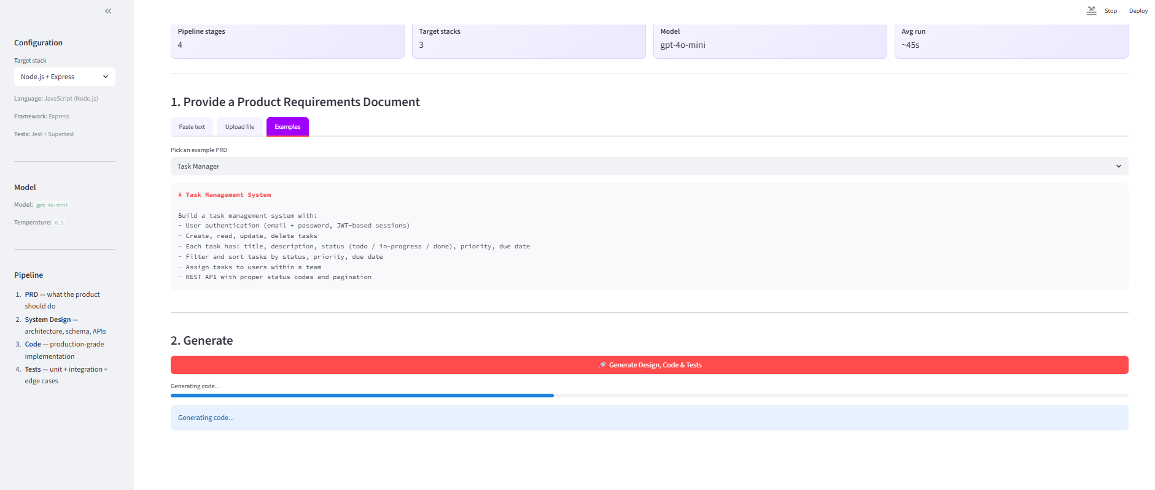
Step 4: Generation in Progress
The app shows real-time progress as the LLM generates code.
AI Code Generator • Demo
10

Slide 11

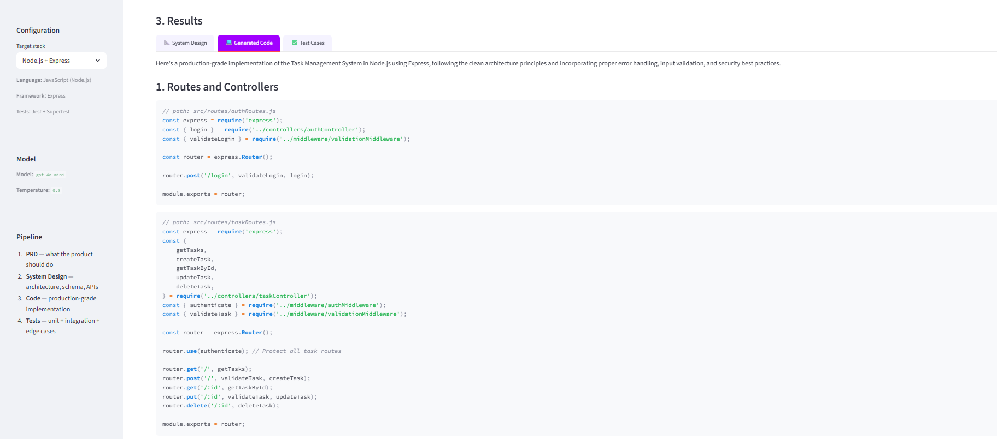
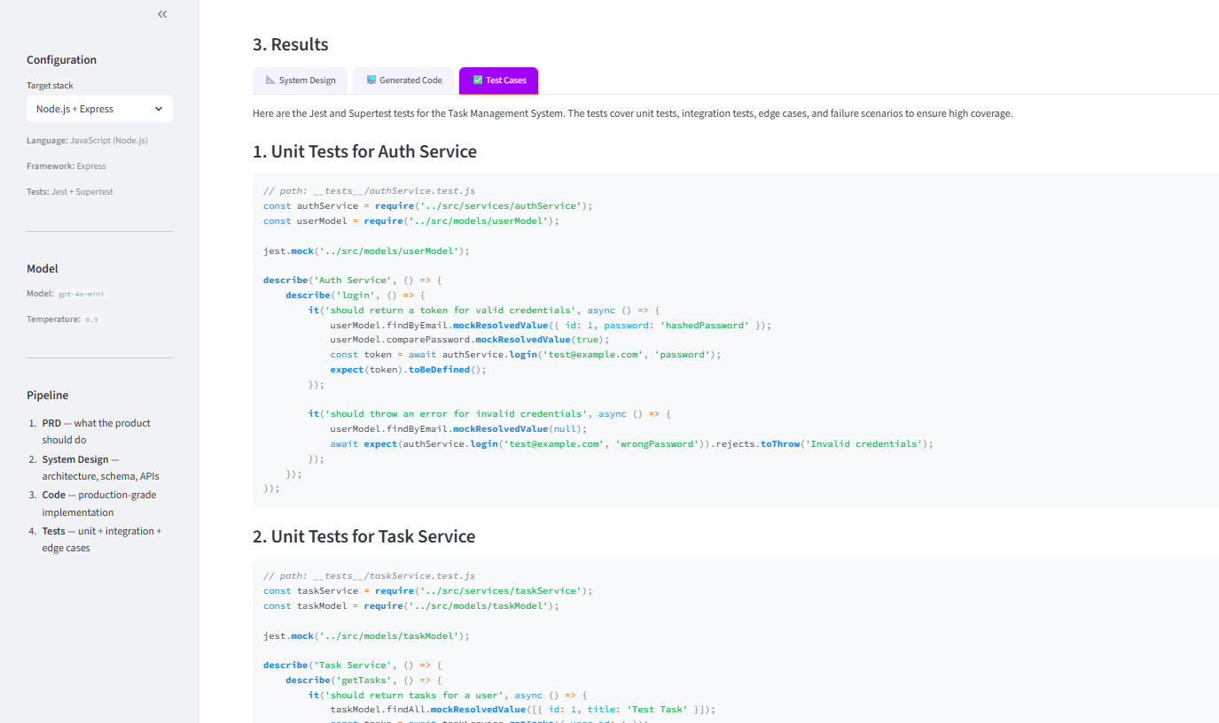
Step 5: Output & Download
System Design Output
Generated Code Output
Test Cases Output
View and download the generated code, system design, and test cases.
AI Code Generator • Demo
11

Slide 12
Why It Matters
Speed
Consistency
Hours of scaffolding compressed into minutes.
Every project starts from the same architectural baseline.
Documentation
Test-first
System design doc is a by-product, not an afterthought.
Tests are generated alongside code — not skipped under deadline.
Onboarding
Stack-agnostic
New devs read a clean, generated baseline before customising.
Same PRD, different language — useful for prototyping and migration.
AI Code Generator • Demo
12
Notes:
Lead with speed — it's the easiest win to communicate. End with 'this is a starting point, not a replacement'.

Slide 13
What This Is — and What It Isn't
Strengths
Honest Limitations
• Excellent for greenfield prototypes.
• Strong on well-known patterns (REST CRUD, auth, etc.).
• Produces readable, idiomatic code.
• Tests cover happy + key edge paths.
• Not a replacement for an engineer — it's a first-draft generator.
• Generated code needs review for security & correctness.
• Complex domain logic still needs human design.
• LLM cost scales with PRD size and number of regenerations.
AI Code Generator • Demo
13
Notes:
Showing limitations builds credibility. Audience trusts you more when you name the trade-offs before they do.

Slide 14
What's Next
Near-term
Mid-term
Long-term
• Multi-file output as a runnable repo (not just markdown).
• Git-init + first-commit automation.
• Diagram generation (Mermaid) alongside design doc.
• Agentic refinement loop — generator critiques and self-edits.
• Plug in retrieval over org-specific patterns and guardrails.
• CI pipeline scaffolding (GitHub Actions / Azure DevOps).
• Iterative dev loop: developer edits → LLM re-syncs design & tests.
• Compliance / security checks built into the generation pipeline.
• Multi-service architecture generation from a single PRD.
AI Code Generator • Demo
14
Notes:
Pitch this as a roadmap, not a wishlist. Invite collaborators if your forum is the right audience.

Slide 15
Thank you.
Questions & feedback welcome.
ritwika.law@accenture.com
Notes:
Close with: 'I'd love to hear which parts of your team's workflow this could plug into.' Open the floor.

