Slide 1
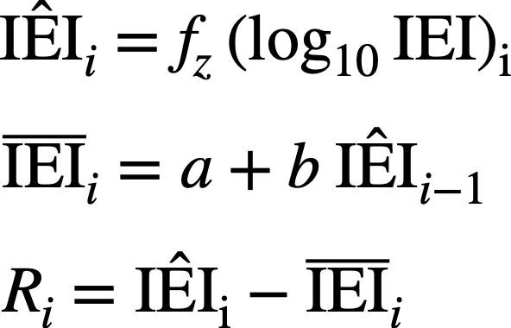
A
Duration
Onset
Offset
T_{resp}
ChSp
Ad
Inter-event Interval (IEI)
without response (NoResp)
IEI with response (Resp)
IEI $<$ T_{resp}
B
IEI₁
IEI₂
IEI₃
IEI₄
IEI₅
IEI₆
ChSp
1. Log transformation and normalization:
2. Correlation estimation:
3. Residual computation:
IEI₁
IEI₂
Ad
Notes:
Fig 1 (main text) schematics

Slide 2
Hum
ChSp
Ad
ChNsp
NA
ChSp
NA
Ad
NA
ChNsp
NA
NA
1 frame = 1 ms
Notes:
Reliability (Fig. S17) (Original slide size: 13.33in x 10.5 in; use this slide size for best results)

Slide 3
(A)
Key segments:
20 frames (T)
Hum
LENA
Miss: 3 frames (M)
False alarm: 5 frames (FA)
Confusion: 2 frames (C)
(B)
Hum
Total
L
Legend
H
ChSp
ChNsp
Ad
NA
M
ChSp
3
0
0
1
4
Miss rate (MR) = M/T = 0.15
False alarm rate (FAR) = FA/T = 0.25
Confusion rate = C/T = 0.1
FA
ChNsp
0
5
2
0
7
C
Ad
0
0
7
2
9
Identification error rate (IDER) =
FAR + MR+ CR = 0.5
T
NA
0
1
4
20
25
LENA
Total
3
6
13
23
45
Total num.
frames
Notes:
Reliability (Fig. S18) (Original slide size: 13.33in x 10.5 in; use this slide size for best results)

Slide 4
Infant
C
C
R
X
R
Adult
T
U
N
N
Identify
overlaps
Remove
overlaps
C
R
R
X
R
T
T
N
N
Notes:
OverlapProcessing (Fig. S21) (Original slide size: 13.33in x 4.5 in; use this slide size for best results)

