Slide 1

Collaborative AI Agents for Classical Music Composition - A Multi-Agent System for Music Generation
Bridging art and technology to democratize classical music creation

Slide 2

Problem Statement
Challenge: Classical music composition requires deep expertise in theory, harmony, rhythm, orchestration, and arrangement. It is inaccessible to most non-musicians.
Opportunity: AI agents can collaborate to automate these processes, enabling anyone to create high-quality classical compositions.
Vision: Redefine music creation by combining human creativity with autonomous AI precision.

Slide 3

Table of contents
01
02
03
04
05
06
Overview
Technical Details
Technical Details-Architecture
Impact
Future Vision
Why this project matters?

Slide 4
Overview
What We Built: A multi-agent system where specialized AI agents work collaboratively to generate complete classical compositions.
Key Features:
Melody generation based on style and mood.
Harmony progression tailored to the melody.
Rhythmic patterns with beat variations.
Instrumental arrangement with dynamic structuring.
Feedback loops for iterative refinement.

Slide 5

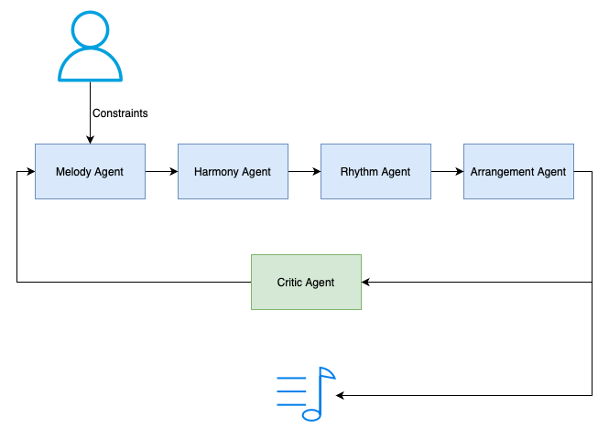
Technical Details - Architecture

Slide 6
Technical Details
1. Music Notation and Processing
music21:
A Python library for music theory, notation, and MIDI/score generation.
Used to create melodies, harmonies, rhythms, and render MusicXML scores.
2. AI Agent Framework
LlamaIndex:
Provides tools like ReActAgent for orchestrating specialized agents (e.g., MelodyAgent, HarmonyAgent).
Enables multi-agent collaboration and memory management for iterative composition workflows.
3. Audio Rendering Tools
FluidSynth:
Converts MIDI files into high-quality audio formats (WAV or MP3) using SoundFont files.
ffmpeg:
Converts WAV files to MP3 for more compact audio output.

Slide 7

Impact
Democratizing Music Creation:
Film Scoring & Media Production:
Non-musicians can compose professional-grade classical music without formal training
Generate custom compositions for movies, games, and advertisements.
Education:
Personalized Music Experiences:
Teach music theory interactively using AI-generated examples.
Create compositions based on user emotions or preferences.

Slide 8
Why this project matters?
Ambition:
Effectiveness:
Scalability:
Tackles the complexity of structured classical composition across multiple musical domains.
Produces end-to-end outputs—scores and audio—ready for professional use cases.
The Framework can be extended to other genres (jazz, pop) or integrated with live performance systems (MIDI inputs).

Slide 9
Future Vision
Expand genre capabilities beyond classical, and accommodate fusion
Integrate voice agents for accessibility
Develop user-friendly interfaces for non-musicians to interact with the system seamlessly

Slide 10

Thank You!
Do you have any questions?

