Slide 1

College Logo
Open-Source Workforce Administration System Using Django
Ritika Rastogi
Student, Computer Science, and Engineering Department
ABES Engineering College
Riya Gupta
Student, Computer Science, and Engineering Department
ABES Engineering College
Conference Acronym

Slide 2

What to Include ?
One slide information may be used for 30-60 seconds presentation; it may be organized as below.
  Introduction (1 slide)
  Background Theory/Equation/Problem (1-2 slides)
  Brief Related works or Literature survey (1-2 slides)
  Detailed Proposed model (5-7 Slides)
  Graphs, Tables, Results on proposed system (3-5 Slides)
  Comparison, Advantages & Disadvantages (1-2 Slides)
  Conclusion & Future Work (1-2 Slides)
  Acknowledgement (if any)
  References (1 Slide)
Conference Acronym

Slide 3
What NOT to Include?
Full of text may be avoided; (only points may be displayed on the slides and further can be discussed/presented).
Junk Animation, & Graphics may be avoided.
Try to avoid Programs, Pictures, Images, Screenshots; instead of Graphs, Algorithms, Tables, Block Diagrams, Circuits, etc.
Introduction, Background & Related Literature should not go beyond 3-4 slides.
Concentrate more on Proposed system or equations or algorithms, rather than existing one.
Slides are aiding tool for presentation; Slides shall be prepared to give a brief idea on the Aims & Objectives of the presentation or paper.
Conference Acronym

Slide 4
Introduction (1 slide)
The main objective of the paper is the introduction of a new system to solve the existing problems of small-scale organizations to manage their workforce efficiently.
It is very tedious task for small scale organizatios to manage their employees and some organizations still use the old conventional methods like recording information of employees or to keep track of their attendance and work progress.
Through, this system we are trying to solve this problem by making an open-source application which can be used by anyone easily.
Conference Acronym

Slide 5
Background of the Paper (1 slide)
Background of the paper on this paper is written.
Core and related subject area may be discussed
Conference Acronym

Slide 6
Related works (1 slide)
Related works/papers or Literature survey to be done from the recent developments (not older than 6-18 months) in the specific subjects.
The basic related Literatures of the proposed system shall be based on a systems which are proposed within 6-12 months prior to the paper submission.
Conference Acronym

Slide 7
Problem Formulation
Design a system for the organizations especially the small ones, that can’t afford the cost of expensive software to manage their employees they still do it manually on paper. The organizations have bundles of registers to track their attendance and keep their details etc.
It makes it very difficult if they have to search for any information for any particular day or search about any particular employee etc.
This was just one of the problems that they faced, apart from this they have various other problems.
It solve all these problems we have created this system.
Conference Acronym

Slide 8
Proposed System (2-3 Slides)
The proposed system has one main admin dashboard which is referred to as HR View or Dashboard here. The Hr dashboard has been provided with all the administrative rights. There are other views for employees, team leads and freshers.
The main technologies that are used to implement this system are:-
i)Django(a web-based python framework)
ii)HTML,CSS and CSS libraries like Bootstrap and Material Admin are being used.
Conference Acronym

Slide 9
Proposed System (2-3 Slides)
Django follows MVT architecture i.e.
i.)Model
ii.)View
iii.)Template
Conference Acronym

Slide 10
Proposed System (2-3 Slides)
HTML, CSS and JavaScript-HTML are used to provide structure to the website.CSS is used for styling the website and JavaScript is used to provide interactivity to the website. In this application, we have used two CSS frameworks: -
Bootstrap-It is one of the most extensively used HTML, CSS, and JavaScript frameworks. It is an open-source framework and is free to use. It follows a mobile-first approach. It helps to make the website fully responsive and has various built-in classes which could easily manipulate the styling of the web page.
Materialize CSS-It is a UI component library developed and designed by Google. The main goal of building this was to allow for a unified user experience across all the products developed by them across all the platforms. We have used bootstrap to make the dashboards more interactive and to follow the dashboard convention.
Conference Acronym

Slide 11
Results (2-3 Slides)
1.)HR View:-
View the Employees List, and their details, and execute CRUD actions on them.
View the Organization's different departments.
Take a look at the projects the company is working on and keep track of their progress.
Verify any employee's attendance record.
Distribute discounts and bonuses to various staff.
Send out crucial notifications.
Examine employee feedback.
Approve leaves
Conference Acronym

Slide 12
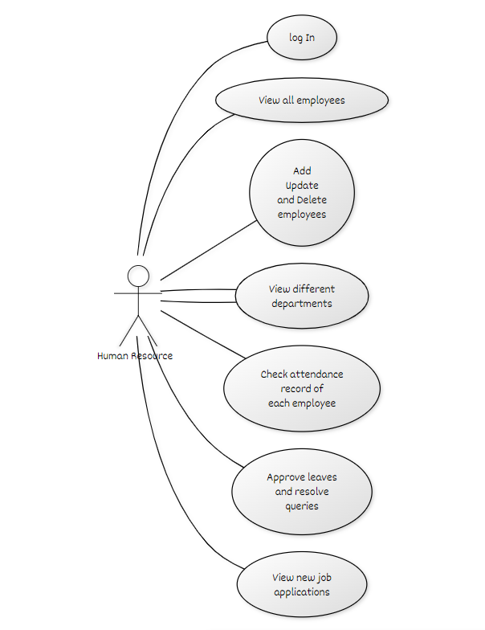
Results (2-3 Slides)
Conference Acronym

Slide 13
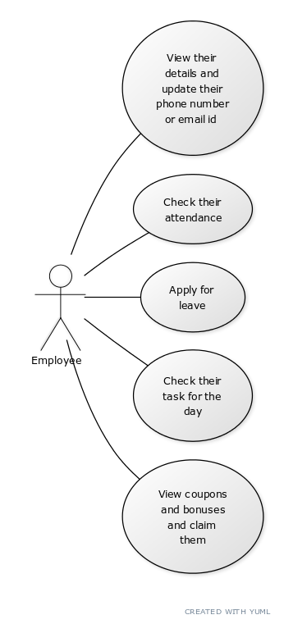
Results (2-3 Slides)
2.)Employee View:-
(i)Review their information and make any necessary changes.
(ii)Mark their attendance.
(iii)Request leave.
(iv)Verify the day's assignment.
(v)View discounts and rewards and redeem them.
Conference Acronym

Slide 14
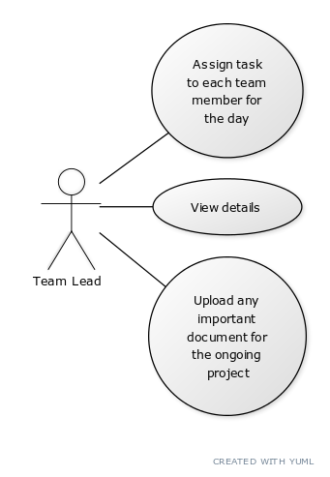
Results (2-3 Slides)
3.)Team-Lead View:-
(i)View information
(ii)Assign daily tasks to each team member.
(iii)Any necessary documents for the current project
could be uploaded.
Conference Acronym

Slide 15
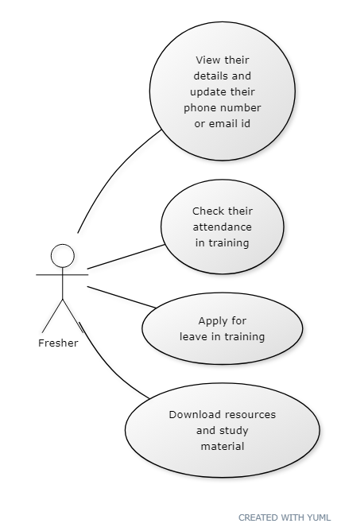
Results (2-3 Slides)
4.)Freshers View:-
(i)View information
(ii)Assign daily tasks to each team member.
(iii)Any necessary documents for the current project
could be uploaded.
Conference Acronym

Slide 16
Results (2-3 Slides)
Most relevant parameters and characteristics of the proposed system may be studied and analyzed.
Appropriate external parameters or raw materials may be used or provided
System may be passed through the relevant and fair conditions and environment.
Competent Machines or simulation tools may be used for experiment and result analysis.
Conference Acronym

Slide 17
Comparison (2-3 Slides)
Comparison of the results of the proposed system (in the paper) with the recently proposed system.
Presenters shall compare the proposed system with two or more a systems which are proposed within 6-12 months prior to the paper submission.
Conference Acronym

Slide 18
Discussion (1-2 Slides)
Comparison of the proposed system and results can be discussed and substantiated further with two or more case studies.
Conference Acronym

Slide 19
Conclusions (1 slide)
One of the major achievement of the system are that is if help manage organizations manage their workforce without any external cost.
This system will increase the transparency between organizations and employees and reduce the communication gap between the organizations and employees.
This system is highly secured as compared to the manual handling systems.
Conference Acronym

Slide 20
Future work (1 slide)
These days for taking attendance mainly biometric systems are used but we haven’t integrated it with our system yet. So, our future plan is to integrate biometric attendance system in our proposed system.
Conference Acronym

Slide 21
References
[1] Bajpayi, Rishabh. (2020). Employee Management System. International Journal for Modern Trends in Science and Technology. 6. 225-234. 10.46501/IJMTST061242.
[2] Singh, P., Fartyal, H., Zubair, K. A. A., & Laddha, A. (2019). Employee Management System. International Research Journal of Engineering and Technology (IRJET), 6.
[3] Punia, R., Panwar, S., Kamra, R., & Gupta, R. (2020). Voice-Based Employee Management System Using AWS and Alexa. International Journal of Innovative Research in Computer Science & Technology (IJIRCST), ISSN, 2347-5552.
[4] "Administration in Employee Management System", International Journal of Emerging Technologies and Innovative Research (www.jetir.org | UGC and ISSN Approved), ISSN:2349-5162, Vol.7, Issue 1, page no. pp125-132, January-2020, Available at:http://www.jetir.org/papers/JETIR2001022.pdf
Conference Acronym

