Slide 1

Department of Computer Science & Engineering
PROJECT EVALUATION
Team Members
Ritika Rastogi -1900320100127
Riya Gupta-1900320100129
Guide
Ayushi Agarwal, Asst. Professor, CSE

Slide 2
Open –Source Workforce Administration System Using Django
Ritika Rastogi 1 1900320100127
Riya Gupta I 1900320100129
Guide: Ayushi Agarwal

Slide 3

Problem Statement
Design a system for the organizations especially the small ones, that can’t afford the cost of expensive software to manage their employees they still do it manually on paper. The organizations have bundles of registers to track their attendance and keep their details etc. It makes it very difficult if they have to search for any information for any particular day or search about any particular employee etc.
Moreover, in this type of system, the proxy could also be easily done, which would create difficulty for the organizations to manage the employees moreover searching for anything related to them was also a very tedious task.
Therefore we need to develop an application system that could easily run on their computers just with a few installations. This would also be cheap and help automate the system.

Slide 4
Aim
The main objective of the project is to create a WORKFORCE ADMISTRATION SYSTEM using Django that is open-source and can be used by any organization who want to automate the system of managing their employees in a secure and easy way.
The system ensures organization's growth and seamless operation by managing its most valuable asset i.e the employees .

Slide 5
Scope of the Project
The project's primary goal is to develop a workforce administration system. The Software application provides 4 views namely-
1. HR
2. Employee
3. Team Lead
4. Fresher

Slide 6
Scope of the Project
The system's capabilities include-
Keeping each employee's information, adding new hires, and eliminating those who leave the company. This system will also keep track of the employees' daily attendance as well as their absences.
The system will make it easy for the project teams and leads to interact with each other and would also make the working on the project and its progress very transparent.
This application would not only make the administration of employees easy but would also increase the performance rate of the employees as they would be offered bonuses and coupons for their good performance, which could be redeemed easily by the employees through the dashboard

Slide 7
Software & Hardware Requirements
We have used Django in this project. The minimum requirements to run Django are :
4GB RAM,
Intel Core-i3
Windows 7 or above.

Slide 8
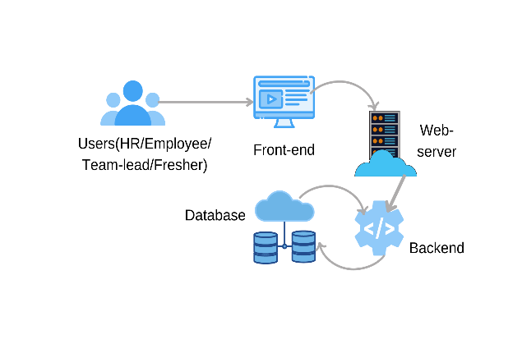
Proposed Method
To create this project, we have used Django, a high-level python web-framework.
The architecture of the system mainly consists of the following parts:-
Frontend-This is the interface with which the users will interact..
Backend-The backend of any application is basically what goes on behind the scenes. It consists of APIs, servers, operating systems, databases and more all of which come together to ensure that correct information is served to the user as quickly as possible.
Database-It is an organized collection of structured data. It is responsible for storing the information entered by the user and for storing the data which is displayed on the front-end of the application after being fetched from here.

Slide 9
Proposed Method
To create this project, we have used Django, a high-level python web-framework.
1.)Django-It is a high-level python framework used to create websites that use python. It has many ready-to-use features like user login and authentication system and database connection and it supports various databases also. The database that we have used in this project is the default database that is being used by Django that is db.sqlite3.Django also helps in the re-usability of various components and features like template inheritance etc. Django follows MVT architecture that is Model, View and Template.
i.)Model-The data that we want to display on the frontend of the website or the data that we want to store in the database is done with the help of models.
ii)View-It is responsible for handling the requests from the user. It renders and associated content on receiving request from the user.
iii)Template-It is an HTML file that contains the layout of the webpage to be rendered.

Slide 10
Proposed Method
2. HTML,CSS and JavaScript-HTML are used to provide structure to the website.CSS is used for styling the website and JavaScript is used to provide interactivity to the website. In this application, we have used two CSS frameworks:-
I.)Bootstrap-It is one of the most extensively used HTML, CSS and JavaScript frameworks. It is an open-source framework and is free to use. It follows a mobile-first approach. It helps to make the website fully responsive and has various built-in classes which could easily manipulate the styling of the web-page.

Slide 11
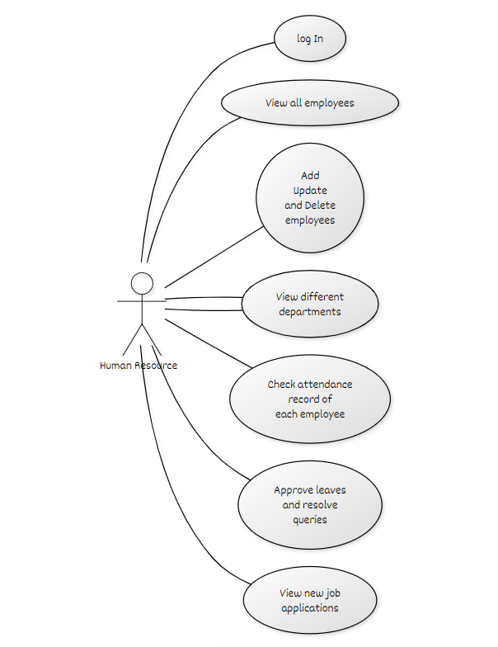
Deliverables
The output of the project will be an employee management system dashboard that will provide following functionalities to each view-
1. H.R VIEW
(i)View the Employees List, and their details, and execute CRUD actions on them.
(ii)View the Organization's different departments.
(iii)Take a look at the projects the company is working on and keep track of their progress.
(iv)Verify any employee's attendance record.
(v)Distribute discounts and bonuses to various staff.
(vi)Send out crucial notifications.
(vii)Examine employee feedback.
(viii)Approve leaves
(ix)View issues and questions and address them.
(x)View fresh applications on the job portal of the organization and decide whether to accept or reject them.

Slide 12
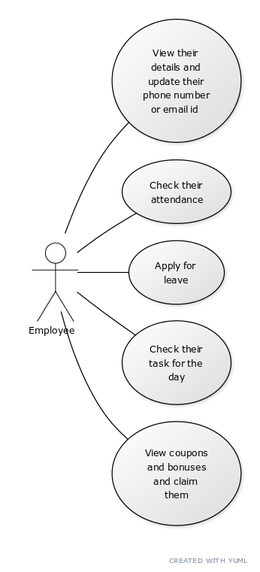
Deliverables
2. EMPLOYEE VIEW
(i)Review their information and make any necessary changes.
(ii)Mark their attendance.
(iii)Request leave.
(iv)Verify the day's assignment.
(v)View discounts and rewards and redeem them.

Slide 13
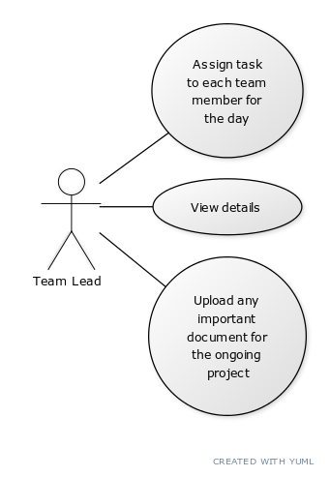
Deliverables
3. TEAM LEAD VIEW
(i)View information
(ii)Assign daily tasks to each team member.
(iii)Any necessary documents for the current project could be uploaded.

Slide 14
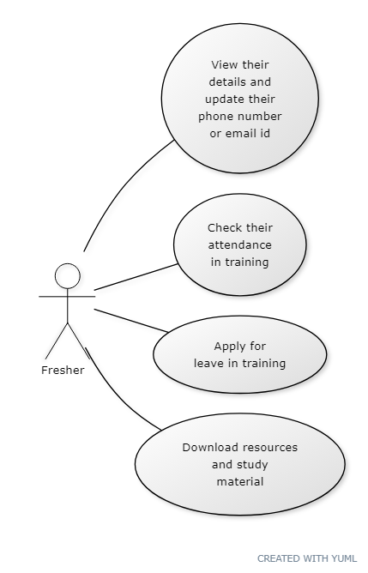
Deliverables
4. FRESHER'S VIEW
(i)View their information and make any necessary changes.
(ii)Verify their participation in training.
(iii)Submit a request for training leave.
(iv)Download reference materials and study guides.

Slide 15
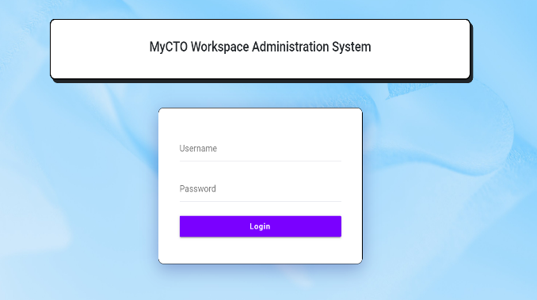
Results & Discussions
1. On successful installation of the software, the user can login using the credentials to access the portal.

Slide 16
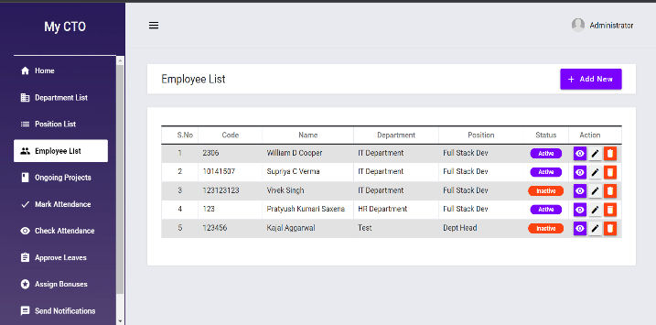
Results & Discussions
2. When the HR of the company logins, he is directed to the following page where he can take several actions as discussed under the functionalities of HR view.

Slide 17
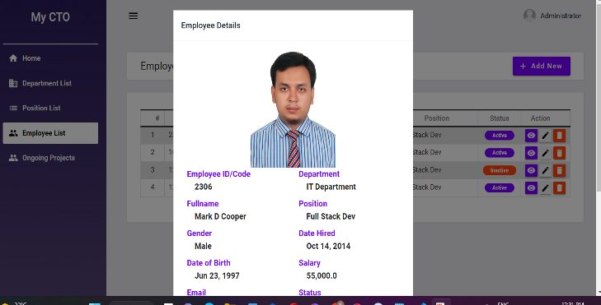
Results & Discussions
3. Below is the screenshot of the portal’s detailed employees view.

Slide 18
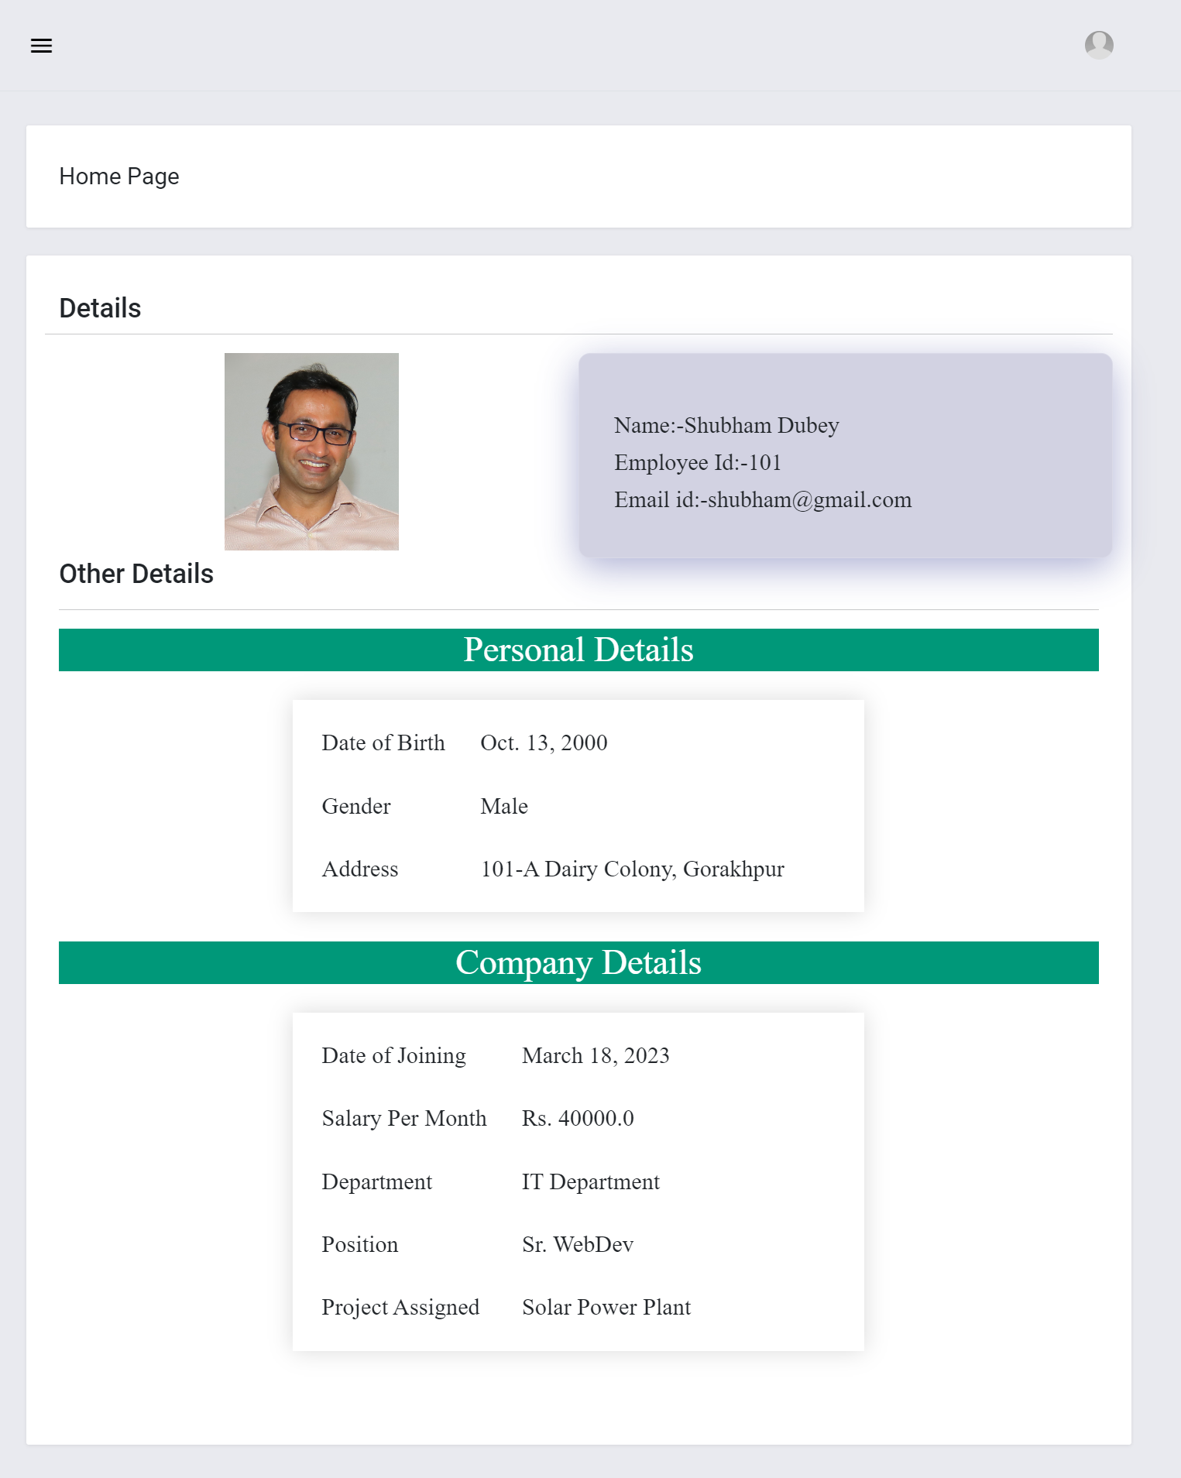
Results & Discussions
4. Below is the screenshot of the portal’s Employee View.
This how the details of the employee will be presented once a employee receives his credentials.

Slide 19
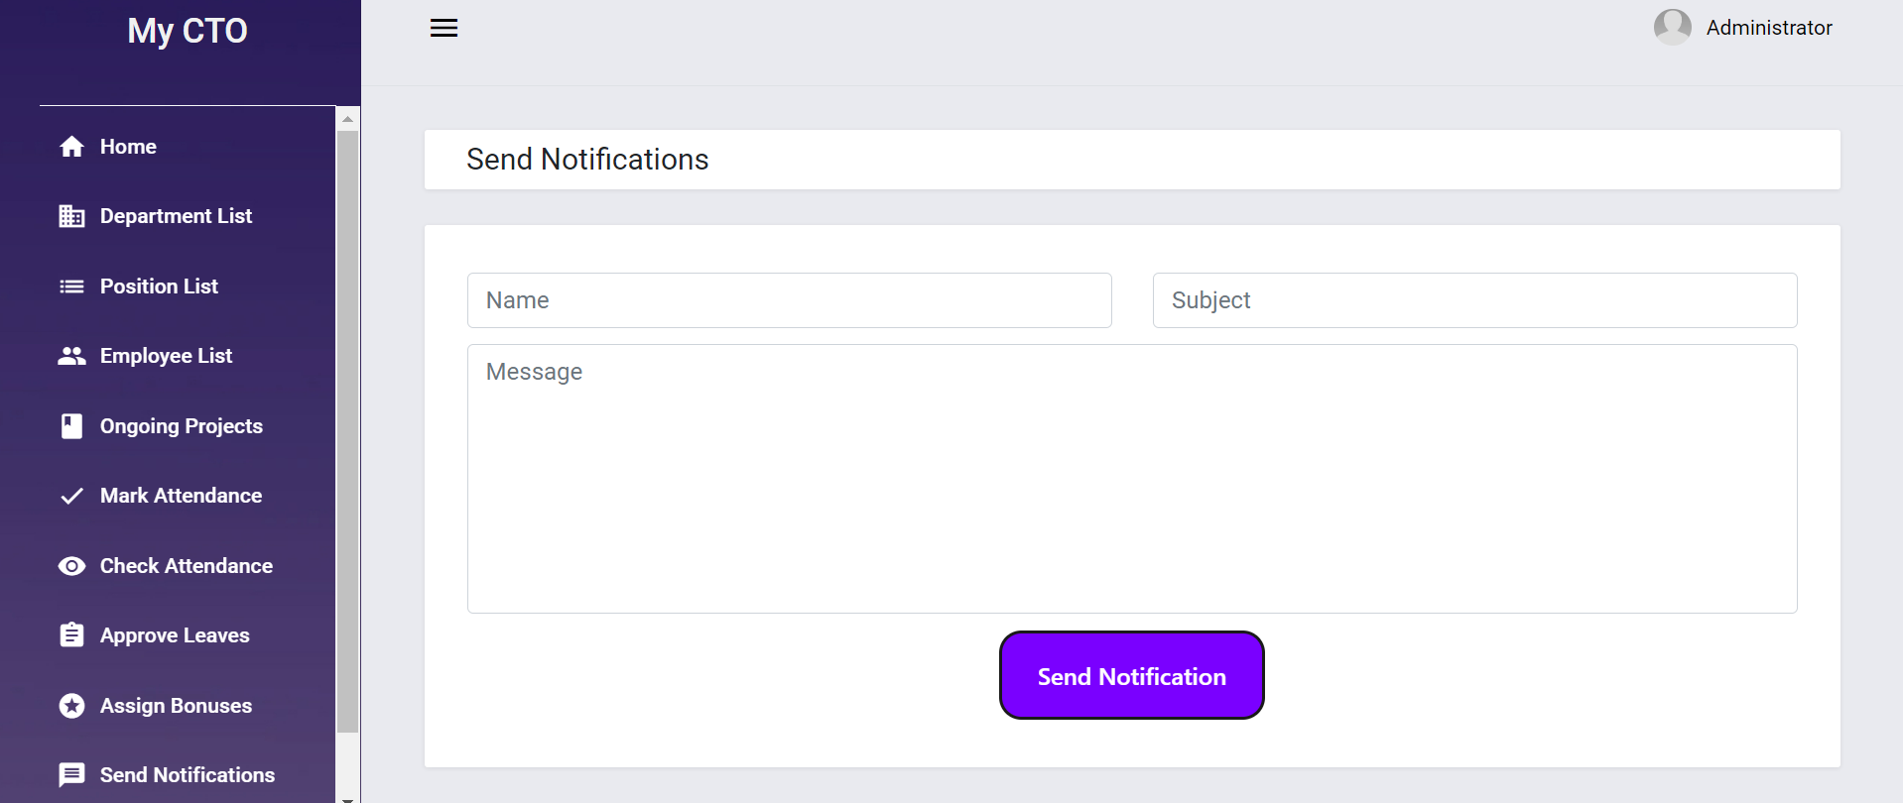
Results & Discussions
5. Above is the screenshot of how notifications can be sent by team lead through the portal

Slide 20
Conclusion
Thus, we have created a system that will help organizations to manage their workforce efficiently. Thus, reducing the problems faced by the organizations earlier. This system will also ensure transparency in the organization and bridge the communication gap between the employees and the employers as they will be able to directly write their queries through the portal. This system in comparison to the other system will make use of analytics which would make it easier to analyze data and make important decisions based on them.

Slide 21
References
Bajpayi, Rishabh. (2020). Employee Management System. International Journal for Modern Trends in Science and Technology. 6. 225-234. 10.46501/IJMTST061242.
Singh, P., Fartyal, H., Zubair, K. A. A., & Laddha, A. (2019). Employee Management System. International Research Journal of Engineering and Technology (IRJET), 6.
Punia, R., Panwar, S., Kamra, R., & Gupta, R. (2020). Voice-Based Employee Management System Using AWS and Alexa. International Journal of Innovative Research in Computer Science & Technology (IJIRCST), ISSN, 2347-5552.
"Administration in Employee Management System", International Journal of Emerging Technologies and Innovative Research (www.jetir.org | UGC and ISSN Approved), ISSN:2349-5162, Vol.7, Issue 1, page no. pp125-132, January-2020, Available at:http://www.jetir.org/papers/JETIR2001022.pdf

Slide 22
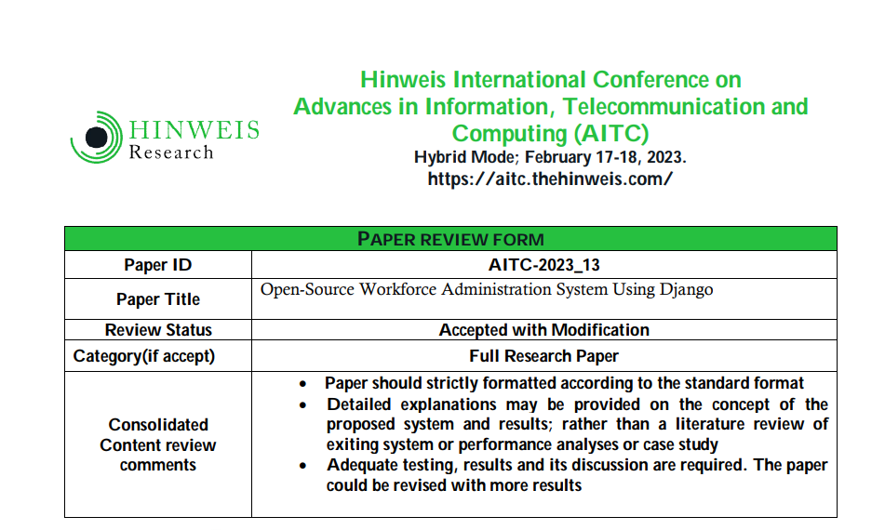
Proof OF SUBMISSION OF RESEARCH PAPER
The papers will be published in the International Journal on Engineering and Technology in the month of July and the same paper will be indexed as Conference Proceedings on Scopus and Cross Ref by the month of November. Once the paper gets published and indexed, we will notify you with the published link.

