Slide 1

Pawsible
A Secure and Organized Way to Manage Your Pet's Information
Team:
{ Quantum Cookie }
Category:
{ Open Innovation }

Slide 2
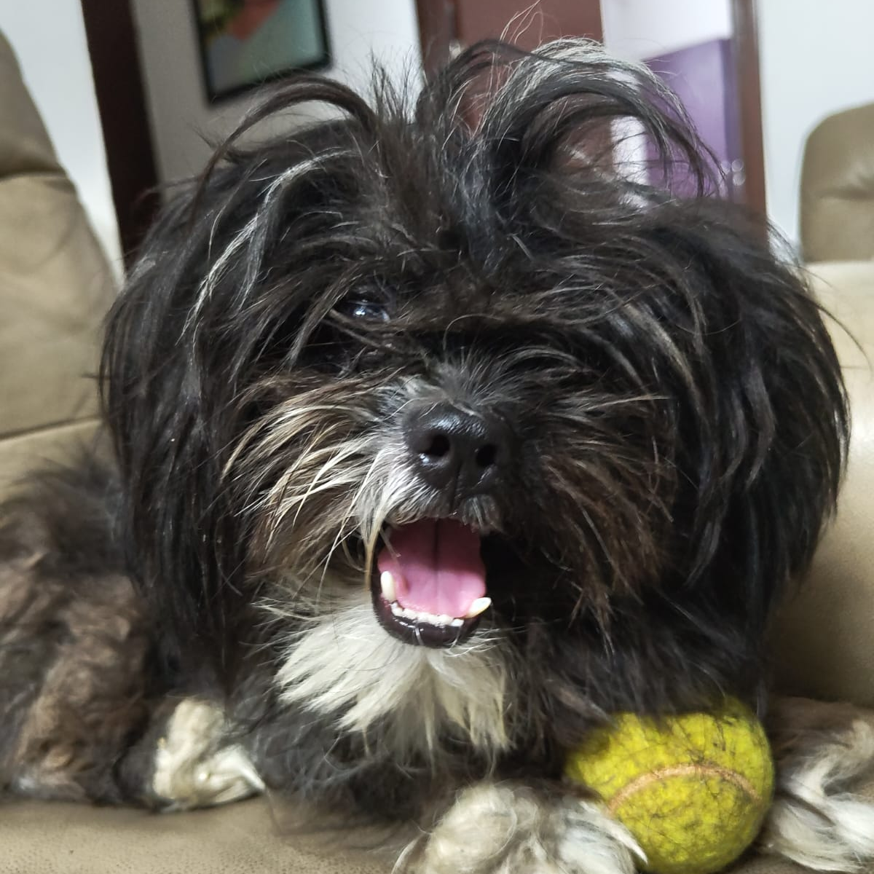
Pet owners have a hard time running around keeping track of their furry friends’ lives.
Taking care of pets is a lot more than just cuddles and playtime. We often struggle to keep track of essential information like certificates, vaccination records, and health details, which are scattered in various places, often in physical form. This can lead to missed vaccinations, delayed treatments, and challenges in sharing accurate information with vets or pet sitters. A simple, organized solution is needed to manage all these records in a reliable and accessible manner.

Slide 3
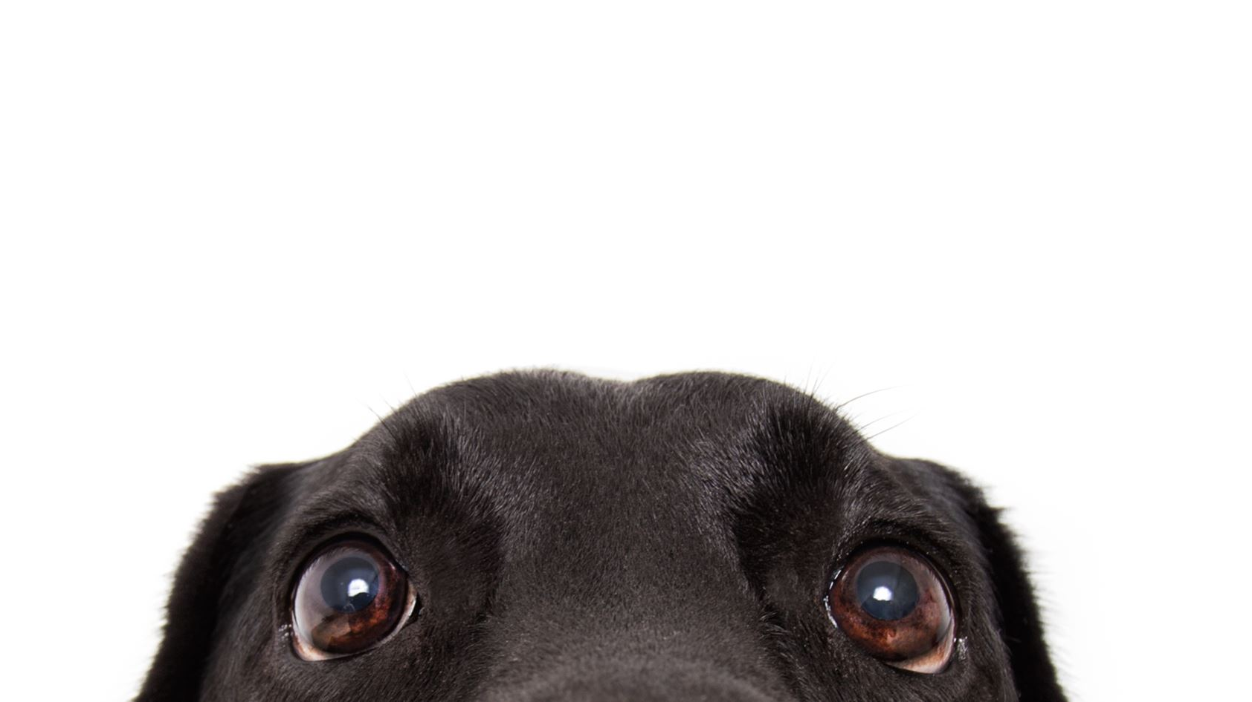
Solution – Pawsible Centralized Pet Dashboard
A centralized dashboard that allows pet owners to securely store and manage their pet's information, including verified certificates, vaccination records, health history, and other critical details.
This platform ensures that all pet-related information is easily accessible and organized in one place.
And some fun stuff like planning play dates and resort/spa bookings and treats.

Slide 4
Basic Workflow:
There will be 3 login options to choose from – Owners, Vets, and Organizations.
For Owner:
Login / Create Account with email.
Input Owner Details (Name, Phone Number [to be verified], Aadhar Number, etc).
Upload Pet Information (Name, Picture, Breed, etc).
Upload KCI Certificate (Kennel Club Of India) for dogs and similar certificates for other animals.
For Vet:
Login / Create Account with email.
Vet Account will have an option to link a treated pet’s account to the vet’s dashboard.
They can schedule vaccination dates, checkup dates, etc. which will be automatically updated to the pet owners account.
For Government Agencies, Shelters and Businesses:
Login / Create Account with an official email.
After email verification, they can access some data.

Slide 5
Technical Approach
Frontend:
React: To build a dynamic, component-based user interface.
Fetch data from Flask API and display it on the frontend.
Implement forms to add or update pet information.
Ensure the app is mobile-friendly using CSS frameworks like Bootstrap or custom CSS.
Backend:
Flask: For building the web server and API endpoints.
Create RESTful API endpoints for CRUD operations on pet data.
Implement user authentication and authorization.
Set up routes for fetching, updating, and deleting pet data.
Python: The core language for backend development.
Database:
MongoDB / PostgreSQL / MySQL: For storing and accessing structured pet data.
Monitor Performance:
We will use Google Analytics and New Relic to monitor overall performance.

Slide 6
Pet Owners /
Caregivers
Pet Boarding/Pet - Friendly Hostels and Businesses
Vets And Pet Clinic /
Grooming
Pet Insurance Providers
TARGET
AUDIENCE
Blue Cross and other smaller Animal Shelters and Pet Adoption Agencies
Pet Product Suppliers
Government Organizations like DAHD (Department of Animal Husbandry, Dairying and Fisheries) and DGFT (Director of General Foreign Trade)
Pet Trainers, Breeders and Show Organisers.

Slide 7
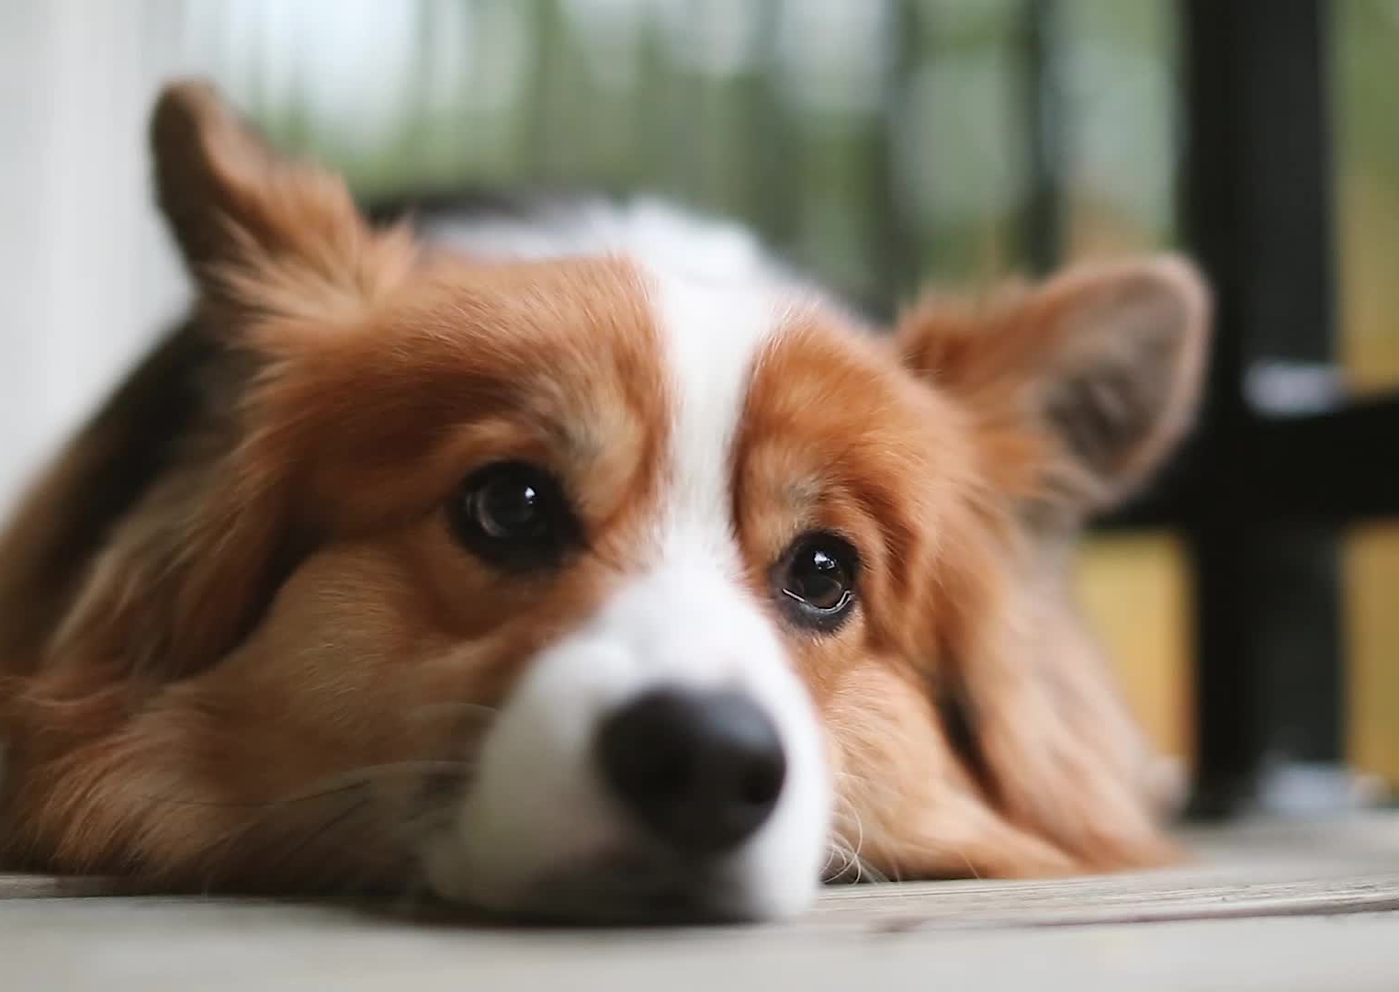
Industry
Facts
To address the feasibility and scalability of Pawsible, let’s first present you with some facts:
55% of Indians have a pet.
There are over 31 million pet dogs in India.
There are 2.44 million pet cats in India, and it may reach 4.89 million by 2026.
Dogs are the most common pets in India, with 63% of pet owners having a dog and 42% having a cat.
Notice how those numbers add up to over a 100%? That’s because 11% of people in India (that’s over a 159 million people) own AT LEAST four pets.
India’s pet care market is projected to grow at a value of INR 7,500 Crores by the end of 2026.
Indian veterinary healthcare market is currently valued at INR 1416 Crores and is expected to reach INR 1676 Crore by 2030.

Slide 8
Feasibility and Scalability:
Feasibility is huge since we will gain huge amounts of valuable data of pets which is becoming more and more of a booming industry every day.
This data will be free to us since we’ll obtain it through the uploaded information from the users.
1
This valuable data can be used in almost all pet - related services and provide huge profits to both them and us.
The pet industry would be very eager to have the information we can provide.
2
The facts show just how much untapped potential exists in this space.
Growing pet community and future enhancements for integrating new technologies and partnerships
3

Slide 9
Impact
As a website to revolutionize the pet care experience for pet parents, veterinarians and the pet industry we see the impact to be hitting new heights and expanding exponentially.
This industry is worth INR 823 Billion and with a handy website and user-friendly interface, every pet essential falls into place. This platform will be a go to mandate to raise a pet.
Future Plans:
Expansion to various species of pets and across countries

Slide 10
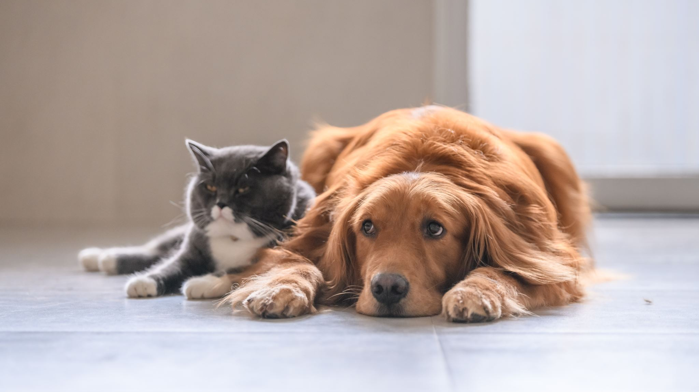
Conclusion
Pawsible provides a simple, effective solution for managing all your pet's important information in one secure, easy-to-use platform. With this tool, pet owners can ensure their pets receive the best care possible, with all records and details readily available when needed.

