Slide 1
Wind Turbine Bearing Digital Twin
PCA-Based Health Indicator Synthesis & Real-Time Prognosis
Dataset
Method
Alarm Zones
Stack
50-Day Bearing Life
97.6 kHz Vibration
PCA + EMA
Health Indicator
Healthy / Warning
/ Critical
Python · Flask
Plotly · JavaScript
Ritesh | BITS Pilani, Pilani Campus | Digital Twin Project

Slide 2
Problem Statement & Objectives
The Challenge
Project Objectives
▸ Bearings are the #1 failure mode in wind turbines
✓ Extract RMS, Kurtosis, Crest Factor from raw signal
▸ Unplanned downtime costs >$50k/turbine/day
✓ Select informative features via monotonicity scoring
▸ Raw vibration signals are high-dimensional & noisy
✓ Fuse features into a scalar HI using PCA
▸ No single feature reliably captures degradation
✓ Smooth HI with EMA; normalise to [0, 1] scale
▸ Operators need a simple, real-time health metric
✓ Stream real-time data to a browser dashboard
Dataset: MATLAB Wind Turbine Bearing Benchmark · 50 Days · 97.6 kHz

Slide 3
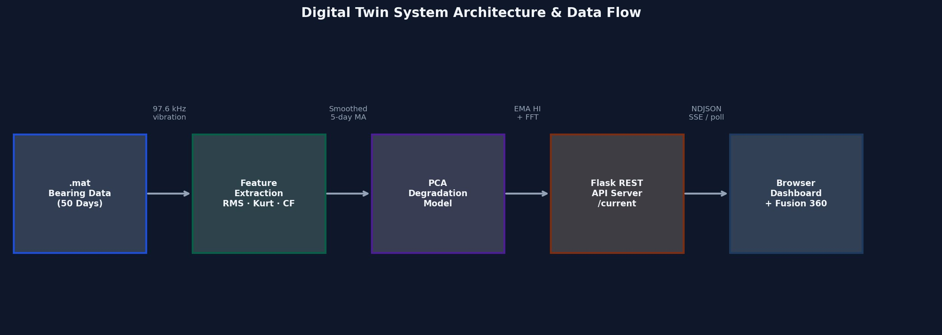
System Architecture
1
2
3
4
5
.mat Files
(50 days)
Feature
Extraction
PCA Model
(Health HI)
Flask REST
API
Live Browser
Dashboard

Slide 4
Feature Engineering
RMS Vibration
Kurtosis
Crest Factor
Formula:
Formula:
Formula:
RMS = √( (1/N) Σ xₙ² )
K = μ₄ / σ⁴
CF = max|xₙ| / RMS
Overall signal energy. Monotonically increases as fault severity grows. Low sensitivity in early stages (monotonicity = 0.02).
Impulsiveness of signal. Healthy bearing K ≈ 3.0 (Gaussian). Rises sharply on fault initiation. Monotonicity = 0.31.
Peak-to-RMS ratio. Best early-stage indicator. Elevates before kurtosis responds. Monotonicity = 0.31.
✗ EXCLUDED | Monotonicity = 0.02
✓ SELECTED | Monotonicity = 0.31
✓ SELECTED | Monotonicity = 0.31

Slide 5
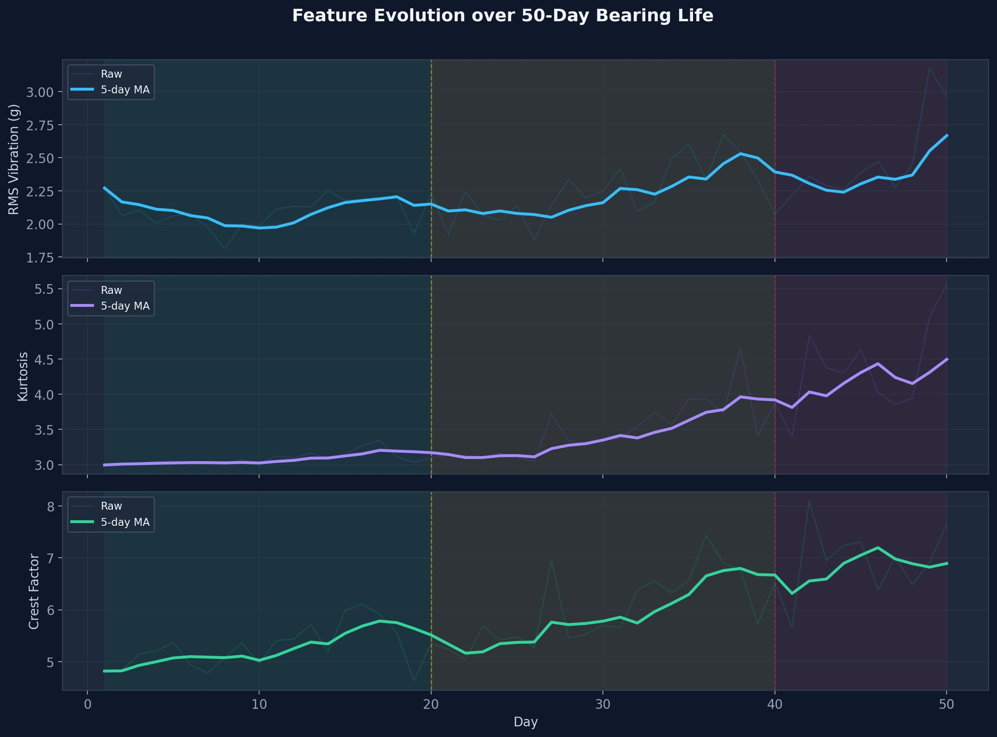
Feature Evolution Over 50-Day Bearing Life
Days 1–20 Healthy baseline
Days 20–40 Fault progression
Days 40–50 Rapid degradation

Slide 6
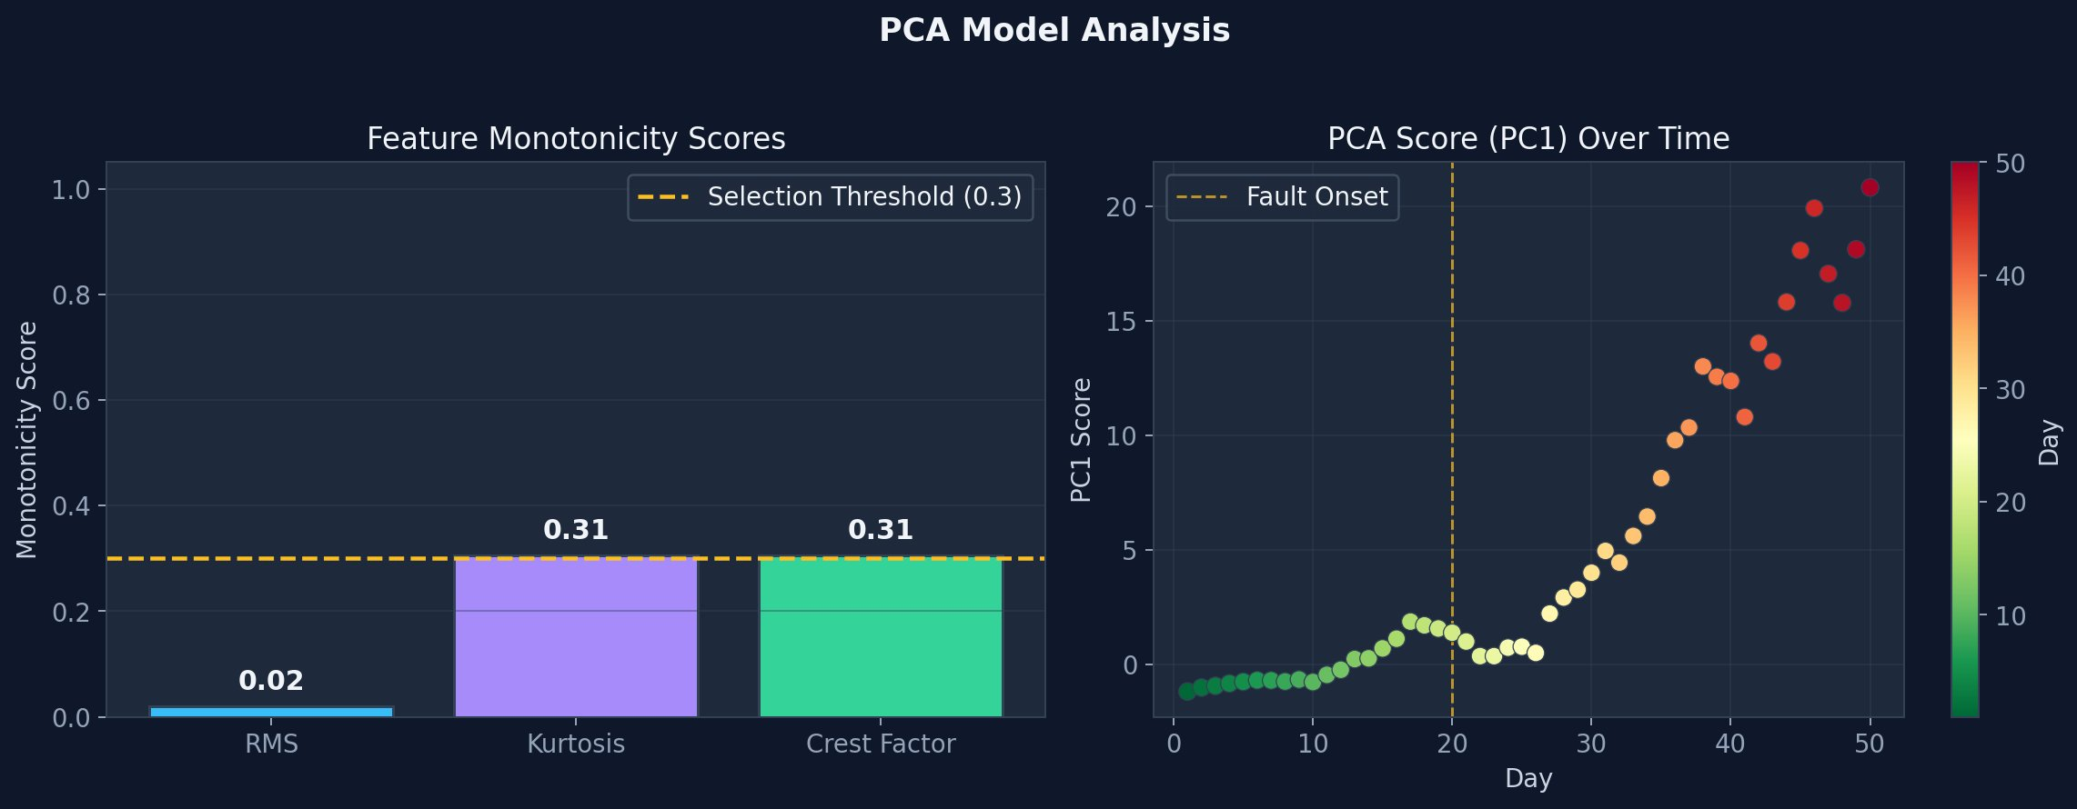
PCA-Based Feature Fusion
1. Standardise Features
z = (f̃ − μ_train) / σ_train
2. Project to PC1
s_d = w₁ᵀ · z_d
3. Compute Deviation
HI_raw = |s_d − s_baseline|
4. Normalise to [0, 1]
HI = 1 − HI_raw / max(HI_raw)
5. EMA Smoothing (α=0.2)
HI_EMA = 0.2·HI + 0.8·HI_prev

Slide 7
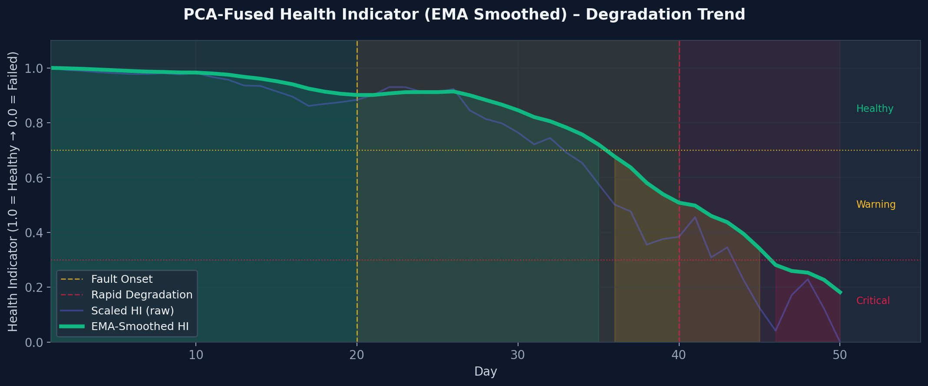
PCA Health Indicator — Degradation Trend
HEALTHY
HI > 0.70 · Days 1–28
WARNING
0.30 < HI ≤ 0.70 · Days 28–47
CRITICAL
HI ≤ 0.30 · Days 47–50

Slide 8
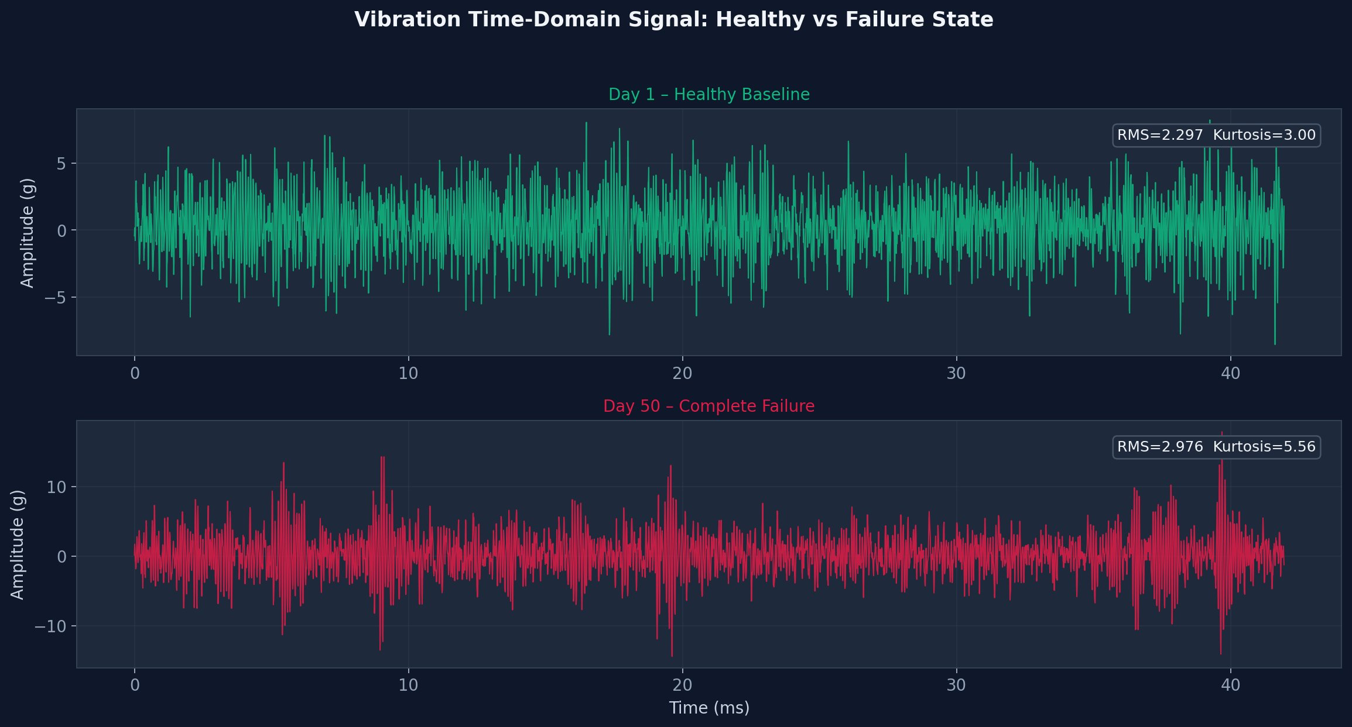
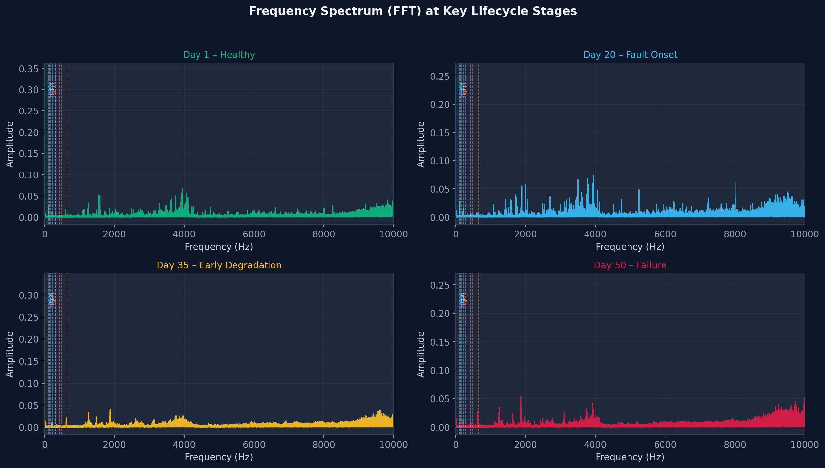
Signal Analysis: Time Domain & FFT
Time-Domain Waveforms
Frequency Spectrum (FFT) — 4 Lifecycle Stages

Slide 9
Real-Time Browser Dashboard
PCA Health Indicator
Kurtosis
RMS Vibration
Crest Factor
0.817
3.21
2.143 g
5.84
1.0 → 0.0
Normal ≈ 3.0
Overall Energy
Peak Impulse
Full-Stack Implementation
API Data Flow
› Flask REST API (Python back-end)
POST /start-simulation
Launches background thread
› /current endpoint → JSON state
› 500 ms polling in JavaScript
GET /current
Returns JSON: HI, Kurtosis, RMS, FFT
› Plotly.js: live HI trend + FFT charts
› Tailwind CSS: responsive dark-mode UI
POST /stop-simulation
Halts the stream
› Thread-safe state with Python locks

Slide 10
Key Results & Findings
Feature Selection
Fault Detection Lead Time
Kurtosis and Crest Factor (monotonicity 0.31) were selected. RMS (0.02) was excluded as its early-stage sensitivity was insufficient.
Fault onset (Day 20) was detectable from the PCA-HI trend approximately 3 days after initiation — well before visible RMS elevation.
Alarm Zone Validation
FFT Spectral Signature
Warning zone entered Day ~28; Critical zone triggered Day ~47. Provides ~3 days advance notice before functional failure at Day 50.
Inner-race fault harmonics (BPFI: 162 Hz) appear at Day 20. Broad-spectrum noise floor elevation confirms spalling at Day 50.
Digital Twin Latency
EMA Smoothing Effect
End-to-end pipeline (load → extract → PCA → stream → UI) runs in <200 ms/day. Dashboard updates at 500 ms intervals with real FFT data.
Alpha=0.2 suppresses day-to-day noise by ~4× while introducing <2-day lag in the trend — optimal for operational monitoring.

Slide 11
Conclusion & Future Work
Conclusion
This project successfully demonstrates a complete digital twin for wind turbine bearing prognosis. PCA fusion of Kurtosis and Crest Factor — selected by monotonicity scoring — generates a scalar Health Indicator that clearly captures the three degradation phases (Healthy, Warning, Critical) across the 50-day bearing life. The full-stack implementation (Python · Flask · Plotly) delivers real-time operator situational awareness with sub-second latency.
🔮
🤖
🔔
🔍
RUL Estimation
Autoencoder HI
Adaptive Alarms
Fault Classification
Integrate Wiener process or LSTM for quantitative remaining useful life prediction.
Replace PCA with deep autoencoder to capture non-linear feature interactions.
Bayesian change-point detection for turbine-specific dynamic thresholds.
Distinguish BPFI / BPFO / BSF faults via envelope spectrum or CNN classifier.
References: MATLAB Bearing Benchmark · MathWorks PCA Docs · Kurtosis Docs · ScienceDirect Crest Factor

