Slide 1

Bearing Digital Twin
Wind Turbine High-Speed Shaft Bearing | Run-to-Failure Analysis
Group 5 | ME F434 – Digital Twins in Mechanical Engineering
Ritesh Nallamalli | Pranav Girish Morab | Goutham Mahesh
BITS Pilani, Pilani Campus | April 2026

Slide 2
Presentation Outline
Introduction & Motivation
Feature Engineering
01
02
Why bearing Digital Twins? Objectives and dataset overview
RMS, Kurtosis, Crest Factor — time & frequency domain
PCA Health Indicator
Frequency Spectrum Analysis
03
04
Monotonicity-guided PCA fusion and EMA smoothing
BPFI / BPFO fault frequencies and spectral evolution
System Architecture
Results & Conclusion
05
06
Flask API on Raspberry Pi, browser dashboard, Fusion 360
HI performance, feature analysis, future work

Slide 3
Introduction & Motivation
THE PROBLEM
THE SOLUTION: DIGITAL TWIN
▸ Rolling-element bearings are the most failure-prone components in wind turbines
✓ Live software replica continuously ingesting sensor data
▸ Inner/outer-race faults can escalate to catastrophic failure within days
✓ Signal processing + PCA machine-learning pipeline
▸ Traditional time-based maintenance is costly and wasteful
✓ Flask REST API on Raspberry Pi for real-time updates
▸ Need robust real-time health indicators from operating signals
✓ Browser dashboard + Fusion 360 3-D live colour model
Dataset: 2 MW wind turbine bearing (624ZZ) · 50-day run-to-failure · 97.6 kHz sampling · Inner-race fatigue fault

Slide 4
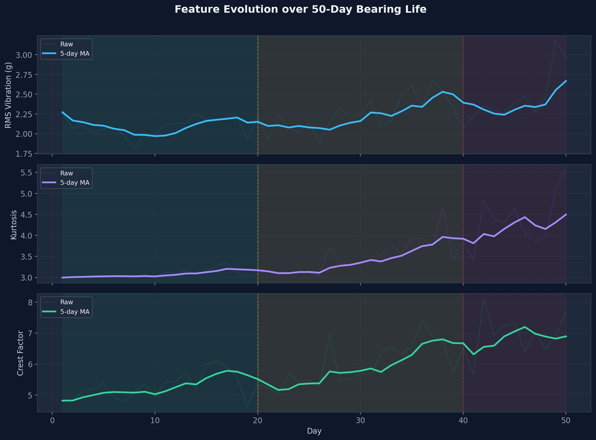
Feature Engineering
√(1/N·Σ x²[n])
RMS
Excluded (M=0.02)
5-day rolling MA applied before PCA input
μ₄ / σ⁴
Kurtosis
✓ Selected (M=0.31)
5-day rolling MA applied before PCA input
max|x[n]| / RMS
Crest Factor
✓ Selected (M=0.31)
5-day rolling MA applied before PCA input

Slide 5
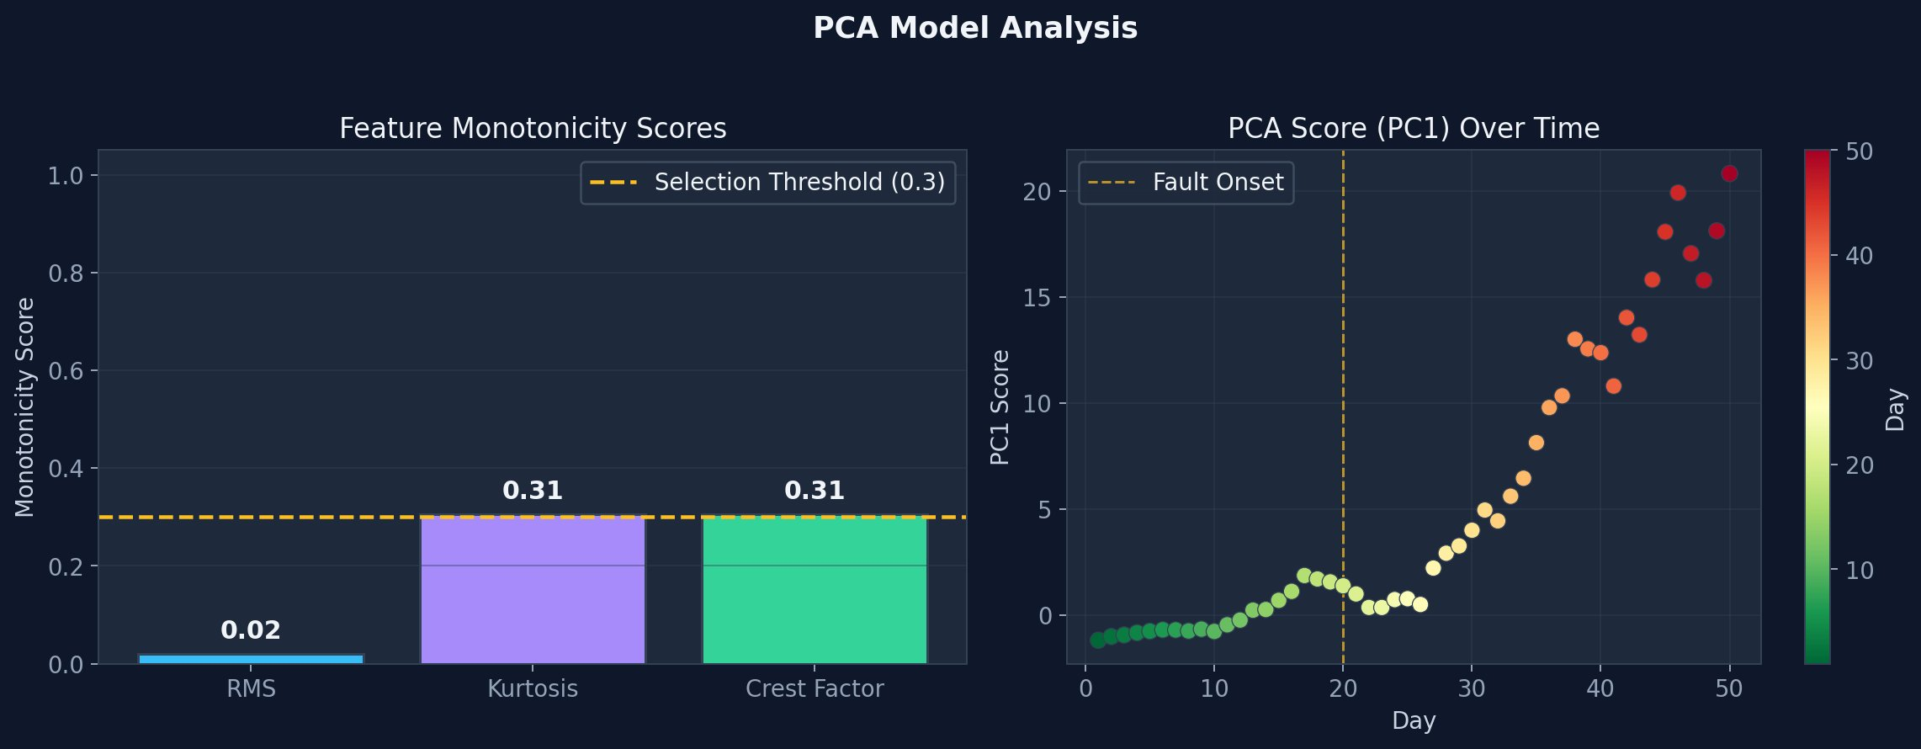
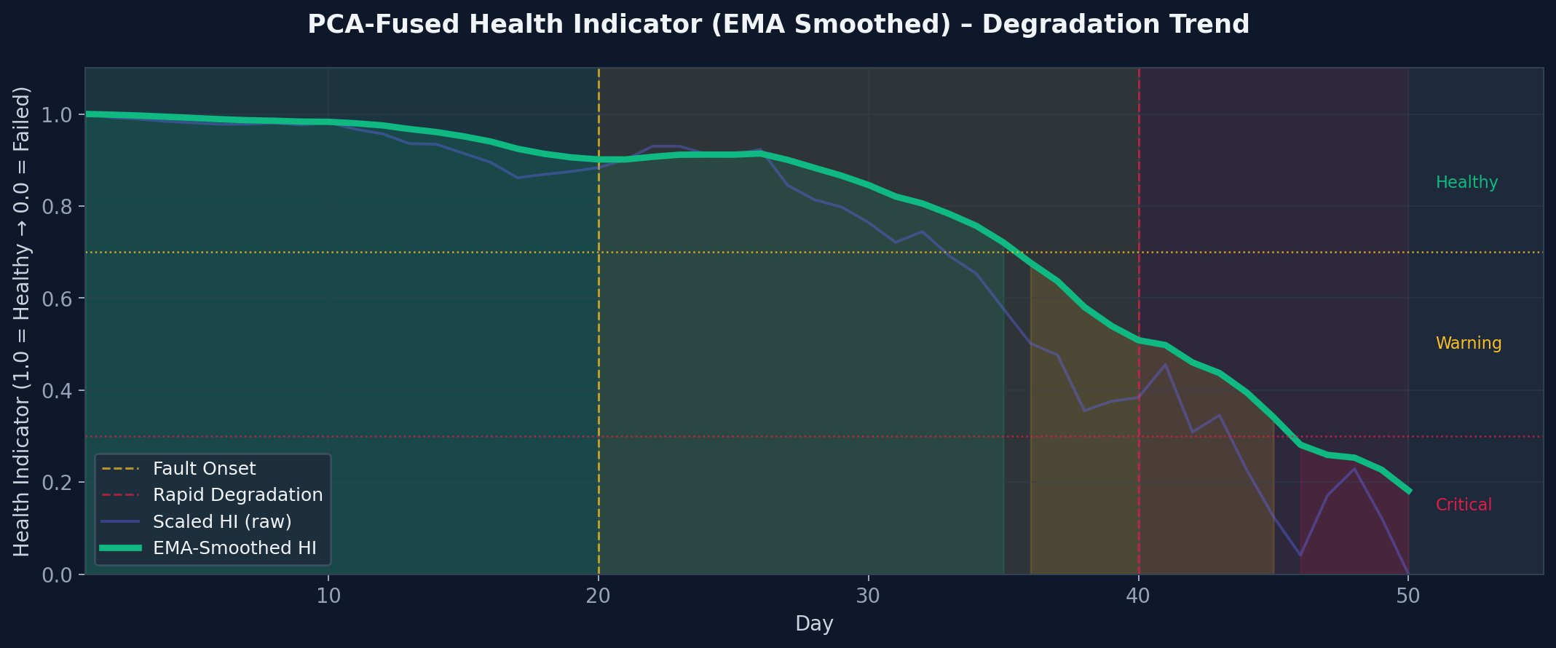
PCA-Based Health Indicator Model
Step 1: Train on Days 1–20
Step 2: Global Scale (All 50 Days)
Step 3: Online Daily Transform
Z-score norm · fit PCA · store PC1 eigenvector w₁ · record baseline score s_base
Compute δᵢ = |sᵢ − s_base| · store δ_max for proper HI scaling [0→1]
Extract → smooth → normalise → PC1 projection → HI = 1 − δᵢ/δ_max → EMA (α=0.2)

Slide 6
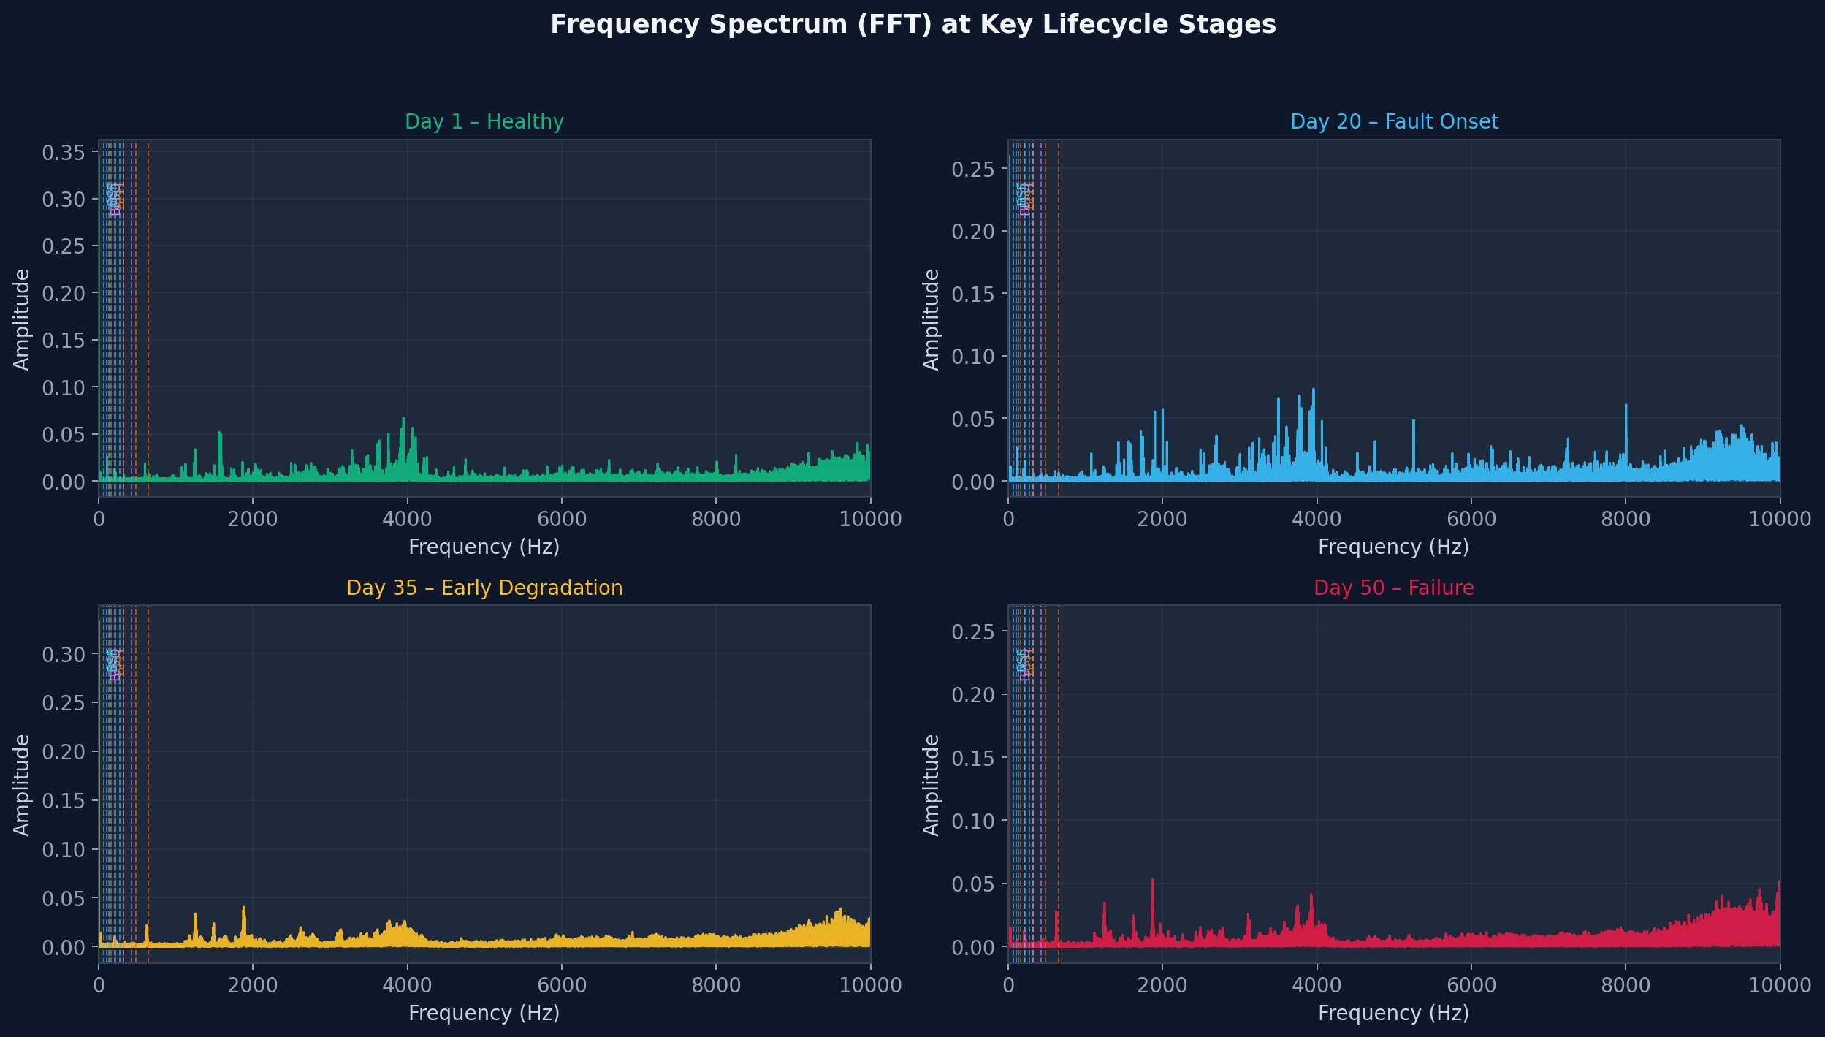
Frequency Spectrum Analysis
Bearing Defect Frequencies
BPFI
≈ 162 Hz
Ball Pass Frequency
Inner Race
★ Confirmed fault
BPFO
≈ 107 Hz
Ball Pass Frequency
Outer Race
Reference
BSF
≈ 68 Hz
Ball Spin
Frequency
Reference

Slide 7
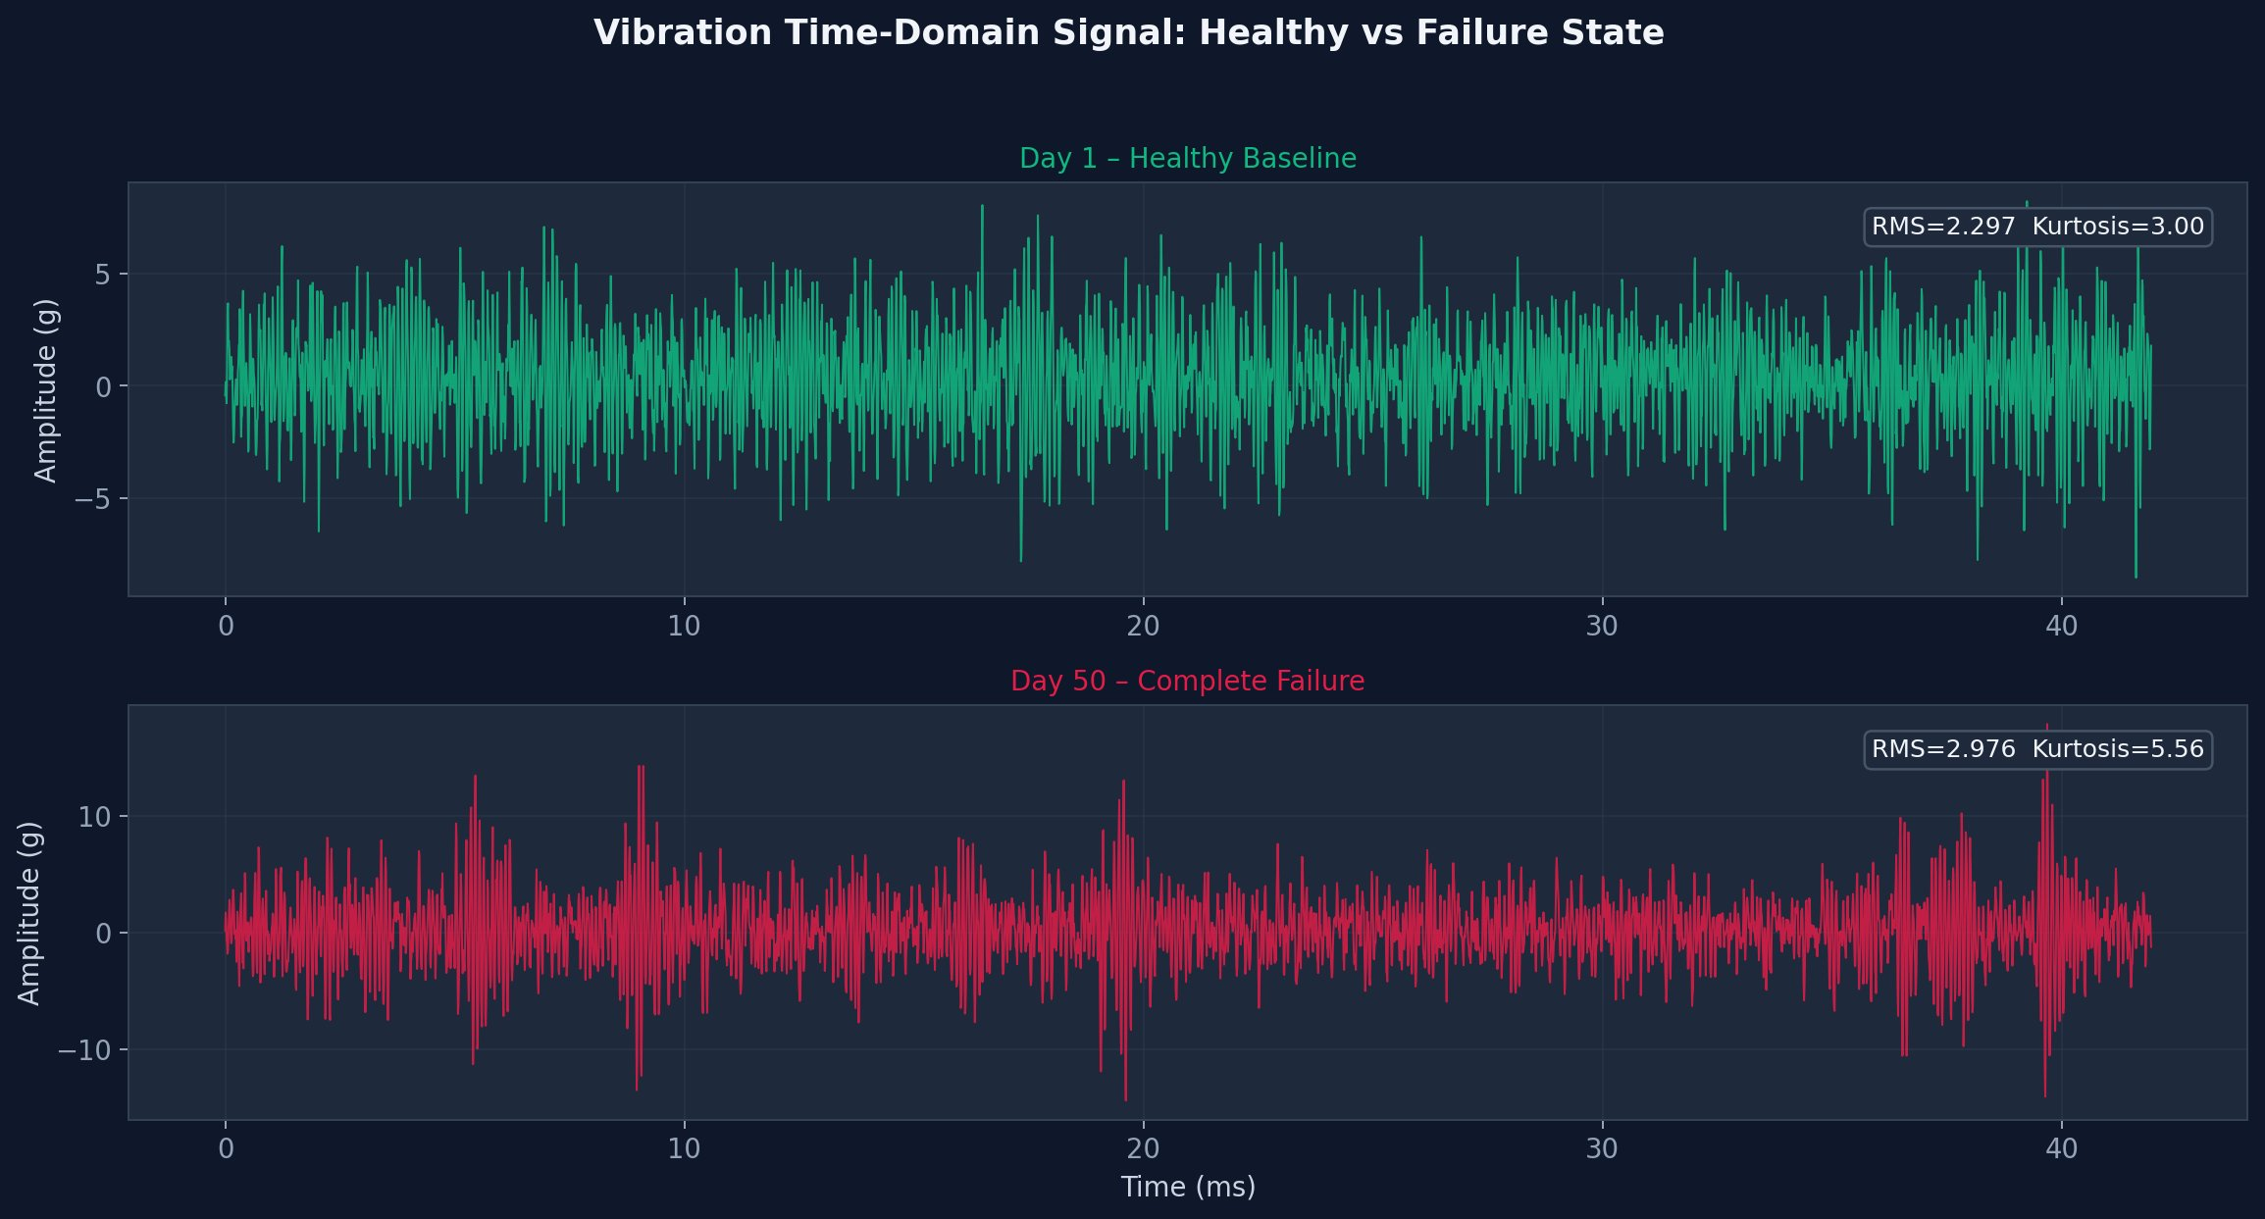
Vibration Signal: Healthy vs Failure
Day 1 – Healthy RMS = 2.297 g · Kurtosis = 3.00
Day 50 – Failed RMS = 2.976 g · Kurtosis = 5.56
Stationary Gaussian noise, no impulsive events
Clear impulsive ring-downs from inner-race spalling, peak amplitudes > ±12 g

Slide 8
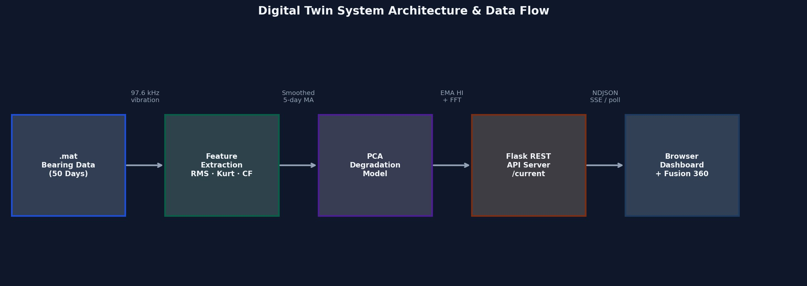
System Architecture & Communication
Backend
Flask (threaded=True) · Raspberry Pi · 0.0.0.0:5000 · Thread-safe state with Lock()
Frontend
Single-page HTML · Tailwind CSS + Plotly.js · 500 ms polling · No install on client
Fusion 360
Color.py · 500 ms poll · Cache-busting timestamps · RGB = (1–HI, HI, 0) × 255
Latency
~500 ms end-to-end file processing → browser update · 1.5 s inter-day simulation delay

Slide 9
Results & Discussion
0.97–1.0
Day 37
0.19
~500 ms
HI in Healthy Phase
(Days 1–20)
Warning Threshold
Crossed
Final HI at Day 50
End-to-End Update
Latency
Health Indicator Performance
EMA-smoothed PCA HI tracks three-phase degradation: stable (days 1–20), gradual decline (days 20–40, Warning at day 37), and accelerated failure (days 40–50, HI = 0.19 at day 50). EMA (α=0.2) suppresses ±0.1 oscillations.
Feature Analysis
Monotonicity analysis reveals RMS is a poor indicator during training (M=0.02). Kurtosis and Crest Factor (M=0.31 each) respond to impulsive ball-pass events before bulk vibration energy rises.
Spectral Observations
BPFI harmonics become distinguishable by Day 20. Broadband 2–8 kHz noise-floor elevation at Day 50 confirms severe surface wear and lubricant degradation. Communication latency ~500 ms suits quasi-real-time monitoring.

Slide 10
Conclusion & Future Work
Key Achievements
Future Work
✓ Fully operational end-to-end Digital Twin pipeline
→ Exponential degradation models for quantitative RUL prediction
✓ PCA Health Indicator degrades cleanly from 1.0 → 0.0 with physical alignment to known fault progression
→ Adaptive retraining as new run-to-failure data becomes available
✓ Monotonicity-guided feature selection filters uninformative signals automatically
✓ Lightweight enough to run on Raspberry Pi at sub-second update rates
→ Multi-bearing parallelism for fleet-level monitoring
✓ Intuitive live colour-coded 3-D Fusion 360 model for engineering visualisation
Thank You | Group 5 · BITS Pilani · ME F434 · April 2026 | Questions?

