Slide 1



About me
High performance computing
Open source project OpenBLAS creator
Founder of PerfXLab
E-mail: traits.zhang@gmail.com
Wechat:
Zhang Xianyi, Ph.D.

Slide 2
Register and Cache

Slide 3
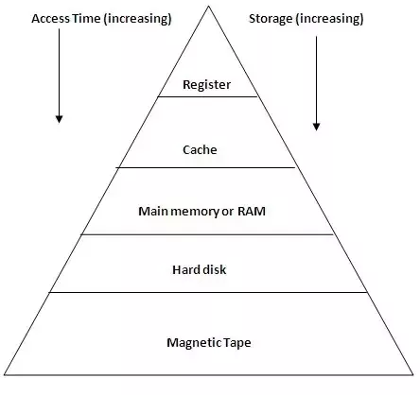
Computer Memory Hierarchy
Register
Cache
Memory
How to measure?
Latency
Bandwidth

Slide 4
Computer Memory Hierarchy
The huge performance gap between Cache and Memory
Latency (e.g. Intel i9-9900k)
L1 Cache 0.8 ns
L2 Cache 2.4 ns
Shared L3 Cache 11 ns
Memory above 80ns and higher (depends on memory chip)
Bandwidth
L1 Cache 2.3 TB/s
Shared L3 Cache 370GB/s
Memory 40GB/s (depends on memory chip)

Slide 5
Cache (e.g. Matrix Addition)
Matrix Addition
Adding the corresponding entries
2-loop
i-j loop and j-i loop
Diferenct loop level
Which loop is faster?
for (size_t i = 0; i < n; i++)
{
for (size_t j = 0; j < n; j++)
{
C[i][j] = A[i][j] + B[i][j]
}
}
for (size_t j = 0; j < n; j++)
{
for (size_t i = 0; i < n; i++)
{
C[i][j] = A[i][j] + B[i][j]
}
}

Slide 6
Cache (e.g. Matrix Addition)
i-j loop is faster
2D array in C
Inner j loop: continuously memory access
Cache higher hit rate
Matrix element is already in Cache
for (size_t i = 0; i < n; i++)
{
for (size_t j = 0; j < n; j++)
{
C[i][j] = A[i][j] + B[i][j]
}
}
for (size_t j = 0; j < n; j++)
{
for (size_t i = 0; i < n; i++)
{
C[i][j] = A[i][j] + B[i][j]
}
}

Slide 7
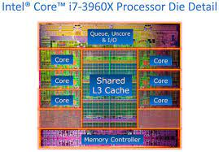
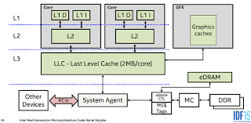
State-of-the-art Computer Memory Hierarchy
Multi-cores CPU
Every core has private L1: Data L1D, Instruction L1I
Every core has private L2：Unified
Shared L3 in CPU

Slide 8
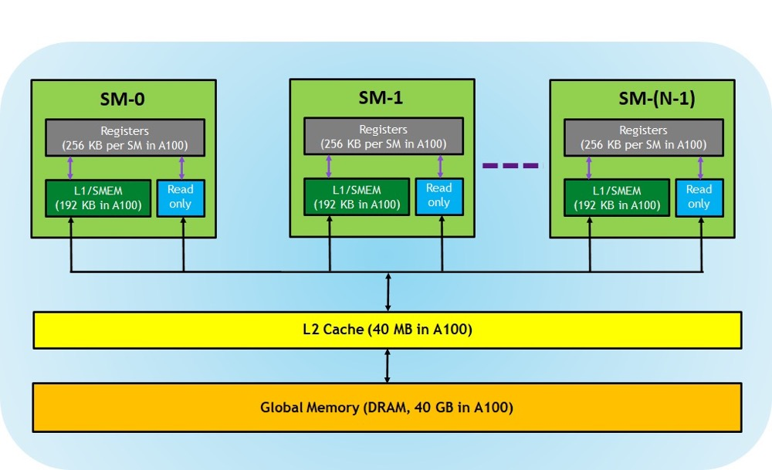
State-of-the-art Computer Memory Hierarchy
GPU
Register: Thread Private
Shared Memory：SM
L1 Cache：SM private
Read only：SM private，instruction cache, texture, const.
L2 Cache：SM shared
Global Memory

Slide 9
Locality of Reference

Slide 10
Locality of Reference
Memory access is not randomly in most case
Temporal locality: the same location will be referenced again in the near future.
Spatial locality: nearby memory locations will be referenced in the near future.
Hardware Cache
Use locality
Keep the referenced data in Cache (Temporal locality )
Cache line and Hardware Prefetch the near cache line (Spatial locality)
Good locality in Program—> Good Cache hit rate—>Good Performance

Slide 11
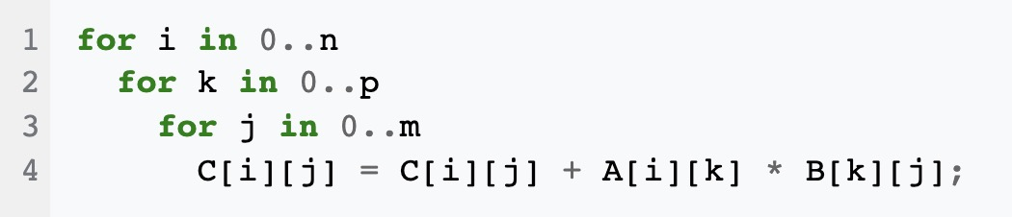
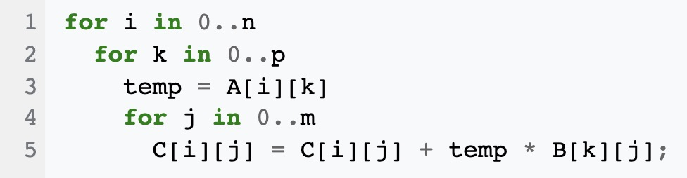
Temporal locality
Reuse the data
For naïve case, the compiler optimization will take care of it.

Slide 12
Spatial locality
Access the near location
Matrix addition
J-I loop breaks spatial locality
Next memory access is the next matrix line.
Higher Cache miss
for (size_t j = 0; j < n; j++)
{
for (size_t i = 0; i < n; i++)
{
C[i][j] = A[i][j] + B[i][j]
}
}

Slide 13
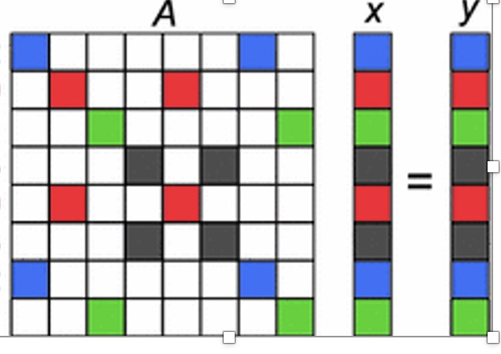
The locality of Sparse Matrix Vector Multiplication
y = Ax
Sparse matrix A, dense vector x
Result Dense vector y
Only calculate the nonzero of A and x
Bad locality of accessing vector x
Spatial
Temporal

Slide 14
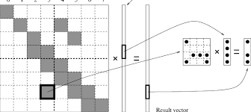
The locality of Sparse Matrix Vector Multiplication
How to improve the locality
Matrix Blocking
In small dense matrix block, better locality

Slide 15
Performance Evaluation and OpenBLAS Matrix Multiplication (GEMM)

Slide 16
How to calculate CPU Peak FLOPS
State-of-the-art CPU
Multi-core
Multi-issue
SIMD instruction (Multiply-add instruction)
Frequency (GHz)
CPU Peak FLOPS
If CPU has simd multiply-add instruction, calculate 2 floating ops
Flops = 2 * # of elements per SIMD simd multiply-add instruction * # of SIMD issued per cycle * Frequency (GHz) * # of cores

Slide 17
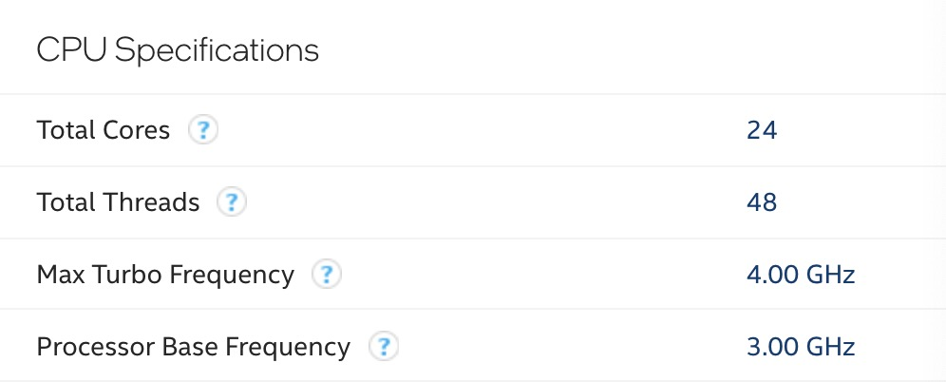
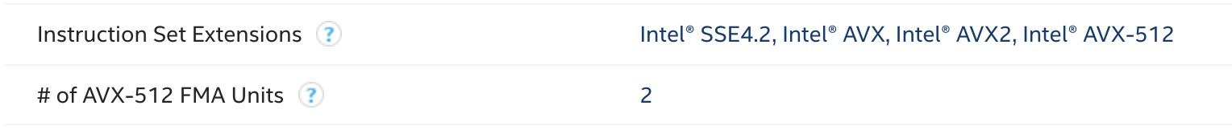
How to calculate CPU Peak FLOPS
Case: Intel Xeon Gold 6248R
24 cores, 48 hyper-threads
Multi issue: 2 multiply-add SIMD per cycle
SIMD instruction : 512-bit multiply-add SIMD
Freq : 3.0 GHz

Slide 18
How to calculate CPU Peak FLOPS
Calculate single core double FLOPS
# of elements per SIMD: 512 / 64 = 8
FLOPS= 2 * 8 * 2 * 3.0GHz = 96 Gflops
Calculate CPU
Single core FLOPS x # of cores = 96 * 24 = 2.304 TFlops
Do not use hyper-threading

Slide 19
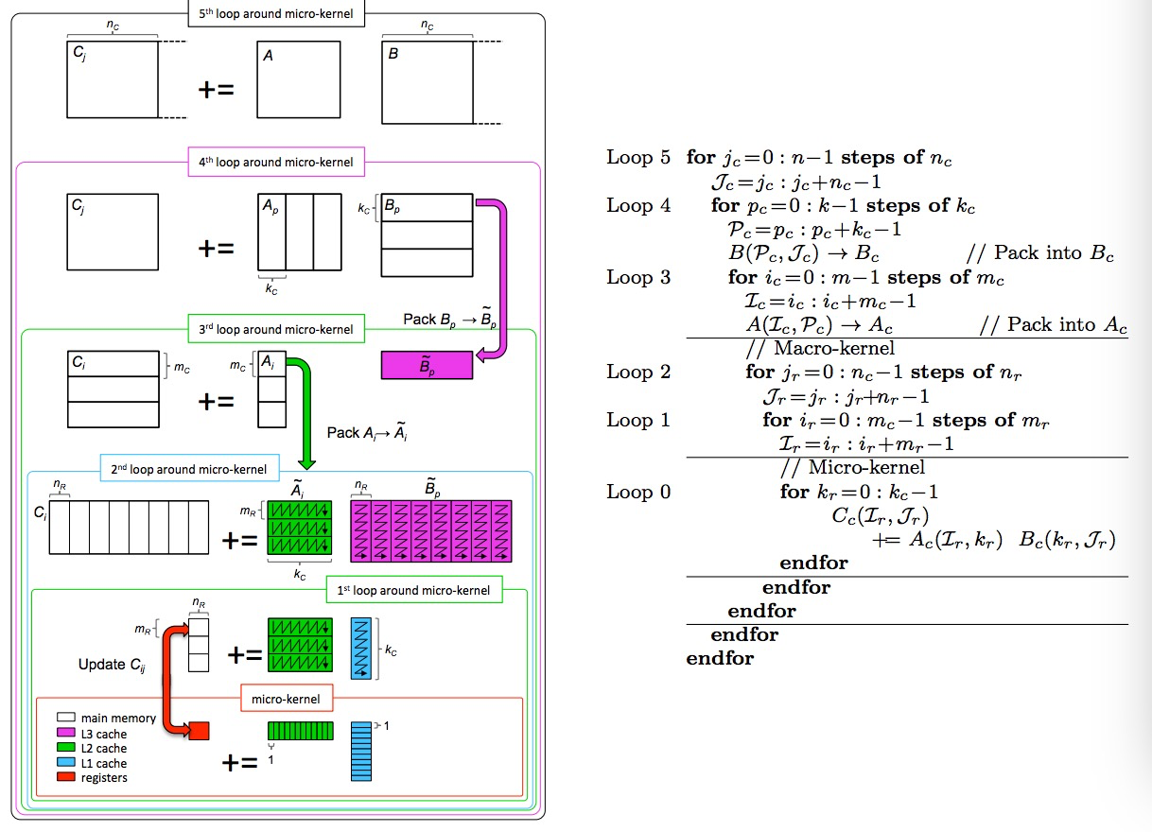
OpenBLAS Matrix Multiplication (GEMM)
Matrix Blocking, improve locality for large matrices
Data packing, improve locality
Kernel in assembly, SIMD instruction
Multi-threading, for multi-core CPU

Slide 20
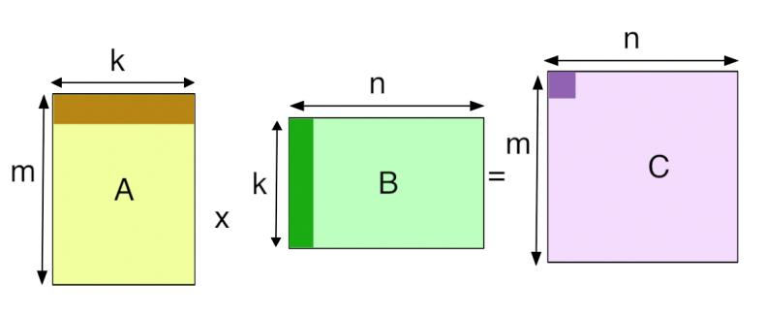
Performance Evaluation of Matrix Multiplication
Timing
Gettimeofday(), wall time
Calculating effected floating op#
Matrix A m x k, Matrix B k * n, Matrix C m x n
Effected floating op# = 2 * m * n * k
Performance Evaluation
Effected Performance = Effected floating op# / time
Efficiency = Effected Performance / Peak Performance
The GEMM efficiency of Intel CPU single core is usually above 90%

