Slide 1
C/C++ Program Design
CS205
Prof. Shiqi Yu (于仕琪)
yusq@sustech.edu.cn
http://faculty.sustech.edu.cn/yusq/

Slide 2
CNN for Image Classification
For Project 5

Slide 3
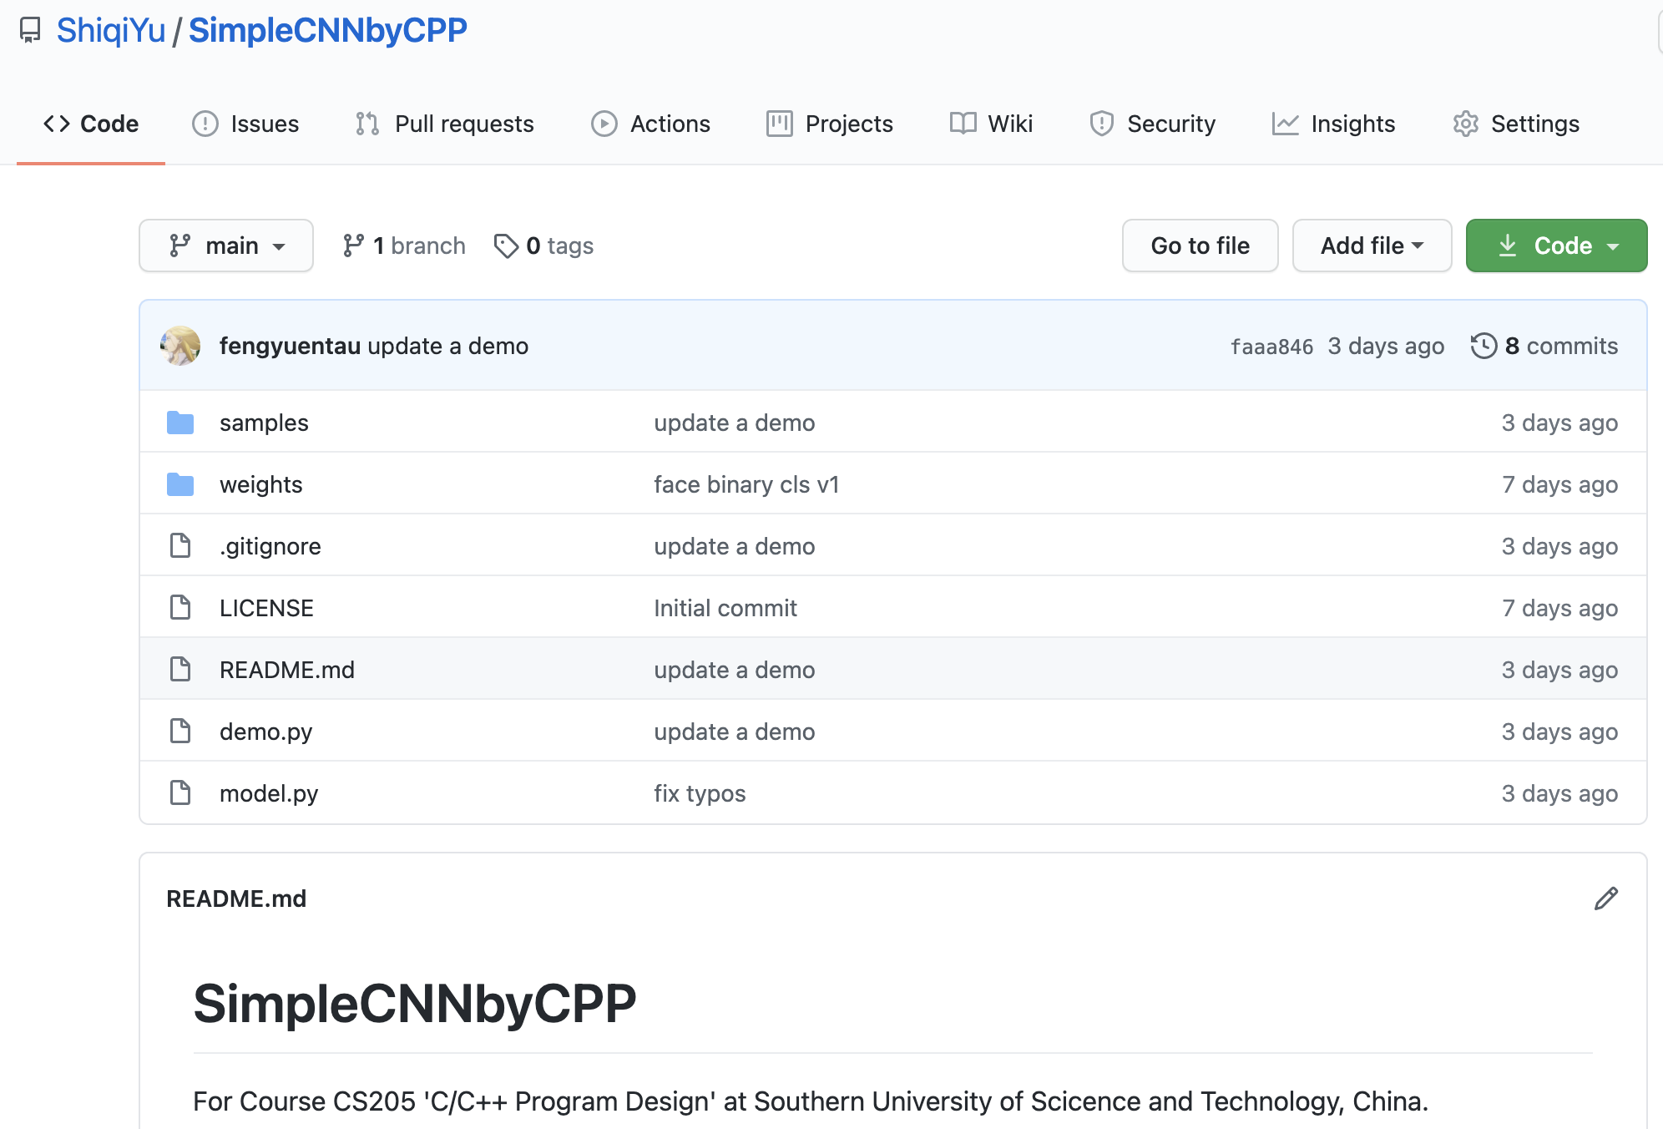

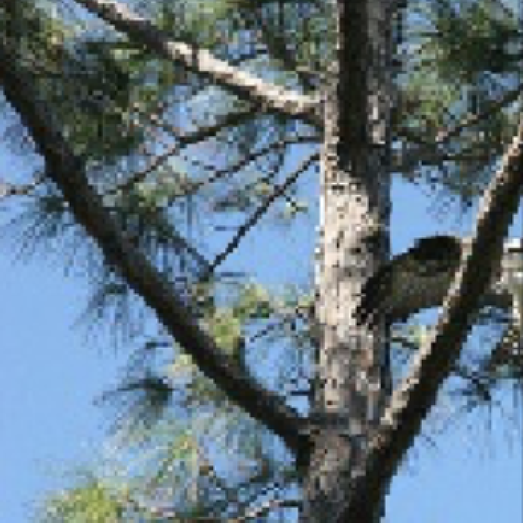
Pre-trained model
https://github.com/ShiqiYu/SimpleCNNbyCPP
CNN
0.02
0.98
CNN
0.95
0.05

Slide 4
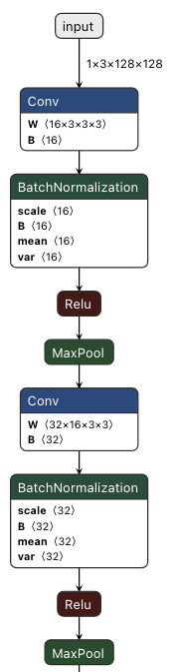
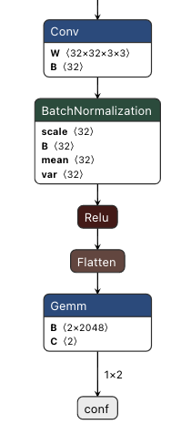
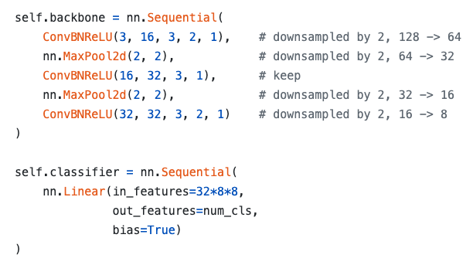
Model
3 Convolutional layers (Conv+BN+ReLU)
2 MaxPool
1 Full connected layer

Slide 5
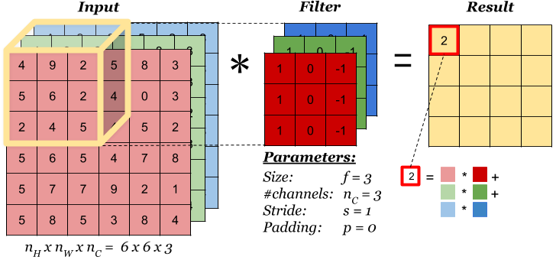
conv
Multiple filters (kernels) can create multiple output channels
https://www.zybuluo.com/hongchenzimo/note/1086311

Slide 6
conv
https://towardsdatascience.com/a-comprehensive-guide-to-convolutional-neural-networks-the-eli5-way-3bd2b1164a53

Slide 7
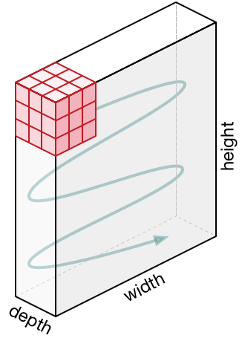
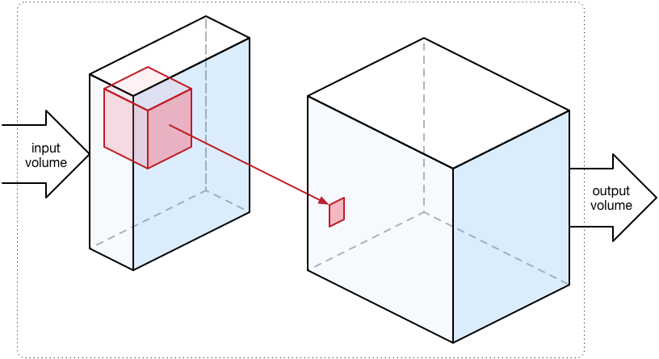
conv
A convolutional kernel create a channel in the output data.
https://towardsdatascience.com/a-comprehensive-guide-to-convolutional-neural-networks-the-eli5-way-3bd2b1164a53

Slide 8
Batch normalization
The BN layers have been merged into conv layers

Slide 9
ReLU: Rectified Linear Unit
if (x < 0)
x = 0;

Slide 10
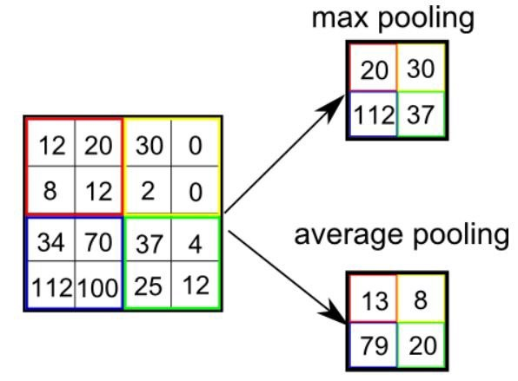
max pooling
For each channel
If the input is C x H x W, the output will be C x H/2 x W/2

Slide 11
Flatten
The data blob is flatted into a 2048-length vector from 32x8x8

Slide 12
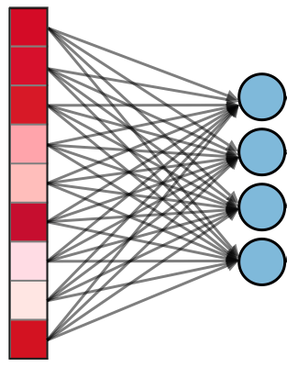
FC: Fully-Connected Layer
If the input is L and the output is N (2 in the model, 4 in left figure), the size of weights is NxL (2x2048 in the model)
output_{2x1} = weight_{2x2048} *input_{2048x1}+bias_{2x1}

Slide 13

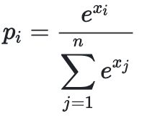
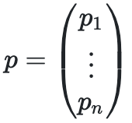
Softmax
To output the confidence vector (n=2 in the model)
for

Slide 14
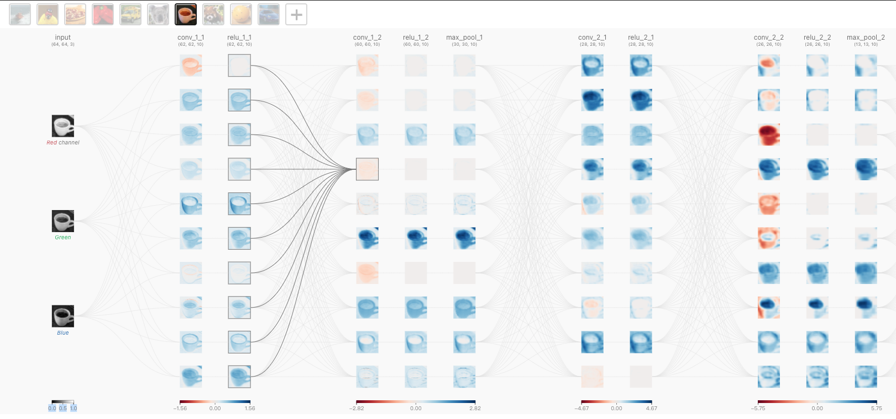
CNN Explainer
https://poloclub.github.io/cnn-explainer/

