Slide 1
C/C++ Program Design
Lab 13, Composition & Template
廖琪梅，王大兴

Slide 2
Composition and Template
Class Objects as members
Class templates

Slide 3
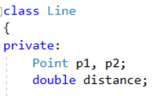
Class Containment(Composition)
Using class members that are themselves objects of another class is referred to as containment or composition or layering.
Containment is typically used to implement has-a relationship, that is, relationship for which the new class has an object of another class.
data in Line class has Point objects

Slide 4
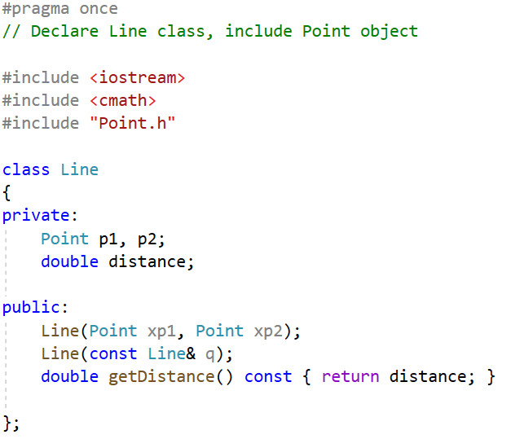
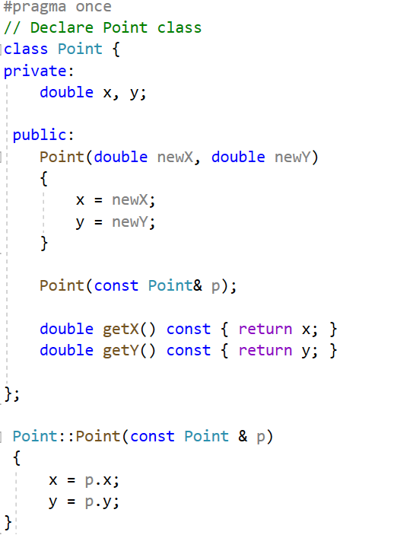
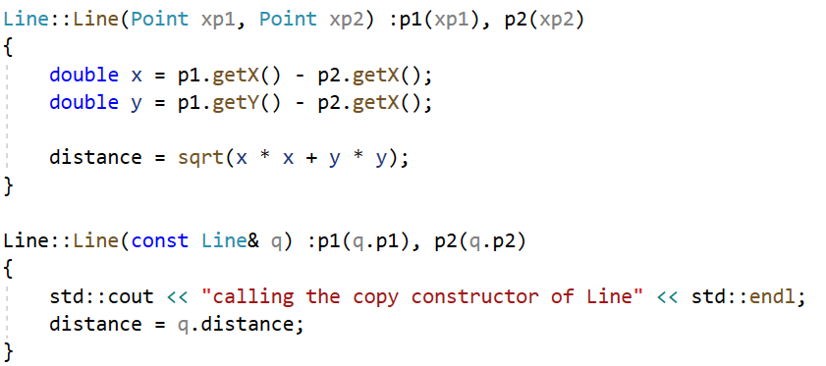
Example:
data in Point class
data in Line class has Point objects
constructor
constructor and
copy constructor
copy constructor
Initialize object first by
initialization list
Initialize object first by initialization list

Slide 5
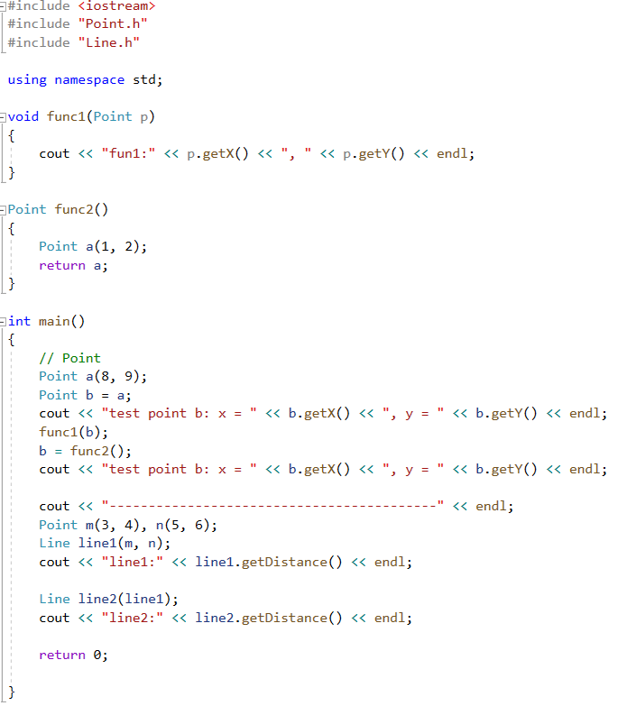
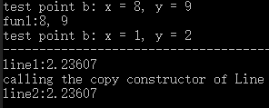
Invoke Point’s constructor
Invoke Point’s copy constructor
Invoke Line’s constructor
Invoke Line’s copy constructor

Slide 6
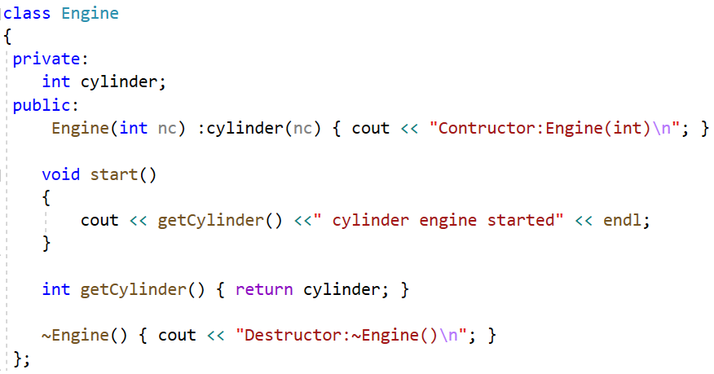
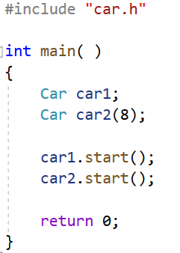
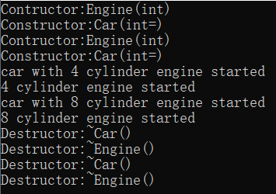
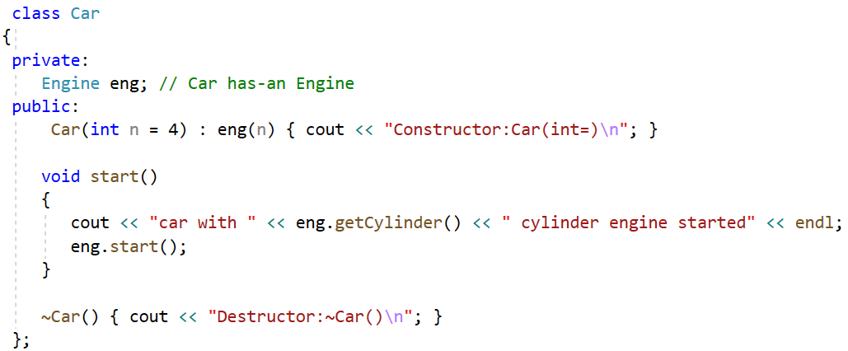
Call the Car’s default constructor
First, constructs the object in Car class
then, constructs the Car object
Define an object of Engine as Car’s attribute
Initialize the object by its own constructor
via initialization list in Car’s constructor
When an object is destructed, the complier first
destructs Car’s object, and then destructs the
composition object in Car class.

Slide 7
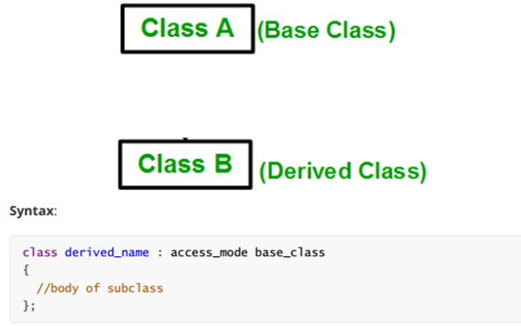
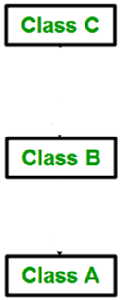
Type of Inheritance
1. Single Inheritance
2. Multilevel Inheritance
(Base Class)
(Directly Derived Class)
(Indirectly Derived Class)

Slide 8
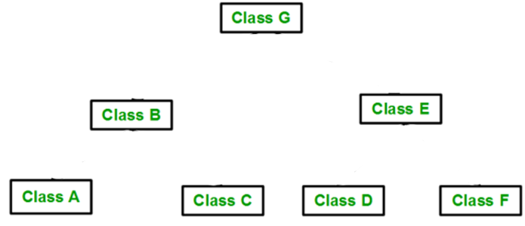
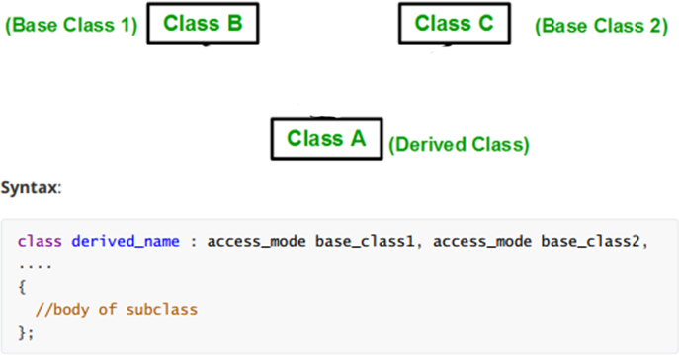
3. Multiple Inheritance(MI)
4. Hierarchical Inheritance

Slide 9
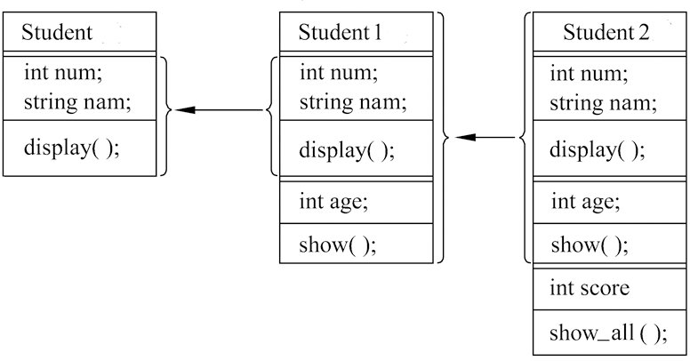
Multilevel inheritance example:
Base class
Directly derived class
Indirectly derived class
Student
Student1
Student2

Slide 10
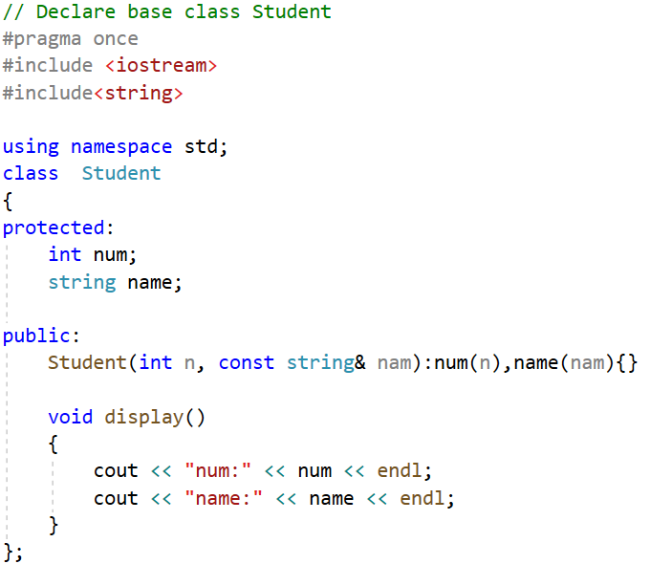
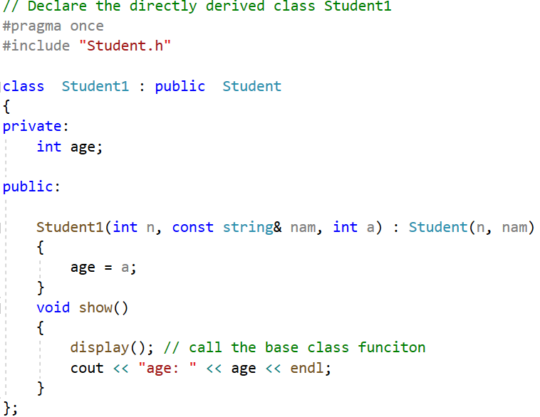
data in class Student1
data in class Student
constructor of Student1
constructor of class Student

Slide 11
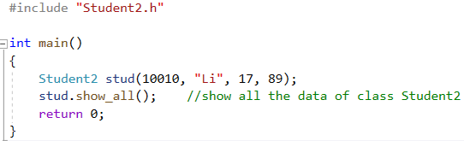
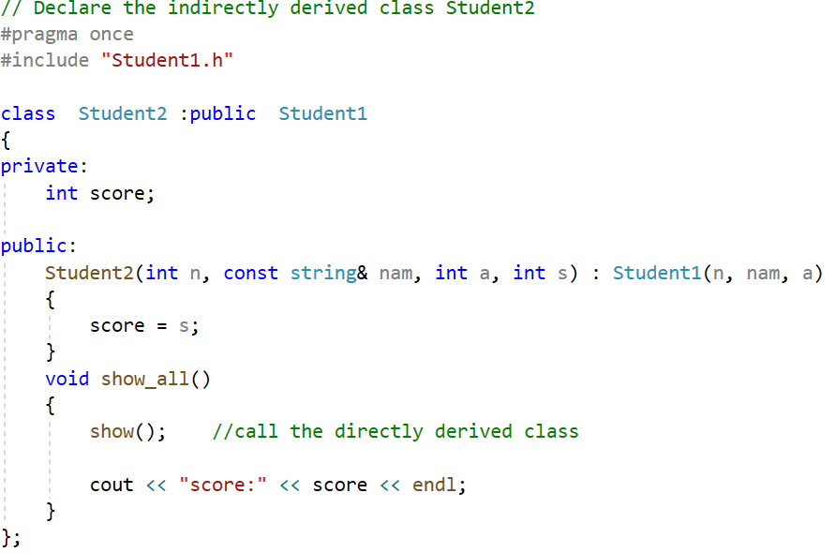

data in class Student2
constructor of Student2

Slide 12
Multiple Inheritance(MI)
MI describes a class that has more than one immediate base class. As with single inheritance, public MI should express an is-a relationship.
Person
you must qualify each base class with the keyword public
Student
Teacher
Graduate has two copies of Person objects. Because both Student and Teacher inherit the Person component, Graduate winds up with two Person components.
Graduate

Slide 13
Virtual Base Classes
Virtual base classes allow an object derived from multiple bases that themselves share a common base to inherit just one object of that shared base class.
virtual and public can appear in either order
A Graduate object will contain a single copy of the Person object.

Slide 14
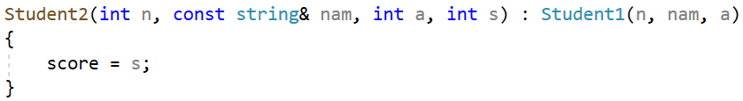
Constructor
With nonvirtual base classes, the only constructors that can appear in an initialization list are constructors for the immediate base classes. But these constructors can, in turn, pass information on to their bases.
Just invoke immediate base class constructor, need not
invoke the upper base class constructor
This automatic passing of information doesn’t work if a class is a virtual base class.
Invoke the Person class(the top-level base class)
constructor explicitly. If you don’t invoke the
constructor, the compiler will invoke its default
constructor.
invoke the Teacher and Student class
(immediate base classes)constructors
initialize its own data

Slide 15
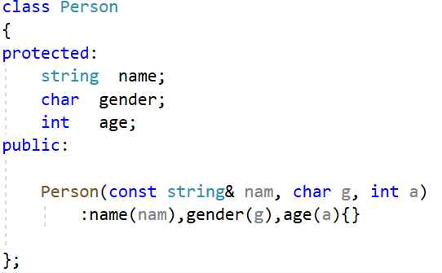
Multiple inheritance example:
Person
data in class Person
Student
Teacher
constructor of Person
Graduate

Slide 16
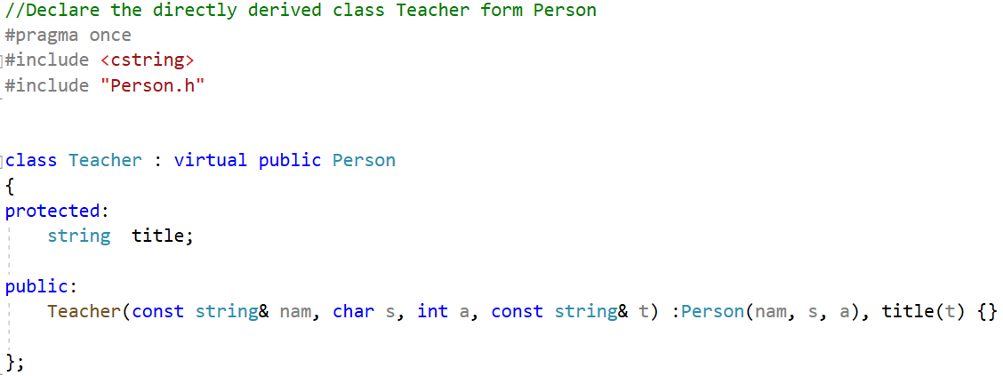
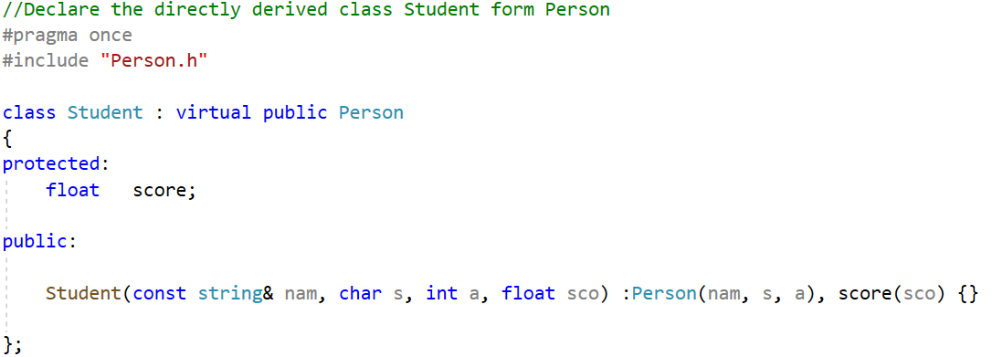
data in class Teacher
data in class Student

Slide 17
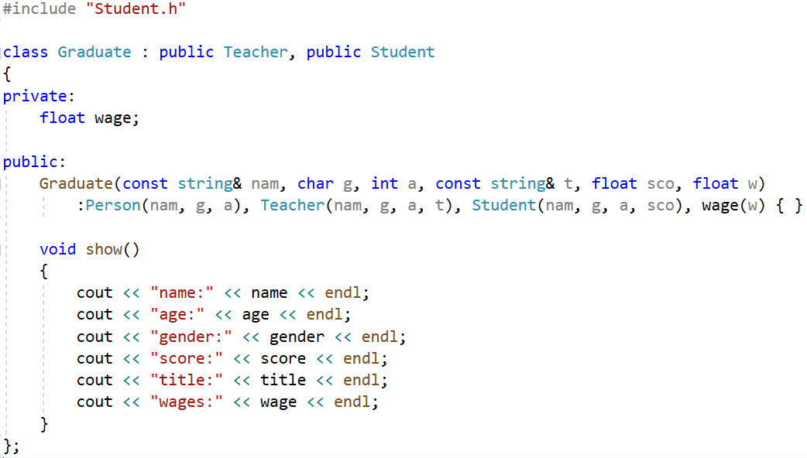
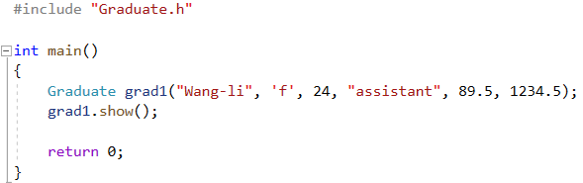
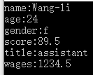
data in class Graduate

Slide 18
Template
Templates are a feature of the C++ programming language that allows functions and classes to operate with generic types. This allows a function or class to work on many different data types without being rewritten for each one.

Slide 19
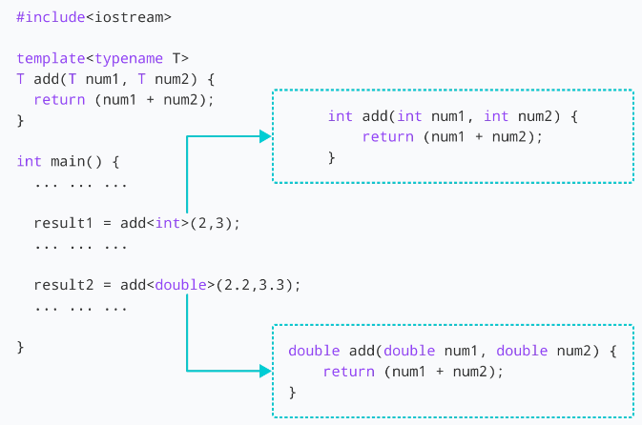
Function Templates
keyword
template parameter
function definition
function call, give the concrete type in <>
To create a prototype for a template function remember to include the template specifier like this:
template <typename T>
T add(T, T);

Slide 20
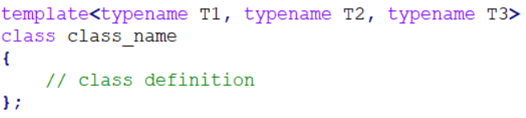
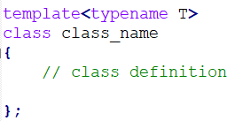
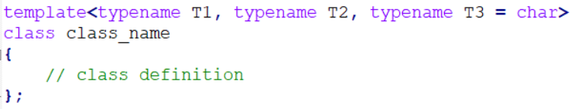
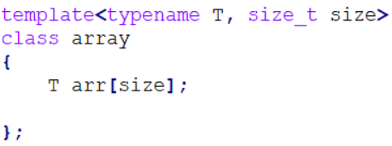
Class Templates
Similar to function templates, we can use class templates to create a single class to work with different data types.
or <class T>
multiple parameters
multiple and default parameters
nontype template argument

Slide 21
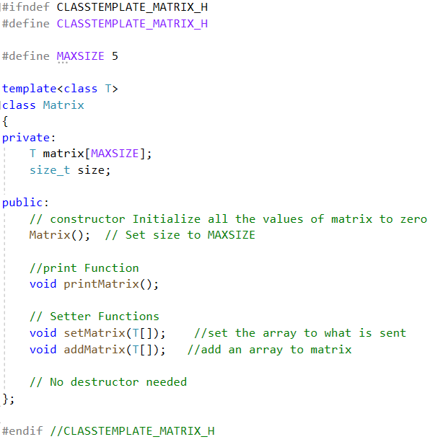
Class Templates
1. Class Definition
data in matrix class

Slide 22
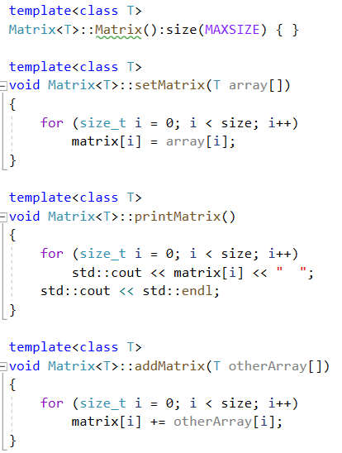
2. Member Function Definition
To refer to the class in a generic way you must include the placeholder in the class name like this:
template <class T>
return_type class_name <T>::
function_name(parameter_list,…)

Slide 23
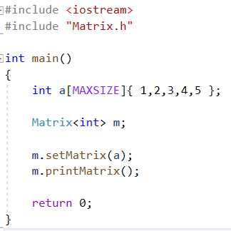
3. Class Instantiation
To make an instance of a class you use this form:
class_name <type> variablename;
For example, to create a Matrix with int you would type:
Matrix<int> m;
Taken together Matrix becomes the name of a new class.

Slide 24
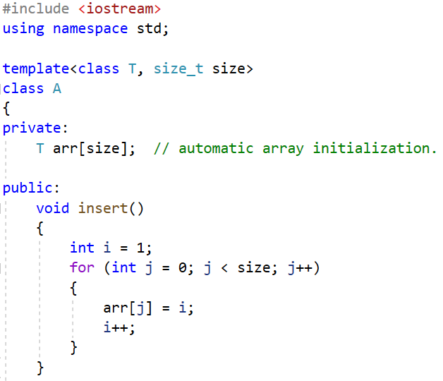
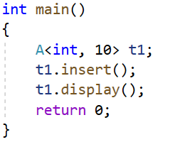
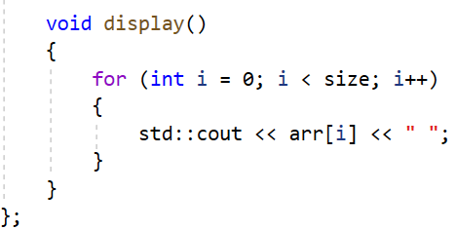
nontype template argument
Nontype template arguments can be strings,
constant expression and built-in types.

Slide 25
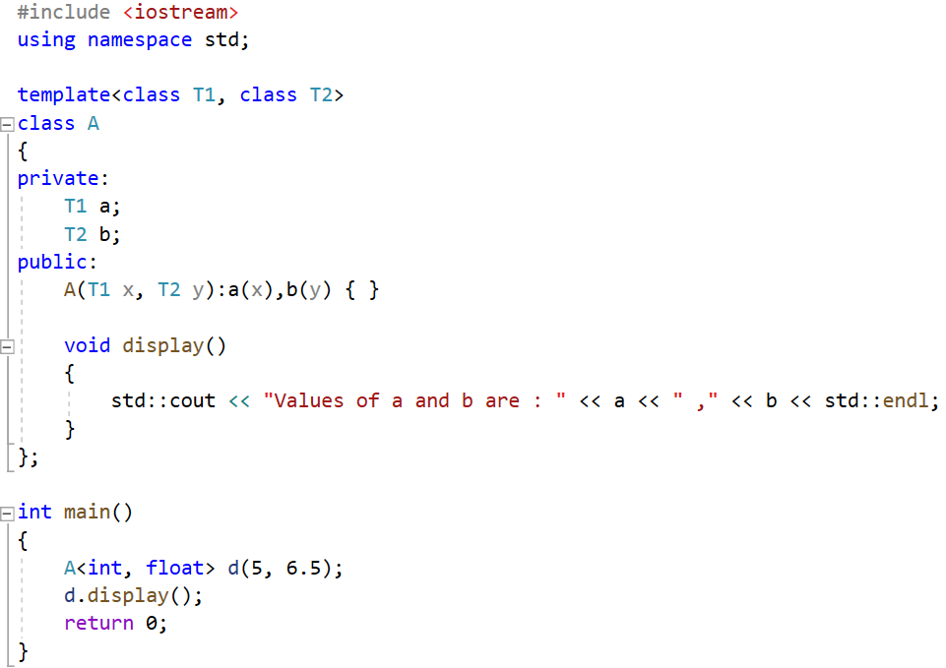
multiple parameters

Slide 26
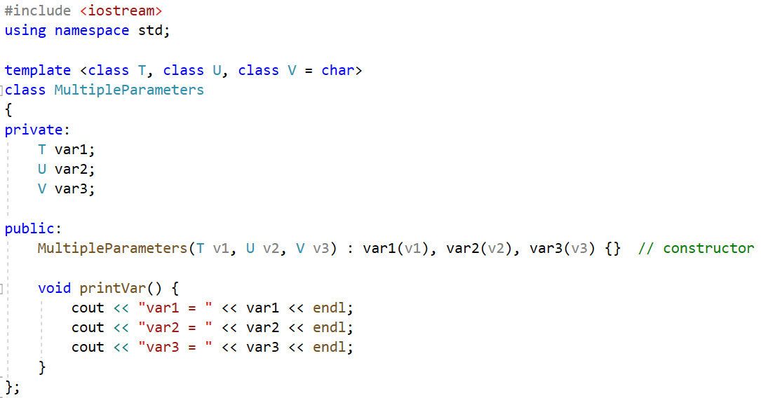
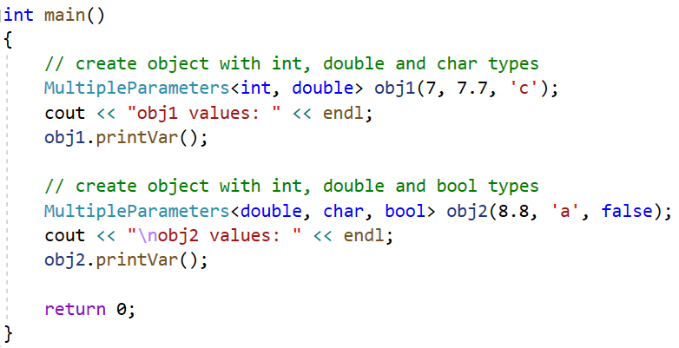
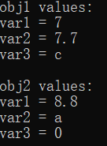
multiple and default parameters

Slide 27
Template specialization
In some cases, it isn't possible or desirable for a template to define exactly the same code for any type. In such cases you can define a specialization of the template for that particular type. When a user instantiates the template with that type, the compiler uses the specialization to generate the class, and for all other types, the compiler chooses the more general template. Specializations in which all parameters are specialized are complete specializations. If only some of the parameters are specialized, it is called a partial specialization.
A template specialization of a class requires a primary class and a type or parameters to specialize. A specialized template class behaves like a new class. There is no inheritance from the primary class. It doesn’t share anything with the primary template class, except the name. Any and all methods and members will have to be implemented.

Slide 28
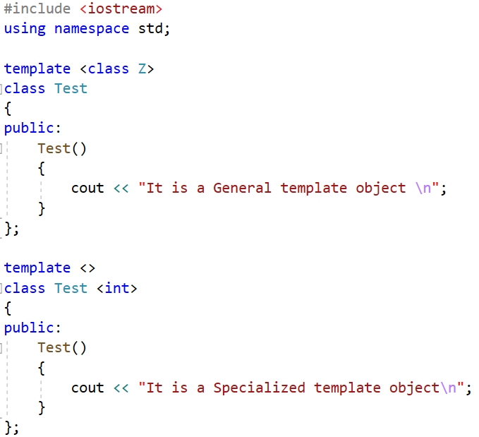
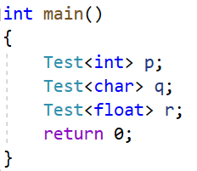

primary class
class specialization

Slide 29
Class templates can be partially specialized, and the resulting class is still a template. Partial specialization allows template code to be partially customized for specific types in situations, such as:
A template has multiple types and only some of them need to be specialized. The result is a template parameterized on the remaining types.
A template has only one type, but a specialization is needed for pointer, reference, pointer to member, or function pointer types. The specialization itself is still a template on the type pointed to or referenced.

Slide 30
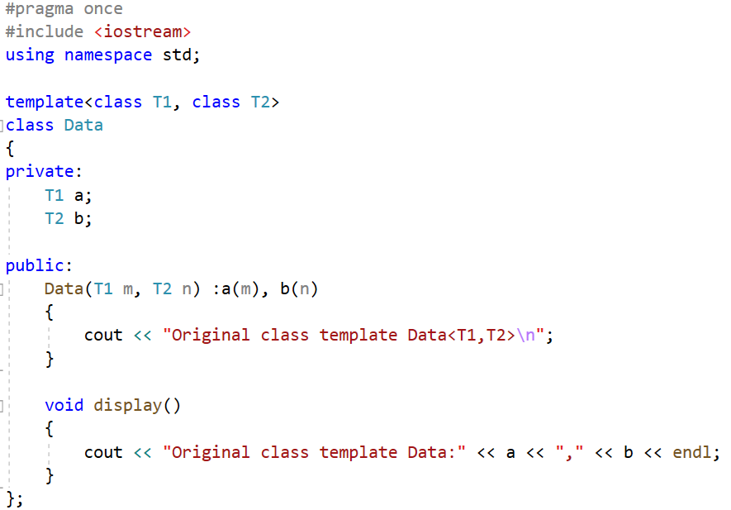
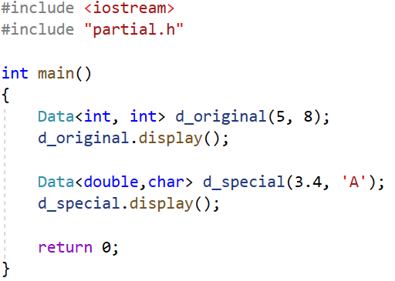
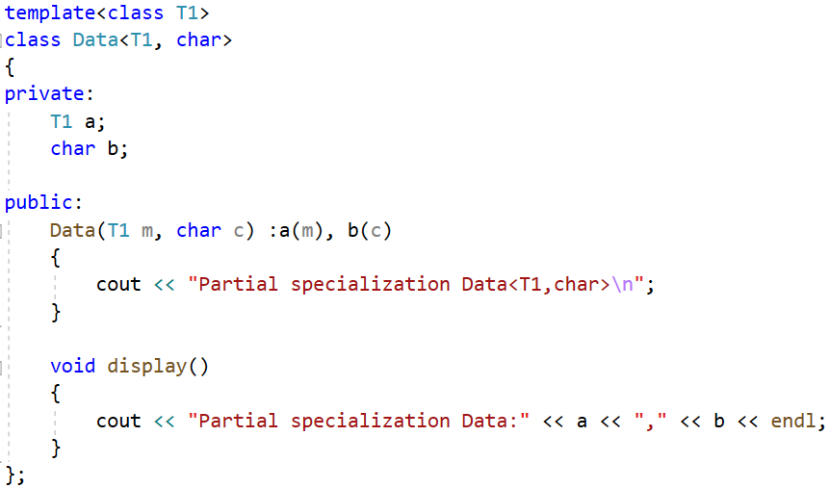

primary class
class partial specialization

Slide 31
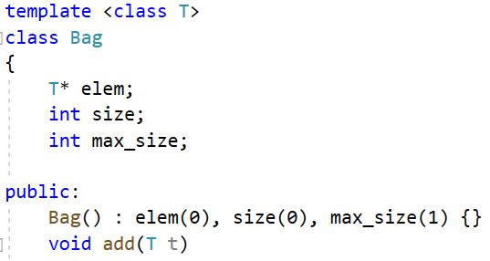

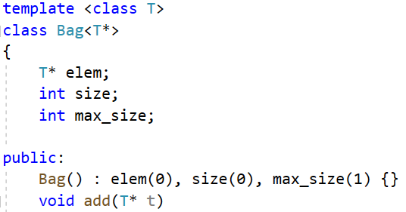
primary class
Original template class
class partial specialization
template partial specialization for pointer types

Slide 32
Bringing it All Together
Normally when you write a C++ class you break it into two parts: a header file with the interface, and a .cpp file with the implementation. With templates this doesn’t work so well because the compiler needs to see the definition of the member functions to create new instance of the template class. Some compilers are smart enough to figure out what to do, but some aren’t. These are usually the most efficient way to use templates. We recommend that template classes be declared and implemented in .h files to ensure proper linking. Or you can include .cpp file in your main program instead of including .h file.

Slide 33
A Word of Warning
Templates are powerful, but they are not magical. They do not give data types features that they did not have before. When you design or use a template you should be aware of what operations the data types you will use need to support.

Slide 34
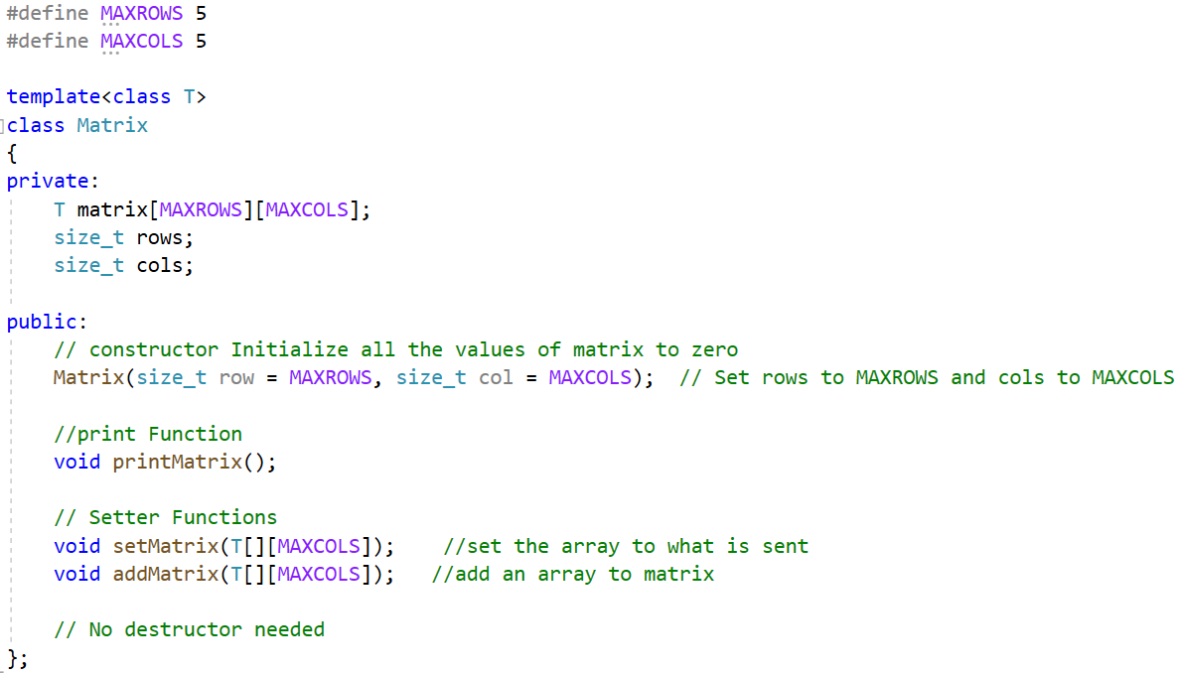
Exercise:
Define a 2D array named Matrix using template type, implement the member functions of Matrix and the function useMatrixTemplate, make the program run as the sample.

Slide 35
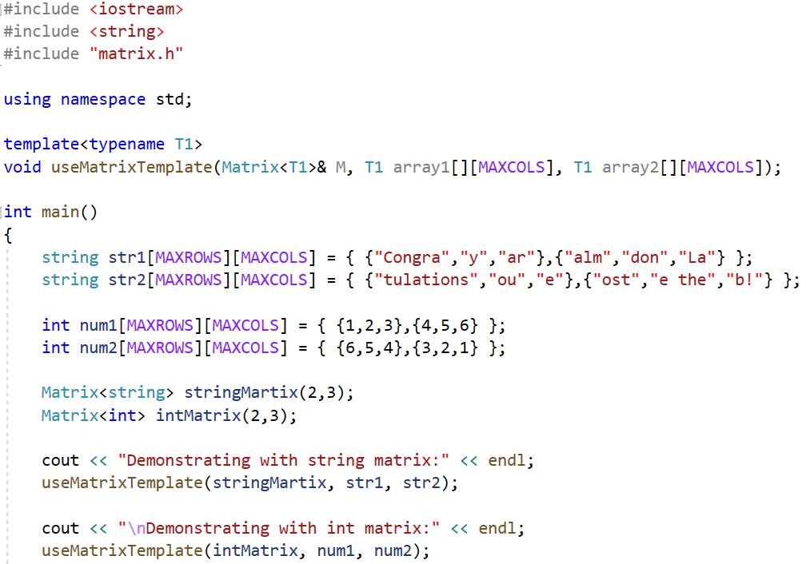

implement the function

