Slide 1
C/C++ Program Design
Lab 14, Exceptions
廖琪梅，王大兴

Slide 2
Exceptions
Exceptions
Assertion

Slide 3
Exception and Exception Handling
What is an exception?
An exception is a situation, which occurred by the runtime error. In other words, an exception is a runtime error. An exception may result in loss of data or an abnormal execution of program. Exception handling is a mechanism that allows you to take appropriate action to avoid runtime errors.
The default behavior for unexpected is to call terminate, and the default behavior for terminate is to call abort, so the program is to halt. Local variables in active stack frames are not destroyed, because abort shuts down program execution without performing such cleanup.
Let’s consider a simple example: a is divided by b, if b equals to zero, what will happen?

Slide 4
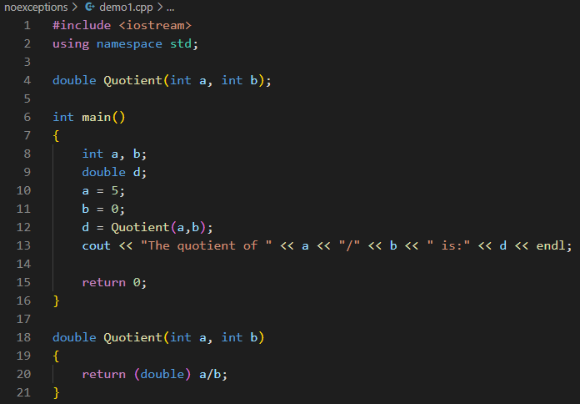
Example of a program without exception handling
When divisor is zero, compiler generates a special floating-point value that represents infinity; cout displays this value as Inf, inf or INF.

Slide 5
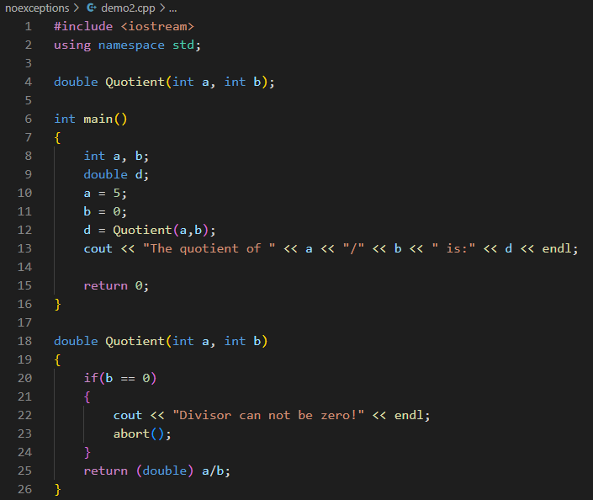

Example of a program with if statement to judge whether the divisor is zero. If the divisor is zero, call abort() function to terminate the program.
You can use exit() function without a message displayed.

Slide 6
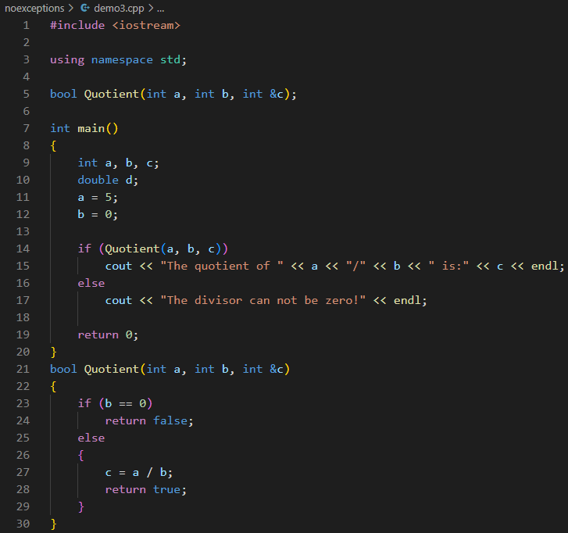
Example of a program with the return a boolean value to judge the condition, add another argument to store the answer.
To judge whether the divisor is zero by return value

Slide 7
Exception handling
Exceptions provide a way to react to exceptional circumstances (like runtime errors) in programs by transferring control to special functions called handlers. C++ provides three keywords to support exception handling.
try: The try block contain statements which may generate exceptions. When an exceptional circumstance arises within that block, an exception is thrown that transfers the control to the exception handler. If no exception is thrown, the code continues normally and all handlers are ignored.
throw: When an exception occur in try block, it is thrown to the catch block using throw keyword.
catch: The catch block defines the action to be taken when an exception occur. Exception handlers are declared with the keyword catch, which must be placed immediately after the try block.

Slide 8
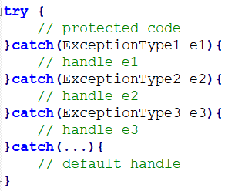
The syntax for using try/catch as follows:
Catches any type exception
You can list down multiple catch statements to catch different type of exceptions in case your try block raises more than one exception in different situations.

Slide 9
How does exception handling work?
When a problem is detected during the computation, an exception is raised by using keyword throw.
The raised exceptions are handled by the catch block. This exception handler is indicated by the keyword catch.
try block is responsible for testing the existence of exceptions.
After an exception has been handled, the program execution resumes after the try-catch block, not after the throw statement.

Slide 10
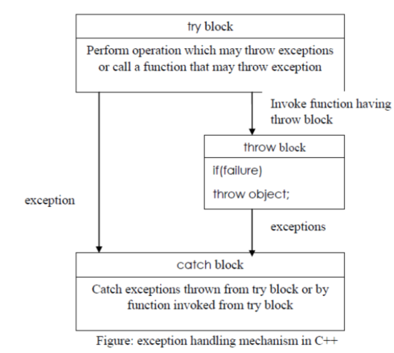
The following figure explains more about this:
Steps taken during exception handling:
1. Hit the exception(detect the problem causing exception)
2. Throw the exception(inform that an error has occurred)
3. Catch the exception(receive the appropriate actions)
4. Handle the exception(take appropriate actions)

Slide 11
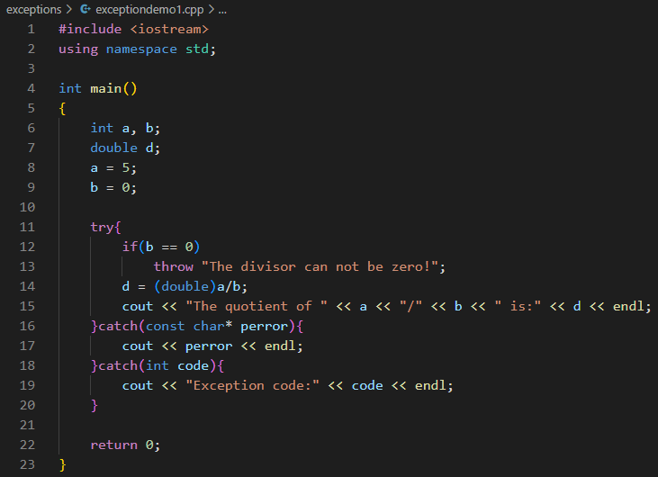
Example of a program with exception handling using try and catch, throw an exception in try block in main()
match

Slide 12
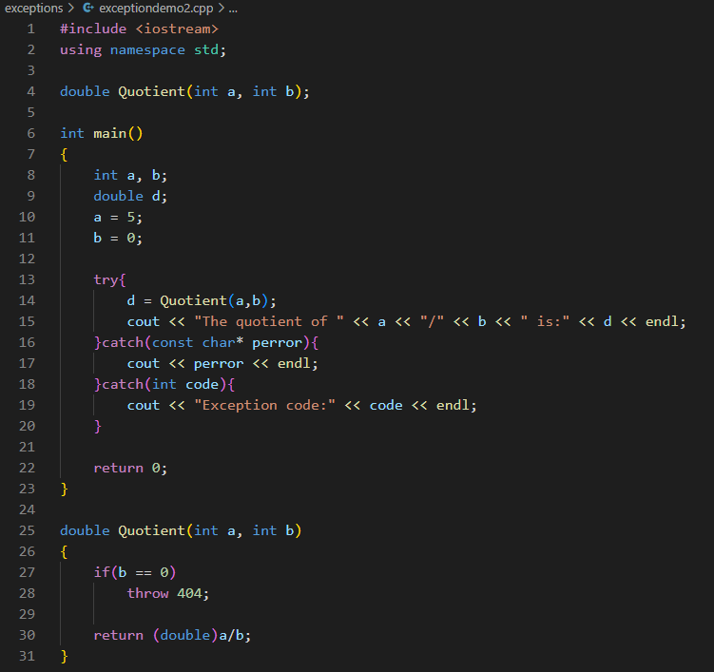
Example of a program with exception handling using try and catch, throw an exception in other function, handlers are in main()
match

Slide 13
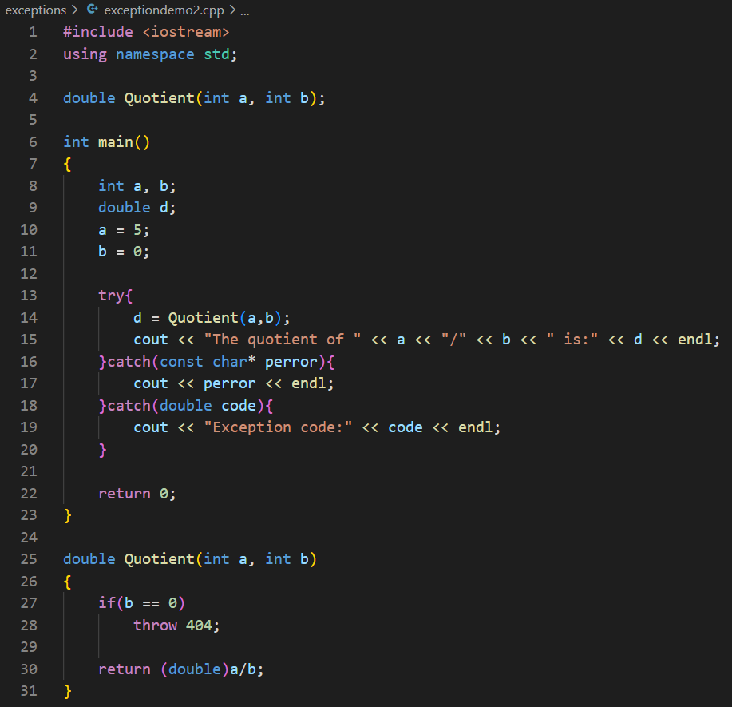

Note: In general, no conversions are applied when matching exceptions to catch clauses.
does not
match

Slide 14
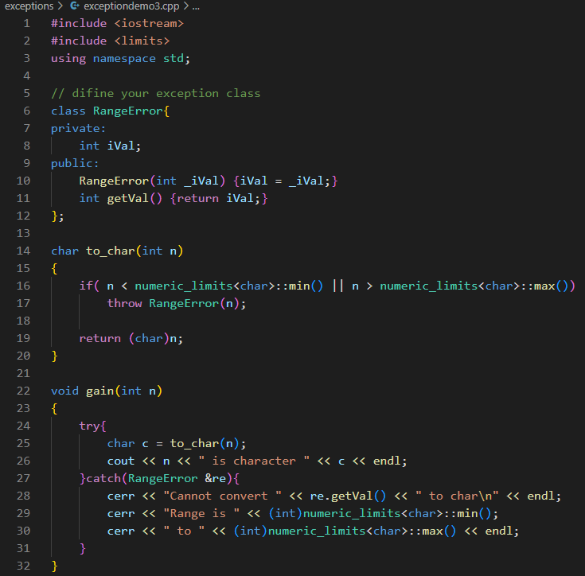
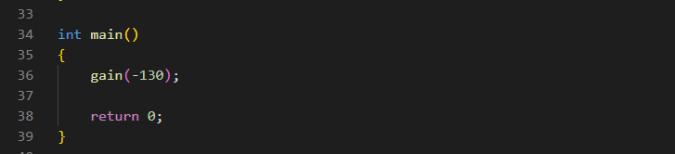

Define and using exception class
Define your exception class
Throw the exception and invoke the constructor
Catch and handle the exception

Slide 15
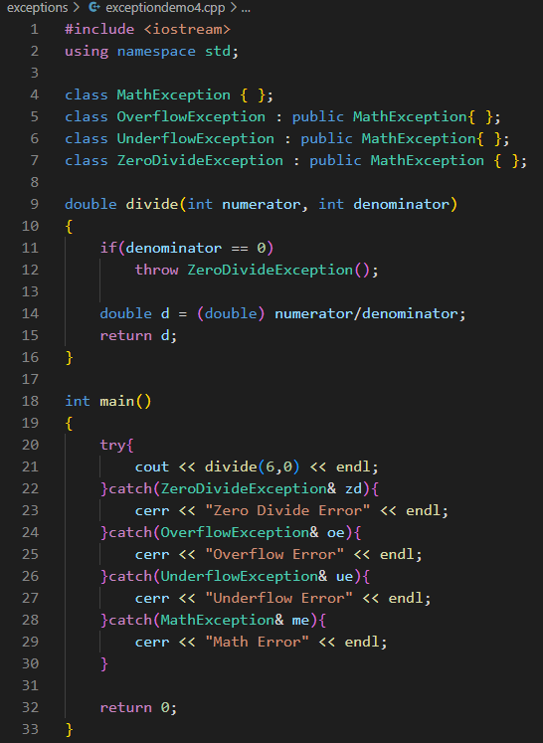
Handling exceptions from an inheritance hierarchy
Note: A kind of conversion is applied when matching exceptions to catch clauses. That is inheritance-based conversions. A catch clause for base class exceptions is allowed to handle exceptions of derived class types, too.

Slide 16

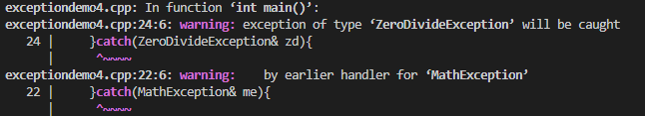
Note: catch clauses are always tried in the order of their appearance. Hence, it is possible for an exception of a derived class type to be handled by a catch clause for one of its base class types.
Compilers may warn you if a catch clause for a derived class comes after one for a base class.

Slide 17
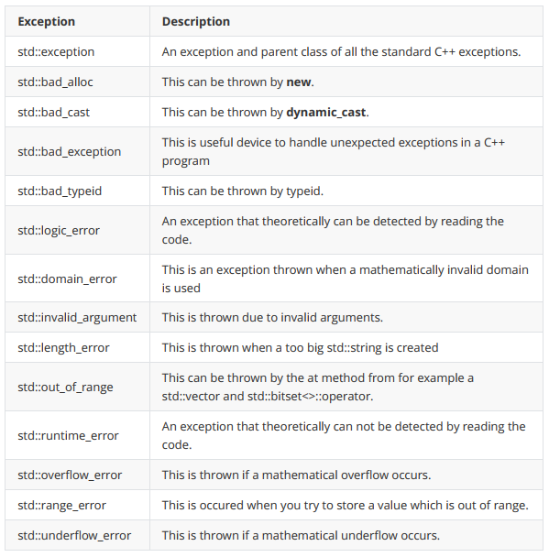
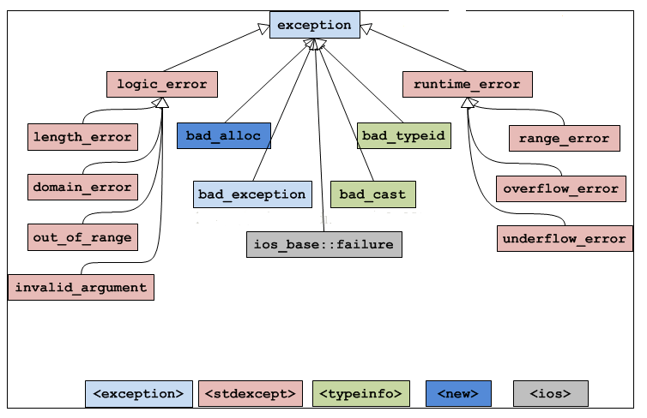
C++ Standard Exceptions
C++ provides a list of standard exceptions defined in which we can use in our programs.

Slide 18
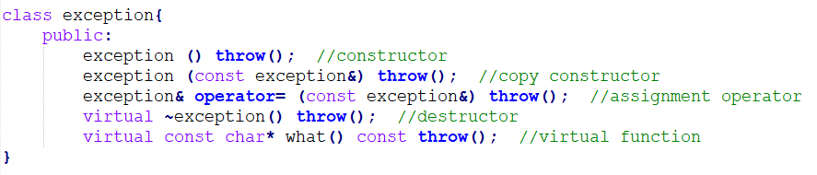
Exception specification used in function declaration, with no argument indicates that the function is not allowed to throw any exceptions.
what() is a public method provided by exception class which returns a string and it has been overridden by all the child exception classes.

Slide 19
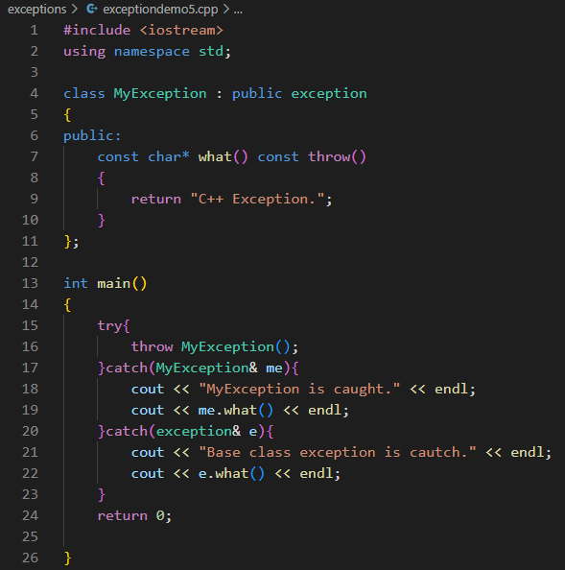

Define your own exception class derived from exception class and override what() method

Slide 20
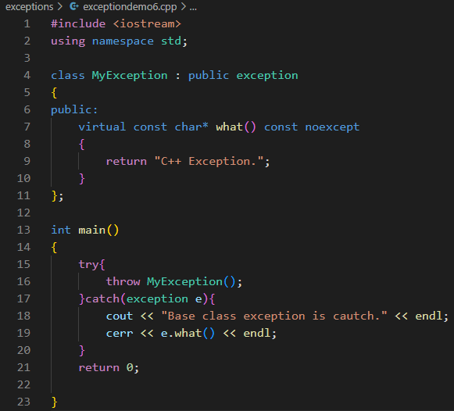

Note: use catch-by-reference for exception objects
catch-by-value:Derived class exception objects caught as base class exceptions have their derivedness "sliced off." Such "sliced" objects are base class objects: they lack derived class data members, and when virtual functions are called on them, they resolve to virtual functions of the base class. So use catch-by-reference for exception objects and invoke the virtual function of the derived class.
It will not throw any exception
Catch the exception
by value
Invoke what() of the exception class
rather than the MyException class.

Slide 21
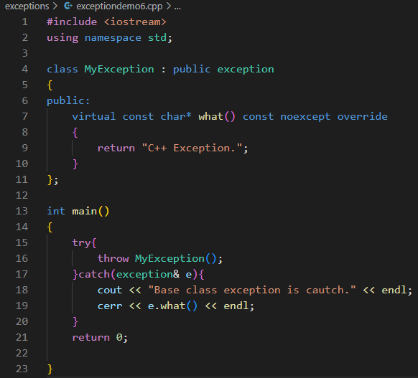

It is overriding a virtual method of the base class.
Catch the exception
by reference
Invoke what() of the MyException class
not the exception class.

Slide 22
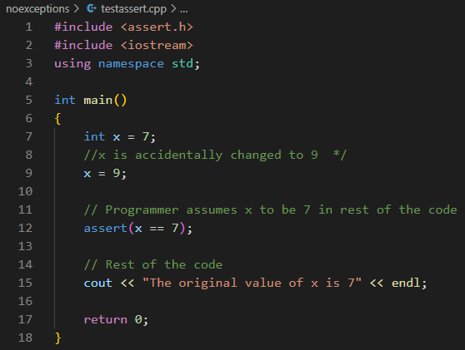
Assertions in C/C++
Assertions are statements used to test assumptions made by programmers. It is designed as a macro in C/C++. Following is the syntax for assertion:
void assert(int expression);
If the expression evaluates to 0 (false), then the expression, source code filename, and line number are sent to the standard error, and then abort() function is called.
source code filename
and line number
file name
expression
abort() function is called and display message on the screen.

Slide 23
Assertions are mainly used to check logically impossible situations. For example, they can be used to check the state of a code which is expected before it starts running, or the state after it finishes running.
Verify the validity of the passed argument at the beginning of the function.
int resetBufferSize(int nNewSize) { assert(nNewSize >= 0); assert(nNewSize <= MAX_BUFFER_SIZE);
... }
// is not recommended
assert(nOffset>=0 && nOffset+nSize<=m_nInfomationSize);
// is recommended, each assert test only on condition
assert(nOffset >= 0); assert(nOffset+nSize <= m_nInfomationSize);
Each assert tests only one condition, because when multiple conditions are tested at the same time, it is not intuitive to determine which condition failed if the assertion failed.
Ignores assertions. We can completely remove assertions at compile time using the preprocessor NDEBUG. Put #define NDEBUG at the beginning of the code, before inclusion of <assert.h>
Therefore, this macro is designed to capture programming errors, not user or run-time errors, since it is generally disabled after a program exits its debugging phase.

Slide 24

Standard output and standard error
Apart from the cout you have used before, there is another output stream you can use call stardad error.
The cout put data into “standard output”, while the cerr put data into “standard error”.
#include <iostream>
using std::cout;
using std::cerr;
using std::endl;
int main() {
cout<<"Hello world 1."<<endl;
cerr<<"Hello world 2."<<endl;
return 0;
}

Slide 25
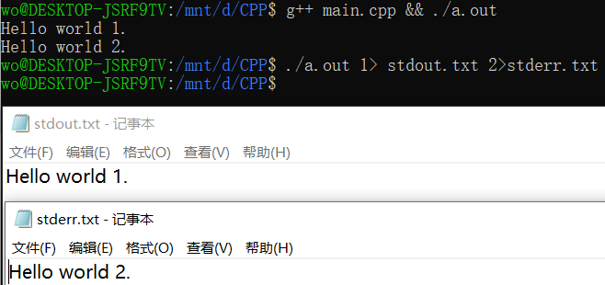
Standard output and standard error
At first it does not make a difference. But you can redirect the streams.
In the example below, we redirect the standard output to “stdout.txt” and the standard error to “stderr.txt”
#include <iostream>
using std::cout;
using std::cerr;
using std::endl;
int main() {
cout<<"Hello world 1."<<endl;
cerr<<"Hello world 2."<<endl;
return 0;
}

Slide 26
Standard output and standard error
Conventionally, we put the output of the program in standard output, and the error information, log information in standard error, even if the language does not require this.
#include <iostream>
using std::cout;
using std::cerr;
using std::endl;
int main() {
cout<<"Hello world 1."<<endl;
cerr<<"Hello world 2."<<endl;
return 0;
}

Slide 27
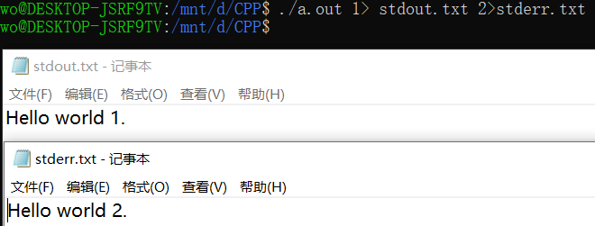
Standard output and standard error
You can do the same with c language.
#include <cstdio>
int main() {
fprintf(stdout, "Hello world 1.\n");
fprintf(stderr, "Hello world 2.\n");
return 0;
}
You may need to search for “linux file descriptor table” to understand the basic idea behind these concepts.

Slide 28
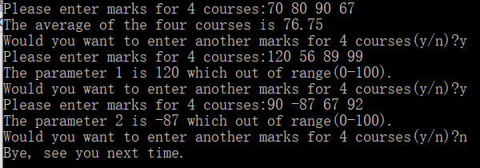
Exercise 1
Write a function calculateAverage() which takes four int arguments which are marks for four courses in the semester and returns their average as a float.
The calculateAverage() function should take only valid range for marks which is between 0-100. If the marks are out of range throw an OutOfRangeException – define this exception as a class.
Invoke the calculateAverage() function in main function and get the following inputs and outputs:

Slide 29
Exercise 2
Rewrite exercise 1, using assert instead of exceptions this time.

