Slide 1
C/C++ Program Design
Lab 15, Friend classes, Nested classes and RTTI
廖琪梅，王大兴

Slide 2
Friend classes,Nested classes and RTTI
Friend class
Nested class
RTTI

Slide 3
Friend Functions
A friend function of a class is a non-member function that has the right to access the private and protected class members.
To declare a non-member function as a friend of a class, place the function prototype in the class definition and precede it with the keyword friend.
friend return_type functionName (parameter list);

Slide 4
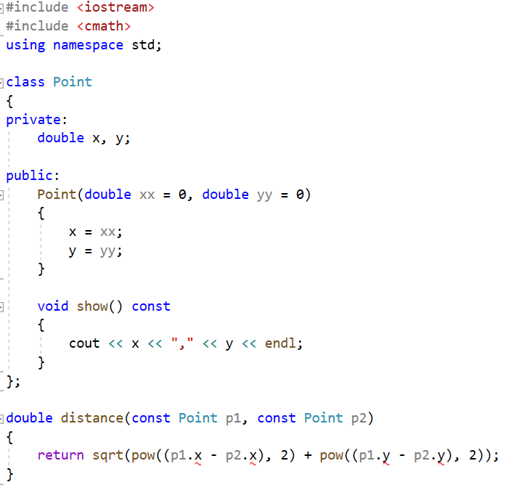
The private data members can not be accessed outside the class

Slide 5
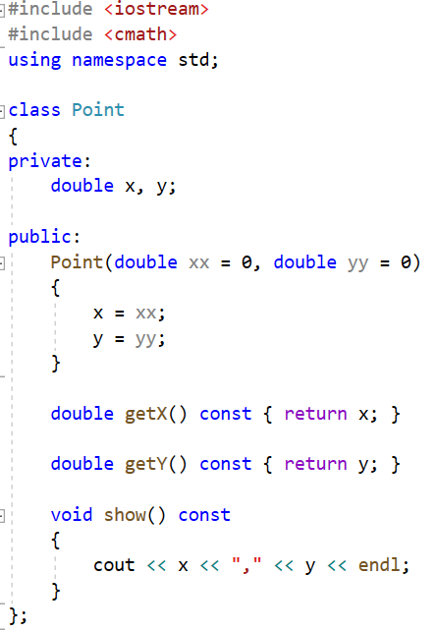
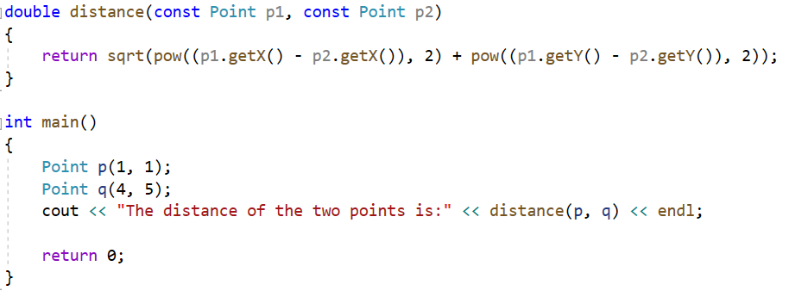
Can distance function be defined as the member function?

Slide 6
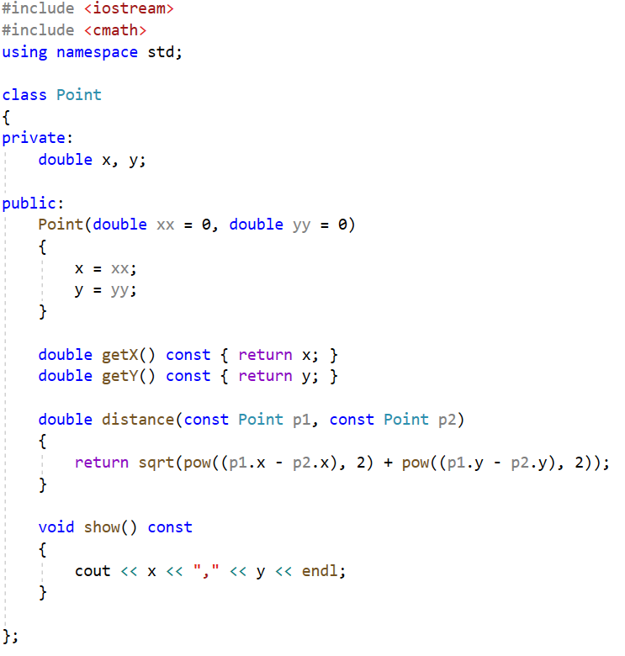
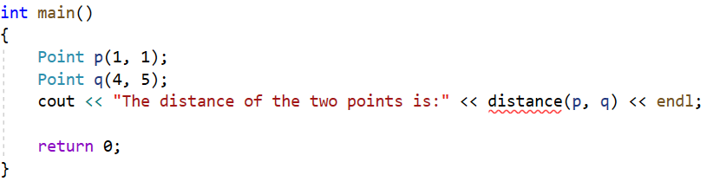
The distance function is defined as the member function.
The member function can access the private members of the class
You cannot invoke the distance function like this,
because it is a member function, which is invoked by object using . operator.

Slide 7
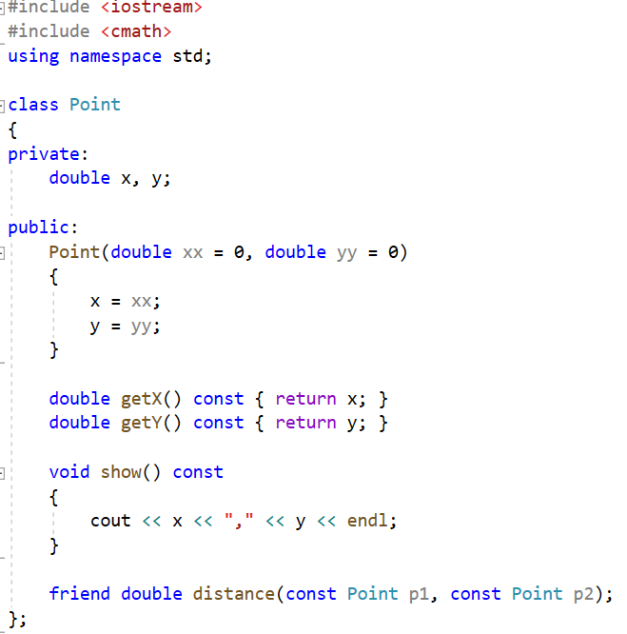
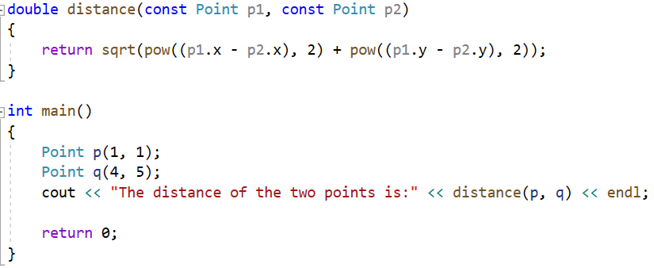
You can define the distance function as a friend function, which can access the private data of Point class.
Declare the friend function inside the class, using friend keyword.
The friend function can access the private data of the class.
You can invoke the distance function directly,
because it isn’t a member function of the class.

Slide 8
Friend Classes
Entire classes or member functions of other classes may be declared to be friends of another class.
To declare all member functions of ClassTwo as friend of ClassOne, place a declaration of the form
friend class ClassTwo;
in the definition of ClassOne. That means all member functions of ClassTwo have the right to access the private and protected class members of ClassOne.
The friend declaration(s) can appear anywhere in a class and are not affected by access specifiers public or private or protected.

Slide 9
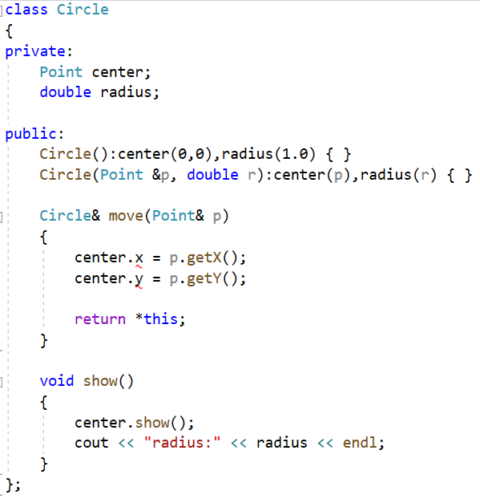
Let’s consider an example: we have a Circle class in which it has a subobject (center point) of Point class--class containment(composition). Can we access the center’s private member in the Point class?
class containment(or class composition)
In move function we want to set the center to the new point p.
But you cannot access the center’s private members x and y.
You can access the public members of the center.

Slide 10
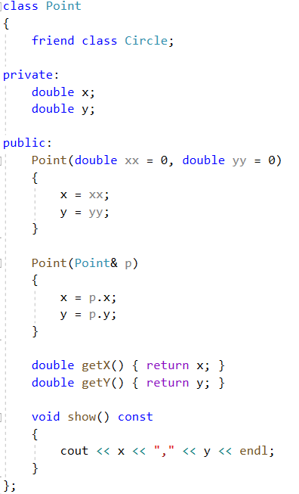
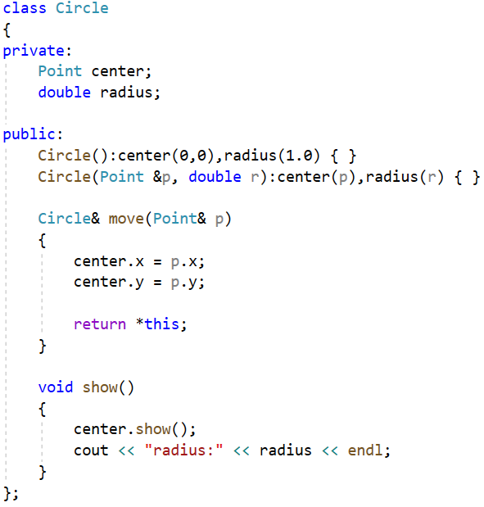
This time you can declare the Circle class as a friend class of the Point class.
This declaration is necessary which is called forward declaration.
Declare the Circle class as a friend of the Point class. That means in Circle class, its member functions can access the private members of the Point class.
Member function of the Circle class can access the private member of the Point class.

Slide 11
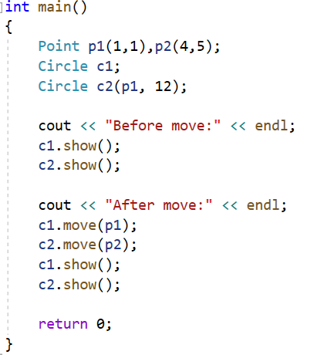
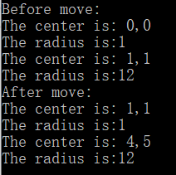

Slide 12
Notes:
Friendship is not symmetric– if class A is a friend of class B, you cannot infer that class B is a friend of class A.
Friendship is not transitive ---if class A is a friend of class B and class B is a friend of class C, you cannot infer that class A is a friend of class C.
When to use friend class?
If one class(or object) is not another class(or object) and vice versa, so the is-a relationship of public inheritance doesn’t apply. Nor it is either a component of the other, so the has-a relationship of containment or of private or protected inheritance doesn’t apply. This suggests making the one class a friend to the other class.

Slide 13
Nested Class
A nested class is a class which is declared in another enclosing class. Nested class can be defined in private as well as in the public section of the Enclosing class. A nested class is a member and as such has the same access rights as any other member. The members of an enclosing class have no special access to members of a nested class; the usual access rules shall be obeyed.

Slide 14
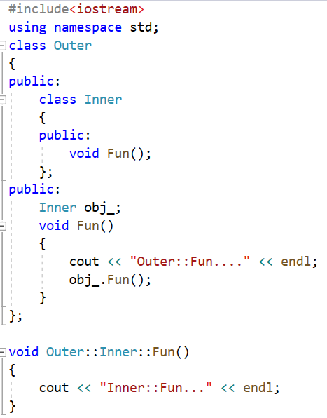
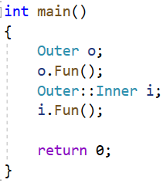

If a nested class is declared in a public section of a second class(in the example Outer class), it is available to the second class, to classes derived from the second class, and, because it’s public, to the outside world. However, because the nested class has class scope, it has to be used with a class qualifier in the outside world.
Declare a nested class Inner
inside the Outer class
Define an object of
the nested class Inner
Invoke the function of Inner object
Define the function of the nested class Inner, using a class qualifier in the outside
Define an object of the Outer class
Define an object of the Inner class using a class qualifier

Slide 15
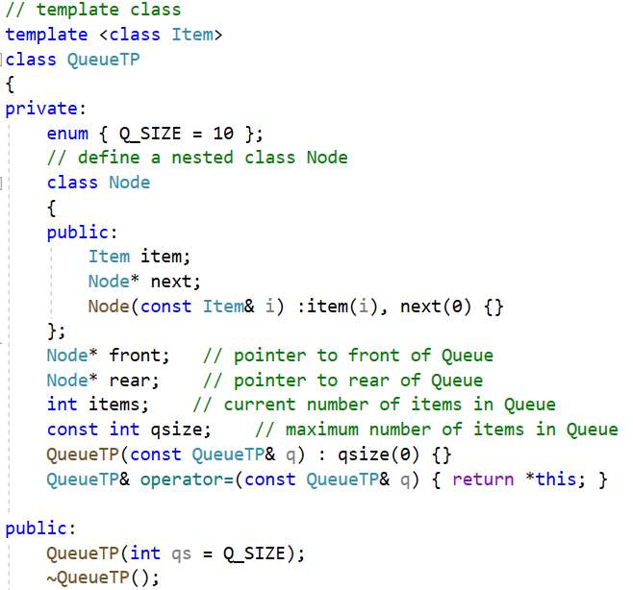
If a nested class is declared in a private section of a second class, it is known only to that second class. This applies, for example, to the Node class nested in the QueueTP declaration . Hence, QueueTP members can use Node objects and pointers to Node objects, but other parts of a program don’t even know that the Node class exists. If you were to derive a class from QueueTP, Node would be invisible to that derived class, too, because a derived class can’t directly access the private parts of a base class.
If the nested class is declared in a protected section of a second class, it is visible to that class but invisible to the outside world. However, in this case, a derived class would know about the nested class and could directly create objects of that type.

Slide 16
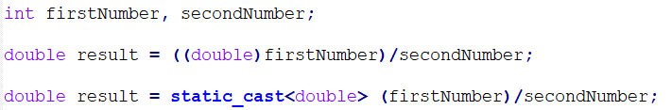
RTTI(Run-Time Type Identification)
Type conversion A type cast is basically a conversion from one type to another. C++ supports four types of casting: Static Cast, Dynamic Cast, Const Cast, Reinterpret Cast.
C-style cast
C++ cast
static_cast has basically the same power and meaning as the general-purpose C-style cast. It also has the same kind of restrictions. For example, you can‘t cast a struct into an int or a double into a pointer. Furthermore, static_cast can’t remove constness from an expression.

Slide 17
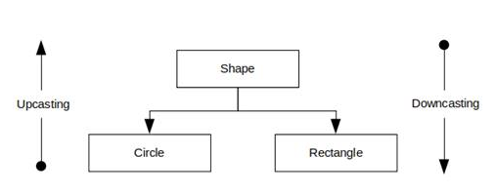

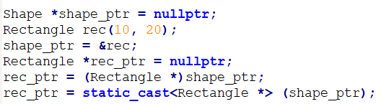
RTTI stands for Runtime Type Identification. It is a mechanism to find the type of an object dynamically(in runtime) from an available pointer or reference to the base type. The RTTI provides an explicit way to identify the runtime type separately from what is possible with the virtual function mechanism.
The casting of an object is mainly required when dealing with the inheritance hierarchy of classes.
Upcasting is the process where we treat a pointer or a reference of a derived class object as a base class pointer. It is automatically accomplished by assigning a derived class pointer or a reference to its base class pointer.
Down casting is converting a base class pointer or reference to a derived class. It requires explicit cast.
Using C-style cast or C++ static_cast, neither conversion is safety

Slide 18
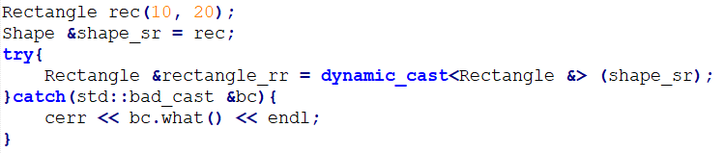
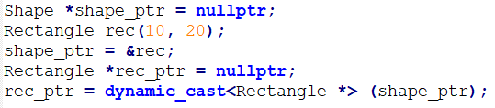
dynamic_cast is used to perform safe casts down or across an inheritance hierarchy. That is, you use dynamic_cast to cast pointers or references to base class objects into pointers or references to derived or sibling base class objects.
dynamic_cast < type-name > ( expression )
In all cases, the type of expression must be either a class type that is publicly derived from the type-name type, a public base class of the type-name which points to the type-name, or the same as the type-name. If expression has one of these types, then the cast will succeed. Otherwise, the cast fails. If a dynamic_cast to a pointer type fails, the result is 0. If a dynamic_cast to a reference type fails, the operator throws an exception of type bad_cast.
When failing to cast a reference, dynamic_cast throws std::bad_cast
exception defined in the typeinfo header.
Note: dynamic_casts cannot be applied to types lacking virtual functions, nor can they cast away constness.

Slide 19
There must be at least one virtual function in the class B, otherwise it fails to compile.
class B { ... };
class D : public B { ... };
void f()
{
B* pb = new D;
B* pb2 = new B;
D* pd = dynamic_cast<D*>(pb); // ok: pb points to D
...
D* pd2 = dynamic_cast<D*>(pb2); // fail,pb2 points to B not D
// pd2 is NULL
...
}

Slide 20
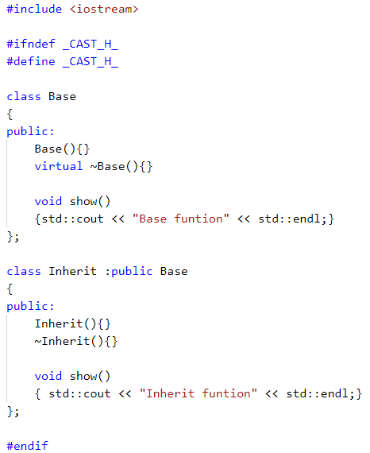
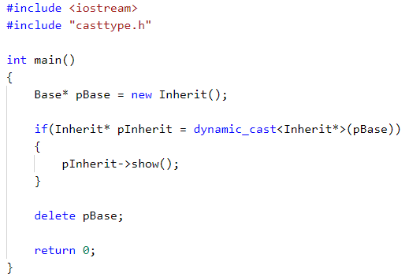
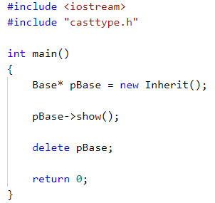
You can check whether the downcast is successful by if statement.
if (Derived *dp = dynamic_cast<Derived*>(bp)) //bp is a base class pointer
{
}
If bp points to a Derived object, then the cast will initialize dp to point to the Derived object to which bp points. In this case, it is safe for the code inside the if to use Derived operations. Otherwise, the result of the cast is 0.
Invoke the show() of base
class, though pBase points
to the derived object.
Invoke the show() of derived class, because
pBase is converted to the derived pointer.

Slide 21
typeid operator
typeid operator can tell you what type is the object.
typeid(expression)
The operand can be any expression or type name.
The typeid operator returns a reference to a type_info object, where type_info is a class
defined in the typeinfo header file. The type_info class overloads the == and != operators
so that you can use these operators to compare types.
If the expression’s type is a class and contains at least one virtual function, the typeid operator returns the dynamic type of the expression; otherwise, it provides static type information.

Slide 22
Suppose there is at least one virtual function in the class B.
class Base { ... };
class Derived : public Base { ... };
Derived *dp = new Derived;
Base *bp = dp;
// compare the type of two objects at run time
if (typeid(*bp) == typeid(*dp))
{ … }
// test whether the run-time type is a specific type
if (typeid(*bp) == typeid(Derived))
{ … }
the operands of the typeid are objects, so use *dp not dp

Slide 23
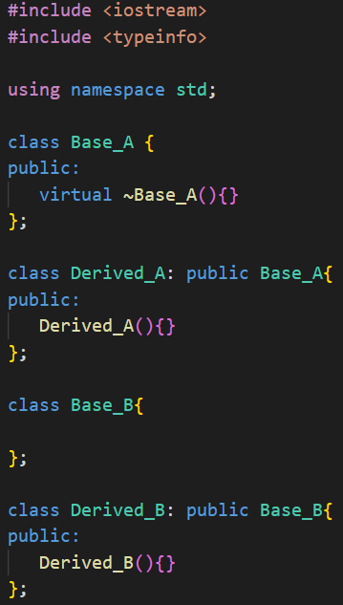
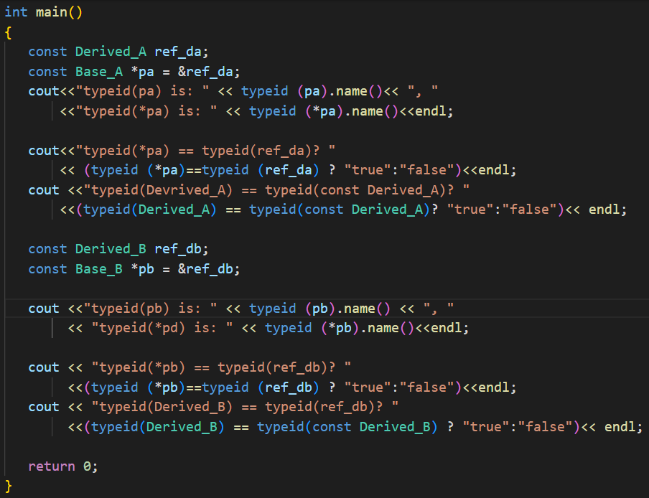
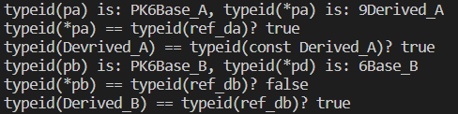
type_info class includes a name() member that returns an string that is typically the name of the class.
has no virtual
function
P:pointer, K: const,
6: numbers of the characters of the type

Slide 24
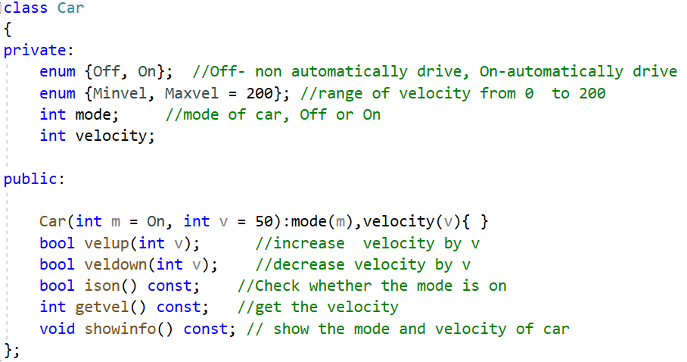
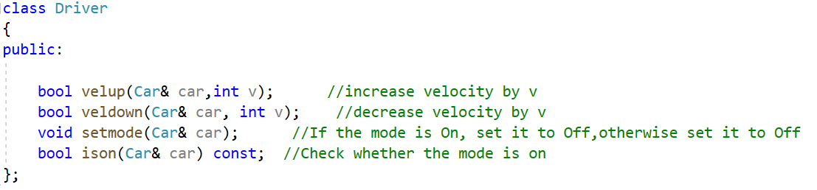
Exercise
There are two classes named Car and Driver, suppose the car can drive automatically, and driver also can drive the car. The declarations of car and driver are as follows:

Slide 25
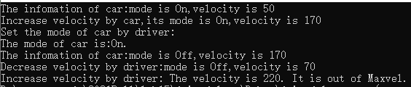
Implement all the member functions of the two classes and make Driver as Car’s friend class so that it can access the members of Car. Write a program to test the two classes.
Output sample:

