Slide 2
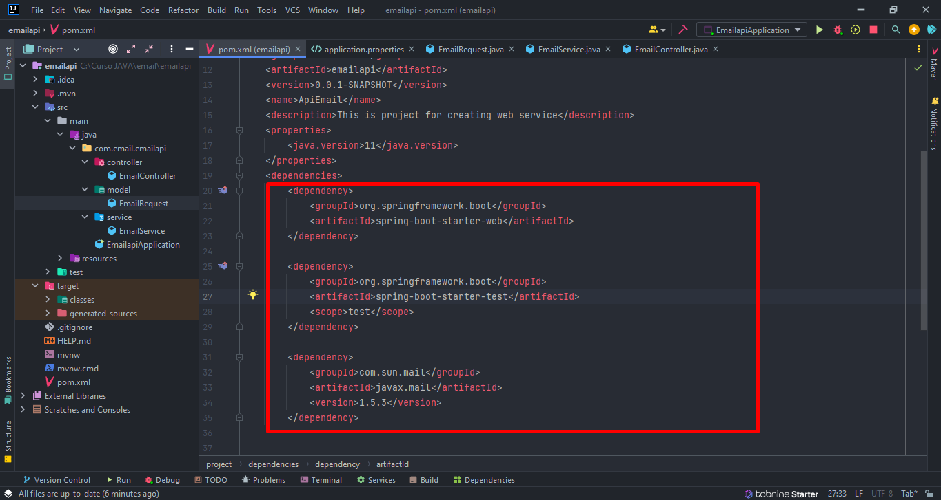

Slide 3
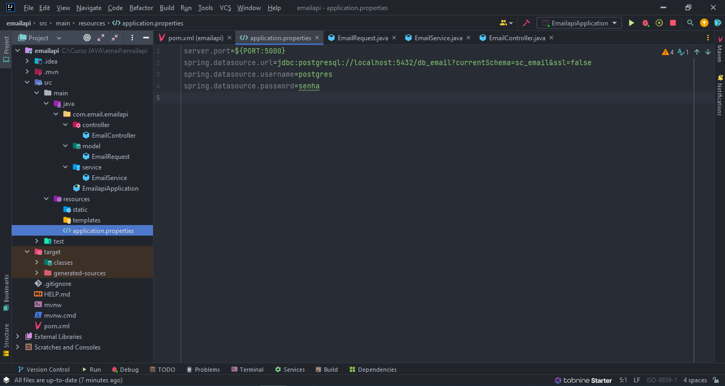

Slide 4
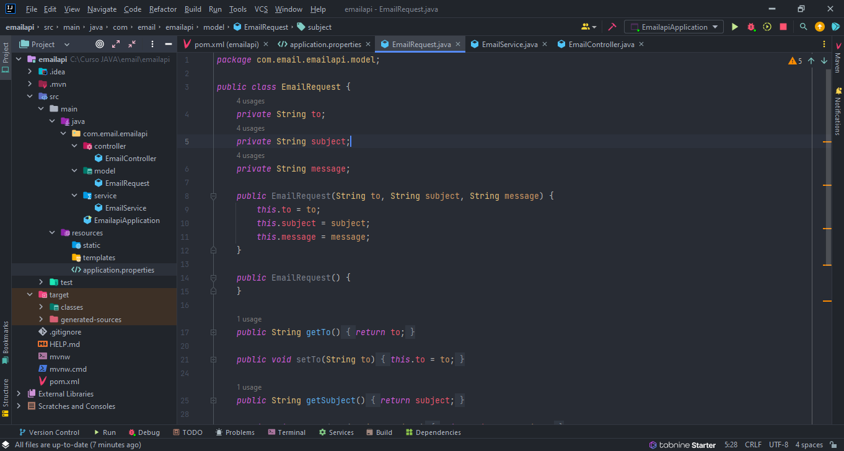

Slide 5
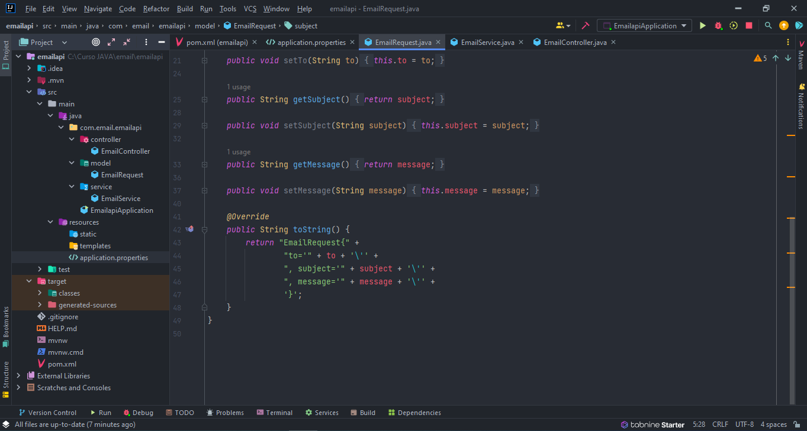

Slide 6
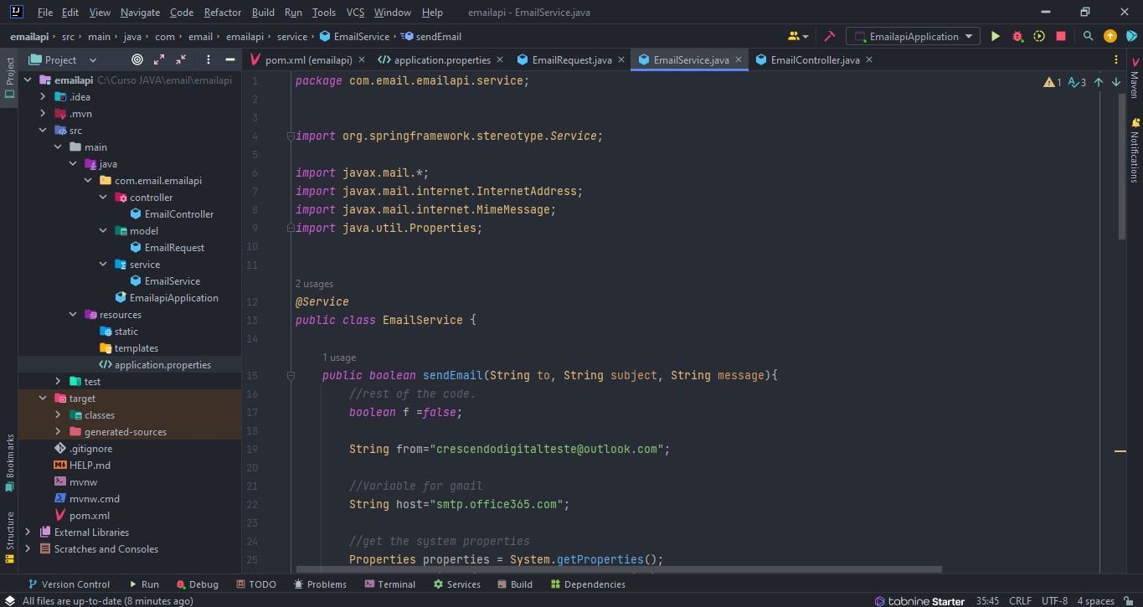

Slide 7
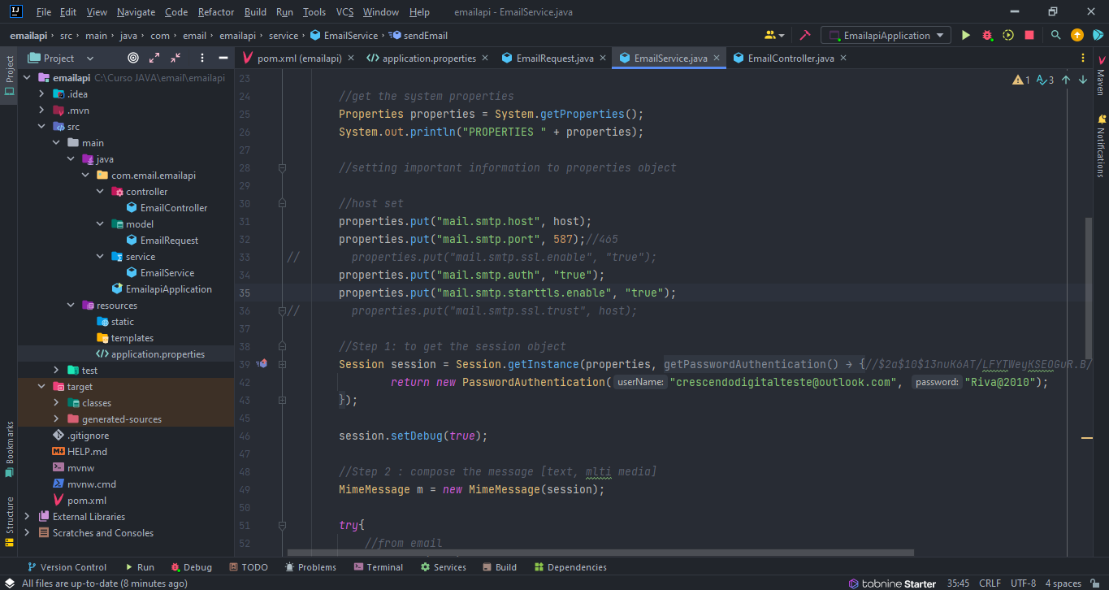

Slide 8
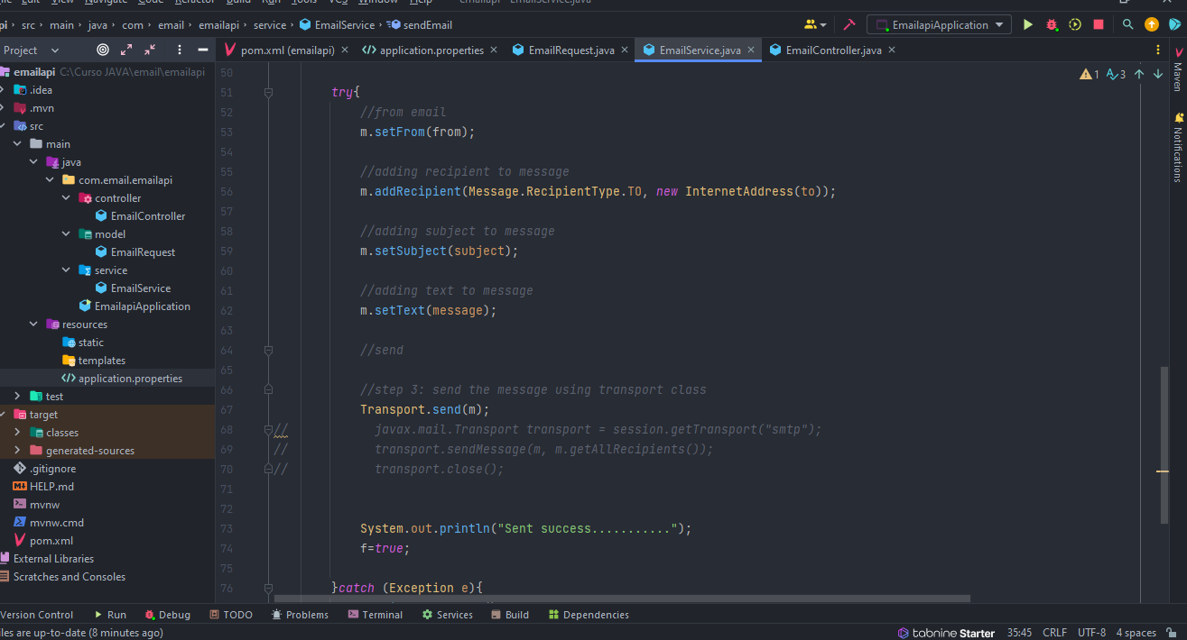

Slide 9
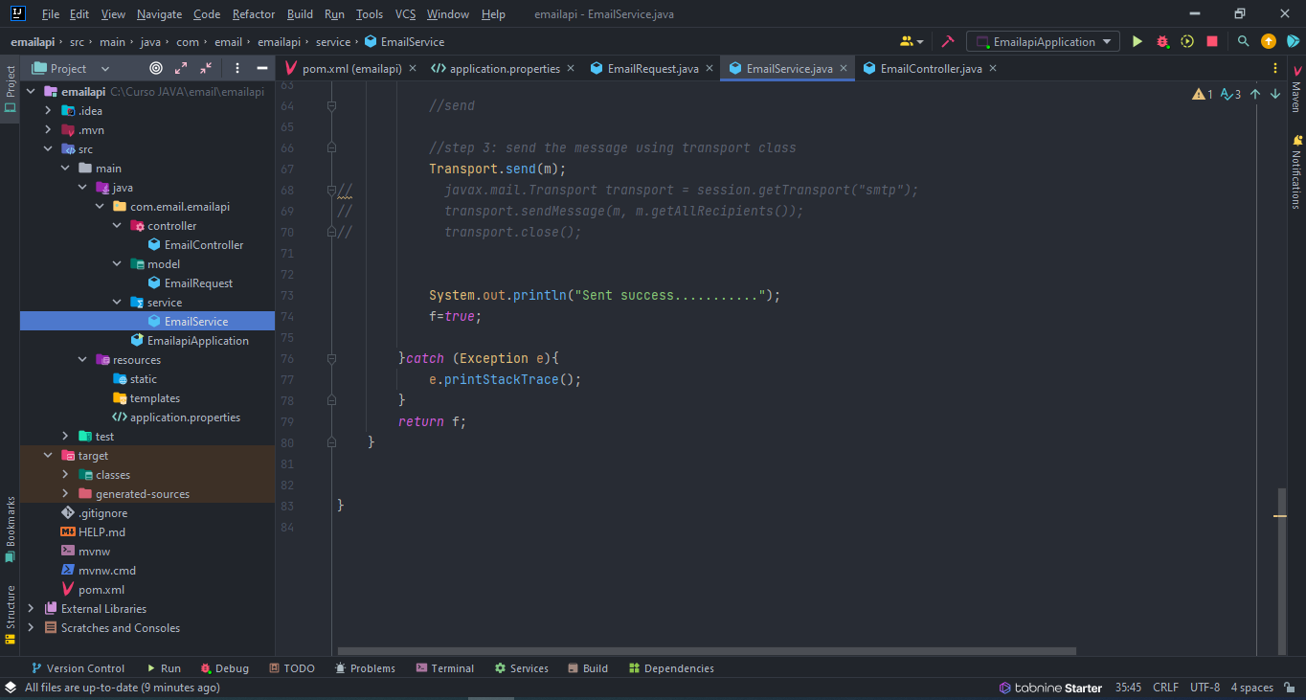

Slide 10
public boolean sendEmail(String to, String subject, String message){
//rest of the code.
boolean f =false;
String from="crescendodigitalteste@outlook.com";
//Variable for gmail
String host="smtp.office365.com";
//get the system properties
Properties properties = System.getProperties();
System.out.println("PROPERTIES " + properties);
//setting important information to properties object
//host set
properties.put("mail.smtp.host", host);
properties.put("mail.smtp.port", 587);//465
// properties.put("mail.smtp.ssl.enable", "true");
properties.put("mail.smtp.auth", "true");
properties.put("mail.smtp.starttls.enable", "true");
// properties.put("mail.smtp.ssl.trust", host);
//Step 1: to get the session object
Session session = Session.getInstance(properties, new Authenticator(){
@Override
protected PasswordAuthentication getPasswordAuthentication(){//$2a$10$13nuK6AT/LFYTWeyKSEOGuR.B/lSwjBA1feVmwQrWRZfCXNqsLn/2
return new PasswordAuthentication("crescendodigitalteste@outlook.com", "Riva@2010");
}
});
session.setDebug(true);
//Step 2 : compose the message [text, mlti media]
MimeMessage m = new MimeMessage(session);
try{
//from email
m.setFrom(from);
//adding recipient to message
m.addRecipient(Message.RecipientType.TO, new InternetAddress(to));
//adding subject to message
m.setSubject(subject);
//adding text to message
m.setText(message);
//send
//step 3: send the message using transport class
Transport.send(m);
// javax.mail.Transport transport = session.getTransport("smtp");
// transport.sendMessage(m, m.getAllRecipients());
// transport.close();
System.out.println("Sent success...........");
f=true;
}catch (Exception e){
e.printStackTrace();
}
return f;
}

Slide 11
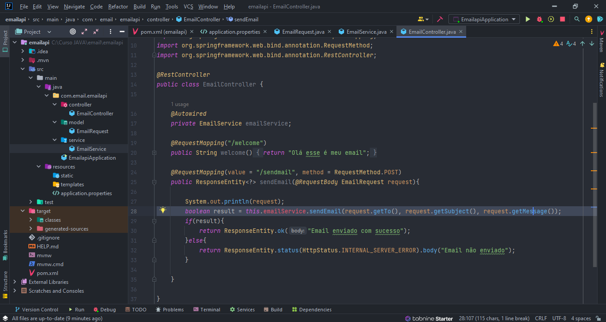

Slide 12
@Autowired
private EmailService emailService;
@RequestMapping("/welcome")
public String welcome(){
return "Olá esse é meu email";
}
@RequestMapping(value = "/sendmail", method = RequestMethod.POST)
public ResponseEntity<?> sendEmail(@RequestBody EmailRequest request){
System.out.println(request);
boolean result = this.emailService.sendEmail(request.getTo(), request.getSubject(), request.getMessage());
if(result){
return ResponseEntity.ok("Email enviado com sucesso");
}else{
return ResponseEntity.status(HttpStatus.INTERNAL_SERVER_ERROR).body("Email não enviado");
}
}

