Slide 1
IP over Optical : Introduction
Yatindra Nath Singh
EE/ACES, IIT Kanpur
Email: ynsingh@ieee.org
http://www.iitk.ac.in/~ynsingh

Slide 2
IP network
IP ROUTER
NET
WORK
IP ROUTER
NET
WORK
IP ROUTER

Slide 3
IP Router functionality
Information is encapsulated in IP and forward to next hop based on routing table and destination IP address in packet.
Each IP router receive the incoming IP packet, analyses the header and forward to appropriate next hop.
Routing table are maintained using distributed algorithm

Slide 4
Routing protocols
Using IP transport facility the routing protocol keep on finding changes in topology
RIP-2, OSPF-2.
At network (autonomous system-AS) boundaries BGP-4 is used.
Routing policy implementation (BGP-4)

Slide 5
Topology
2
1
4
3
5
The physical interconnection pattern is topology

Slide 6
Technology for links
Optical fiber,
Radio,
Coaxial cable,
Physical layer Broadcast LAN (e.g. Ethernet etc.)

Slide 7
Advantages of fiber links backbones
Multiple channels can pass through fiber 160 DWDM channel (L and C) based system standardised by ITU-T
50 GHz and 100 GHz speed DWDM components are available.
Optical fiber - large band width, better reliability electrical isolation, more life.

Slide 8
Packet processing overhead
If a packet passes through K intermediate nodes
Received, processed and retransmitted K times. (at each intermediate node)
With lot of traffic between two nodes a direct link between two nodes - desirable. Reduces processing overhead.
Ideally interconnection topology should change with variation in traffic pattern.
Goal - within given resources, maximize the throughput

Slide 9
Type of Nodes in Optical network
Optical Crossconnects (OXC)
This is optical circuit switching.
Switch
Outgoing signals
Incomming signals
‘I’
‘O’
‘I’ ‘O’ mapping can be charged

Slide 10
Typical components of Switching node
Software component in control plane of switch
software
Control software
controller
Controller
A Typical switch
Switching Hardware
Optical Crossconnect switch

Slide 11
Type of Nodes in Optical network (contd.)
There are other kind of crossconnect switches
DXC ( Digital Crossconnect)
SDH Digital Crossconnects
OC-192
OC-192
OC-48
OC-192
OC-48
OC-48
OC-192
OC-48
[OC-192, OC-48, SDH-4, SDH-16] Various level of multiplexing of digital data streams (Digital Circuits) conti..

Slide 12
Crossconnects (contd.)
Digital crossconnect take inputs at input port and connect them to various output port.
Optical Cross Connect (With Wavelength Conversion)
1 2 3
1
1 2 3
2 3
3 4
1 2 3 4
1 2 3
1 2

Slide 13
Optical Network
OXC and Digital crossconnects Connected by links
X
X
X
X
X
Link
On a fiber multiple wavelength channels
Multiple fiber connecting the OXC

Slide 14
SRLG → Shared Risk Link Group
Links between adjacent OXC grouped together, If all of them share risk of failure.
WDM channels in a fiber forms SRLG.
All fibers passing through same conduit - SRLG

Slide 15
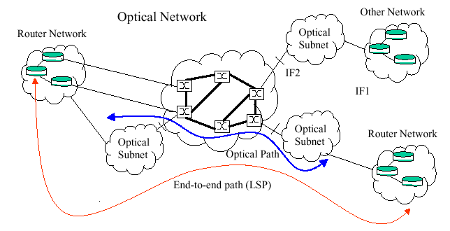
Optical internetwork
Collection of optical networks.
Each optical network under one administration.
Optical network may contain many optical subnetworks

Slide 16
Various Interfaces and control plane
UNI → User to network interface.
INNI → Internal network to network interface.
ENNI → External network to network interface.
Control software at all OXC from a control network (Control plane)
Control plane entities talk to each other using control channels on links.
(Details→ Look into IETF draft on link management protocol)
Current draft proposes (use of IP protocol for control plane functionality).

Slide 17
IP network to optical network {Control interface}
Peers in (a)
IP Networks
←When all
Clients requests
Services from
Manager (b)
mgr
X
UNI
Optical network
Edge Router
a) IP base control channel between edge router and OXC → exchange of in band or out of band signalling and routing information between IP router and OXC.(Direct interface)

Slide 18
IP network to optical network {Control interface}
b) Out-of band IP control channel between IP router & manager .
  signalling of service request and response. (Indirect interface)
c) Provisioned interface
  Optical network services manually provisioned.
  No control interaction between client and optical network.

Slide 19
SERVICE MODELS
  Domain Service Models
  Optical network offers light path ( high bandwidth connectivity)
  standardized signaling invokes following service
    Light path creation - network defined policies and security.
    Light path deletion
    Light path modification
    Light path status enquiry

Slide 20
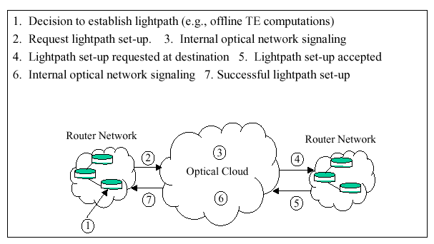

Slide 21
Initial Procedure for edge router (DSM)
Edge Router
End-system discovery procedure to Boot strap control channel.
Service discovery procedure for obtaining UNI services.
Domain Service Model → Does not deal with type and nature of routing protocols across optical networks .

Slide 22
Unified Service Model
IP and Optical network
Considered as single integrated network from control plane point of view.
OXC → Like any IP router in control plane.
No Distinction between UNI and NNI and any other router to router interface from routing and signaling point view.
Control plane is MPLS (Multi Protocol Label Switching) based.
Optical Network Services - obtained implicitly during end to end MPLS signaling.

Slide 23
Unified Service Model (contd.)
  Edge router creates, deletes or modify lightpath while creating, deleting and modifying MPLS-label switched paths (LSPs).
Possible Services
  Can be built over point to point connectivity service provided by optical network.
Example: Virtual Private Network (VPN)

Slide 24
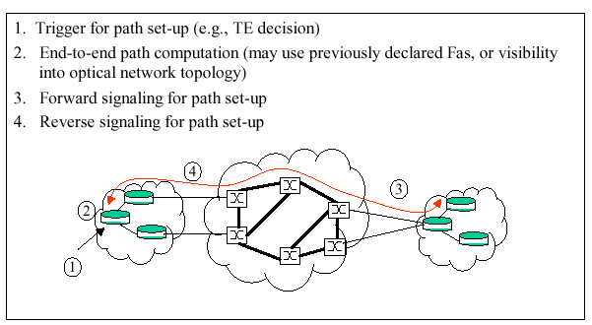

Slide 25
IP Transport over Optical Network
Optical network provides virtual topology
IP router and OXC have peer relationship
  Allows for routing protocols hence dynamic discovery of IP end-points attached to optical network.

Slide 26
Unified Service Model - control plane
Control Plane - Can be tightly or loosely coupled irrespective of peering relationship depending on.
  topology and routing information advertisement across UNI.
  Level of control, IP router can exercise in selection of light paths.
  Policy for dynamic provisioning of optical paths
    Includes
    access control
    Accounting
    security issues

Slide 27
Interconnection Model
Peering Model
IP/MPLS layers – act as peer to optical network.
Common address space for IP as well as optical network
  Optical network element-IP addressable entities.
Common IGP e.g. OSPF or IS-IS with appropriate extension can be used.
Overlay model
IP/MPLS - routing, topology distribution,signaling independent of routing, topology distribution and signaling protocol of optical network.

Slide 28
Routing
Integrated routing- support peer model
IP and optical layer run same instance of routing protocol with suitable extension.
  Extensions
    for handling optical links parameters
    Constraints specific to optical network.
If a capacity is available in a lightpath, then it is advertised as
available virtual link for more label switched paths.

Slide 29
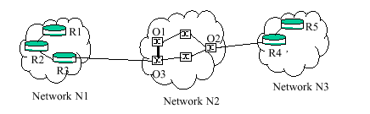
Integrated routing

Slide 30
Overlay Routing
Edge routers registers with network.
Querry for external addresses from registery. (Similar to address Resolution mechanism)
Registry is needed → For edge router IP address
→ For VPN identifiers
A source Edge router allowed to query for edge router belonging to same set of VPN as the source edge router.
Query returns the egress optical port address.

Slide 31
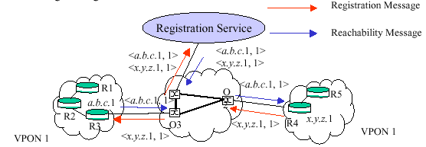
Overlay Routing

Slide 32
Protection Mechanism
Segment wise protection
A
B C D E F
IP
Optical
Network
IP
Each segment have separate protections.
End to End Protection
Protection services of optical network not directly utilized.

Slide 33
Restoration
1 + 1 protection
Shared protection (N to 1)
How the protection (based up path) is decided?
Failure information propagation
Activation of backup path.

Slide 34
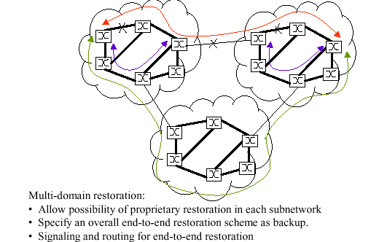

Slide 35
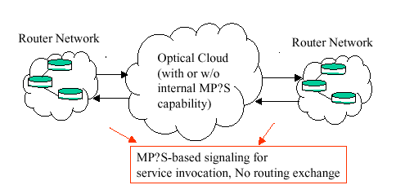
Possible Evolution path of IP over Optical

Slide 36
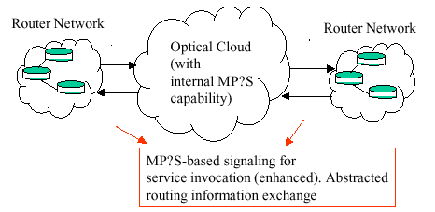

Slide 37
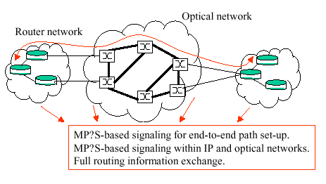

Slide 38
Summary
Introduction to concept of optical network.
How the IP proposed to be carried over optical network.
IP based control plane in optical network.
Possible Evolution of IP over Optical.

