Slide 1



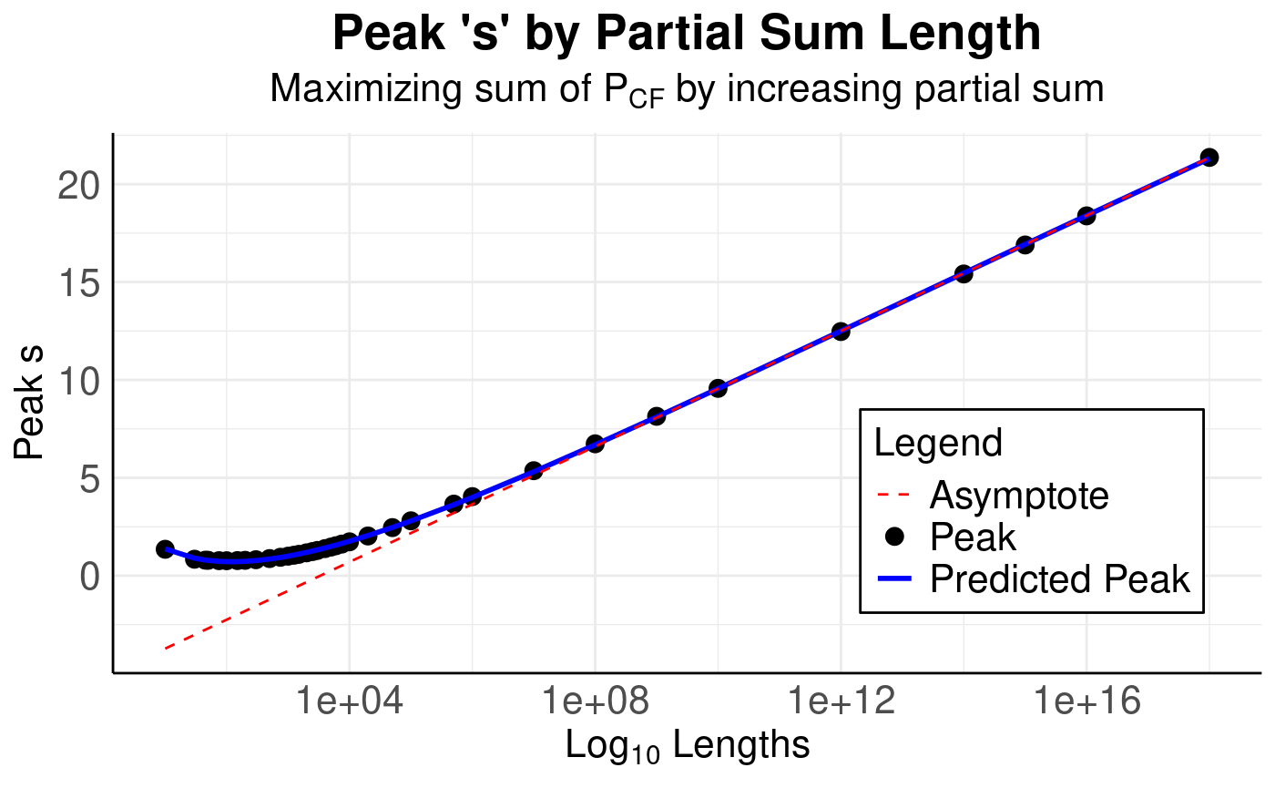
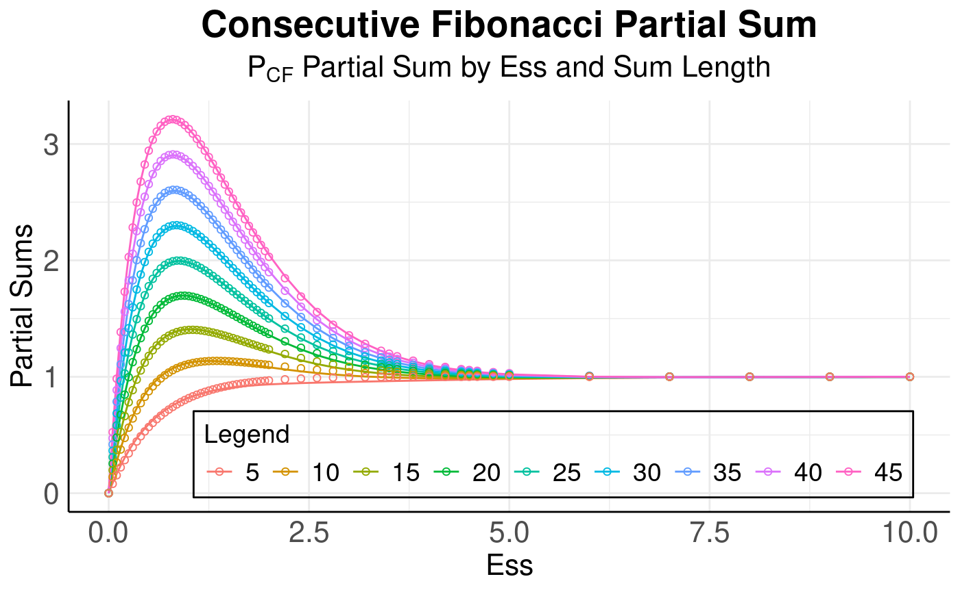
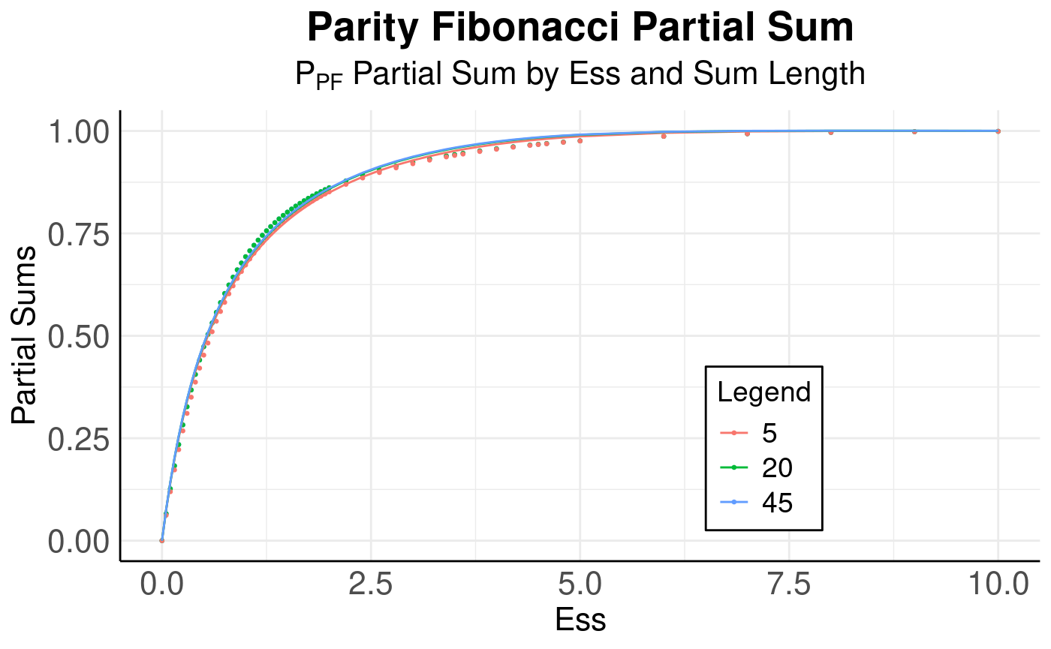
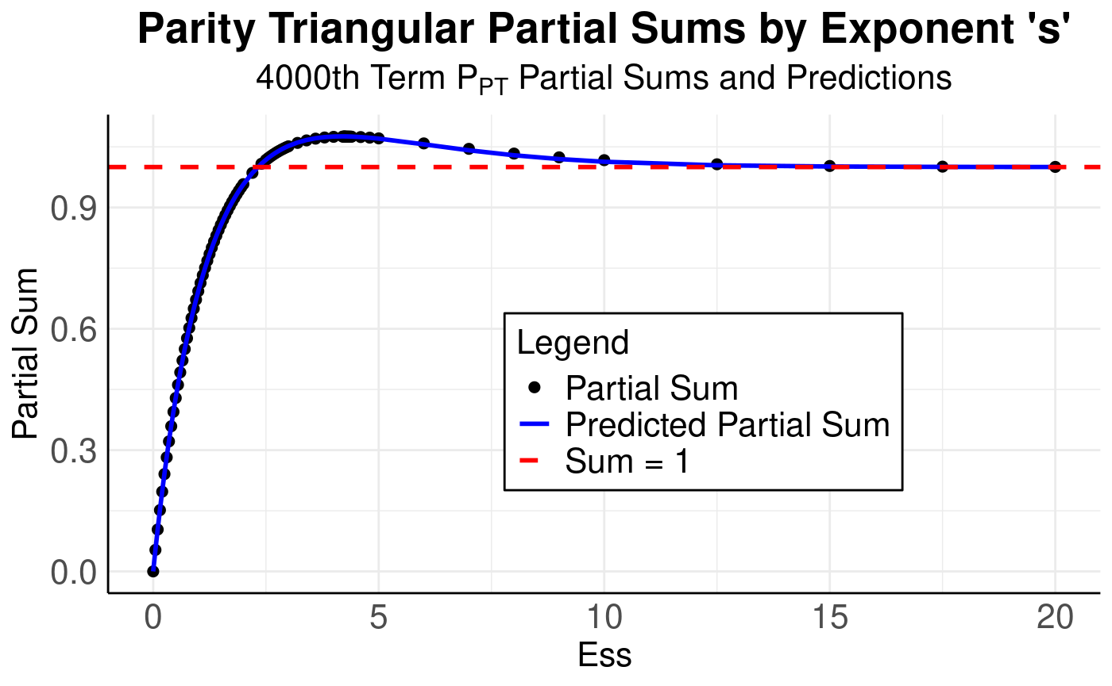
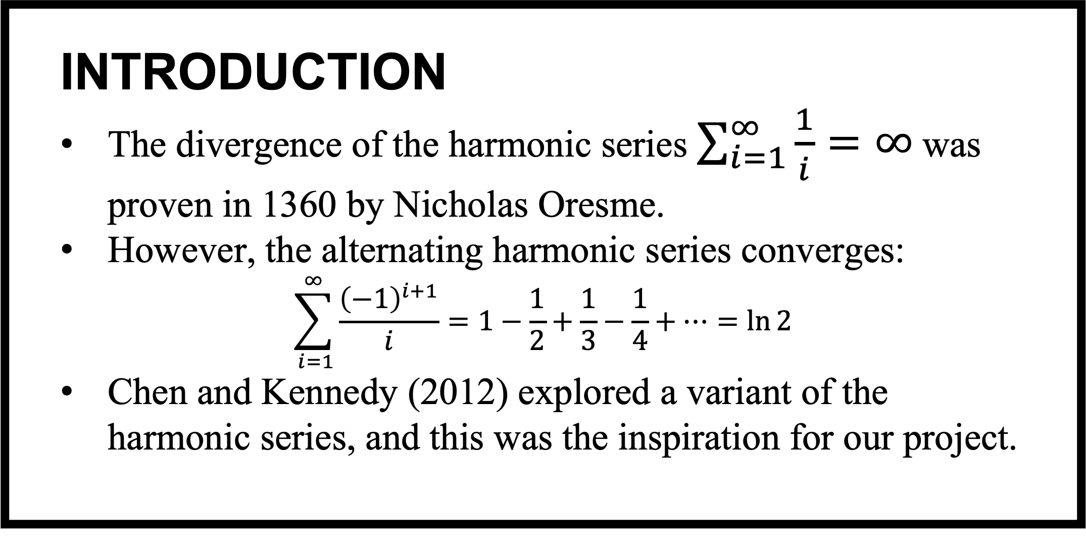
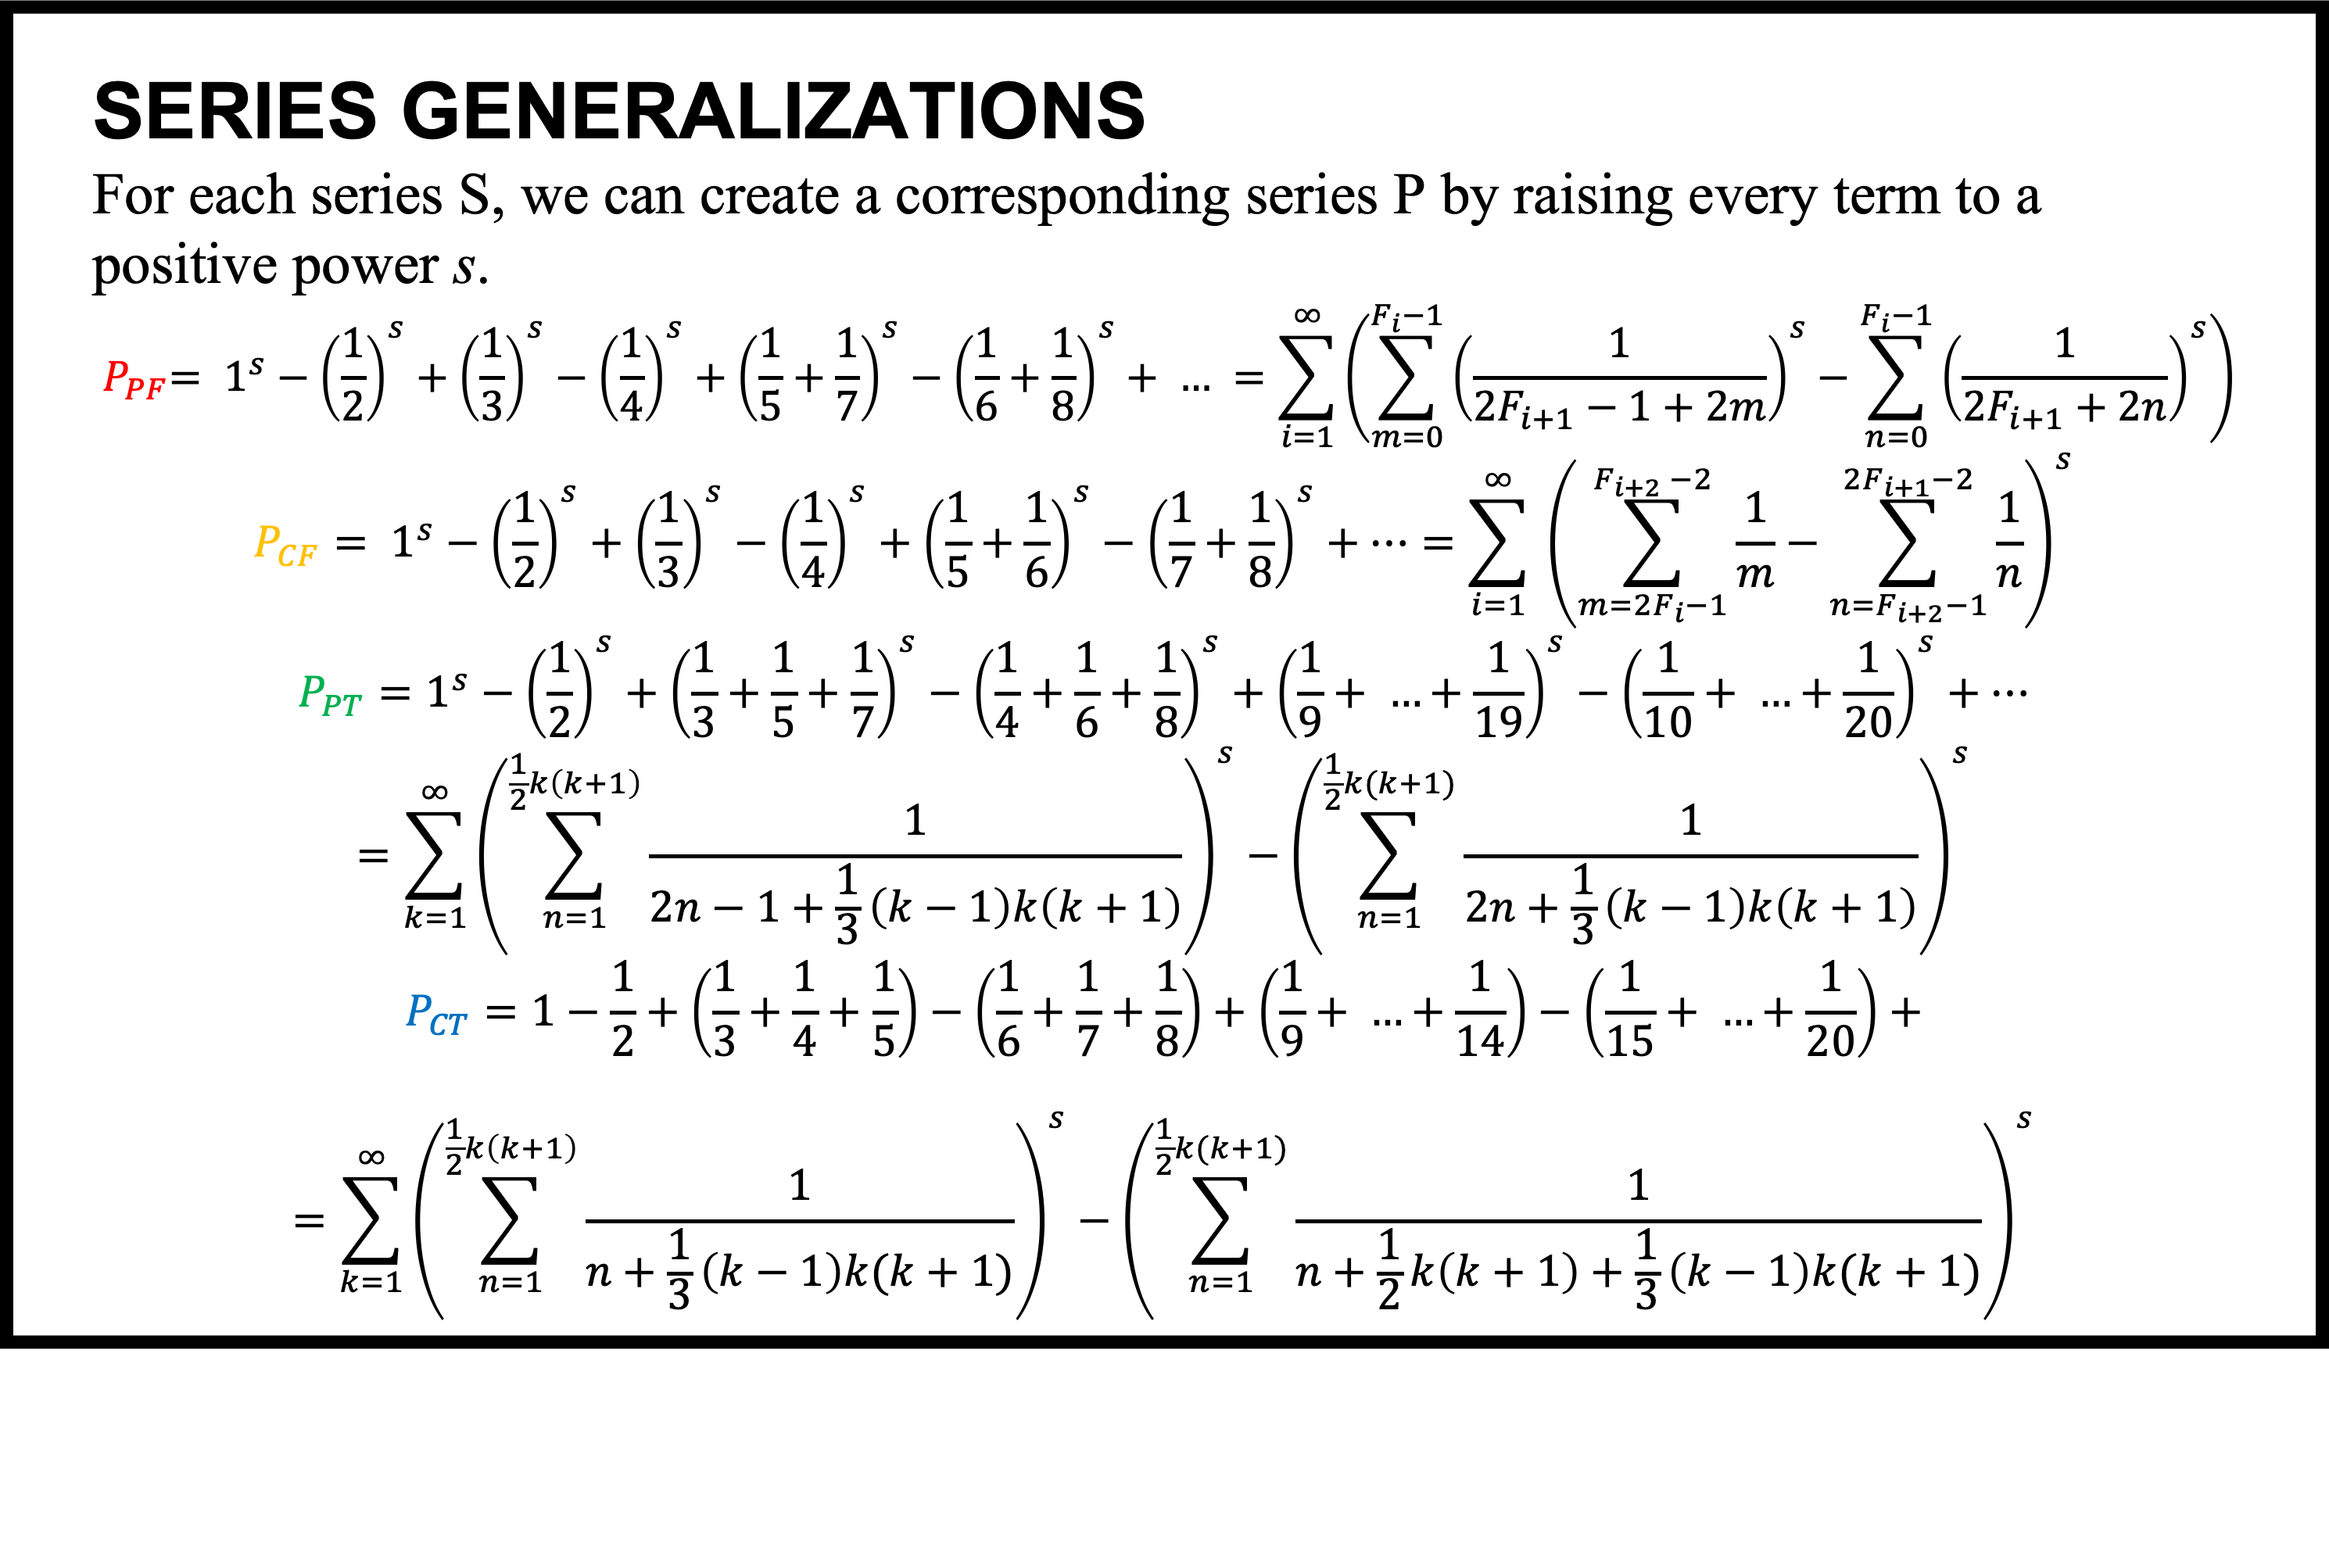
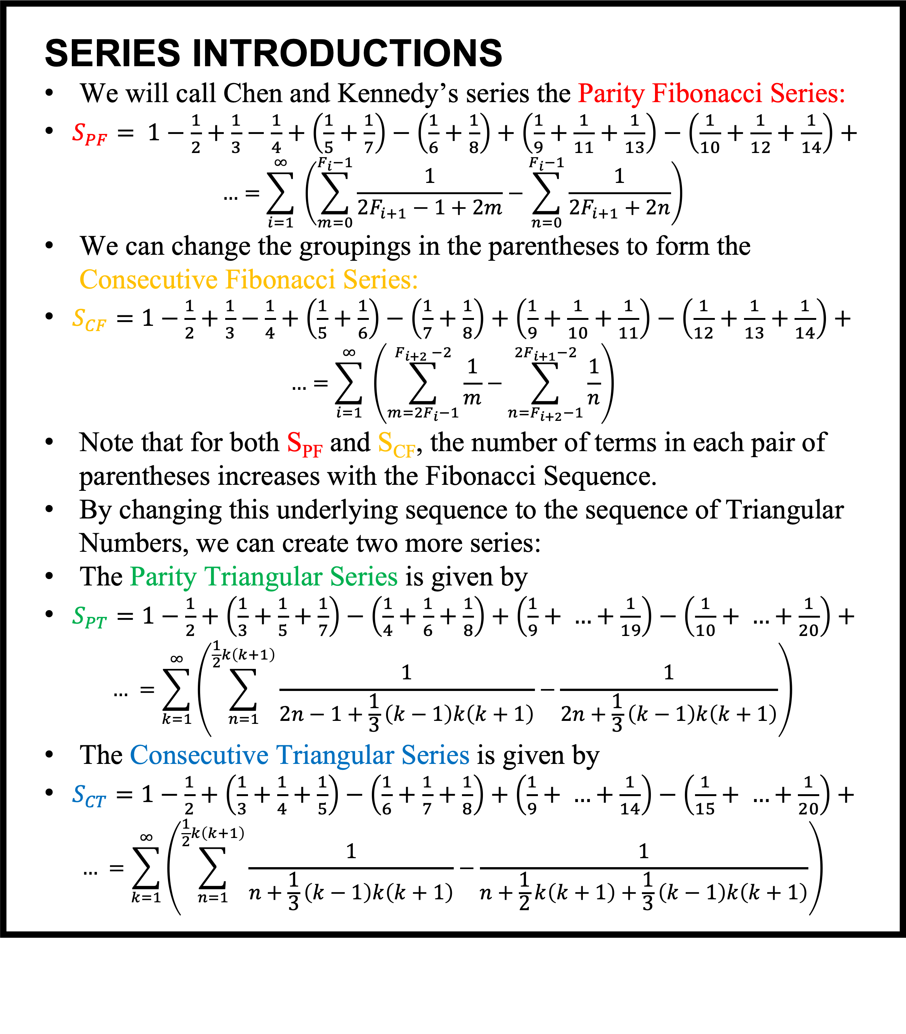
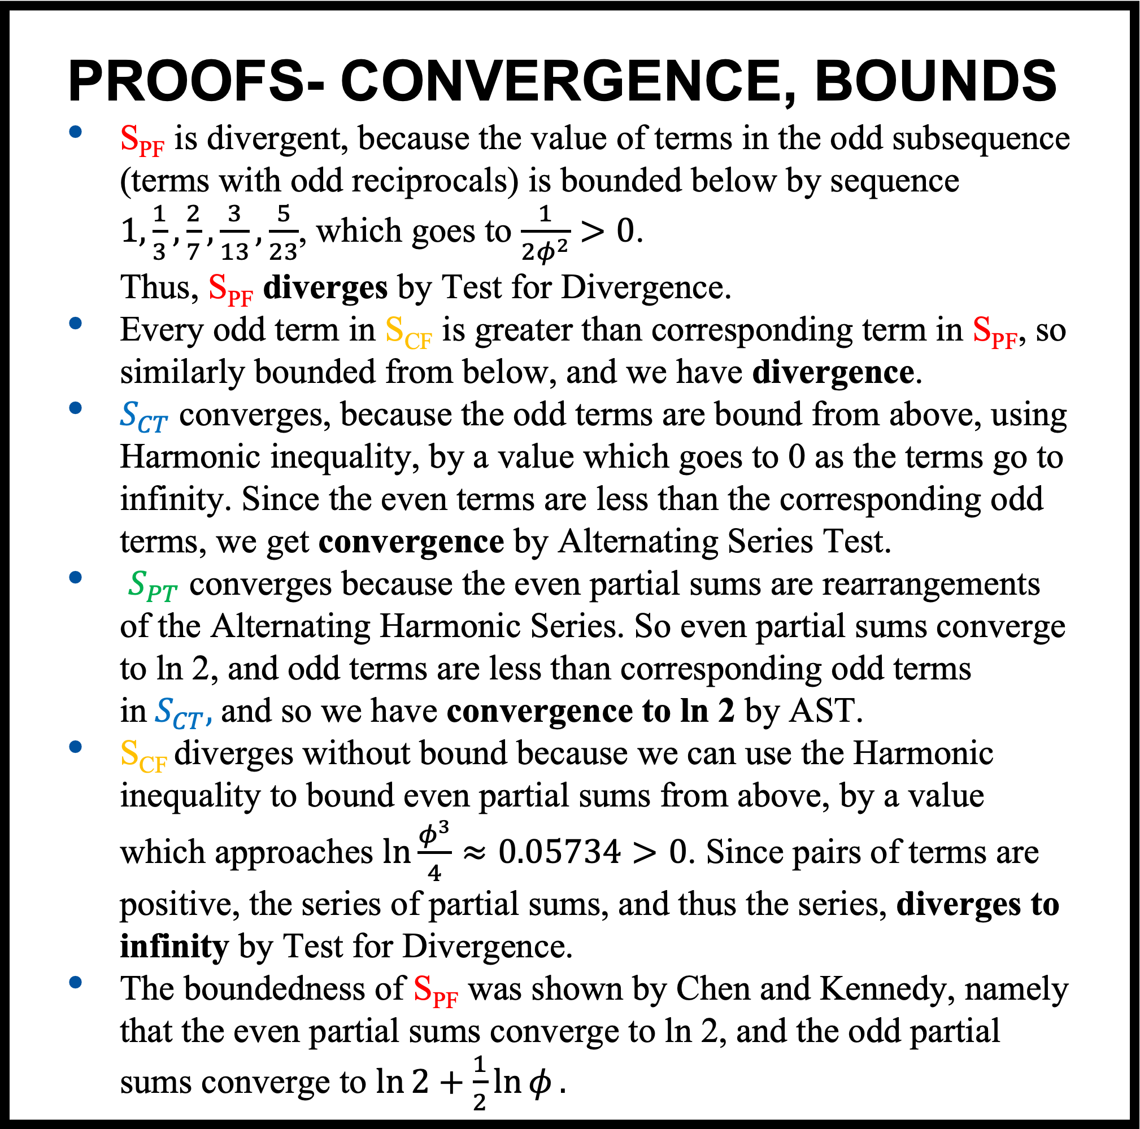
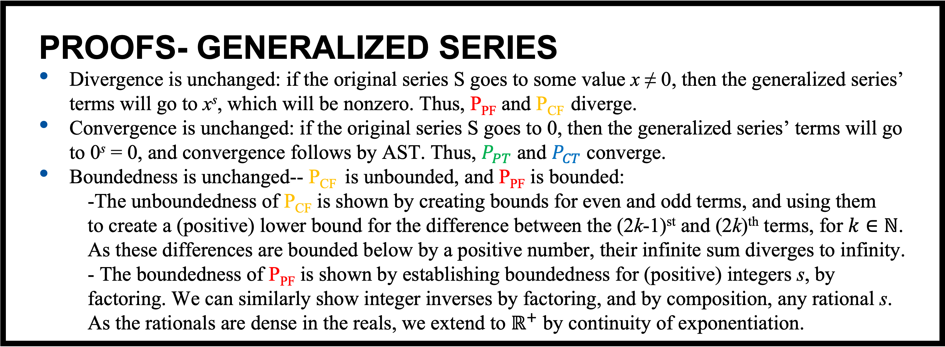
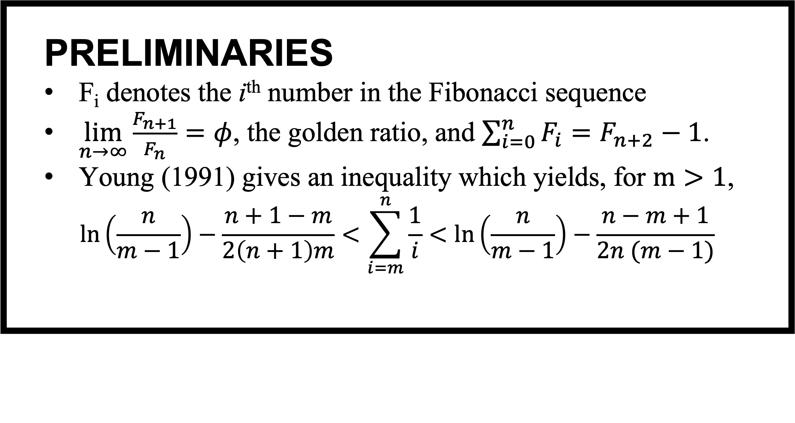
Alternating Harmonic Series Grouped by Fibonacci and Triangular Numbers
Matthew Blake
INTRODUCTION
The divergence of the harmonic series $\sum_{i=1}^{∞}{\frac{1}{i}=∞}$ was proven in 1360 by Nicholas Oresme.
However, the alternating harmonic series converges:
$$\sum_{ i=1}^{∞}{\frac{{\left(−1\right)}^{i+1}}{i}=1−\frac{1}{2}+\frac{1}{3}−\frac{1}{4}+…=\ln{2}}$$
Chen and Kennedy (2012) explored a variant of the harmonic series, and this was the inspiration for our project.
PROOFS- CONVERGENCE, BOUNDS
S_{PF} is divergent, because the value of terms in the odd subsequence (terms with odd reciprocals) is bounded below by sequence $1,\frac{1}{3},\frac{2}{7},\frac{3}{13},\frac{5}{23}$, which goes to $\frac{1}{2φ^{2}}>0$. Thus, S_{PF} diverges by Test for Divergence.
Every odd term in S_{CF} is greater than corresponding term in S_{PF}, so similarly bounded from below, and we have divergence.
$S_{CT}$ converges, because the odd terms are bound from above, using Harmonic inequality, by a value which goes to 0 as the terms go to infinity. Since the even terms are less than the corresponding odd terms, we get convergence by Alternating Series Test.
$S_{PT}$ converges because the even partial sums are rearrangements of the Alternating Harmonic Series. So even partial sums converge to ln 2, and odd terms are less than corresponding odd terms in${ S}_{CT},$and so we have convergence to ln 2 by AST.
S_{CF} diverges without bound because we can use the Harmonic inequality to bound even partial sums from above, by a value which approaches $ln\frac{φ^{3}}{4}≈0.05734>0$. Since pairs of terms are positive, the series of partial sums, and thus the series, diverges to infinity by Test for Divergence.
The boundedness of S_{PF} was shown by Chen and Kennedy, namely that the even partial sums converge to ln 2, and the odd partial sums converge to $\ln{2+\frac{1}{2}\ln{φ}}.$
PRELIMINARIES
F_{i} denotes the i^{th} number in the Fibonacci sequence
$\lim_{n→∞}{\frac{F_{n+1}}{F_{n}}=φ}$, the golden ratio, and $\sum_{i=0}^{n}{F_{i}=F_{n+2}−1}$.
Young (1991) gives an inequality which yields, for $m>1$,
$$\ln\left(\frac{n}{m−1}\right)−\frac{n+1−m}{2\left(n+1\right)m}<\sum_{i=m}^{n}{\frac{1}{i}<\ln\left(\frac{n}{m−1}\right)−\frac{n−m+1}{2n (m−1)}}$$
PROOFS- GENERALIZED SERIES
Divergence is unchanged: if the original series S goes to some value x ≠ 0, then the generalized series’ terms will go to x^{s}, which will be nonzero. Thus, P_{PF} and P_{CF} diverge.
Convergence is unchanged: if the original series S goes to 0, then the generalized series’ terms will go to 0^{s} = 0, and convergence follows by AST. Thus, $P_{PT}$ and $P_{CT}$ converge.
Boundedness is unchanged-- P_{CF} is unbounded, and P_{PF} is bounded:
-The unboundedness of P_{CF} is shown by creating bounds for even and odd terms, and using them to create a (positive) lower bound for the difference between the (2k-1)^{st} and (2k)^{th} terms, for $k∈ℕ$. As these differences are bounded below by a positive number, their infinite sum diverges to infinity.
- The boundedness of P_{PF} is shown by establishing boundedness for (positive) integers s, by factoring. We can similarly show integer inverses by factoring, and by composition, any rational s. As the rationals are dense in the reals, we extend to $ℝ^{+}$ by continuity of exponentiation.
SERIES INTRODUCTIONS
We will call Chen and Kennedy’s series the Parity Fibonacci Series:
$S_{PF}= 1−\frac{1}{2}+\frac{1}{3}−\frac{1}{4}+\left(\frac{1}{5}+\frac{1}{7}\right)−\left(\frac{1}{6}+\frac{1}{8}\right)+\left(\frac{1}{9}+\frac{1}{11}+\frac{1}{13}\right)−\left(\frac{1}{10}+\frac{1}{12}+\frac{1}{14}\right)+$
$$…=\sum_{i=1}^{∞}{ \left(\sum_{m=0}^{F_{i}−1}{\frac{1}{2F_{i+1}−1+2m}−\sum_{n=0}^{F_{i}−1}{\frac{1}{2F_{i+1}+2n}}}\right)}$$
We can change the groupings in the parentheses to form the Consecutive Fibonacci Series:
$S_{CF}=1−\frac{1}{2}+\frac{1}{3}−\frac{1}{4}+\left(\frac{1}{5}+\frac{1}{6}\right)−\left(\frac{1}{7}+\frac{1}{8}\right)+\left(\frac{1}{9}+\frac{1}{10}+\frac{1}{11}\right)−\left(\frac{1}{12}+\frac{1}{13}+\frac{1}{14}\right)+$
$$…=\sum_{i=1}^{∞}{ \left(\sum_{m=2F_{i}−1}^{F_{i+2} −2}{\frac{1}{m}−\sum_{n=F_{i+2}−1}^{2F_{i+1}−2}{\frac{1}{n}}}\right)}$$
Note that for both S_{PF} and S_{CF}, the number of terms in each pair of parentheses increases with the Fibonacci Sequence.
By changing this underlying sequence to the sequence of Triangular Numbers, we can create two more series:
The Parity Triangular Series is given by
$S_{PT}=1−\frac{1}{2}+\left(\frac{1}{3}+\frac{1}{5}+\frac{1}{7}\right)−\left(\frac{1}{4}+\frac{1}{6}+\frac{1}{8}\right)+\left(\frac{1}{9}+ …+\frac{1}{19}\right)−\left(\frac{1}{10}+ …+\frac{1}{20}\right)+$
$$… =\sum_{k=1}^{∞}{\left(\sum_{n=1}^{\frac{1}{2}k\left(k+1\right)}{\frac{1}{2n−1+\frac{1}{3}\left(k−1\right)k\left(k+1\right)}}−\frac{1}{2n+\frac{1}{3}\left(k−1\right)k\left(k+1\right)}\right)}$$
The Consecutive Triangular Series is given by
$S_{CT}=1−\frac{1}{2}+\left(\frac{1}{3}+\frac{1}{4}+\frac{1}{5}\right)−\left(\frac{1}{6}+\frac{1}{7}+\frac{1}{8}\right)+\left(\frac{1}{9}+ …+\frac{1}{14}\right)−\left(\frac{1}{15}+ …+\frac{1}{20}\right)+$
$$… =\sum_{k=1}^{∞}{\left(\sum_{n=1}^{\frac{1}{2}k\left(k+1\right)}{\frac{1}{n+\frac{1}{3}\left(k−1\right)k\left(k+1\right)}}−\frac{1}{n+\frac{1}{2}k\left(k+1\right)+\frac{1}{3}\left(k−1\right)k\left(k+1\right)}\right)}$$
RESULTS
S_{PF} diverges, but is bounded.
S_{CF} diverges without bound
S_{PT} and S_{CT} converge.
Exponential generalization does not affect convergence or boundedness.
Note that convergent series are trivially bounded.
SERIES GENERALIZATIONS
For each series S, we can create a corresponding series P by raising every term to a positive power s.
$${ P}_{PF}= 1^{s}−{\left(\frac{1}{2}\right)}^{s}+{\left(\frac{1}{3}\right)}^{s}−{\left(\frac{1}{4}\right)}^{s}+{\left(\frac{1}{5}+\frac{1}{7}\right)}^{s}−{\left(\frac{1}{6}+\frac{1}{8}\right)}^{s}+ … =\sum_{i=1}^{∞}{\left(\sum_{m=0}^{F_{i}−1}{{\left(\frac{1}{2F_{i+1}−1+2m}\right)}^{s}−\sum_{n=0}^{F_{i}−1}{{\left(\frac{1}{2F_{i+1}+2n}\right)}^{s}}}\right)}$$
$$P_{CF}= 1^{s}−{\left(\frac{1}{2}\right)}^{s}+{\left(\frac{1}{3}\right)}^{s}−{\left(\frac{1}{4}\right)}^{s}+{\left(\frac{1}{5}+\frac{1}{6}\right)}^{s}−{\left(\frac{1}{7}+\frac{1}{8}\right)}^{s}+…={\sum_{i=1}^{∞}{ \left(\sum_{m=2F_{i}−1}^{F_{i+2} −2}{\frac{1}{m}−\sum_{n=F_{i+2}−1}^{2F_{i+1}−2}{\frac{1}{n}}}\right)}}^{s}$$
$$P_{PT}=1^{s}−{\left(\frac{1}{2}\right)}^{s}+{\left(\frac{1}{3}+\frac{1}{5}+\frac{1}{7}\right)}^{s}−{\left(\frac{1}{4}+\frac{1}{6}+\frac{1}{8}\right)}^{s}+{\left(\frac{1}{9}+ …+\frac{1}{19}\right)}^{s}−{\left(\frac{1}{10}+ …+\frac{1}{20}\right)}^{s}+…$$
$$=\sum_{k=1}^{∞}{{\left(\sum_{n=1}^{\frac{1}{2}k\left(k+1\right)}{\frac{1}{2n−1+\frac{1}{3}\left(k−1\right)k\left(k+1\right)}}\right)}^{s}−{\left(\sum_{n=1}^{\frac{1}{2}k(k+1)}{\frac{1}{2n+\frac{1}{3}\left(k−1\right)k\left(k+1\right)}}\right)}^{s}}$$
$$P_{CT}=1−\frac{1}{2}+\left(\frac{1}{3}+\frac{1}{4}+\frac{1}{5}\right)−\left(\frac{1}{6}+\frac{1}{7}+\frac{1}{8}\right)+\left(\frac{1}{9}+ …+\frac{1}{14}\right)−\left(\frac{1}{15}+ …+\frac{1}{20}\right)+$$
$$=\sum_{k=1}^{∞}{{\left(\sum_{n=1}^{\frac{1}{2}k\left(k+1\right)}{\frac{1}{n+\frac{1}{3}\left(k−1\right)k(k+1)}}\right)}^{s}−{\left(\sum_{n=1}^{\frac{1}{2}k(k+1)}{\frac{1}{n+\frac{1}{2}k\left(k+1\right)+\frac{1}{3}\left(k−1\right)k(k+1)}}\right)}^{s}}$$
REFERENCES
Chen, H. and Kennedy, C. (2012). Harmonic Series Meets Fibonacci Sequence. The College Mathematics Journal, 43(3):237– 243.
Oresme, N. (1961). Quaestiones Super Geometriam Euclidis. E. J. Brill. Question 5.27, Conclusion C.
Young, R. M. (1991). 75.9 Euler’s Constant. The Mathematical Gazette, 75(472):187–190.
ACKNOWLEDGEMENTS
I would like to thank Drs. Sooie-Hoe Loke and Dominic Klyve for their mentorship throughout this project.
This work is part of the Central Convergence REU, funded by the NSF (DMS-2050692).

